Slide 1
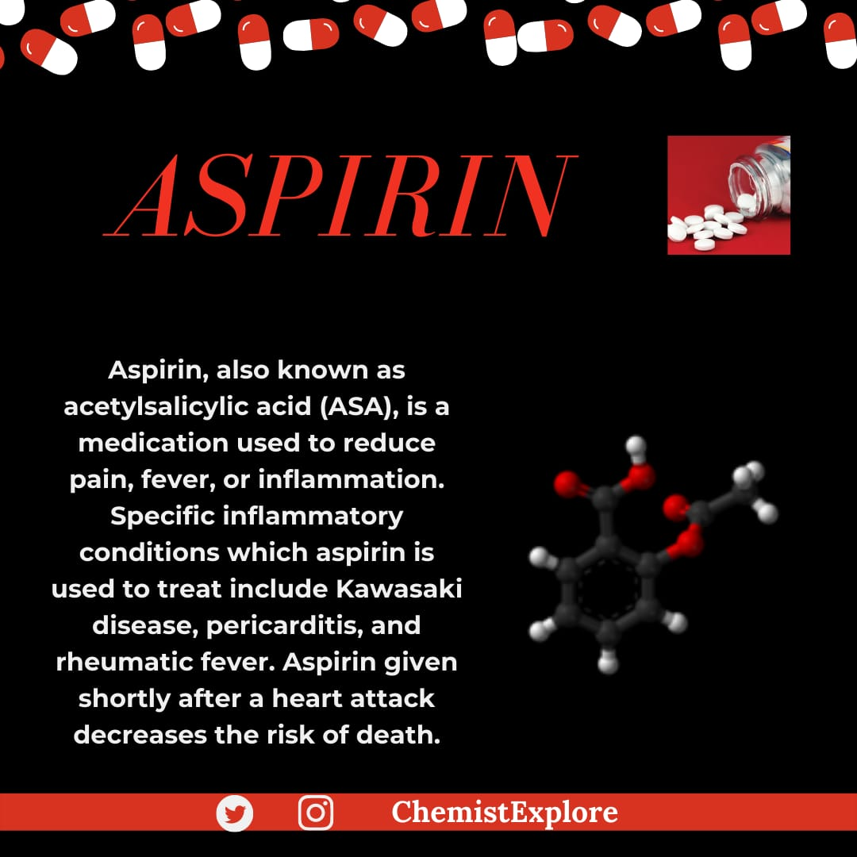

Slide 2
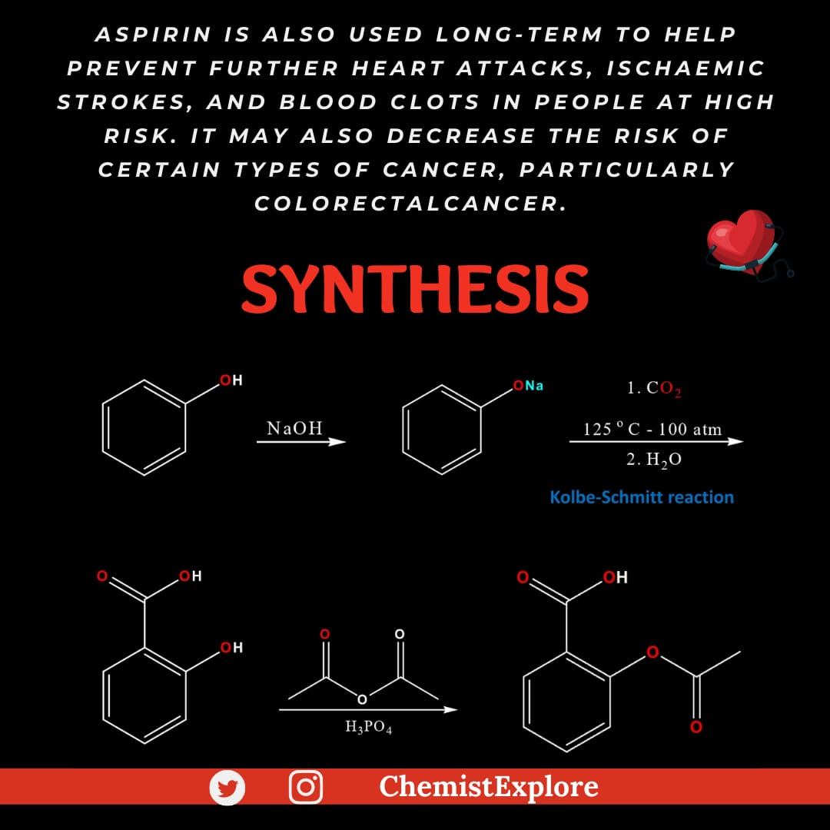

Slide 3
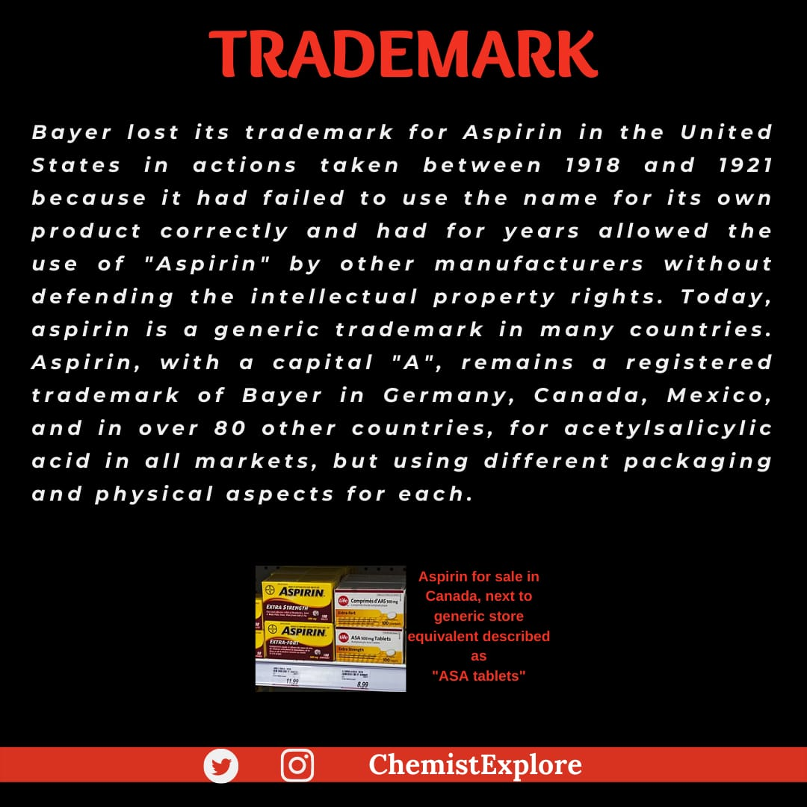

Slide 4
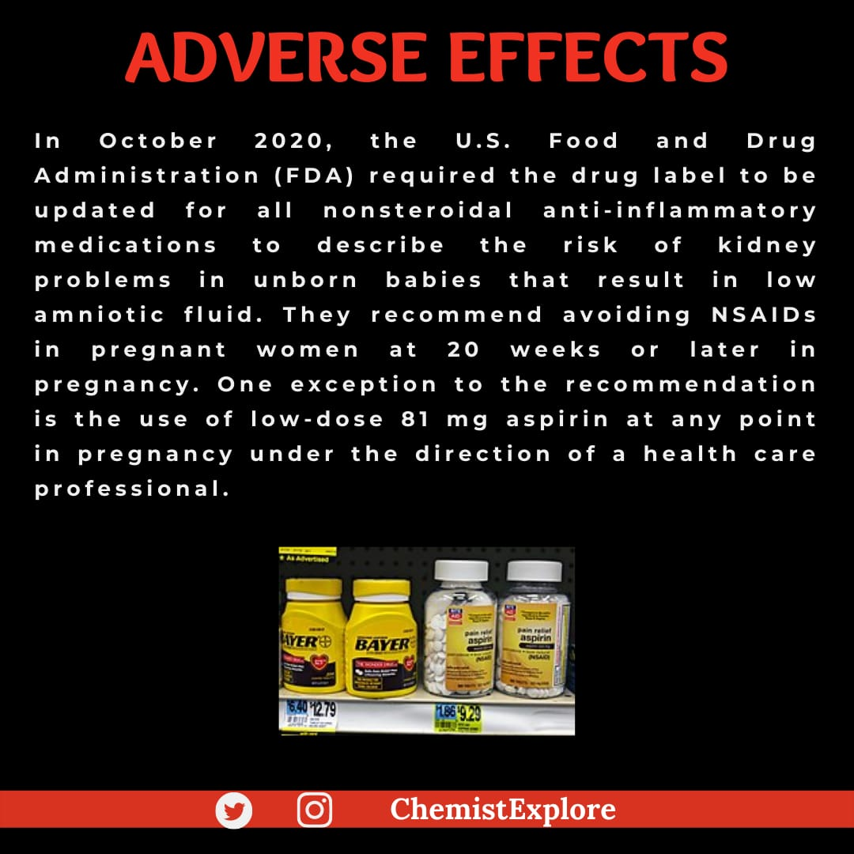

Slide 5
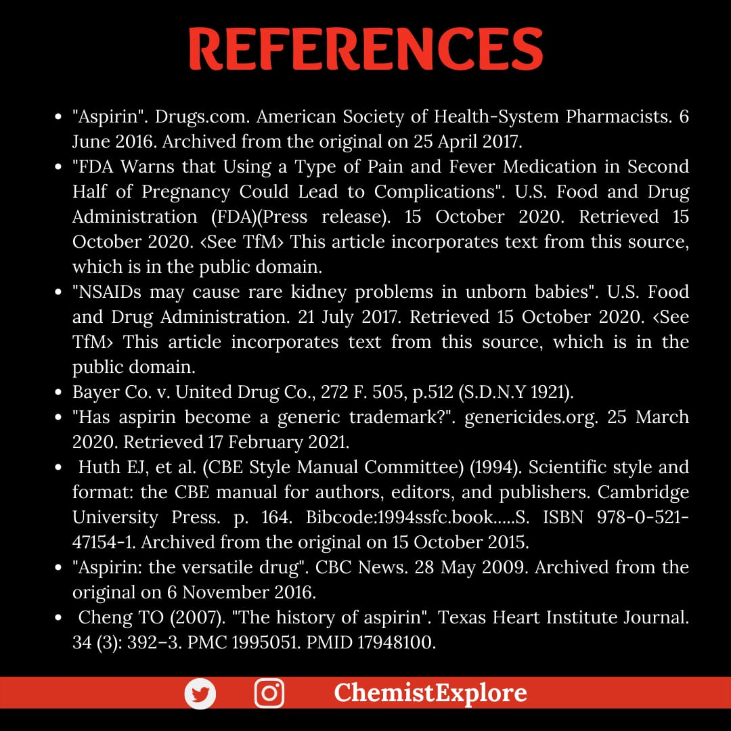

Slide 6
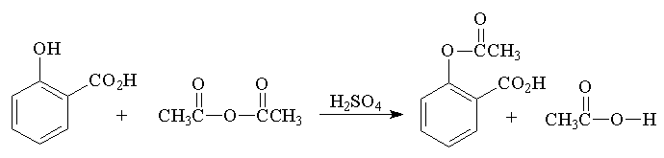
Aspirin Synthesis
(acetylsalicylic acid)

Slide 7
Procedure
Place 2.0 g (0.015 mole) of salicylic acid in a 125-mL Erlenmeyer flask.
Add 5 mL (0.05 mole) of acetic anhydride, followed by 5 drops of conc. H₂SO₄ (use a dropper, H₂SO₄ is highly corrosive) and swirl the flask gently until the salicylic acid dissolves.
Heat the flask gently on the steam bath for at least 10 minutes.
Allow the flask to cool to room temperature. If acetylsalicylic acid does not begin to crystallize out, scratch the walls of the flask with a glass rod. Cool the mixture slightly in an ice bath until crystallization is completed. The product will appear as a solid mass when crystallization is completed.
Add 50 mL of water and cool the mixture in an ice bath. Do not add the water until crystal formation is complete.
Vacuum filter the product using a Buchner funnel. You can use some of the filtrate to rinse the Erlenmeyer flask if necessary.
Rinse the crystals several times with small portions (5 mL) of cold water and air dry the crystals on a Buchner funnel by suction until the crystals appear to be free of solvent. Test this crude product for the presence of unreacted salicylic acid using the ferric chloride test. Record the weight of the crude solid which probably contains water.

Slide 8
Procedure 2nd Part
Stir the crude solid with 25 mL of a saturated aqueous sodium bicarbonate solution in a 150 mL beaker until all signs of reaction have ceased (evolution of CO_2 ceases).
Filter the solution through a Buchner funnel to remove any insoluble impurities or polymers that may have been formed. Wash the beaker and the funnel with 5 to 10 mL of water.
Carefully pour the filtrate with stirring, a small amount at a time, into an ice cold HCl solution (ca 3.5 mL of conc. HCl in 10 mL of water) in a 150-mL beaker and cool the mixture in an ice bath. Make sure that the resulting solution is acidic (blue litmus paper) and that the aspirin has completely precipitated out.
Filter the solid by suction and wash the crystals 3X with 5 mL of cold water each. Remove all the liquid from the crystals by pressing with a clean stopper or cork. Air dry the crystals and transfer them to a watch glass to dry. Test a small amount of the product for the presence of unreacted salicylic acid using the ferric chloride solution.
When the product is completely dry, weigh the product, determine its melting point (lit mp 135-136 °C) and calculate the percentage yield.
Dissolve the final product in a minimum amount (no more than 2-3 mL) of hot ethyl acetate in a 25 mL Erlenmeyer flask. Make sure that the product is completely dissolved while gently and continuously heating on a steam bath.
Cool the solution to room temperature and then in a ice-bath. Collect the product by vacuum filtration and rinse out of the flask with a few milliliters of cold petroleum ether.
When the product is completely dry, weigh its weight, determine its melting point (lit mp 135 °C) and calculate the percentage yield of this recrystallized product. Calculate the % recovery of recrystallized material from crude material. Submit the crystalline sample in a small vial with proper labeling to your instructor

Slide 9
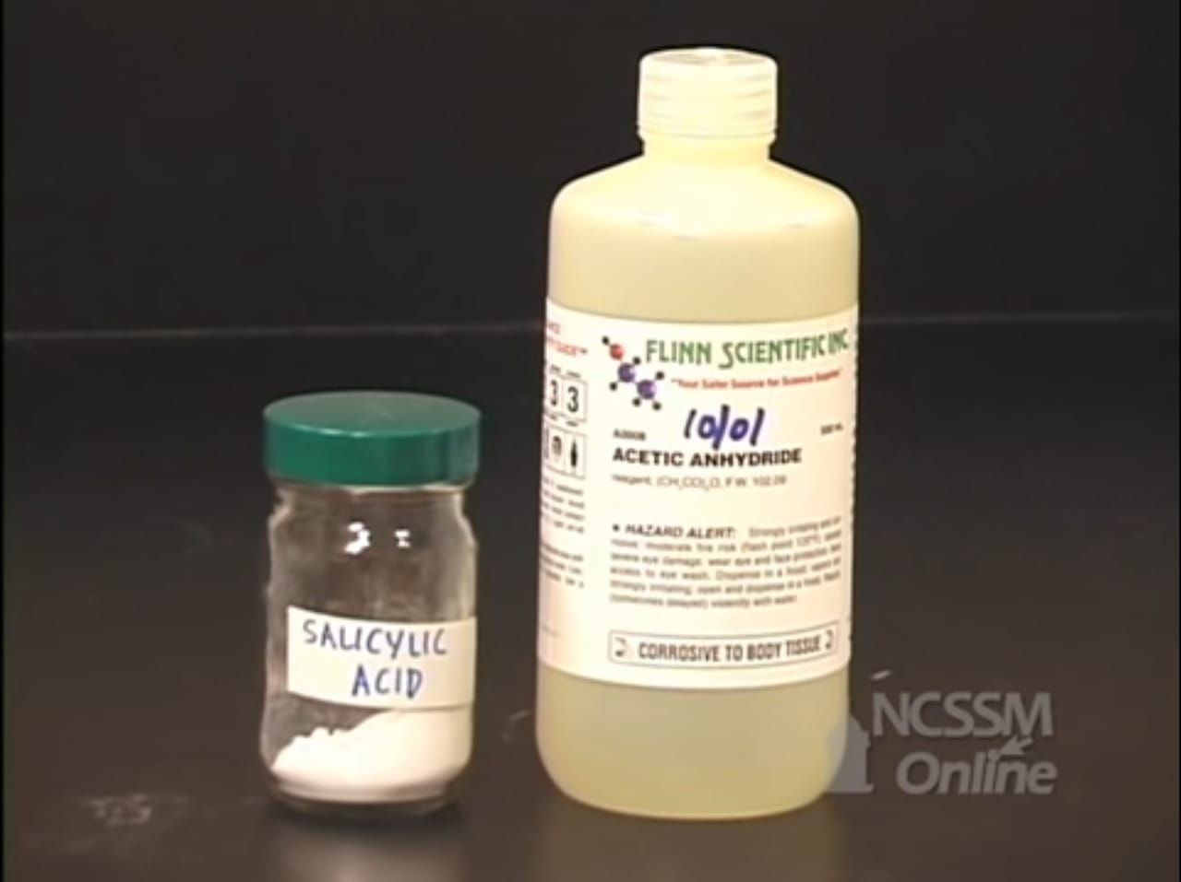
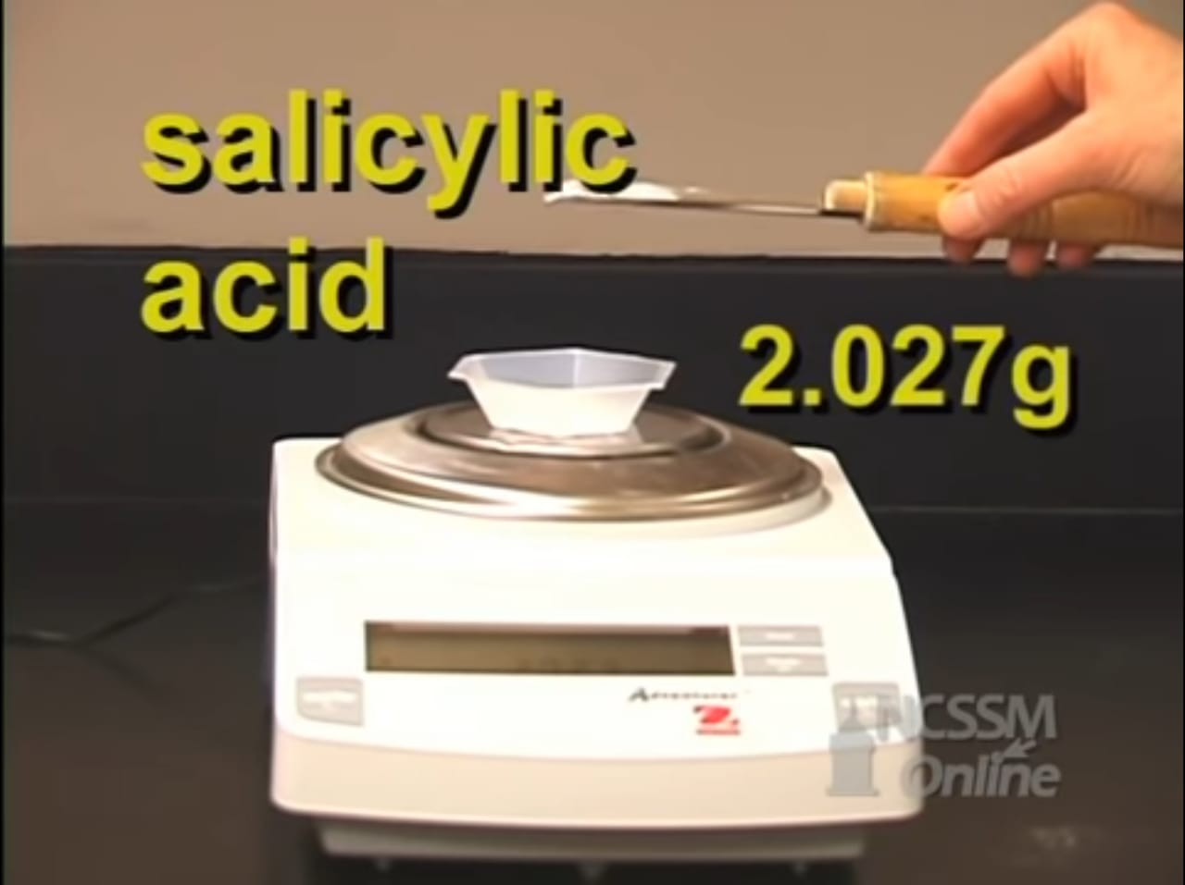
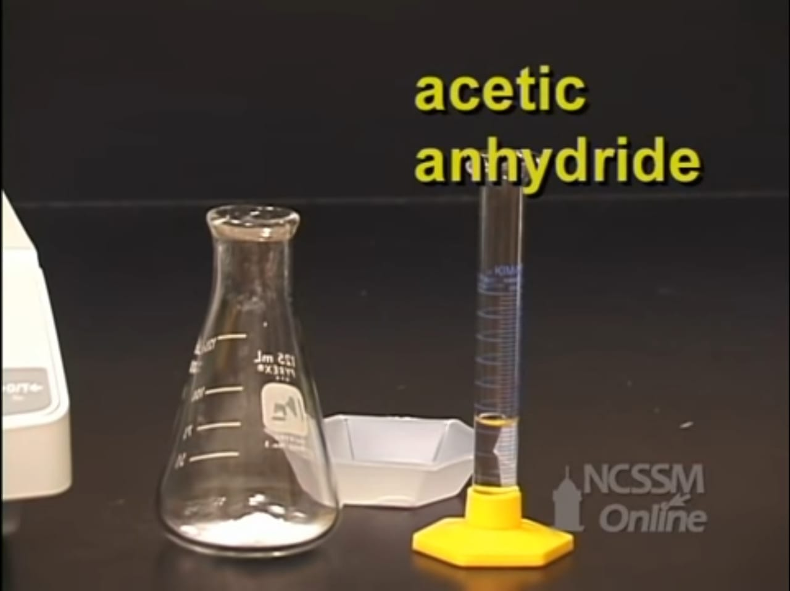
Procedure:
Reactants:
Salicylic acid & Acetic anhydride
1. Weigh 2.027 g of Salicylic acid, then put then into a volumetric flask
2. Add 5mL of acetic anhydride

Slide 10
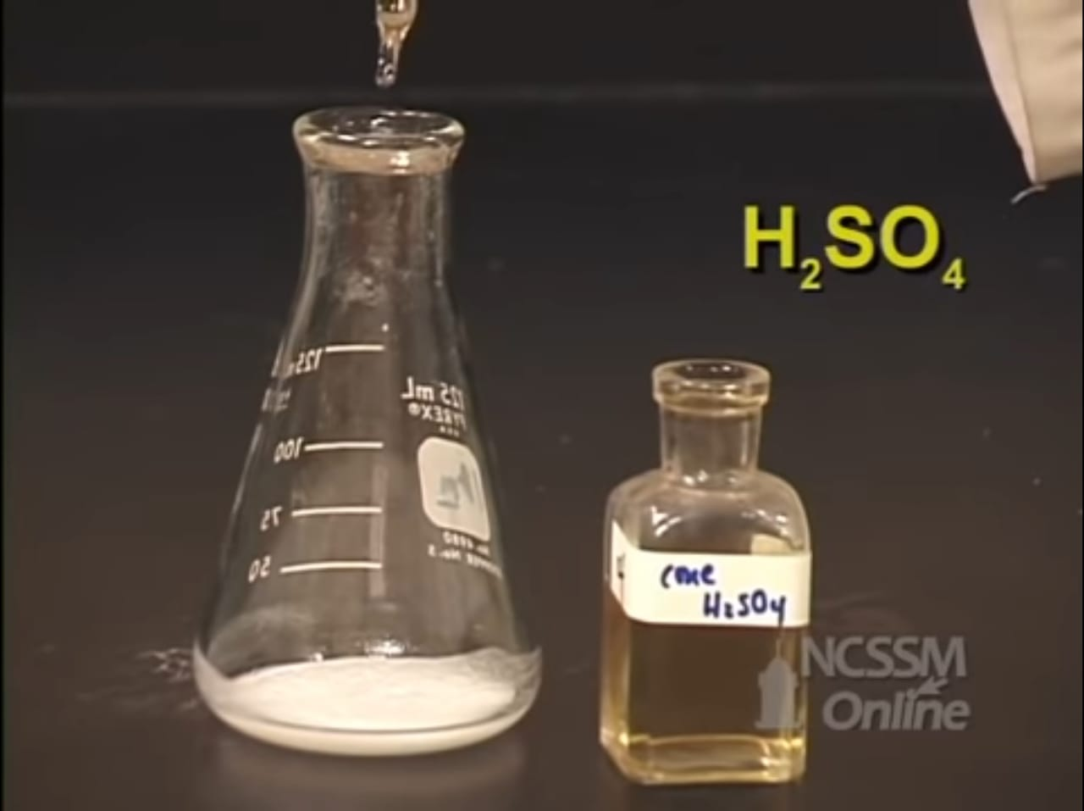
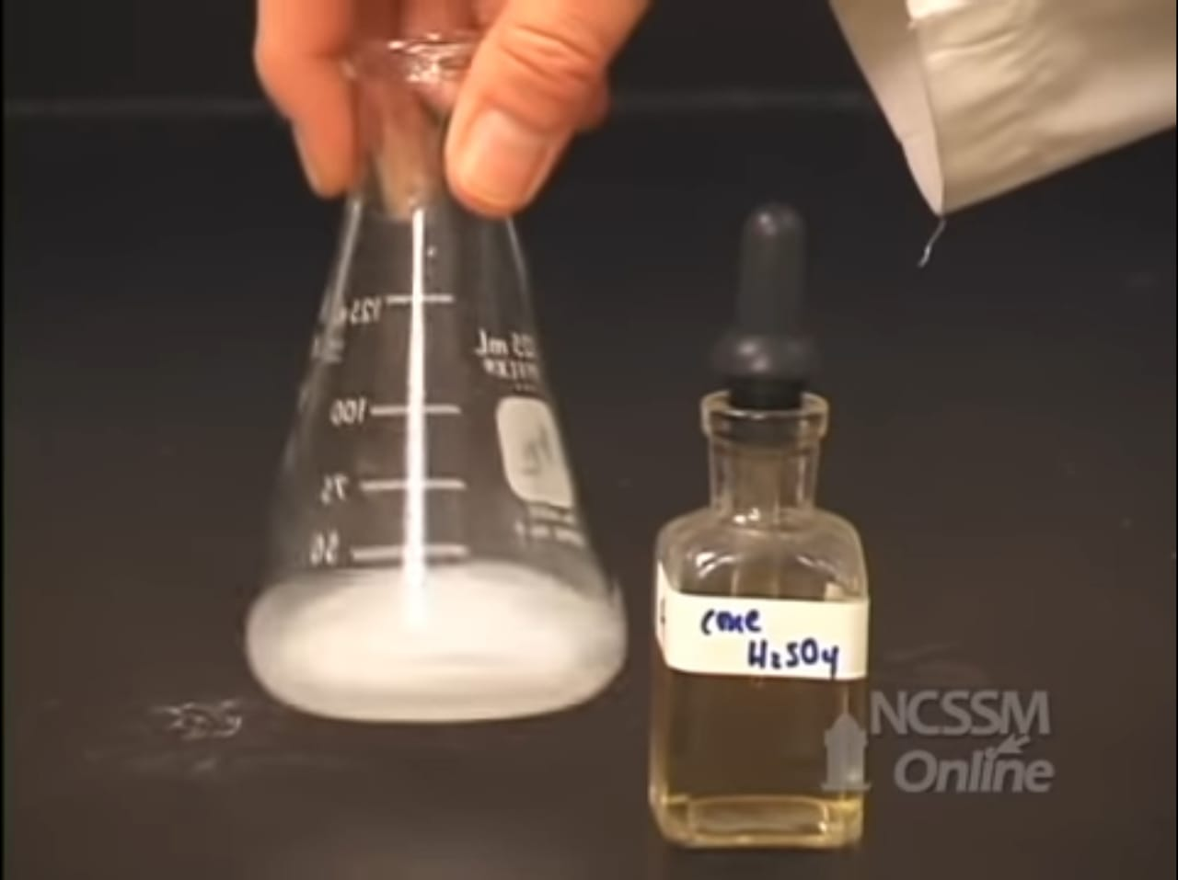
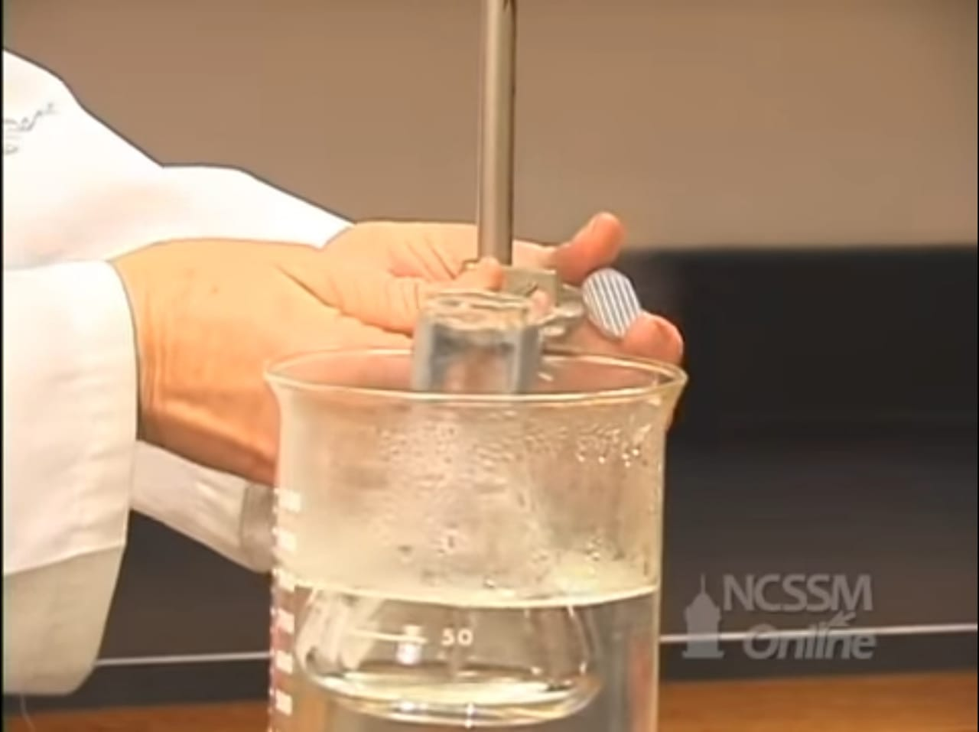
Procedure:
3. Add 5 drops of Sulfuric acid.
4. Shake the volumetric flask well.
5. Put the volumetric flask in a hot water bath.

Slide 11
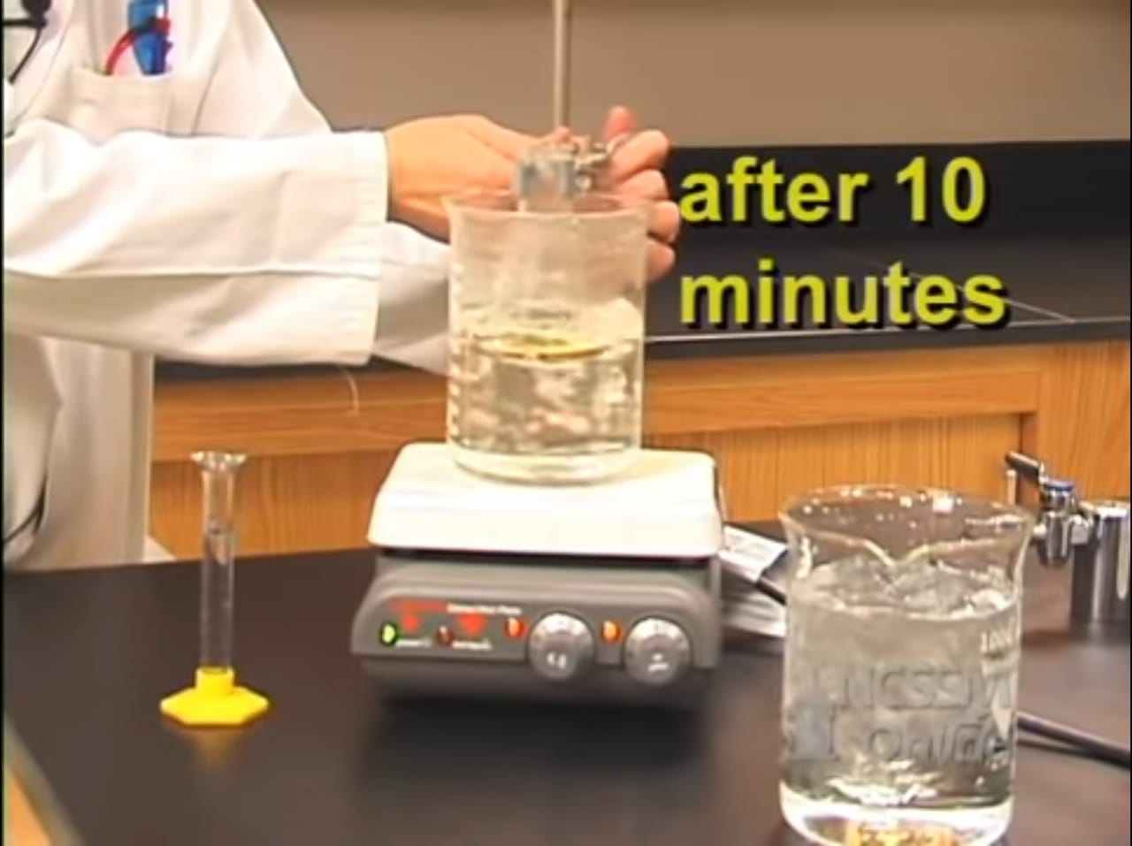
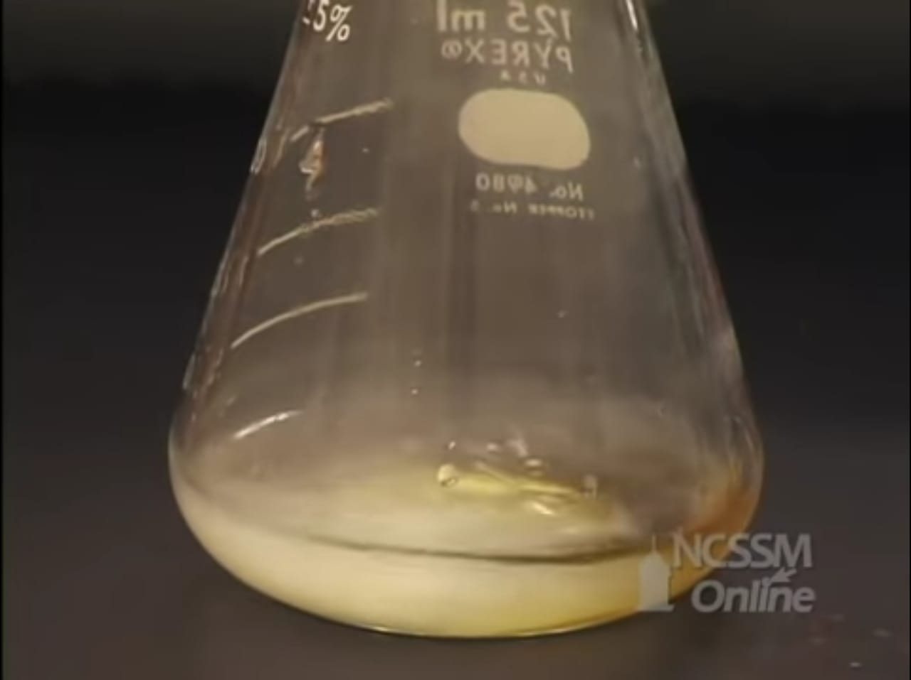
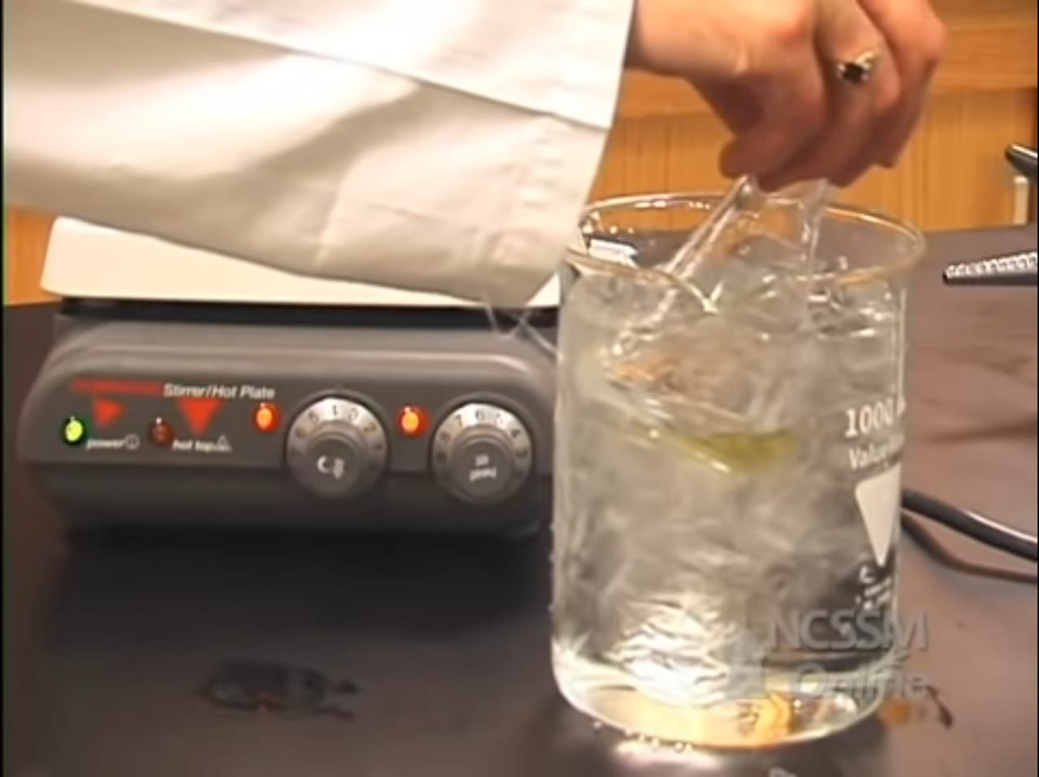
Procedure:
6. After 10 minutes, let the volumetric flask cool down
7. Add 10 mL of warm water.
8. Put the volumetric flask in ice, so aspirin can start precipitating.

Slide 12
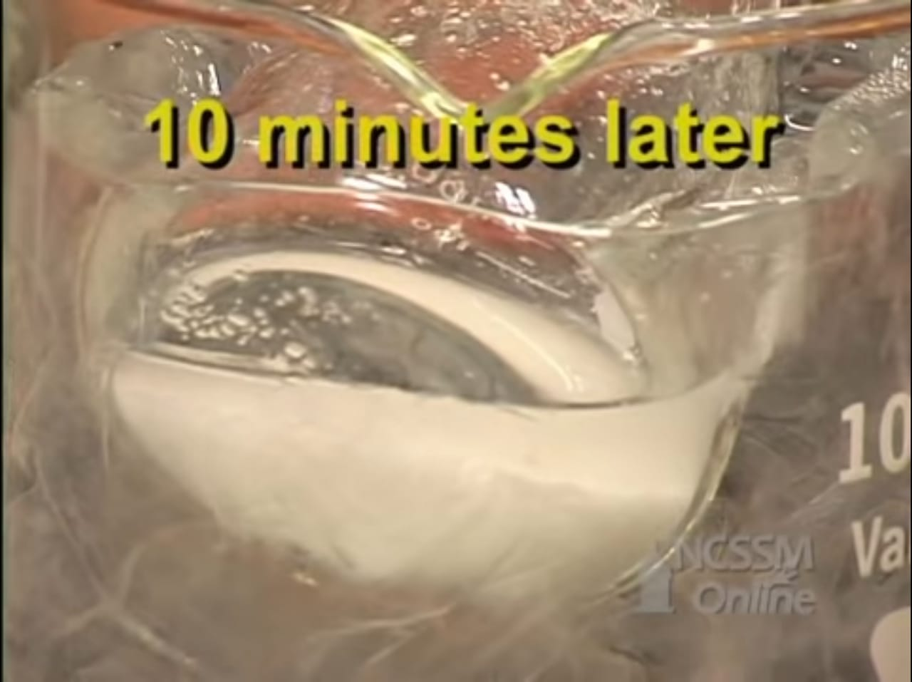
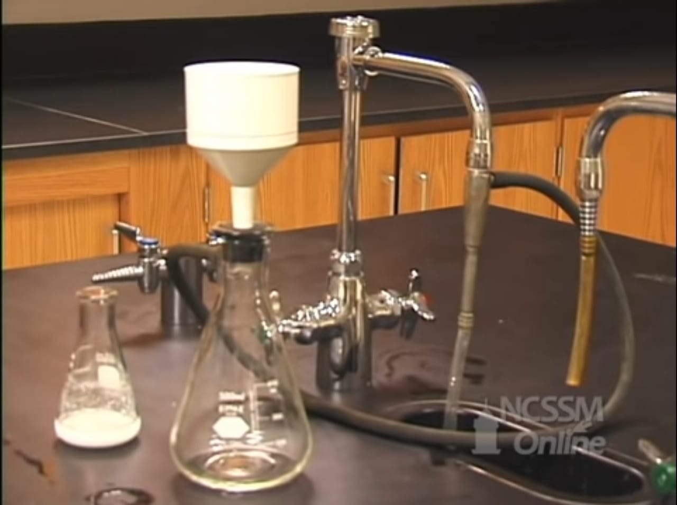
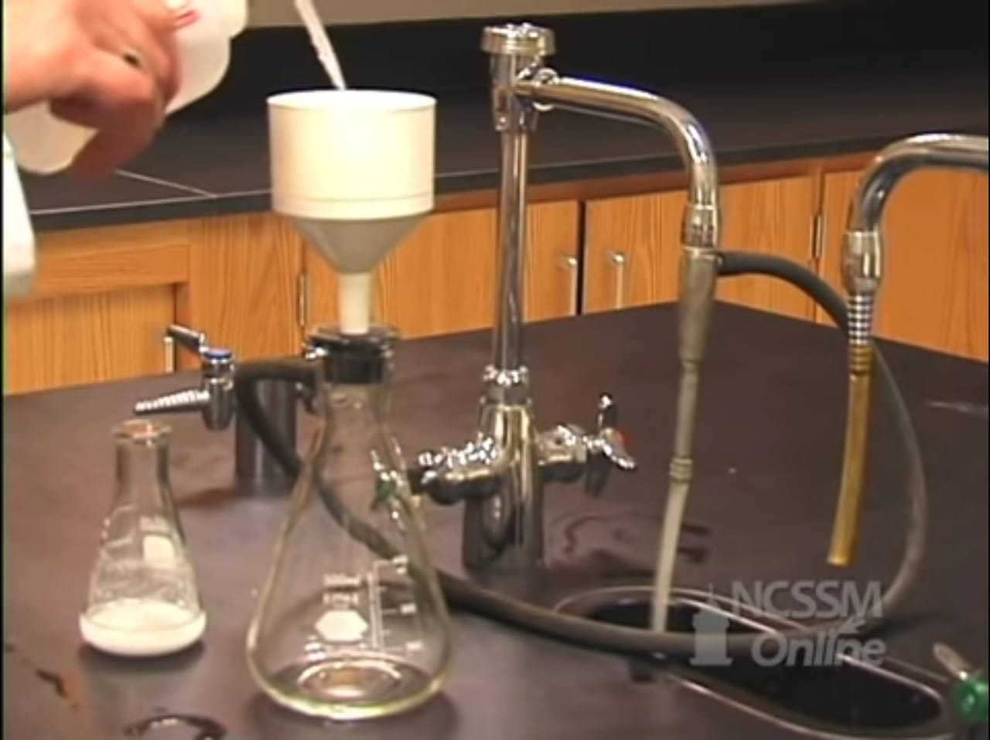
Procedure:
9. 10 minutes later, the aspirin should be precipitated.
10. Now, we filtrate the aspirin by a vacuum filtration.
11. Add small amount of cold water on the filter paper.

Slide 13
Procedure:
9. 10 minutes later, the aspirin should be precipitated.
10. Now, we filtrate the aspirin by a vacuum filtration.
11. Add small amount of cold water on the filter paper.

Slide 14
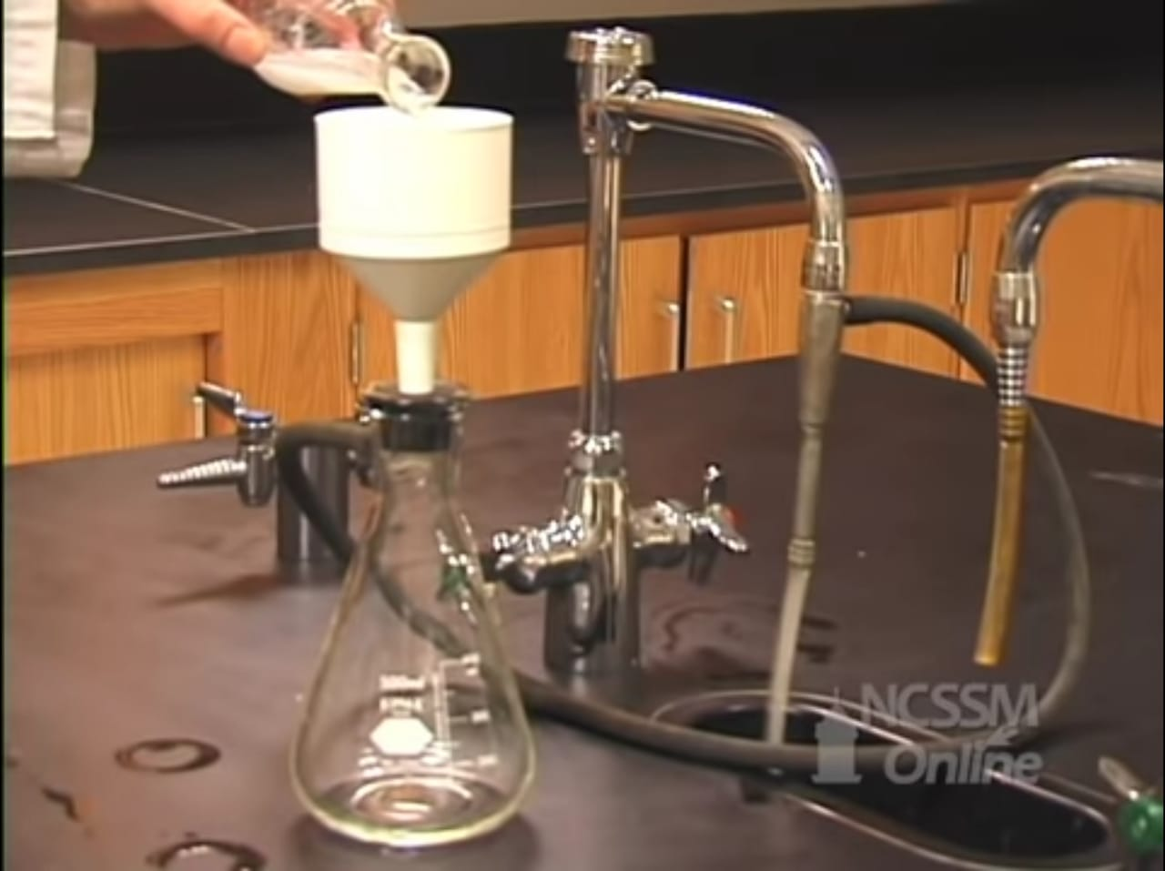
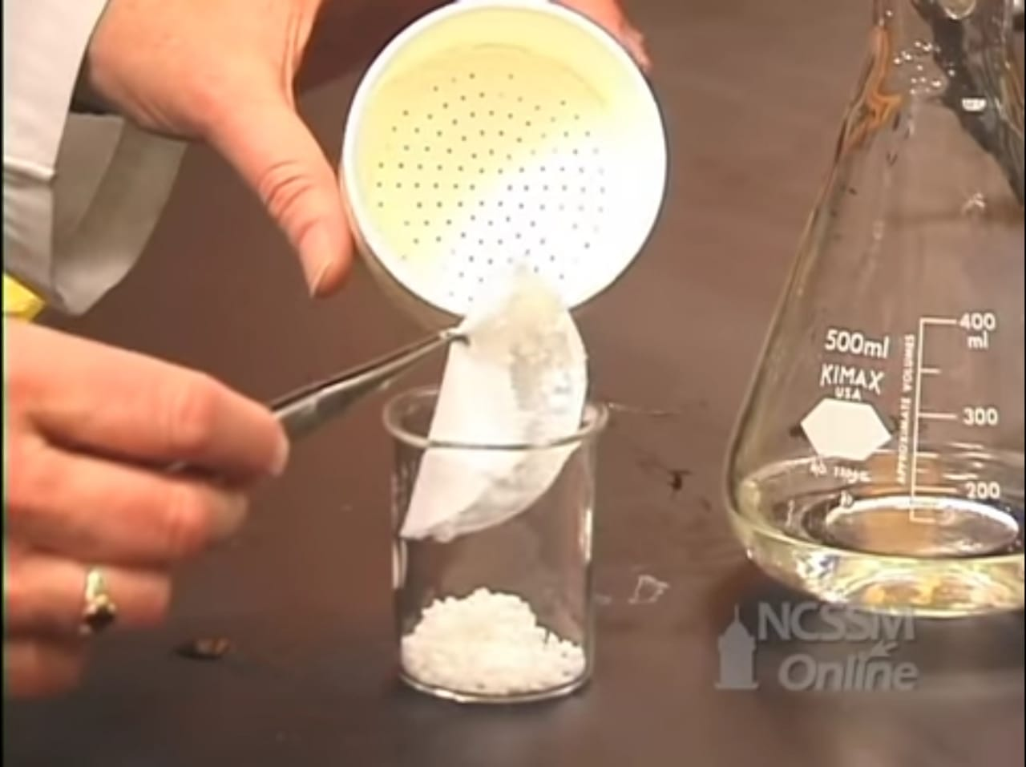
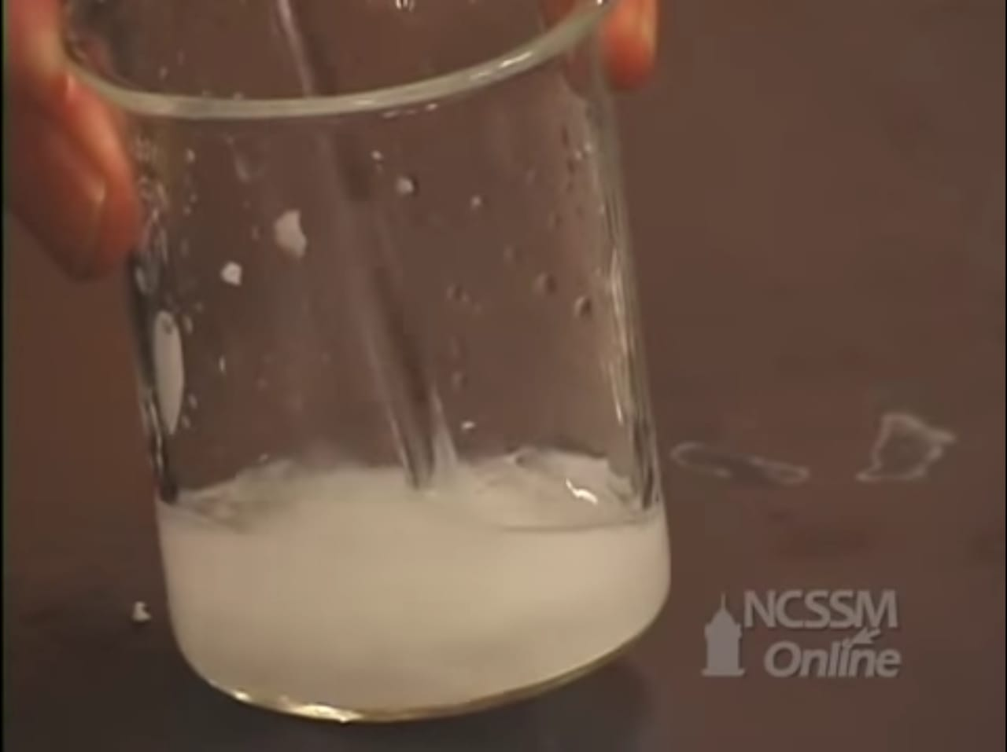
Procedure:
12. Add the solution.
13. Pour the crystals into a beaker.
14. Dissolve them again by adding water.

Slide 15
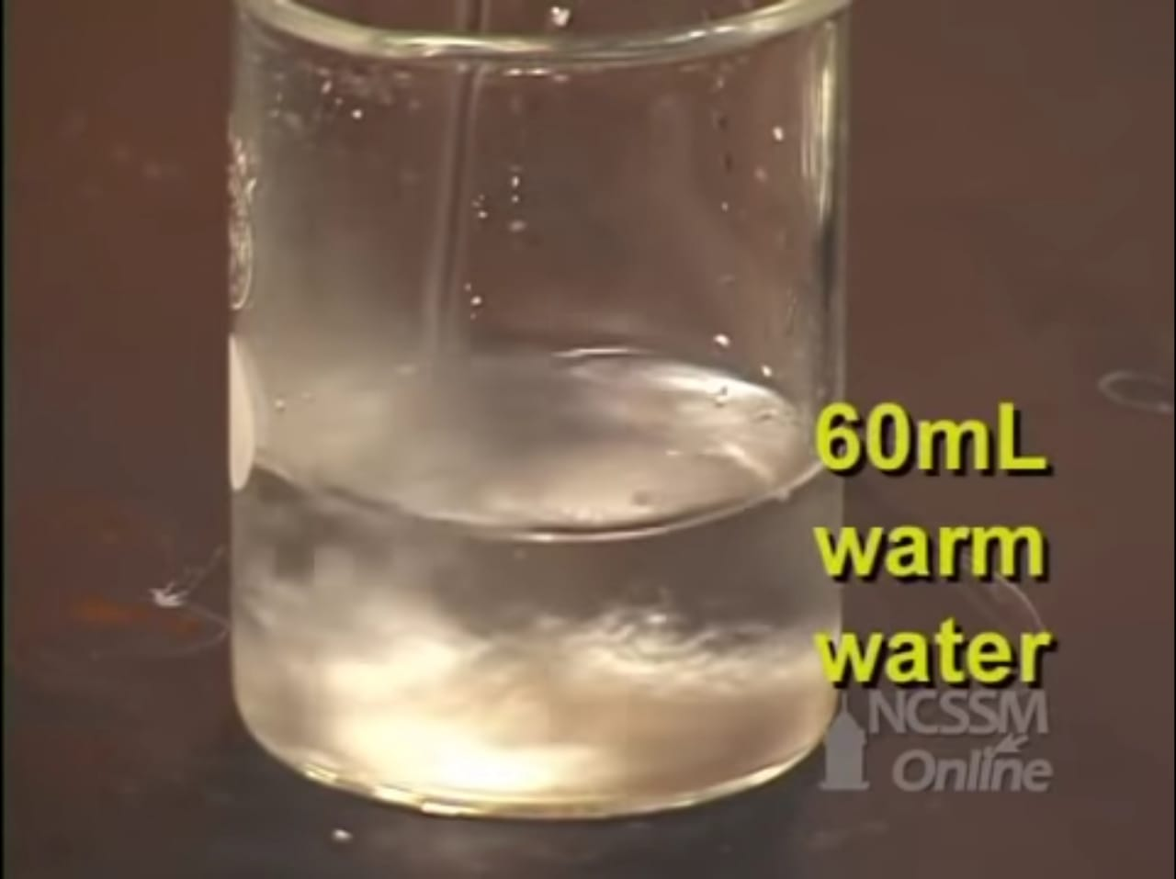
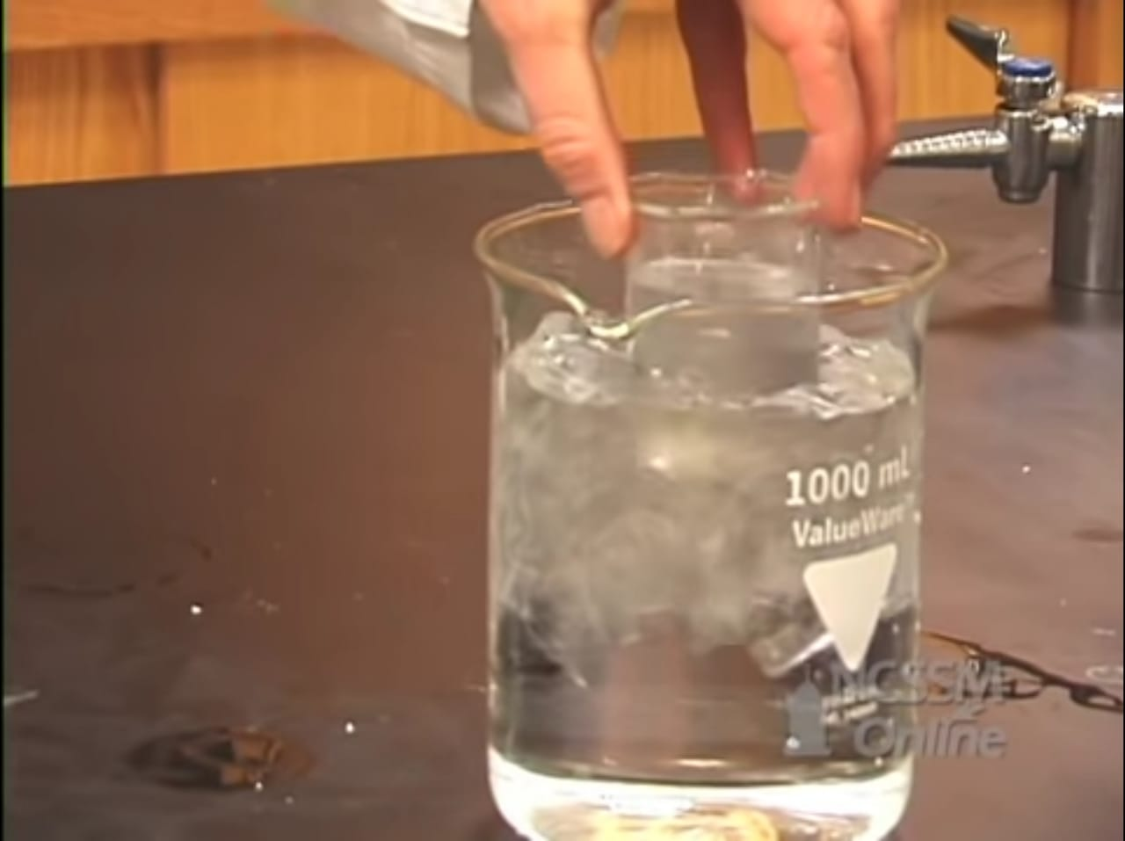
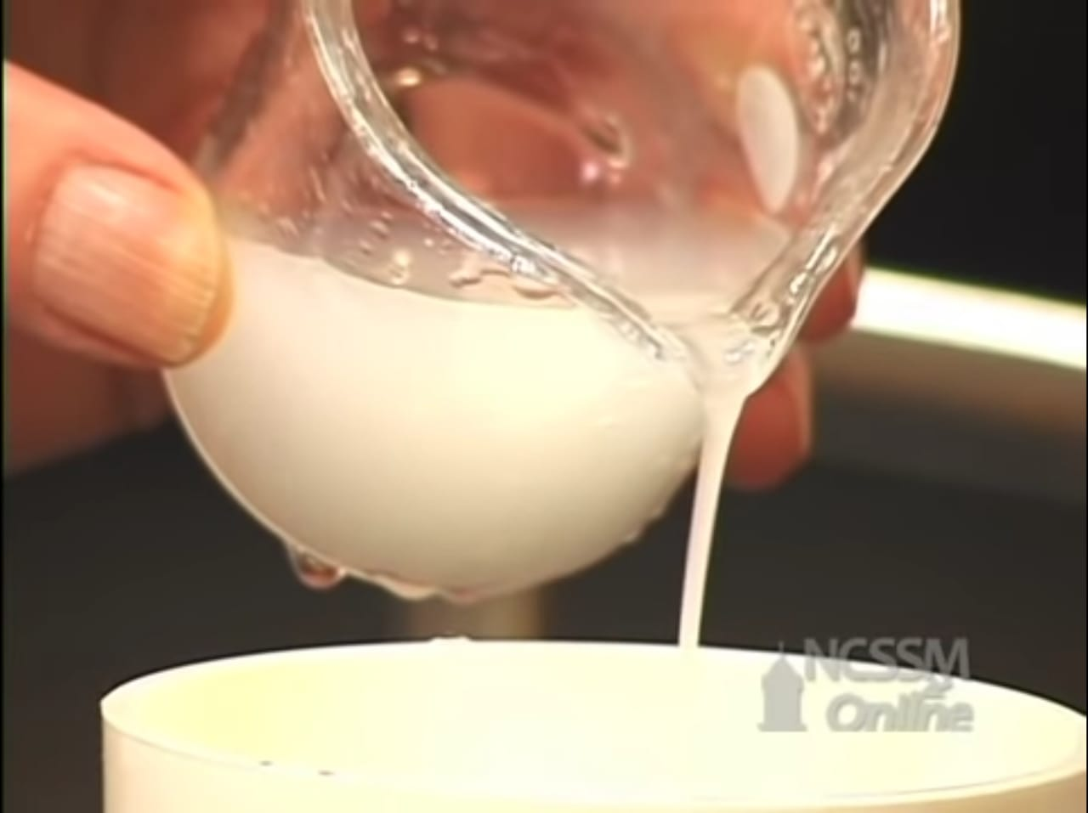
Procedure:
15. Add 60 mL of warm water.
16. Put the beaker in ice to recrystallize.
17. Last step, filter the product again.

Slide 16
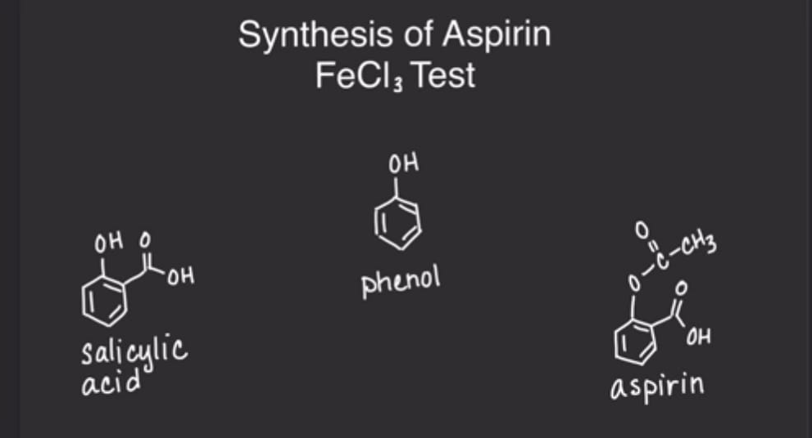
FeCl3 Test which is a qualitative test

Slide 17
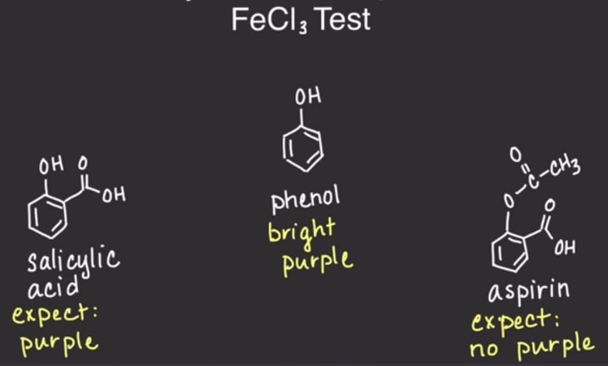
Expected colors! Since FeCl3 react with OH group

Slide 18
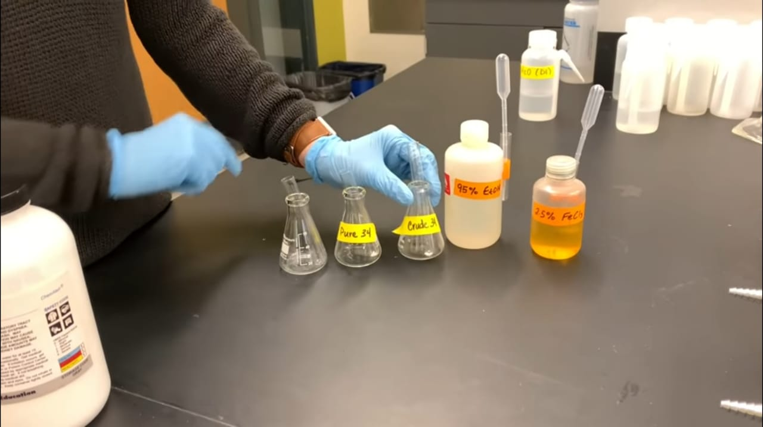
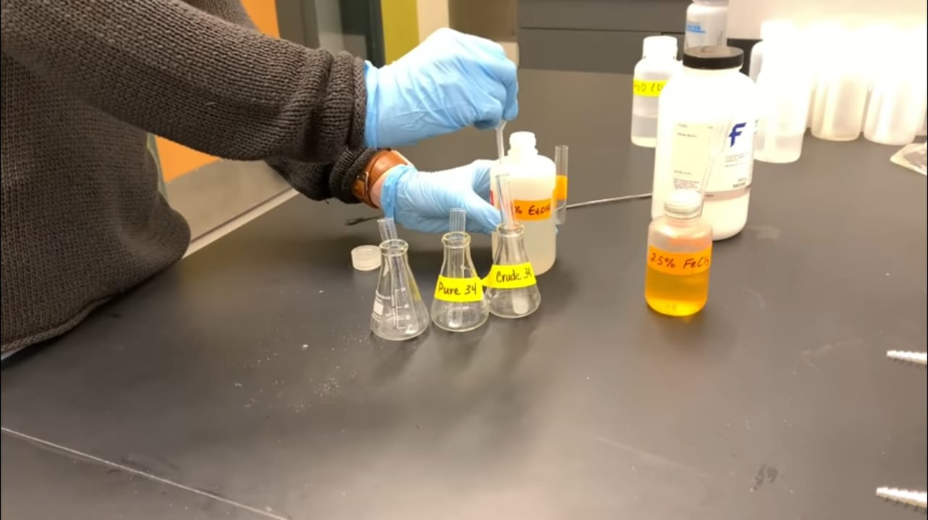
Procedure:
We can do the test for the crude product, pure product, and the salicylic acid.
1. Take a very small amounts of the 3 products and put them in test tubes.
2. Add 1 mL of ethanol 95% to each test tube

Slide 19
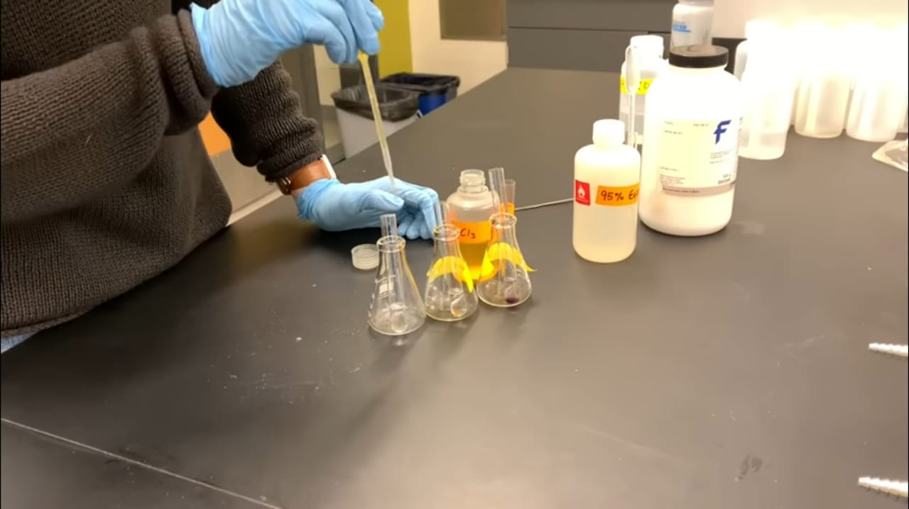
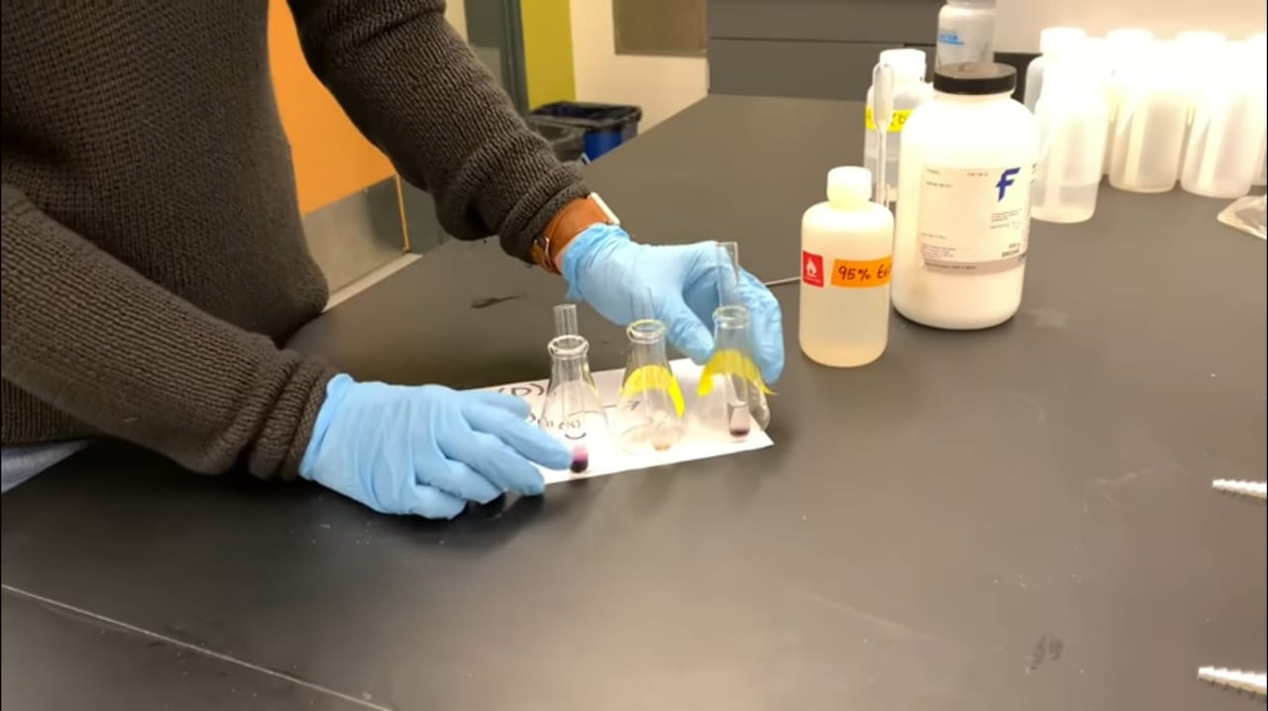
Procedure:
3. Add 1 drop of FeCl3 Solution (2.5%)
4. Shake the test tubes and see the colors.

