Slide 1



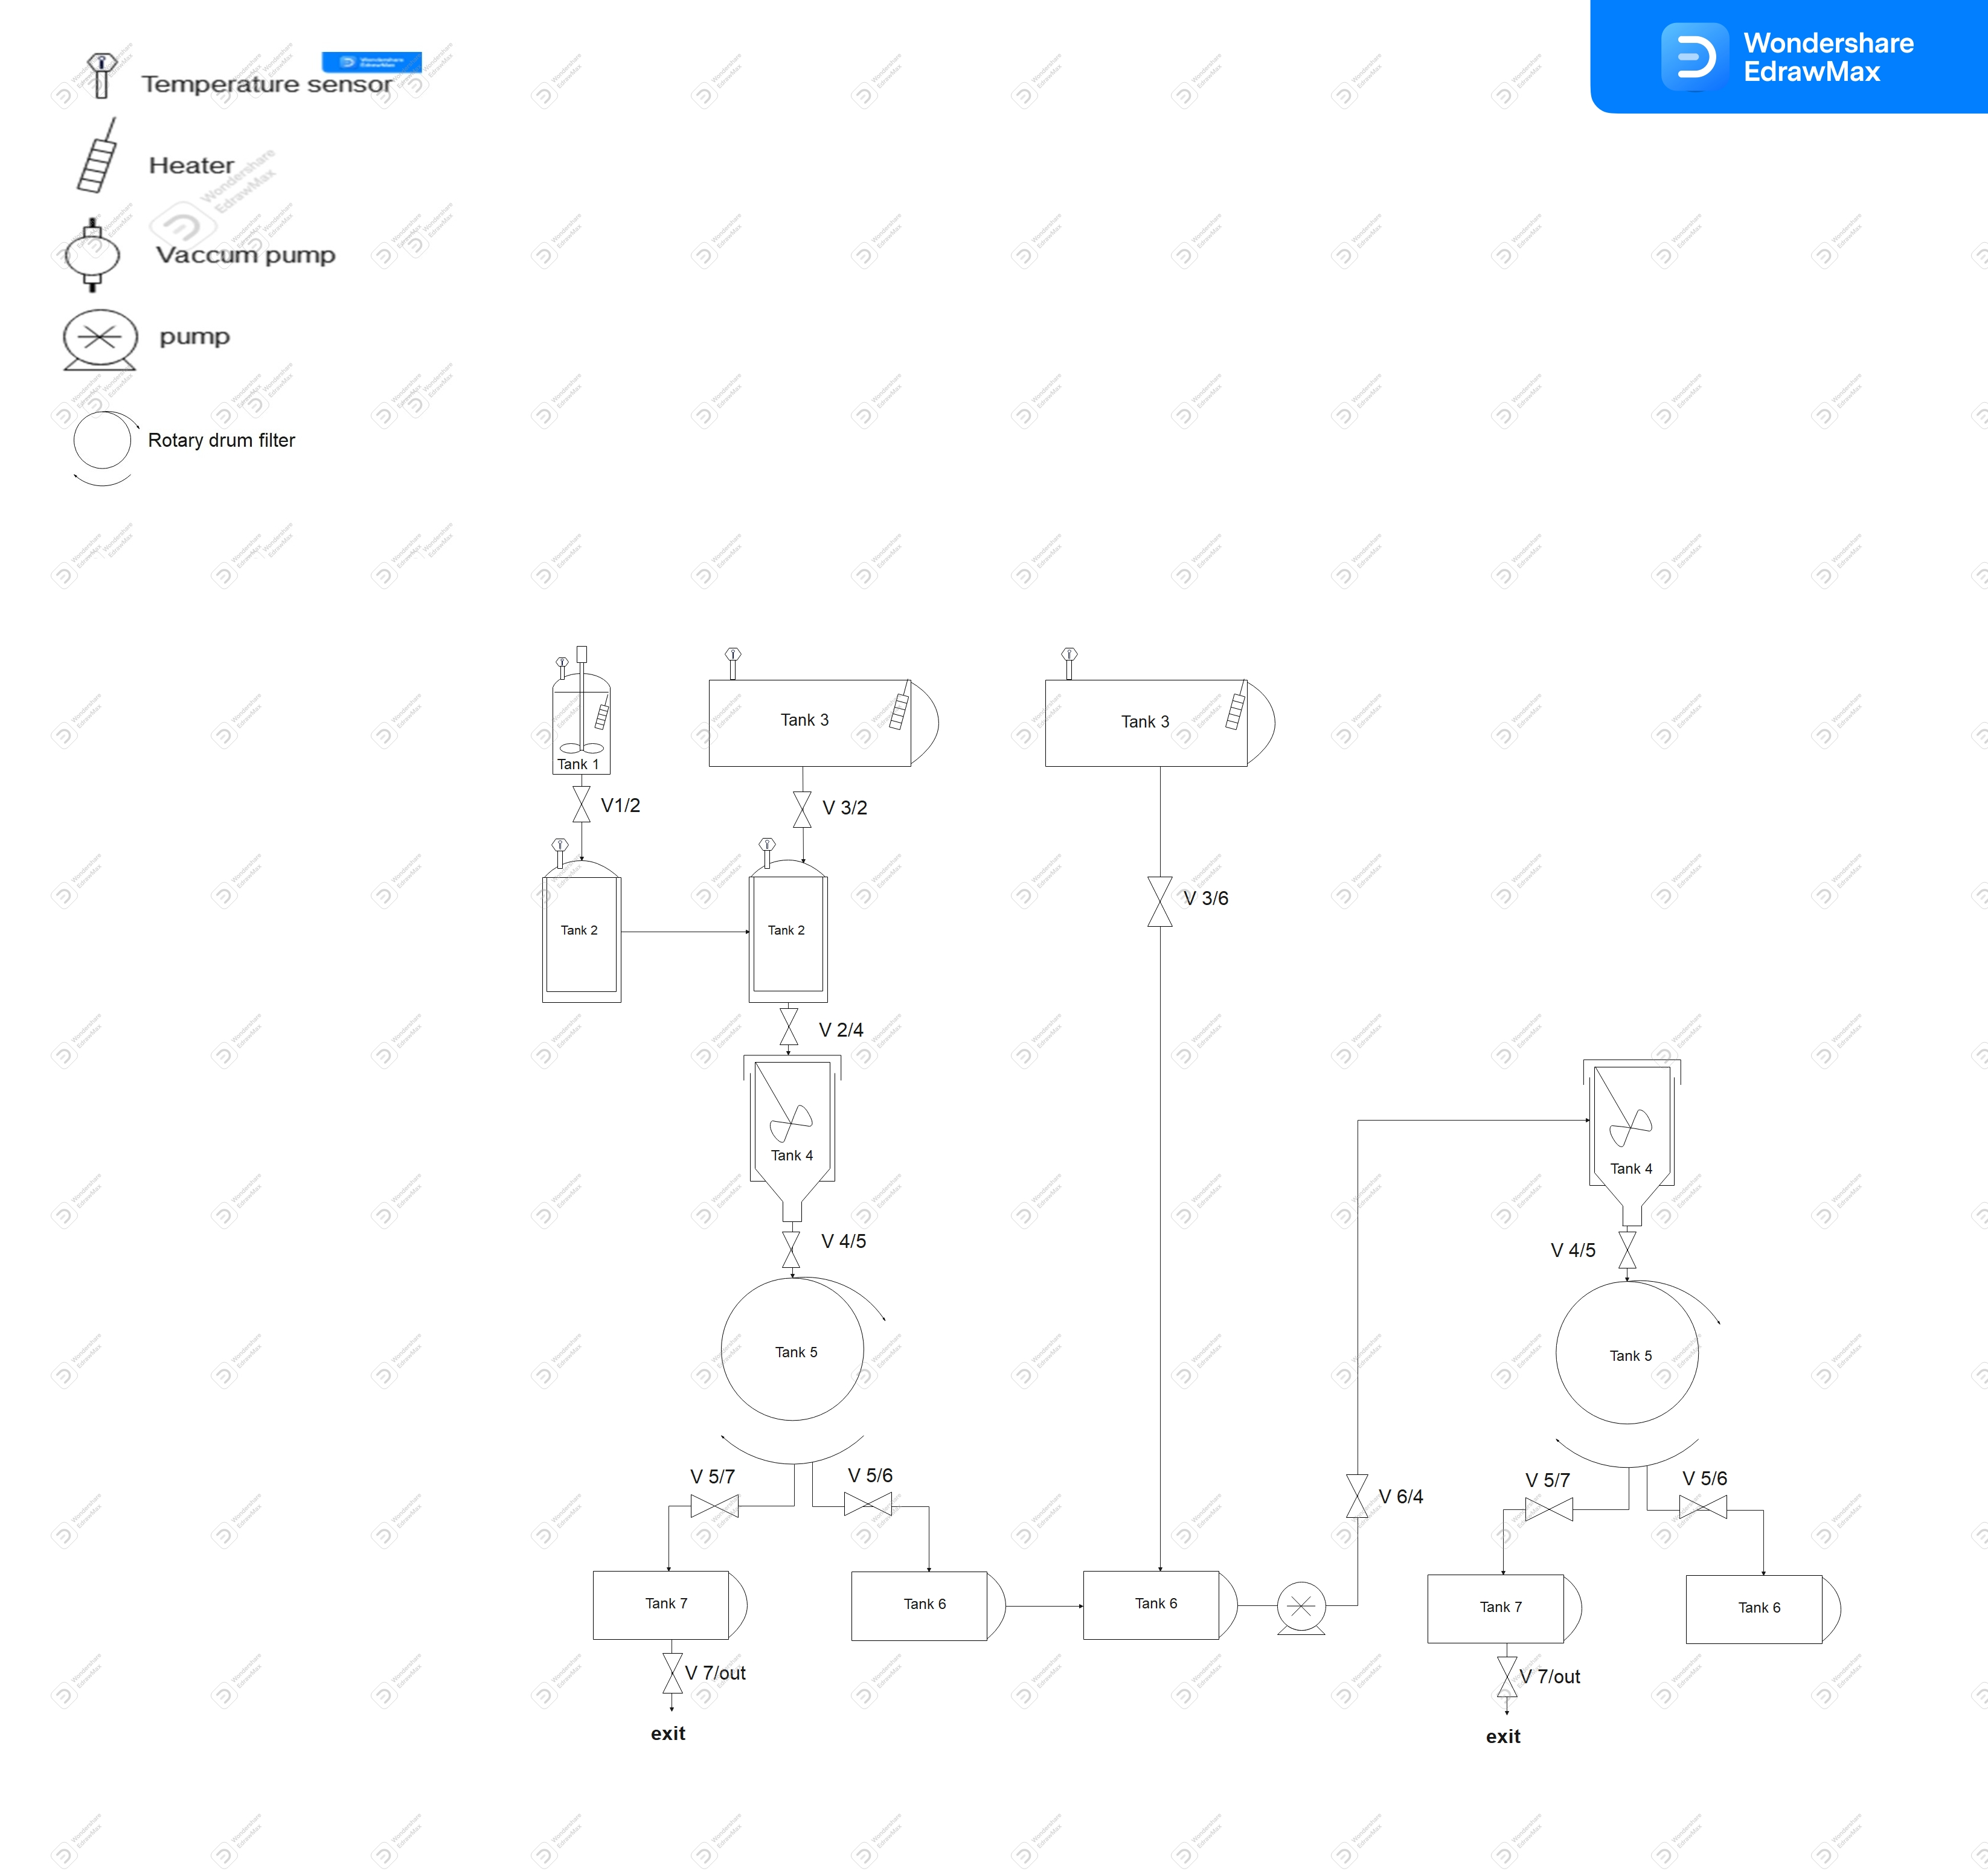

www.aecenar.com
Pilot Plant Scale for Aspirin Production
3- Tank 3 to tank 2 : Open Valve V3/2
Add 5L warm water .
1- Tank 1 :
Place 1013.5g of salicylic acid
Add 2.5L acetic anhydride
Add 125ml concentrated H2SO4
Mix and heat to 85º for at least 10min .
7- Tank 6:
Open valve V3/6
The obtained aspirin crystals are re-dissolved with 30L warm water for about 20 min.
Open valve V6/4 and close valve V5/6
2- Tank 2 :
Open valve V1/2
Cool down the mix to between 25- 28º.
4- Tank 2 to tank 4
Open valve V2/4
Cool the mix about 20min in an ice bath with mixing .
Crystals are formed now.
9-Tank 4:
Re-cool the mix about 20 min in the ice bath with mixing.
Open valve V4/5 for the final drum vacuum filtration.
5- Tank 4 to tank 5:
Open valve V4/5 and V5/6
let the rotary drum vacuum filtration begin.
Aspirin crystals are now in tank 6.
8- Tank 6 to 4
.The solution is pumped now from tank 6 to tank 4 for the second crystallization
10- Tank 6 :
Open valve V5/6
Crude Aspirin crystals are harvested in tank 6 and ready to be dry, tested and compressed for market
6- filtrate discarding
Open valve V5/7 and then V7/out
The filtrate is discarded into the tank 7 and then out of the system.
Close valve V5/7, V4/5, V5/6 and V7/out
Pump 1
V6/out
12- Sterilization system:
Close all the presented valves
Open valve V1/2 (T=120 P=1.5 bar)
Close valve V1/2
Open valve V2/4 (T=120 P=1.5 bar)
Close valve V2/4
Open valve V2/4 (T=120 P=1.5 bar) for second time
Close valve V2/4
Open valve V3/2 (T=120 P=1.5 bar)
Close valve V3/2
Open valve V3/6 (T=120 P=1.5 bar)
Close valve V3/6
Open valve V6/out
11- Tank 7 :
Open valve V5/7 and then V7/out
The filtrate is discarded into tank 7 and then out of the system by opening valve V7/out
Figure 1 : Dynamic view of pilot plant aspirin production system
Rayane Dergham, Hind Abd El Hamid @ MEGBI/ AECENAR November 2022

