Slide 1
Venturi Scrubber
Sizing _ FreeCAD

Slide 2
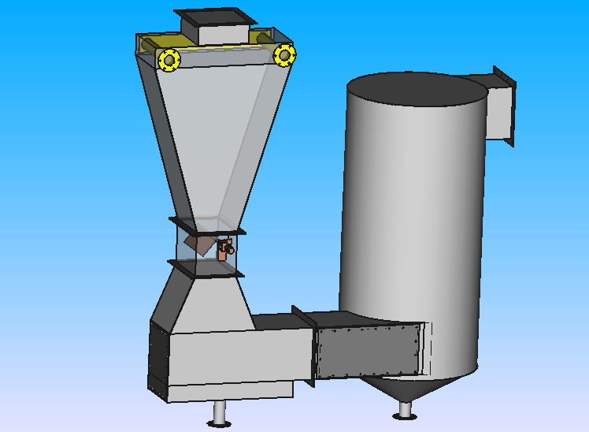

Slide 3
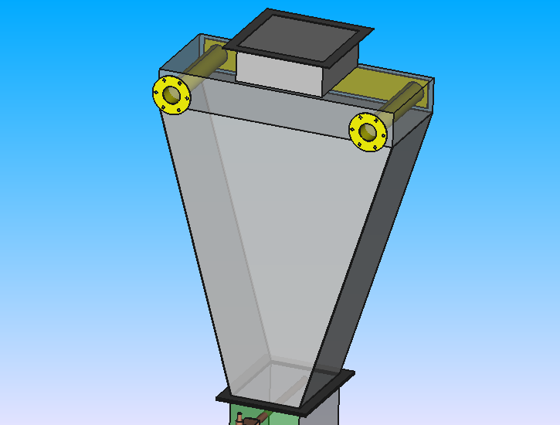
Pipe
Length L = 32 cm
Radius R = 2.5 cm
Thickness t = 2 mm
Duct
Length L = 25 cm
Width W = 25 cm
Thickness t = 2 mm
Flange of Pipe
Radius Ro = 5.5 cm
Thickness t = 2 mm
Hole radius r = 0.3 cm
# of holes = 6
Plate
Length L = 65 cm
Width W = 8 cm
Thickness t = 2 mm
Plate
Length L = 28 cm
Width W = 84 cm
Thickness t = 2 mm
Angle ɑ = 106.7°
Plate
Length L = 68 cm
Width W = 28 cm
Heigh H = 10 cm
Thickness t = 2 mm
Plate
Length L1 = 68 cm
Length L2 = 20 cm
Heigh H = 80 cm
Thickness t = 2 mm
Plate
Length L = 28 cm
Width W = 84 cm
Thickness t = 2 mm
Angle ɑ = 73.3°

Slide 4
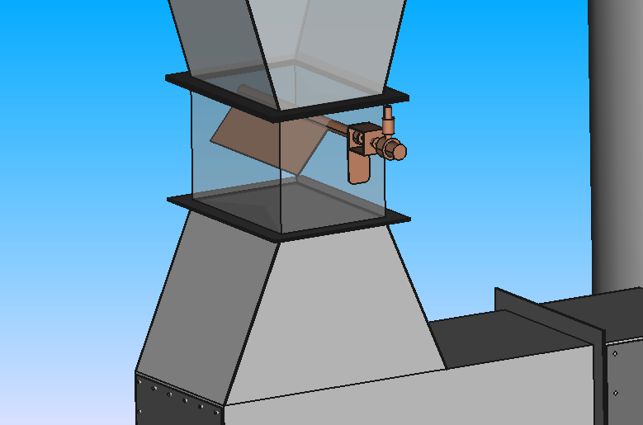
Plate
Length L = 27.6 cm
Thickness t = 2 mm
Cylinder
Radius r = 1 cm
Length L = 38 cm
H = 17 cm
Plate
Length L = 28 cm
Width W = 30 cm
Thickness t = 2 mm
Angle ɑ = 67°
Duct
Length L = 28 cm
Width W = 20 cm
Height H = 20 cm
Thickness t = 2 mm
Plate
Length L1 = 42 cm
Length L2 = 20 cm
Heigh H = 44 cm
Thickness t = 2 mm

Slide 5
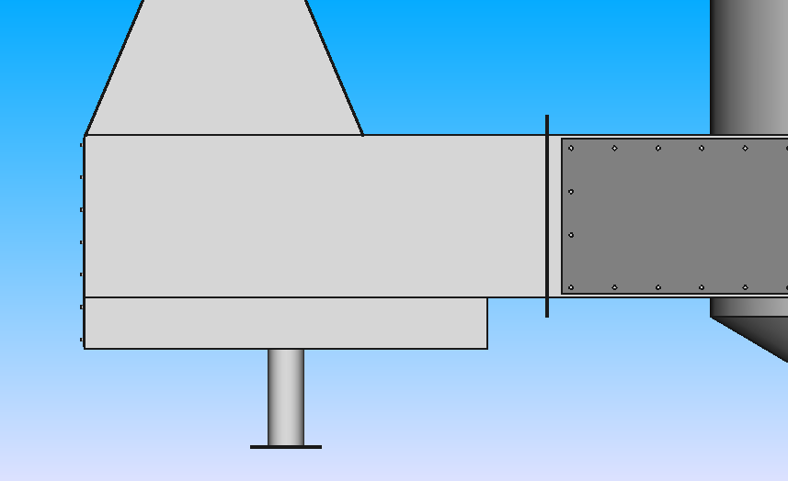
Flange
Length L = 27 cm
Width W = 32 cm
Thickness t = 2 mm
Hole radius r = 0.3 cm
# of holes = 22 (6*7)
Duct
Length L = 71 cm
Width W = 28cm
Height H = 25 cm
Thickness t = 2 mm
Inlet cyclone duct
Length L = 62 cm
Width W = 28 cm
Height H = 8 cm
Thickness t = 2 mm
Tube
Radius R = 2.5 cm Length L = 15 cm
Thickness t = 2 mm
Flange
Radius Ro = 5.5 cm
Radius of hole r = 0.3 cm
# of holes = 8

Slide 6
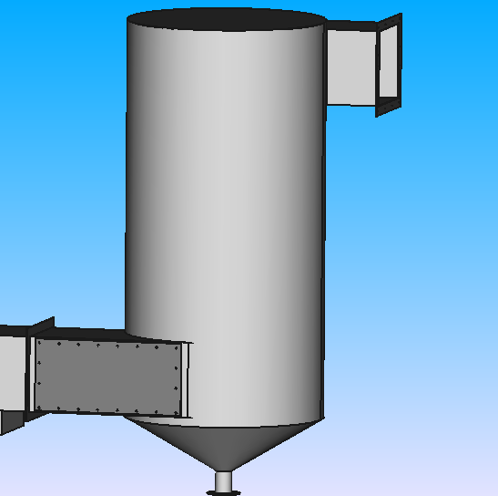
Outlet Duct
Form : Square
Side S = 25 cm
Thickness t = 1 mm
Flange of duct
Side S = 31 cm
Hole radius r = 0.4 cm
# of holes (by side) = 4
Inlet side flange
Length L = 50 cm
Width W = 24 cm
Thickness t = 2 mm
Hole radius r = 0.3 cm
# of holes = 20 (8*4)
Cylinder
Radius R = 33 cm
Thickness t = 2 mm
Height H = 132 cm
Tube
Radius R = 2.6 cm
Height H = 74 cm
Thickness t = 2 mm
Cone
Radius R1 = 33 cm
Radius R2 = 2.6 cm
Height H = 18 cm
Thickness t = 2 mm
Flange
Radius Ro = 5.5 cm
Radius of hole r = 0.3 cm
# of holes = 6

Slide 7
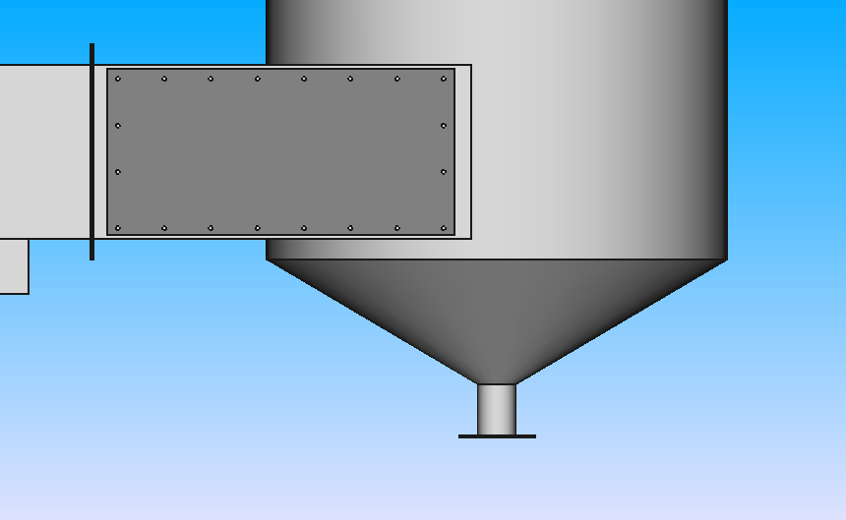
Tube
Radius R = 2.6 cm
Height H = 7.4 cm
Thickness t = 2 mm
Inlet side flange
Length L = 50 cm
Width W = 24 cm
Thickness t = 2 mm
Flange
Radius Ro = 5.5 cm
Radius of hole r = 0.3 cm
# of holes = 6

Slide 8
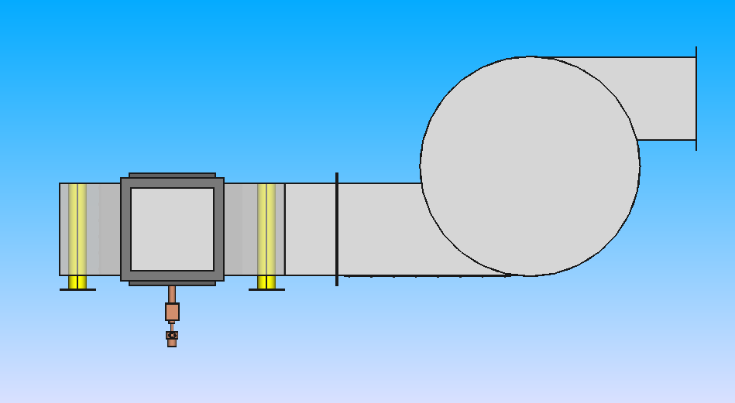
outlet cyclone duct
Length L = 50 cm
Width W = 25 cm
Height H = 25 cm
Thickness t = 2 mm
Inlet water pipe
Length L = 32 cm
Radius R = 2.5 cm
Thickness t = 2 mm
Cylinder
Radius R = 33 cm
Thickness t = 2 mm
Height H = 132 cm
Inlet cyclone duct
Length L = 58 cm
Width W = 28 cm
Height H = 25 cm
Thickness t = 2 mm
Inlet side flange
Length L = 50 cm
Width W = 24 cm
Thickness t = 2 mm
Top duct
Length L = 25 cm
Width W = 25 cm
Height H = 10 cm
Thickness t = 2 mm

