Slide 1
Cyclones
On details _ FreeCAD

Slide 2
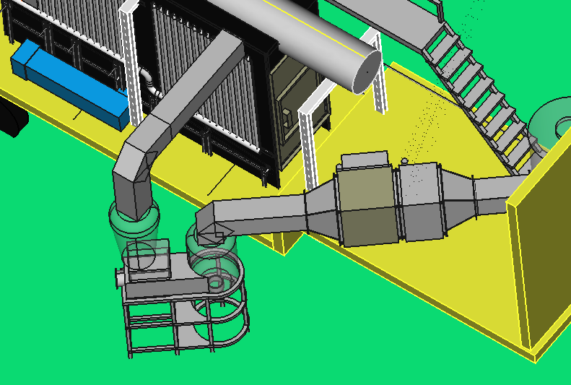
Cooling cyclone
Cyclone of separation

Slide 3
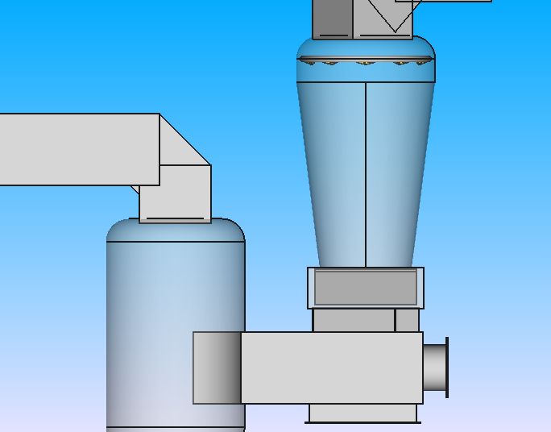
Cooling cyclone
Composed of two parts : Cylinder and cone
Cylinder
Radius R = 30 cm
Height H = 20 cm
Fillet f = 10 cm
Cone
Radius R1 = 30 cm
Radius R2 = 20 cm
Height H = 80 cm
Distance d = 10 cm

Slide 4
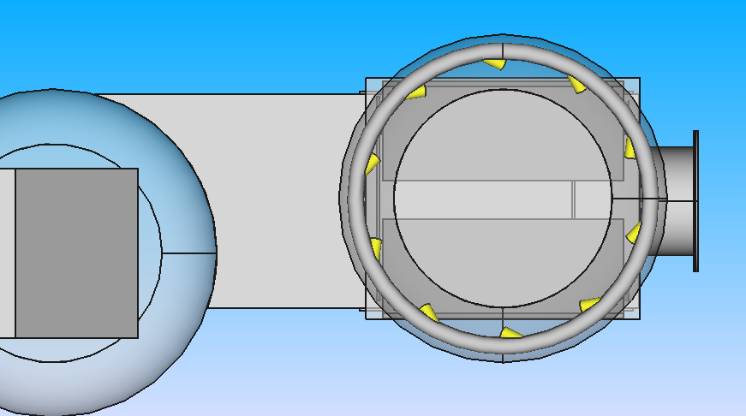
Torus
Radius R1 = 27 cm
Radius R2 = 1.5 cm
Number of sprinklers = 10
Inner radius of sprinkler ri = 0.9 cm
Outer radius of sprinkler ro = 1.2 cm
Length of sprinkler tube L = 5 cm
Angle of sprinkler
In X-direction = 25°
In Y-direction = 75°

Slide 5
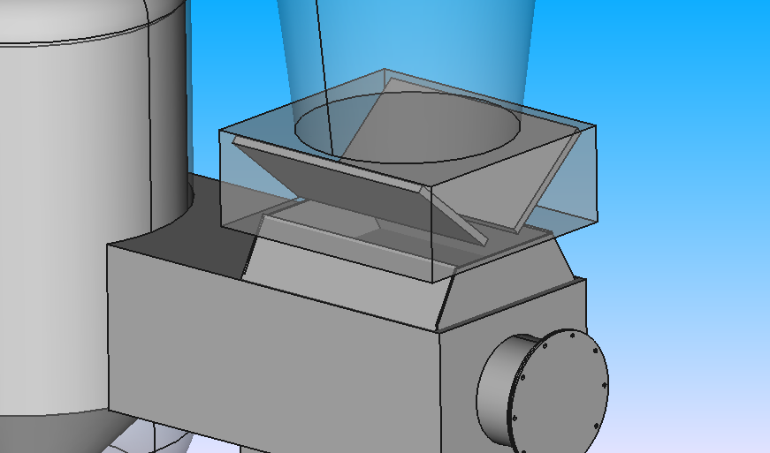
Width W = 44 cm
Length L = 50 cm
Height H = 18 cm
Plate blade
Length L = 44 cm
Width W = 22.5 cm
Thickness T = 1.5 cm
Angle ɑ = 40°

Slide 6
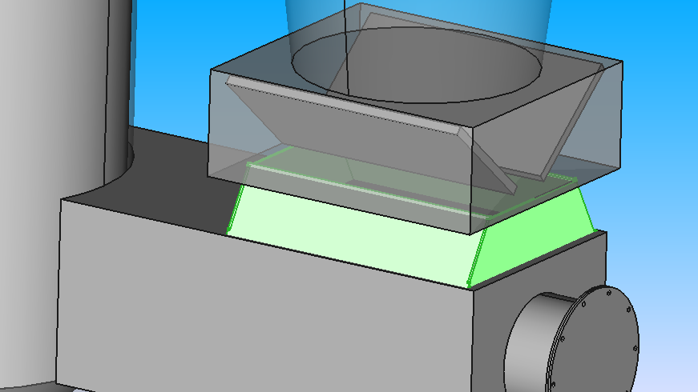
Reduce duct
Length L = 46 cm
Width W = 13 cm
Thickness T = 0.4 cm
Angle ɑ = 60°
Reduce duct
Length L = 37 cm
Width W = 11 cm
Thickness T = 0.4 cm

Slide 7
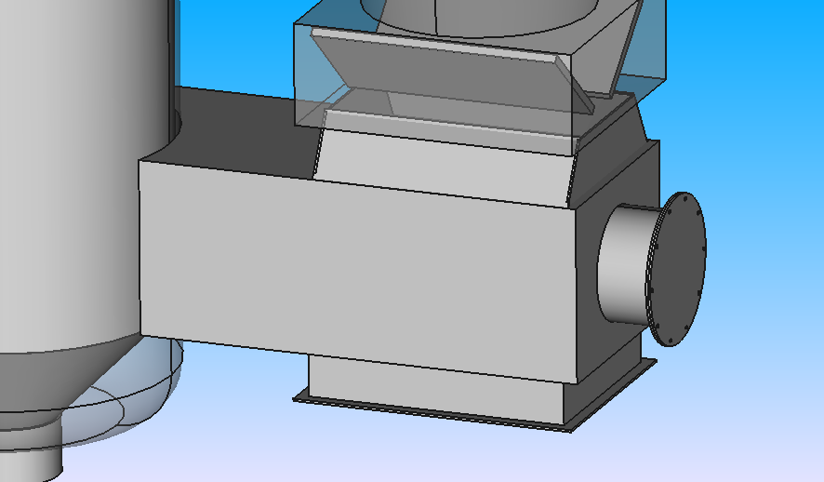
Length L = 100 cm
Radius R = 30 cm
Length L = 78 cm
Width w = 39 cm
Height H = 31 cm

Slide 8
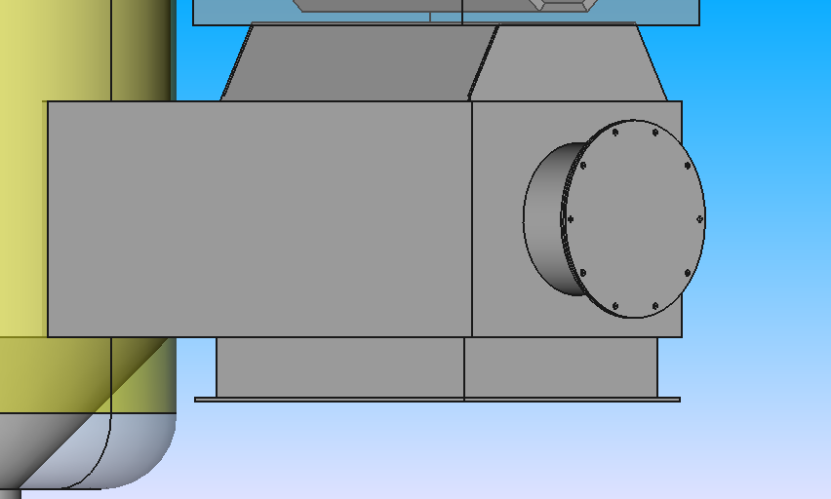
Tube
Radius R = 10 cm
Height H = 10 cm
Flange
Radius R = 13 cm
Thickness t = 0.4 cm
Number of holes = 10
Radius of hole r = 0.4 cm
Duct
Length L = 36 cm
Width W = 46 cm
Height H = 8 cm
Flange of duct
Length L = 40 cm
Width W = 50 cm
Thickness t = 0.4 mm

Slide 9
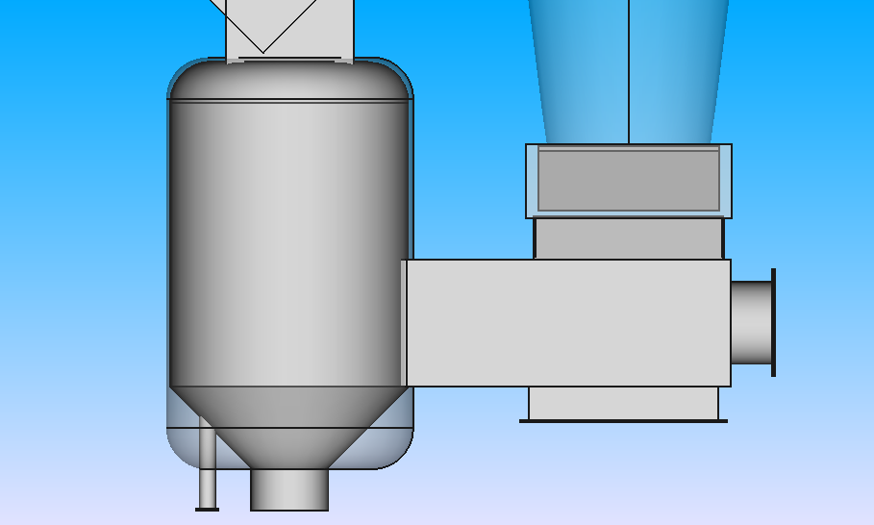
Outer cyclone
Radius R = 30 cm
Height H = 100 cm
Thickness t = 0.2 cm
Fillet f = 10 cm
Inside cyclone
Radius R = 29 cm
Height H = 9 cm
Thickness t = 0.2 mm
Fillet f = 10 cm
Cone of cyclone
Radius R1 = 29 cm
Radius R2 = 9 cm
Height H = 20 cm
Thickness t = 0.4 cm
Tube
Radius R = 2 cm
Height H = 30 cm
Flange
Radius r = 3 cm
Height h = 0.4 cm
Outlet of cyclone
Inner radius Ri = 8.5 cm
Outer radius Ro = 8.1 cm
Height H = 10 cm

Slide 10
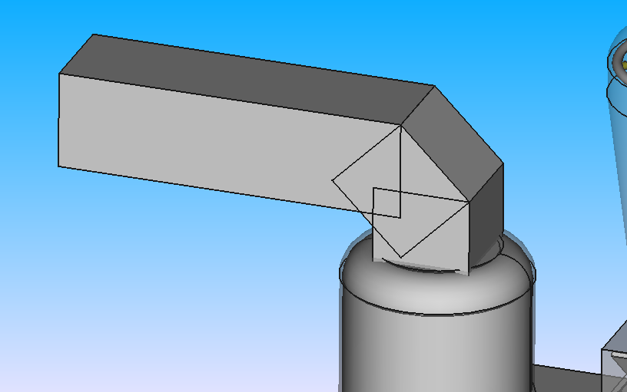
Square duct
Side length S = 31 cm
Height H = 100 cm
Thickness t = 0.1 cm
Angle between duct and other ɑ = 45°

Slide 11
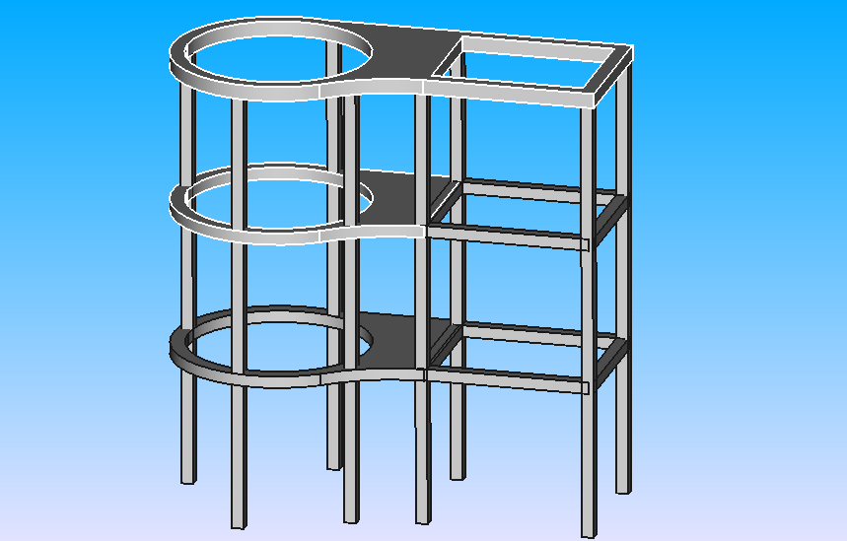
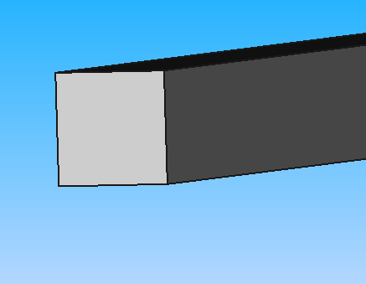
Height H = 50 cm
Square metal
Length L = 5 cm
Width W = 5 cm
Thickness t = 0.2 cm

Slide 12
