Slide 1
Waste management in Dannieh
Project Planning
Choose the project zone “municipalities”.
Estimate the cost of the project.
Draw the road map (starting point).
Municipalities
Timeline
Bqaa sefrin,
Bakhoun,
Beit El Fakes
1-2days
Project location
Dannieh
Dannieh Zero waste
4
Number of employer
Cost of the project

Slide 2
1- Choose the project zone
Project Planning
Bqaa Sefrin
Bakhouun
Beit El Fakes

Slide 3
2- Estimate the cost of the project
Project Planning
 | Cleaner | Driver | Fuel
Number | 3 | 1
Cost/pers/day | 300000 | 300000 | 700000

Slide 4
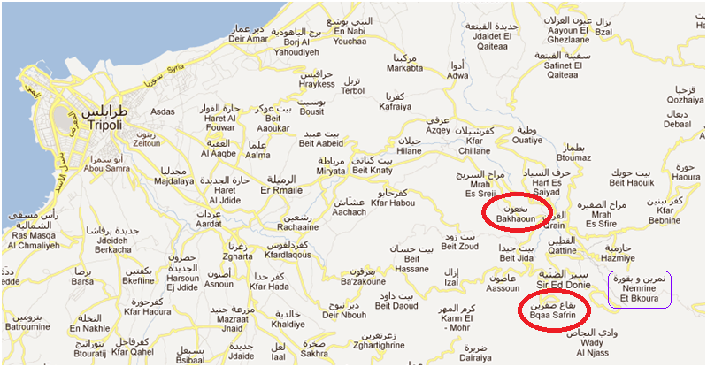
3- Draw the road map
In
Addition
we
have
Beit
El Fakes

Slide 5
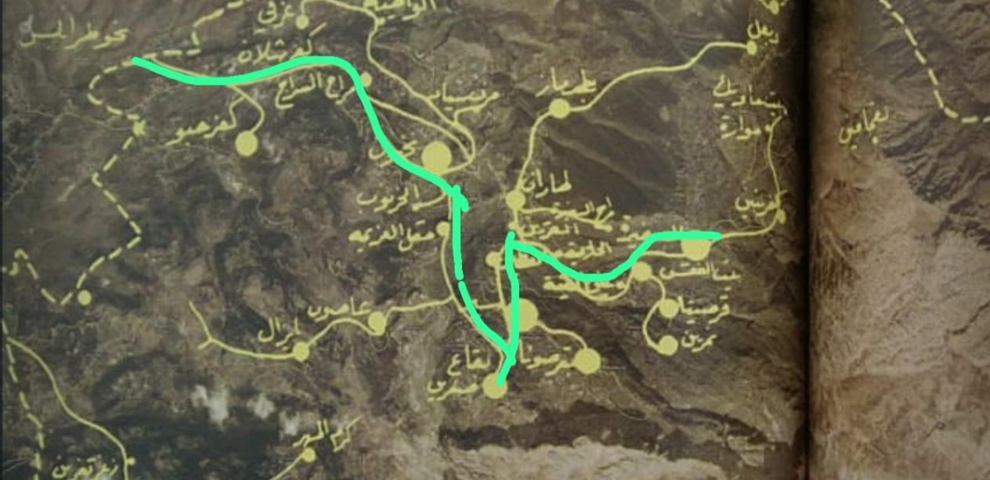
3- Draw the road map

