Slide 1
North Lebanon Telecommunication
Presented by: Maryam abdel-karim

Slide 2
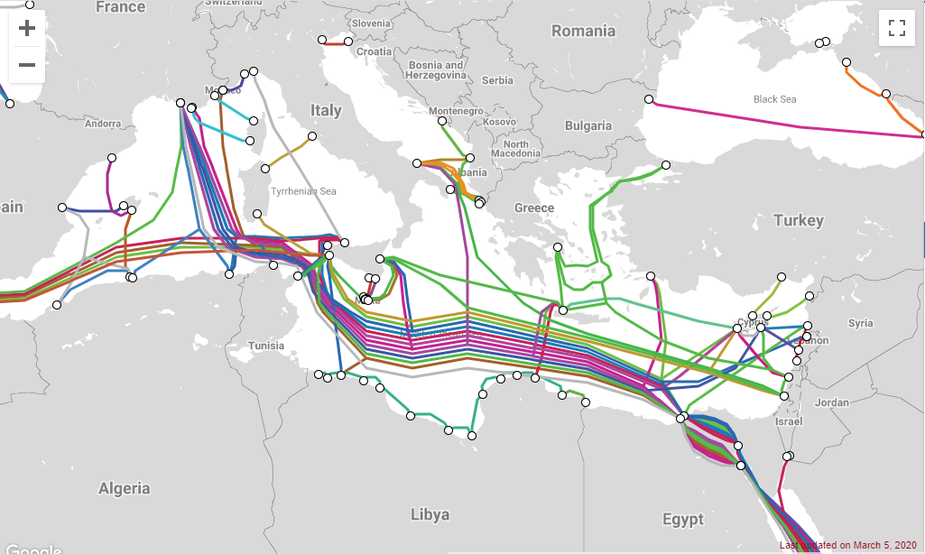
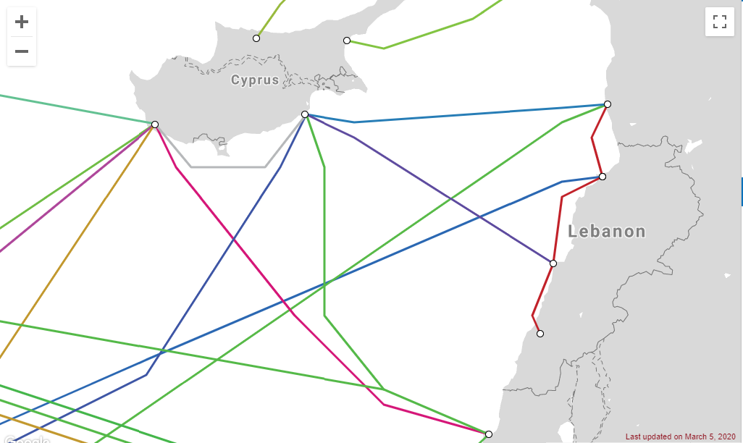
The I-ME-WE (India-Middle East-Western Europe) submarine communication cable linking Tripoli, Lebanon with other countries

Slide 3
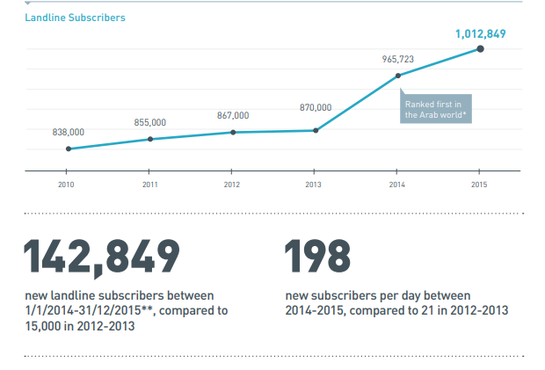
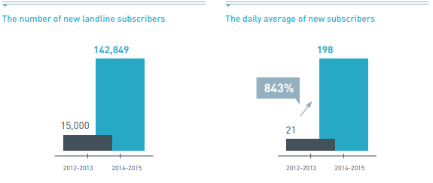
landlines

Slide 4
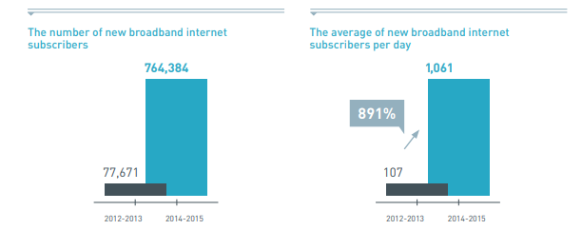
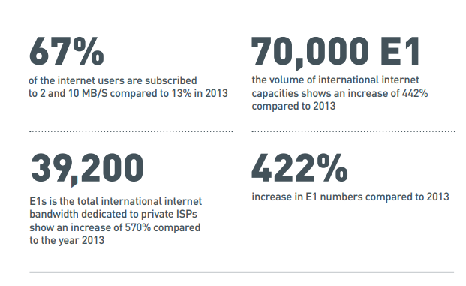
internet

Slide 5
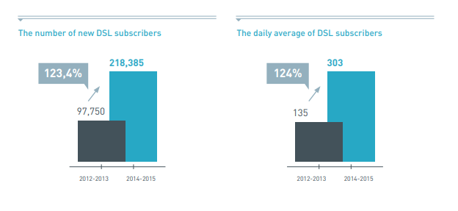
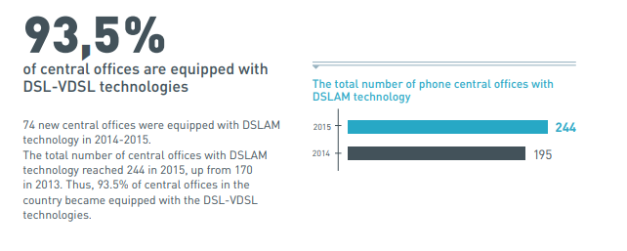
DSL

Slide 6
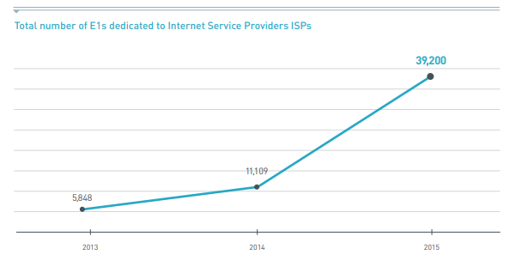

Slide 7
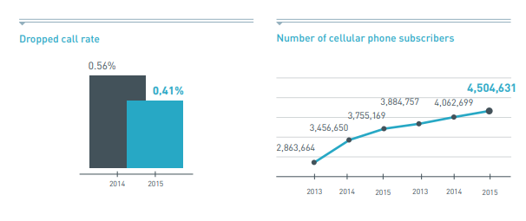
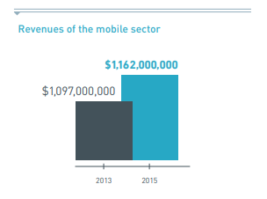
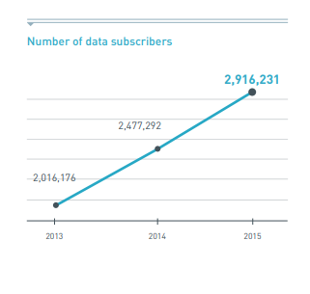
Mobile cellular

Slide 8
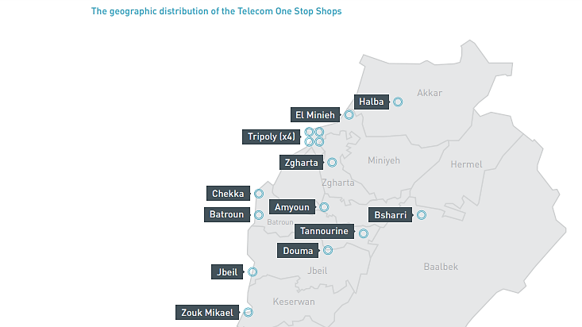
Telecom One Stop Shops (OSS)
Common sale centers (Telecom One Stop Shops) for Alpha, Touch and Ogero were set up to provide fixed and mobile telecommunications services.

Slide 9
Upcoming Projects

Slide 10
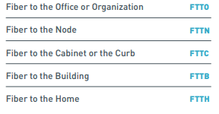
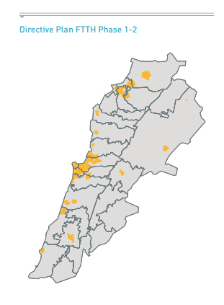
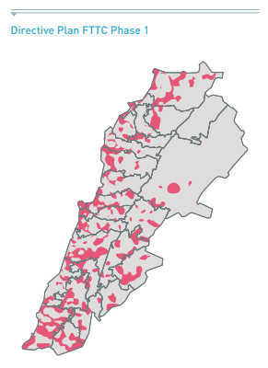
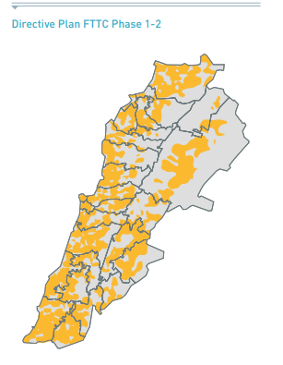
1.The fixed network: the transition from copper wire to fiber optics (FTTX)

Slide 11
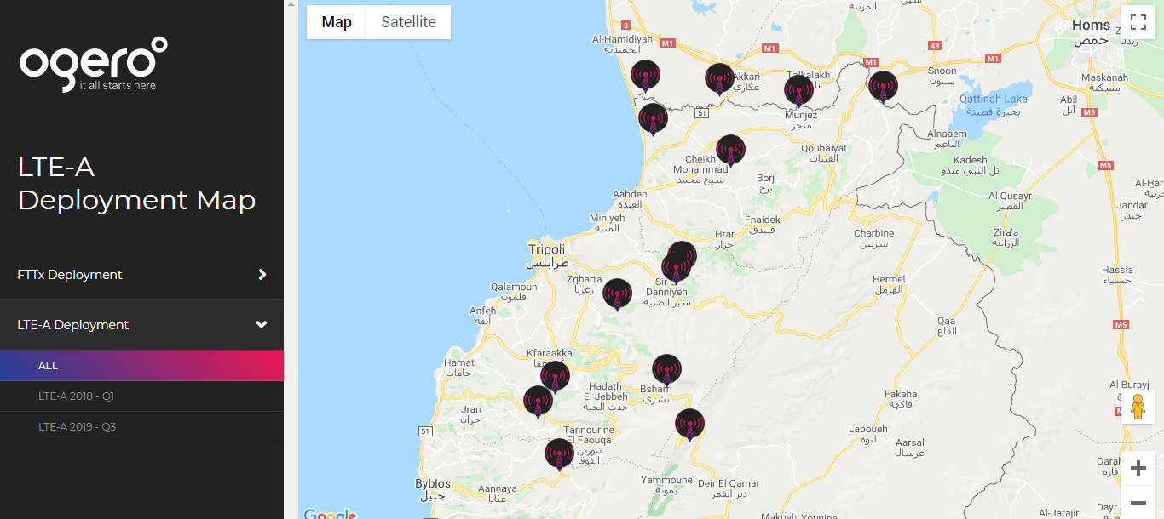

Slide 12
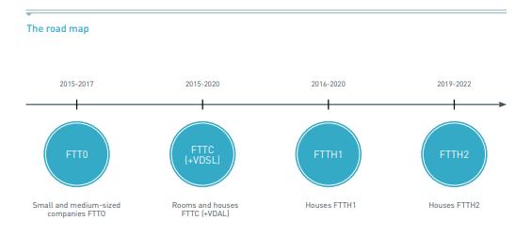

Slide 13
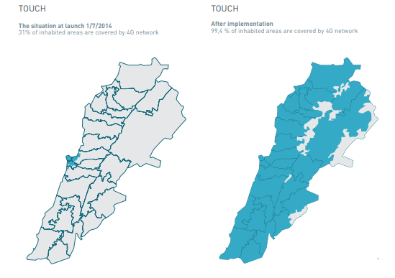
2.The mobile network: the transition from the third generation (3g) to the fourth generation (4g advanced)

Slide 14
Reasons Lebanon’s internet is so slow
The brand new fiber optic network is not on :
This network connects the bulk of the central offices (COs) in the country as well as heavy users such as businesses, universities, hospitals, mobile operators and the army, with the newest generation of cables. This network, however, has not yet been approved for further development and use. The foggy reason given by advisors to the ministry is that there are mistakes made by contractors that are still in the process of being corrected.
The last mile
the fiber optic network installed by CET and Alcatel–Lucent connected the COs and heavy users, it does not connect the COs to the final leg of the telecommunication network: the average end user. These connections are still made through much slower copper infrastructure.
Bottleneck in the E1 lines
apparent obstruction in the distribution of international capacity to the private sector internet service providers (ISPs). Lebanon does not lack in international capacity. A very small percentage of this is actually passed down to the private sector ISPs. Some claims that one of the reasons Ogero is not granting the ISPs E1 lines is because they are reselling them illegally to Alpha, Touch, and illegal ISPs and DSPs.
The high prices
The price of internet service is neither an outcome of market competition or of cost to the providers. Rather, the prices are set by the government and are linked to internet speeds, and every time the government wants to lower the price of the internet, they have to issue a decree. That means a service provider cannot actually lower the price of the internet without a change in the tariffs applied to them.

Slide 15
System dynamics

Slide 16
جزاكم الله خيرا

