Slide 1



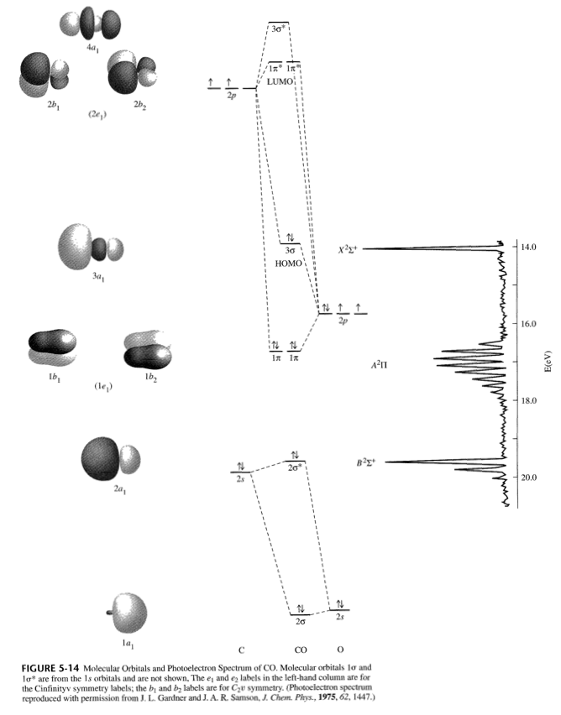
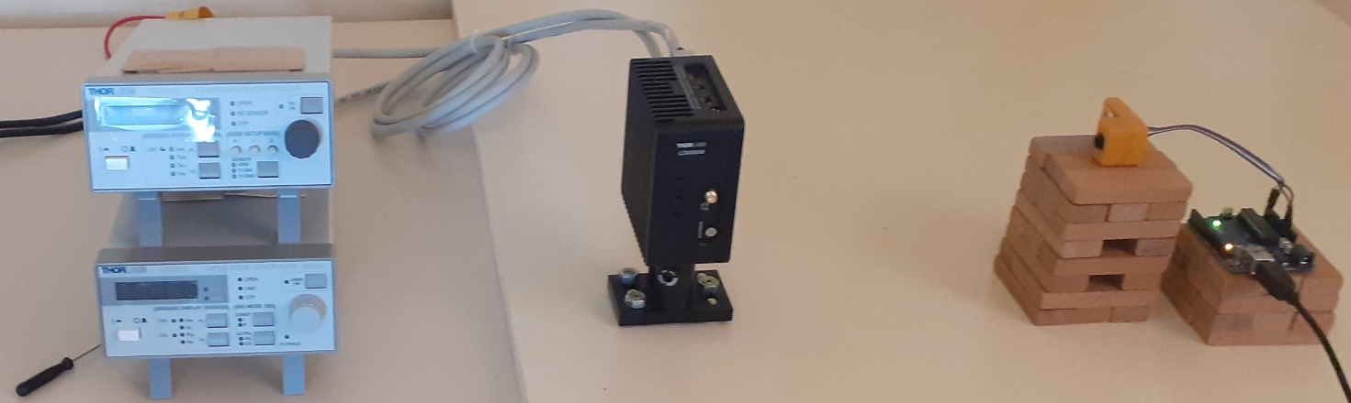
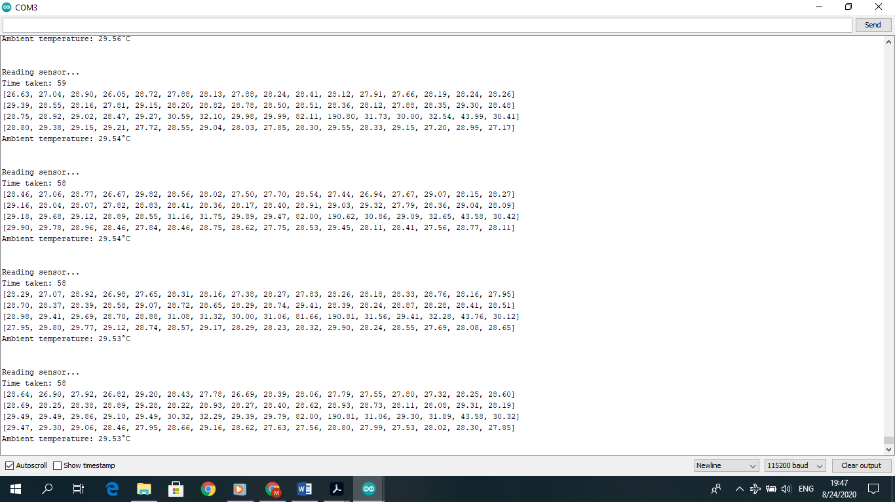
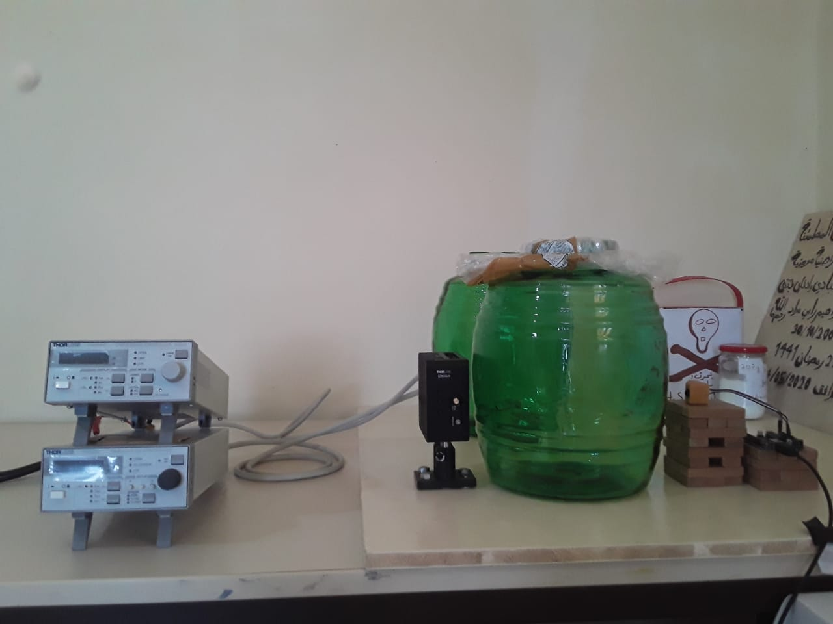
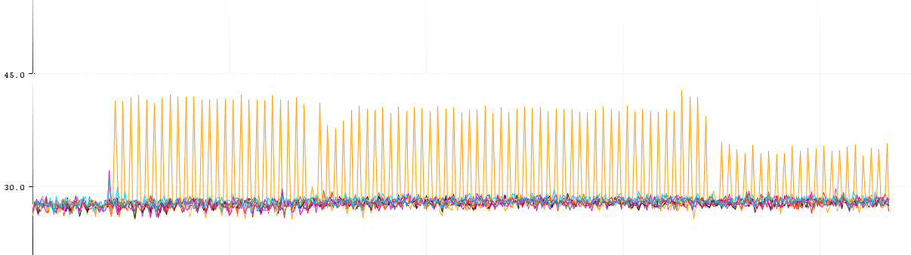
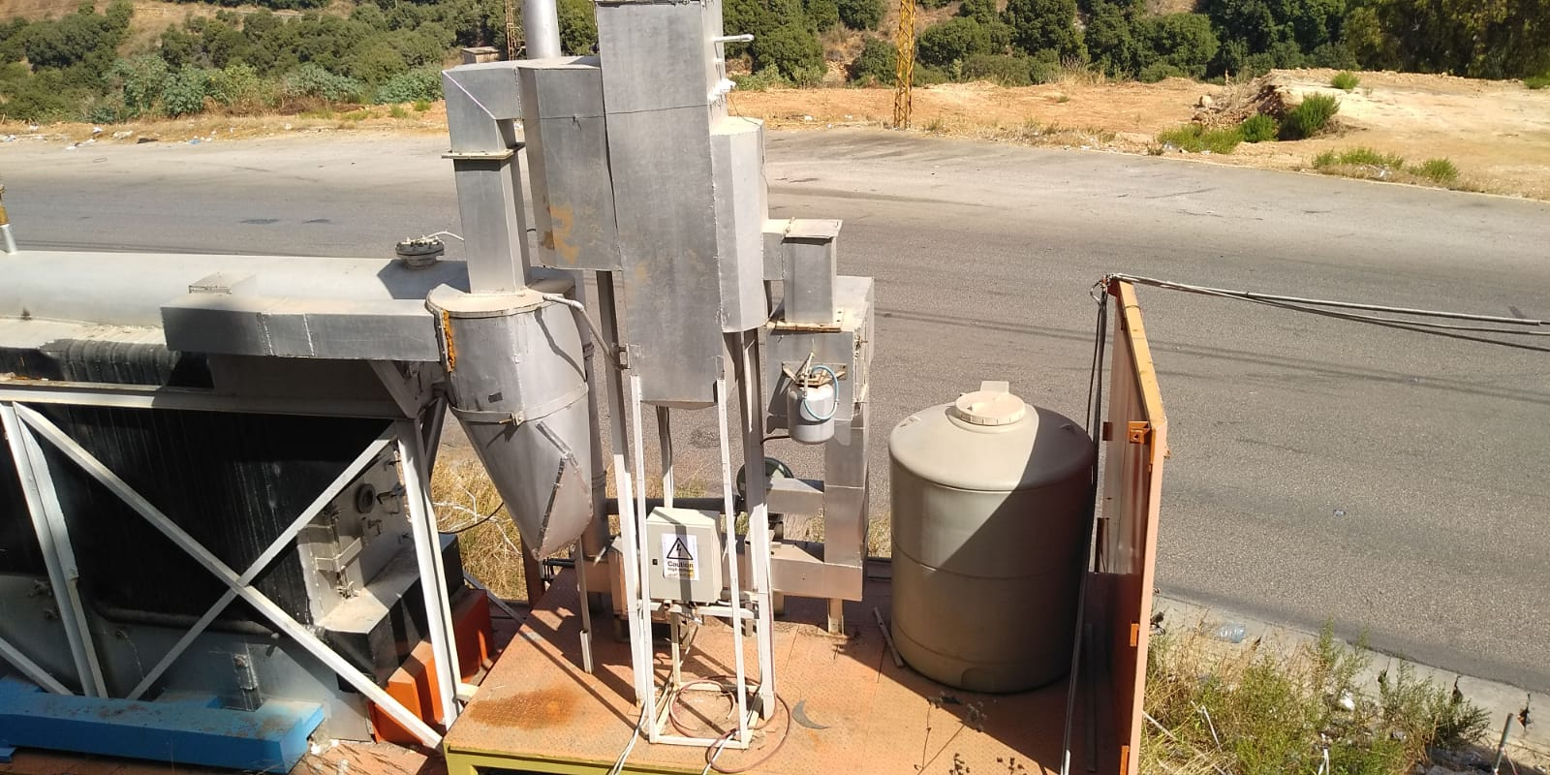
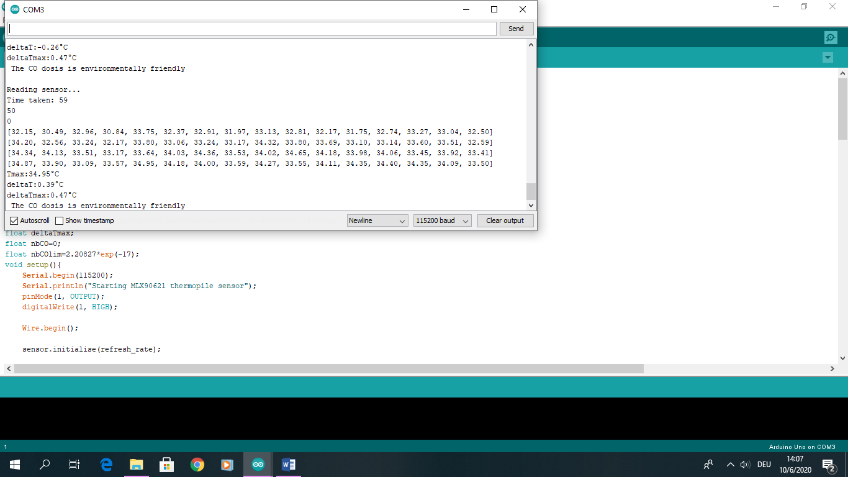
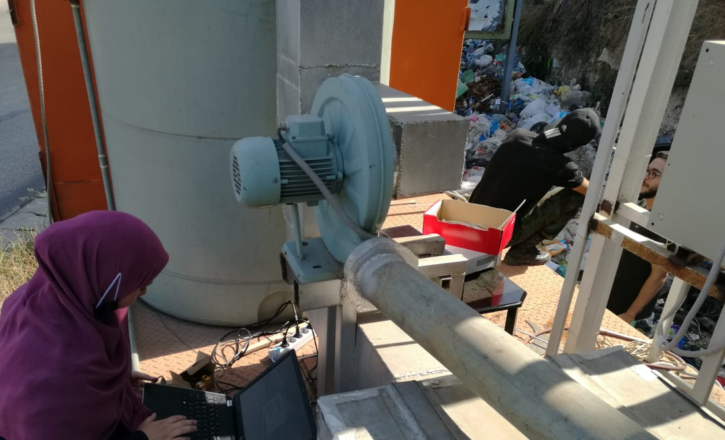
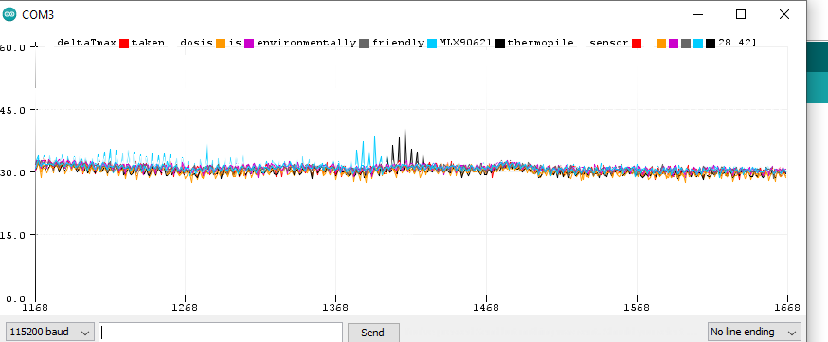
Theory
Beer’s law
The gas absorbs the laser energy according to Beer’s law.
That means, the absorption is proportional to the concentration. In this case, the carbon monoxide is studied.
The wavelength of the Laser is 1550nm
which corresponds to an energy of 0.79990eV. This wavelength is usually used to detect the CO. According to the diagram this energy fits between the A²π energy levels.
Laser Based Flue Gas Detection
CO absorbs Laser Energy
Concentration <-> absorption
1550nm
0.79990 eV
<=>
Experimental Calculation method
P | T
λ
deltaT
ΔP
t
ΔE
δE
nbCO
[CO]_{lim}
V
nbCO_{lim}
The detector measures the temperatures in fuction of time.
The Arduino Program calculates the variation of temperature deltaT. If the variation is bigger than the usual variation of the Laser itself, the number of the detected gas molecules is calculated nbCO. From the caracteristic table of this system, the corresponding power variation ΔP can be deduced. Knowing the time t wich is the refreshtime of the program, the absorbed energy ΔE is calculated. The wavelength of the laser give us the absorbed Energy by one molecule δE. The quotient of ΔE and δE gives us the nbCO.
The detected volume is separately calculated. It is the product of the width of the chimney and the surface of one pixel (pixel_x*pixel_y).
Because in our special case just one pixel of the 64 is influenced by the radiation.
The volume let us deduce the limit number of molecules which is allowed to measure,
from the limit concentration nbCO_{lim} given by the WHO.
Finally the program compares the measured nbCO with the limit nbCO, and tells us if the gas concentration is environmentally friendly or not.
Temperature controller
LD mount
Laser
Schematic
The laser diode controller gives the necessary intensity
and power to the laser diode. The temperature controller fixes the wavelength by fixing the temperature. The collimator lets the radiation be parallel. The laser is produced. It is an infrared one. So an IR detector like the Melexis temperature camera can detect its power. The Arduino reads, converts and processes this information, and gives it to the Laptop.
Laser diode controller
Laser diode
collimator
IR camera: detector
Arduino
Laptop
2 cases: with or without gas
Indoor result
temperature controller
Indoor experimental setup
The serial monitor on the right is like one picture.
Instead a colored pixel a temperature in °C is displayed. The pixels which detect the laser have a higher temperature than the others.
Laser diode
+ collimator
Detector
Arduino
Serial Monitor
To see if this system really detects CO and
to develop the system, CO is produced by the
dehydration of formic acid with sulfuric acid.
The CO is produced in this hermitically closed
container. And to not forget the influence of this green glass, the 3 cases are compared: nothing in the lasers path (air), an empty container (glass) and the container with CO.
Like you see in the photo left, the result is the serial plotter right.
Arduino do not save the data. This problem was solved by python.
LD controller
Serial Plotter
Temperature (°C)
air
>
air
glass
CO
CO
>
Experiment at the power plant
Results: Power plant
Time (s)
All this was actually done to prove that the power plant at the right is environmentally friendly. This power plant converts waste to electrical energy by heat treatment. The flue gas goes throw several filters. After the last filter the measurements are taken. At the right you see the results of the first real experiment at the power plant.
This experiment was done to see which problems we have at the outdoor experiment to solve them.
During the measurement the gas was environmentally friendly concerning the CO.
But we have to repeat this measurement to ensure
The results and with better conditions.
Temperature (°C)
>
Problems:
High ambient temperature
Difficulty to compare: with and without gas
Challenge to fix the Laser
>
Time (ms)
Mariam Mourad@INT/AECENAR 2020

