Slide 1
Electrolysis of water
Presented by:
Siham Aisha

Slide 2
Plan:
Alkaline electrolysis
Stack design
Power supply
Calculate gas flow rate
Calculate of electrolyte
Hydrogen storage

Slide 3
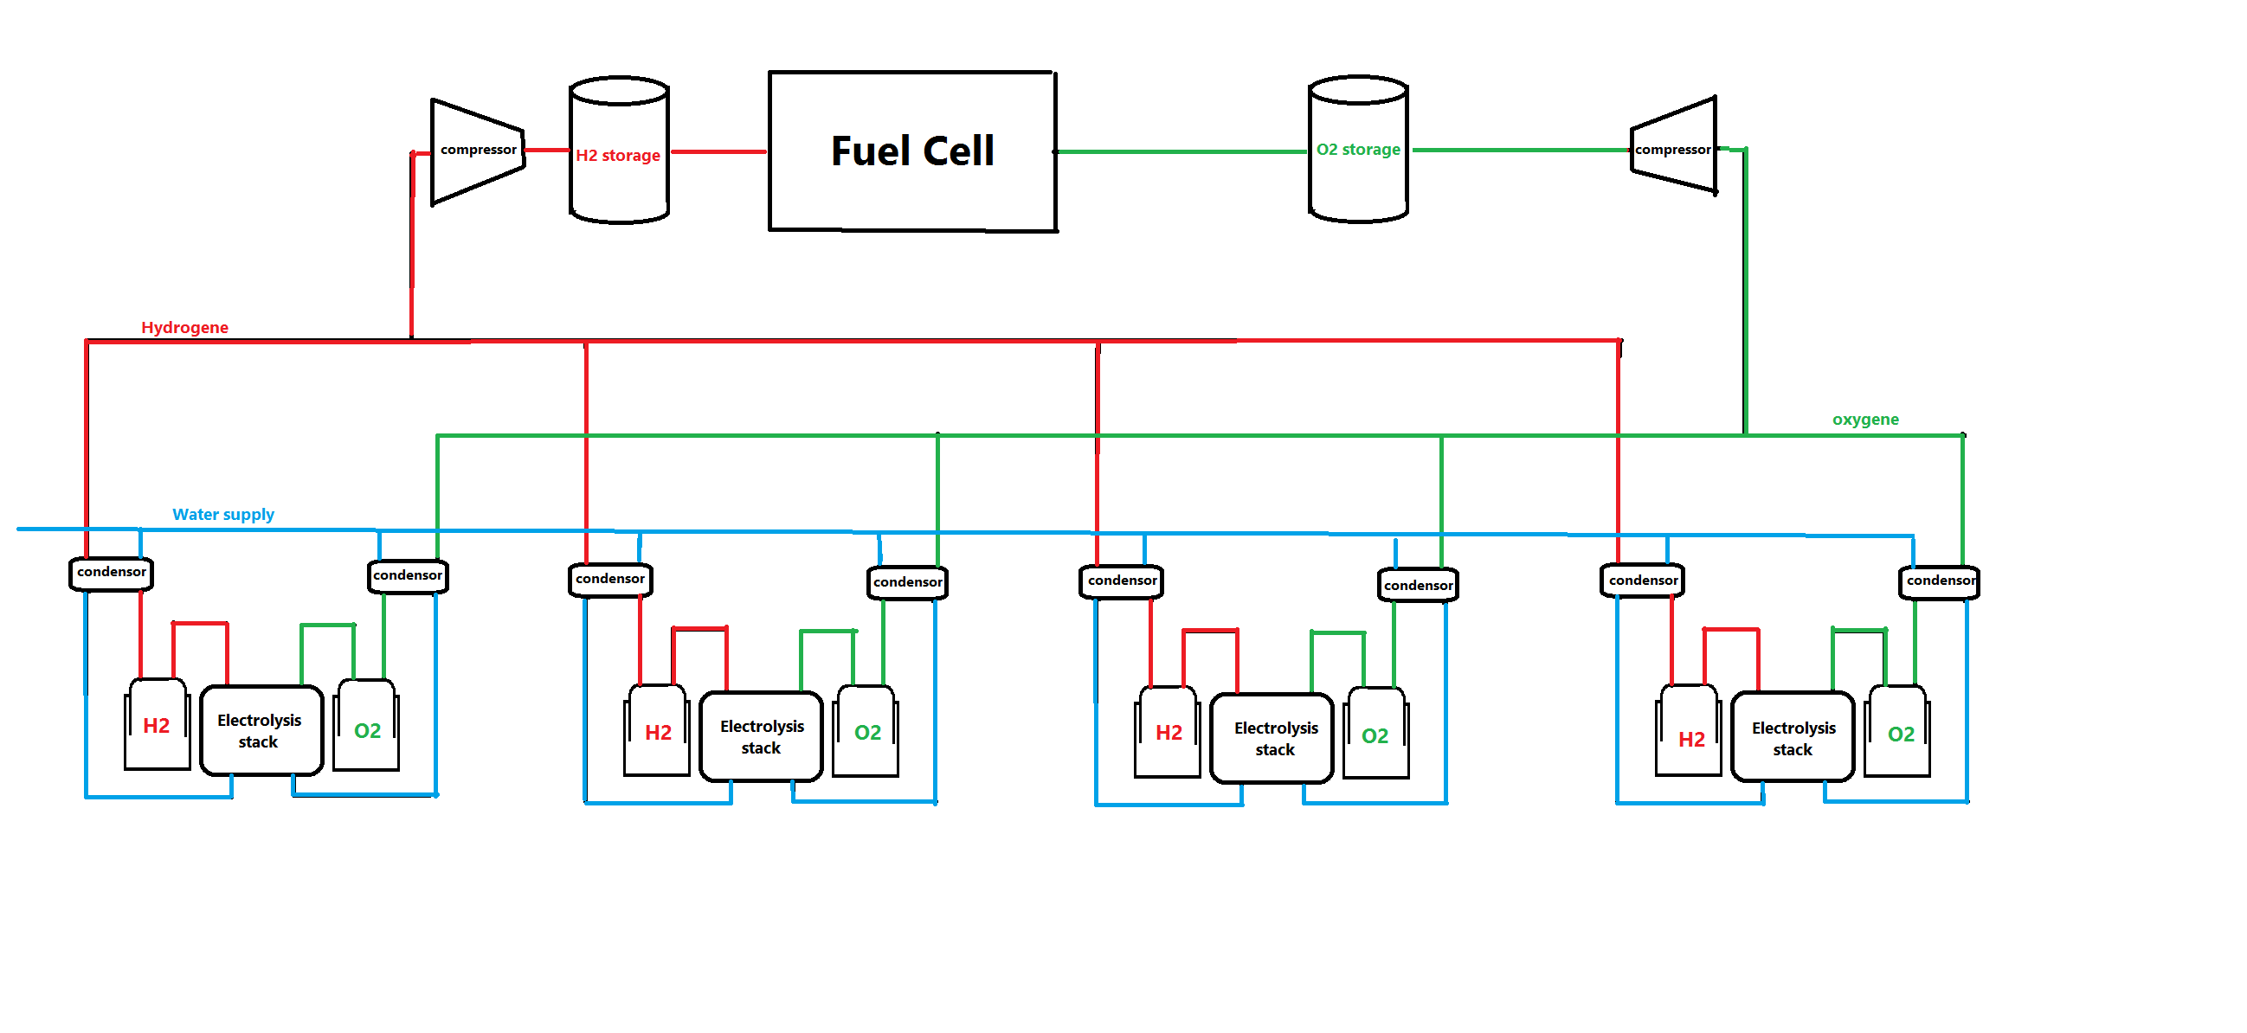
Alkaline electrolysis

Slide 4
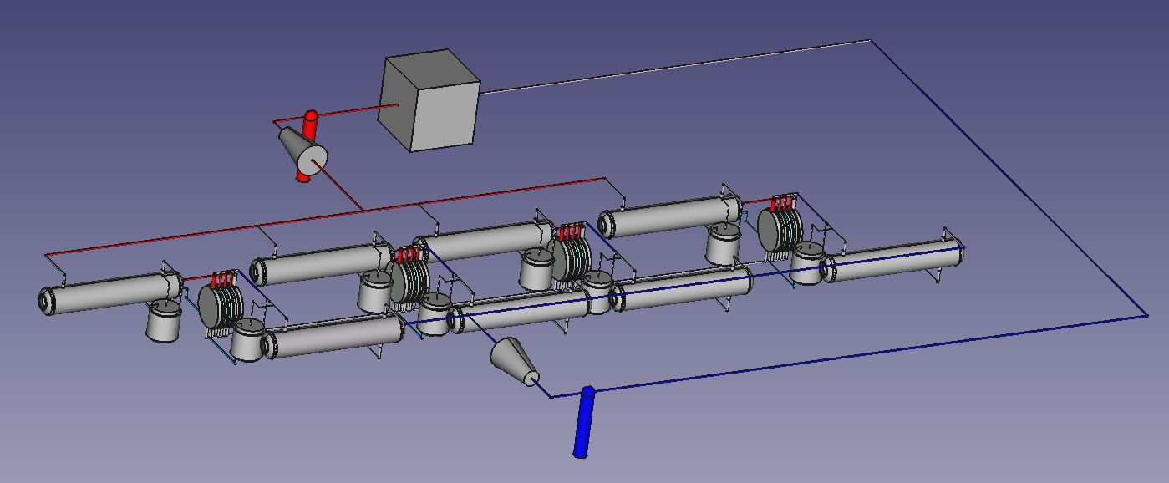
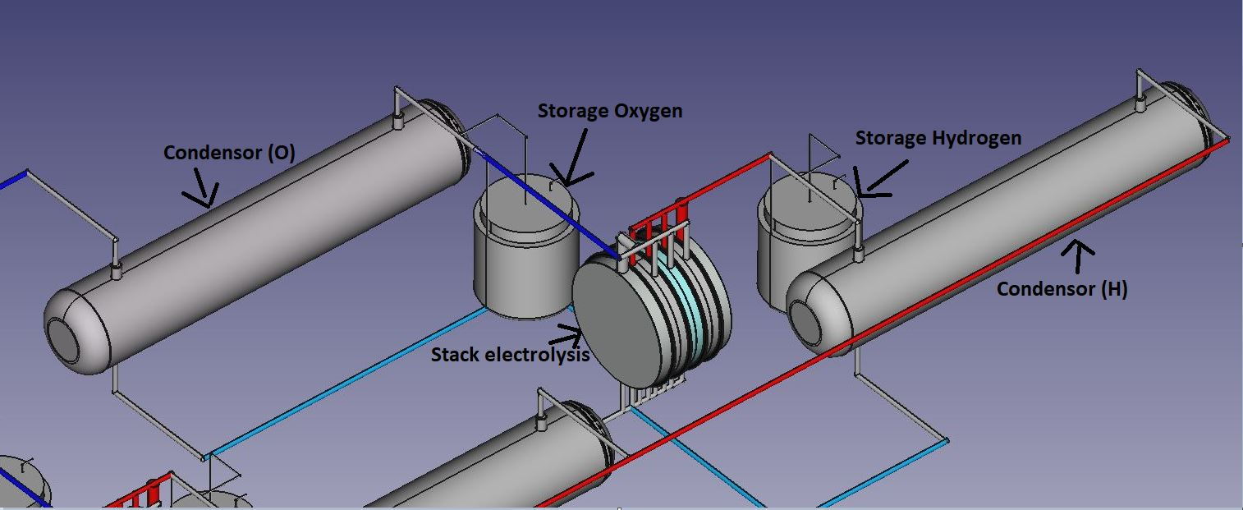
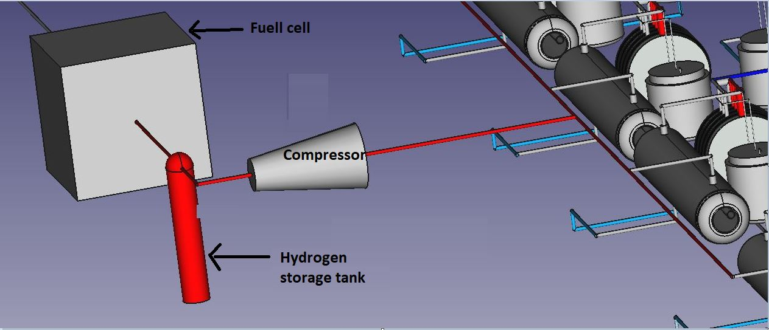
FreeCad design
Plant of 4 stacks parallel
Stack of serial cells

Slide 5
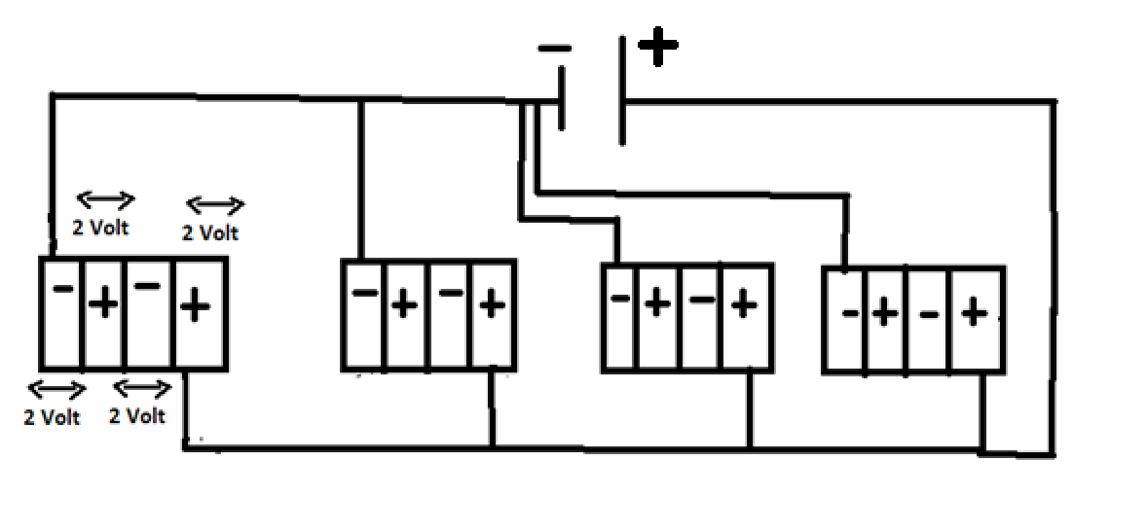

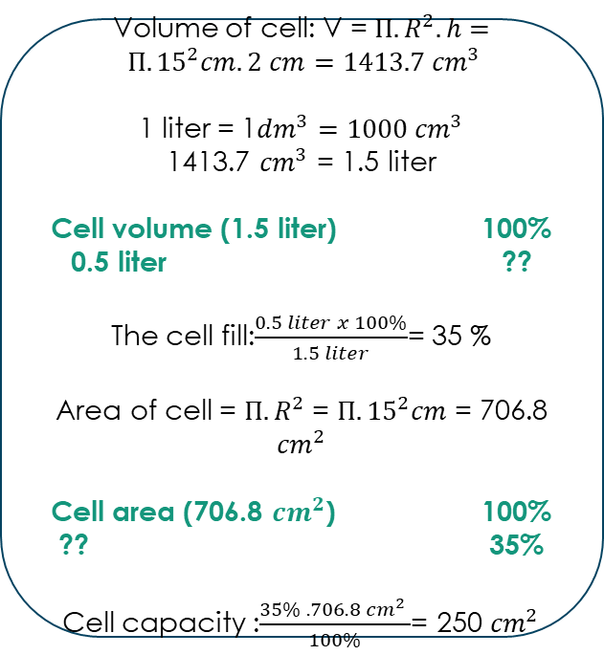
Power supply
Volume of cell: V = $Π.R^{2}.h= Π.{15}^{2}cm.2 cm=1413.7 {cm}^{3}$
1 liter = 1${dm}^{3}=1000 {cm}^{3}$
1413.7 ${cm}^{3}$ = 1.5 liter
Cell volume (1.5 liter) 100%
0.5 liter ??
The cell fill:$\frac{0.5 liter x 100\%}{1.5 liter}$= 35 %
Area of cell = $Π.R^{2}$ = $Π.{15}^{2}cm$ = 706.8 ${cm}^{2}$
Cell area (706.8 ${cm}^{2}$) 100%
?? 35%
Cell capacity :$\frac{35\% . 706.8 {cm}^{2} }{100\%}$= 250 ${cm}^{2}$
8 volt / 300 Ampere
Current density per cell: 0.2 – 0.4 A/cm²
Our cell capacity 0.5 liter correspond to 250 cm²
Current applied for each cell = $250 {cm}^{2} ∗0.3 A/{cm}^{2}=75 A$
Voltage applied for each cell is 2V
Each stack has 4 serial cell => voltage = 4*2 V = 8 V
Current = 75A
The total is 4 parallel stack => voltage = 8 V
Current = 4 * 75 A = 300 A

Slide 6
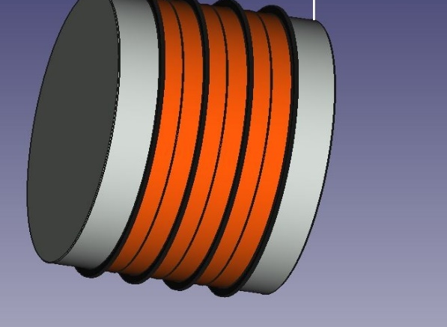
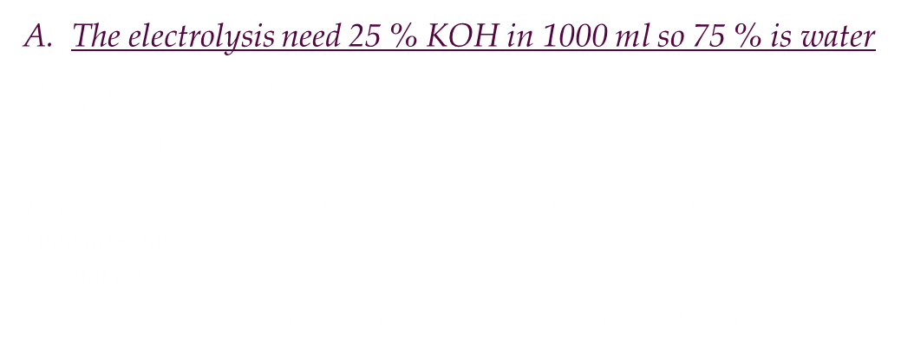
Calculate of electrolyte amount needed for electrolysis
The electrolysis need 25 % KOH in 1000 ml so 75 % is water
250 g (KOH) → 750 ml (water)
?? 1000 ml
Amount of KOH in half cell end plate electrode = $\frac{1000 ml∗250 g}{750 ml}=333.33 g$
We have 2 electrodes end plate: 2*333.3 g = 666.6 g
333.3 g KOH
333.3 g KOH

Slide 7
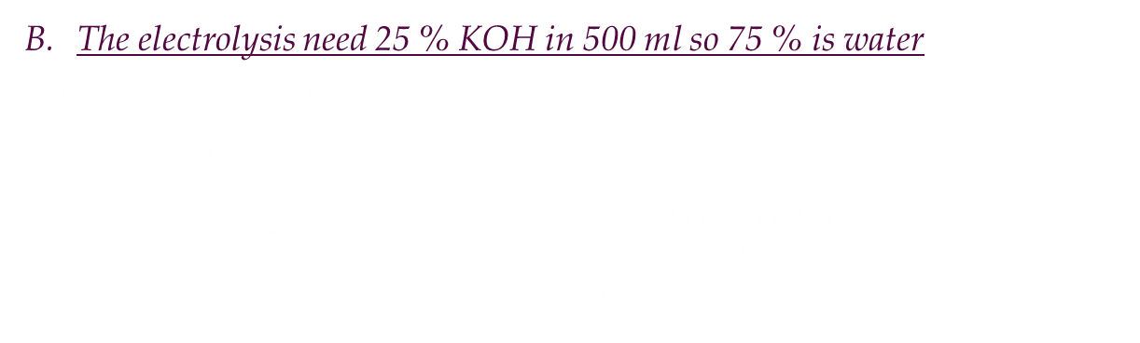
The electrolysis need 25 % KOH in 500 ml so 75 % is water
125 g (KOH) → 375 ml (water)
?? <--500 ml
Amount of KOH in half cell base plate = $\frac{500 ml∗125 g}{375 ml}=166.66 g$
We have 30 electrodes: 30 * 166.66 g= 5000 g
166.66 g KOH

Slide 8


Calculate gas flow rate
The maximum cell current value of 75 A is selected for the calculation. Faraday constant (F= 96485 C.${mol}^{−1}$ or C: coulomb (1C = 1A.s)). Moreover, Eq. 1 is used to calculate the number of hydrogen moles as follows.
$$n_{(H_{2})}=\frac{I∗t}{2F}= \frac{75 \left(C/s\right)∗60(s/min)}{2\left(electrons\right)∗96485 C.{mol}^{−1} }=0.0233 mol/min$$
Considering Eq. 2, assuming the pressure of 1 atm and the operating temperature of 25°C, the theoretical V_{H2(g)} can be determined as,
$$V_{H_{2(g)}}= \frac{n_{H_{2}}RT}{P}=\frac{0.0233 mol/\min{∗0.082 Latm K^{−1}{mol}^{−1}∗298 K}}{1 atm}$$
$$V_{H_{2}}=0.569 L. \min^{−1}$$
Each stack produce 0$.569 L.\min^{−1}$ => 4 stack produce = 0.569 $L.\min^{−1}$ * 4 (stacks) = 2.279 L.$\min^{−1}$
Every 1 hour the cell can produce : 2.279 $L.\min^{−1}$ * 60 min = 136.76 Liter

Slide 9

Calculate gas flow rate
For oxygen:
The amount of substance for O₂ (g) can be determined by using either Eq. 5.1 or the electrochemical reaction of the alkaline electrolysis cell. According to the electro chemical reaction, the number of O₂(g) moles should be half of H₂(g) moles. Hence, the number of O₂(g) moles can be easily determined as in Eq.
$$n_{O_{2}}=\frac{n_{H_{2}}}{2}$$
$$n_{O_{2}}=0.0116 mol/min$$
$$V_{O_{2(g)}}= \frac{n_{O_{2}}RT}{P}=\frac{0.0116 mol/\min{∗0.082 Latm K^{−1}{mol}^{−1}∗298 K}}{1 atm}$$
$$V_{O_{2}}=0.284 L.\min^{−1}$$
Each stack produce 0.284 L.$\min^{−1}$ => 4 stacks produce = 0.284 $L.\min^{−1}$ * 4 (stacks)= 1.138 L.$\min^{−1}$

Slide 10
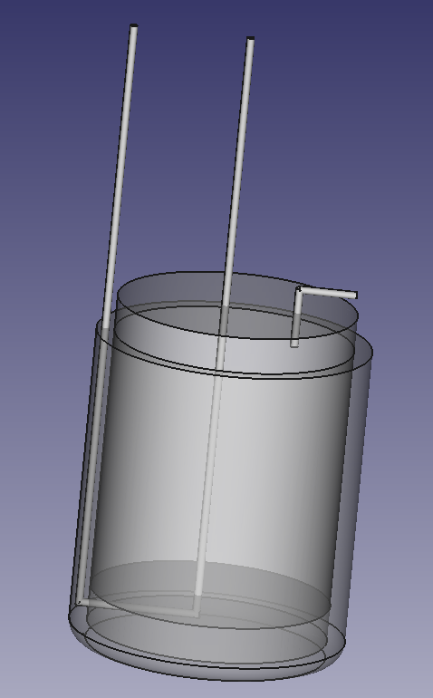
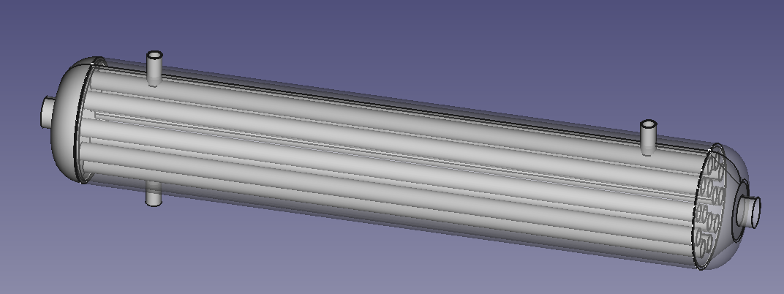
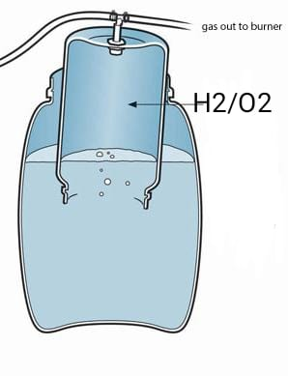
Hydrogen storage
H2 is transfered to condenser
Inlet H₂
Outlet H₂
Inlet H₂ + steam
Outlet H₂
Inlet cool water
Condenser
outlet cool water
Hydrogen storage
outlet water
When Hydrogen exit from condenser, it’s transfer to compressor at 700 bar then it’s storage in hydrogen tank

