Slide 1
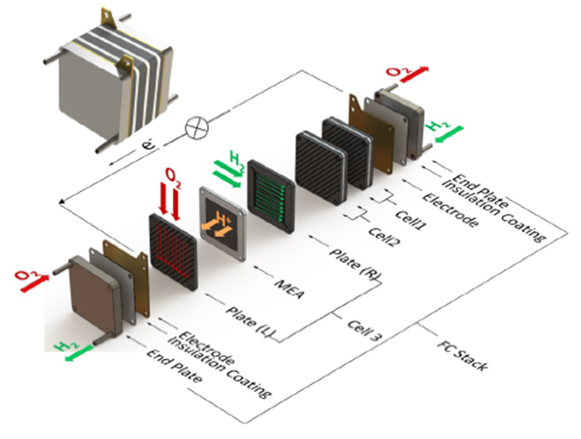
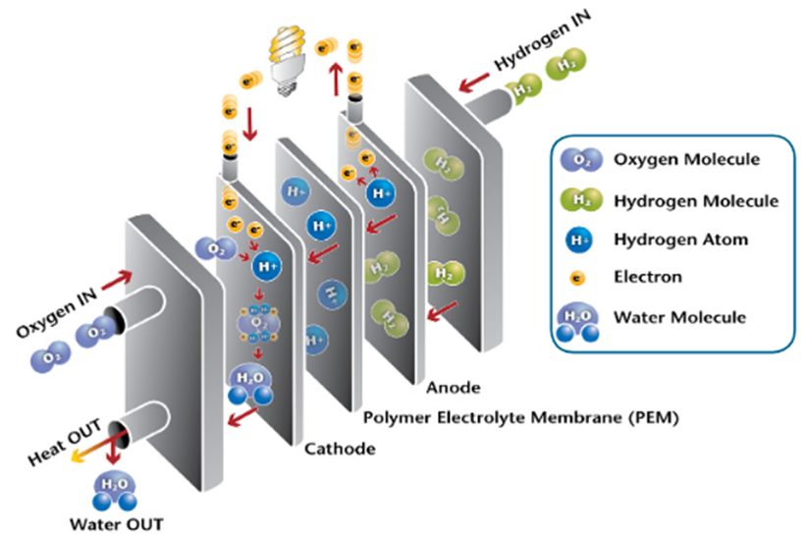
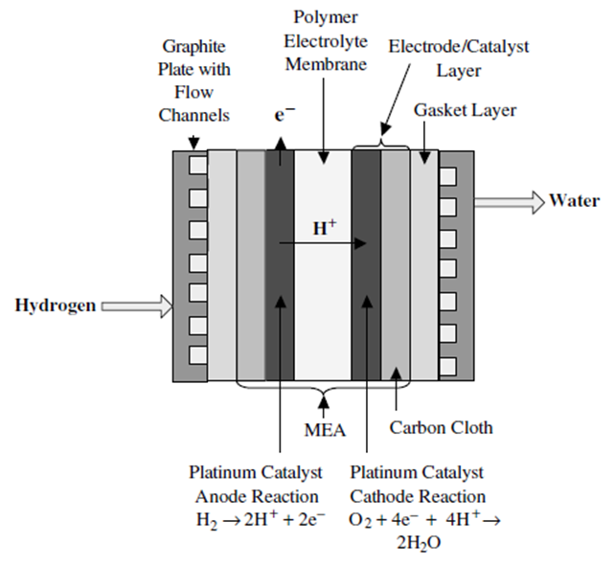
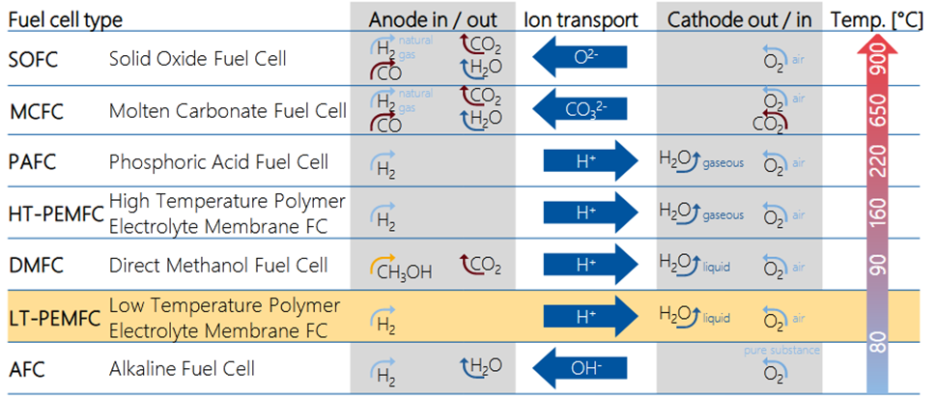
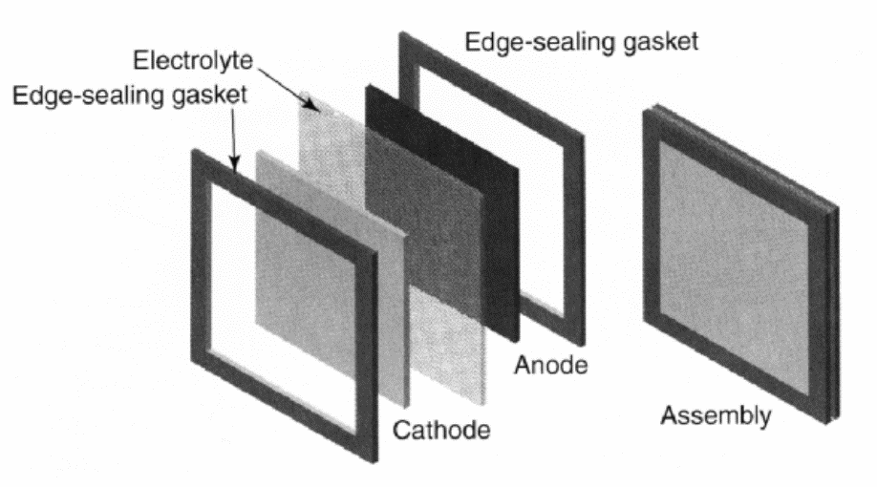
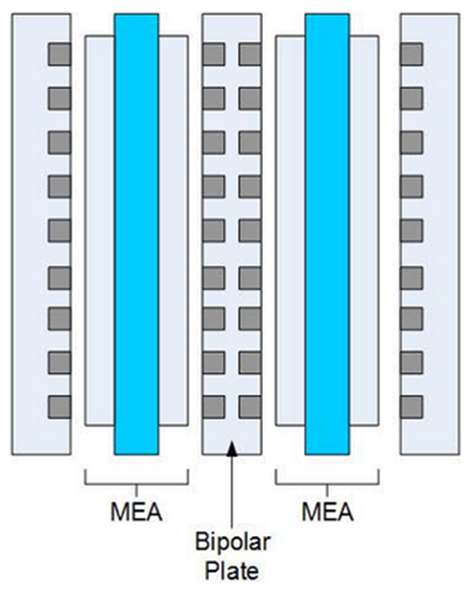
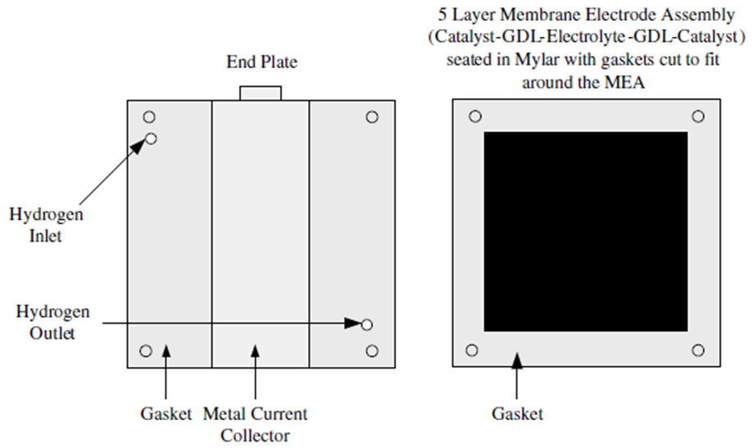
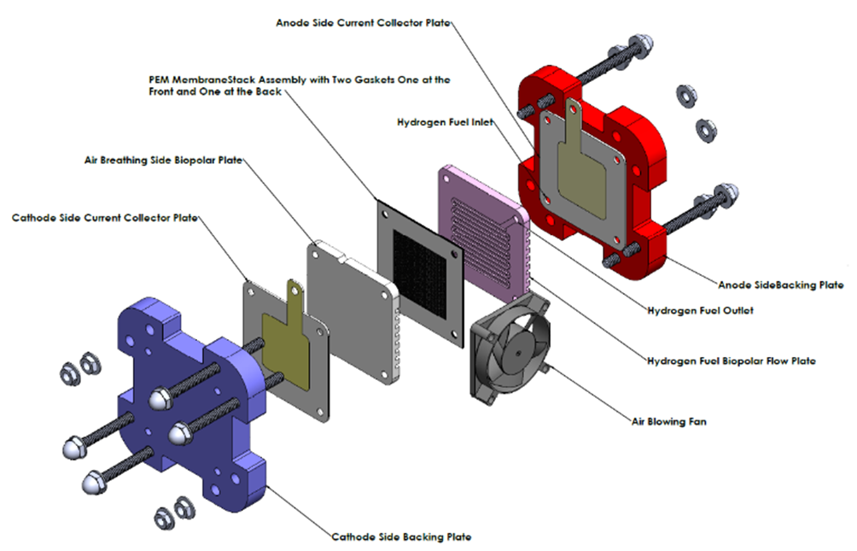
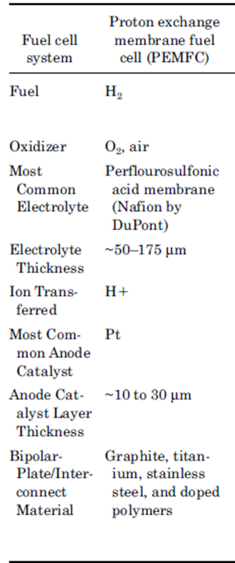
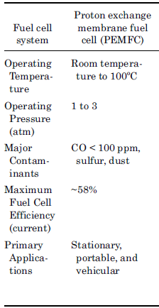
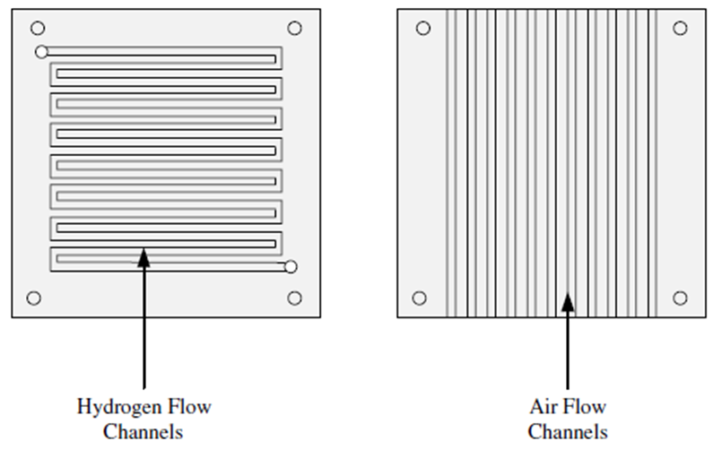
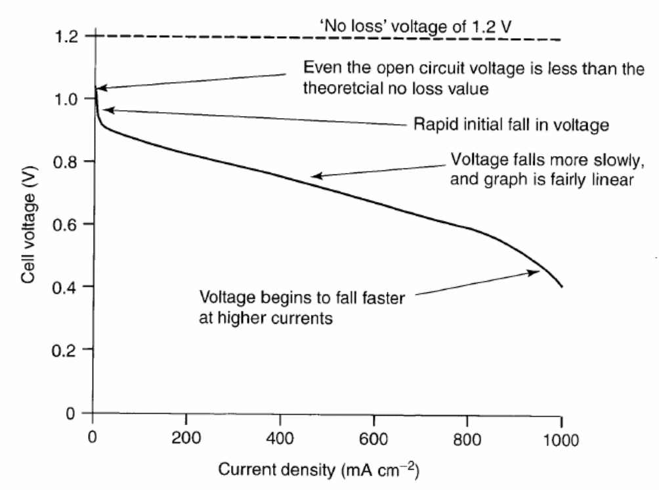
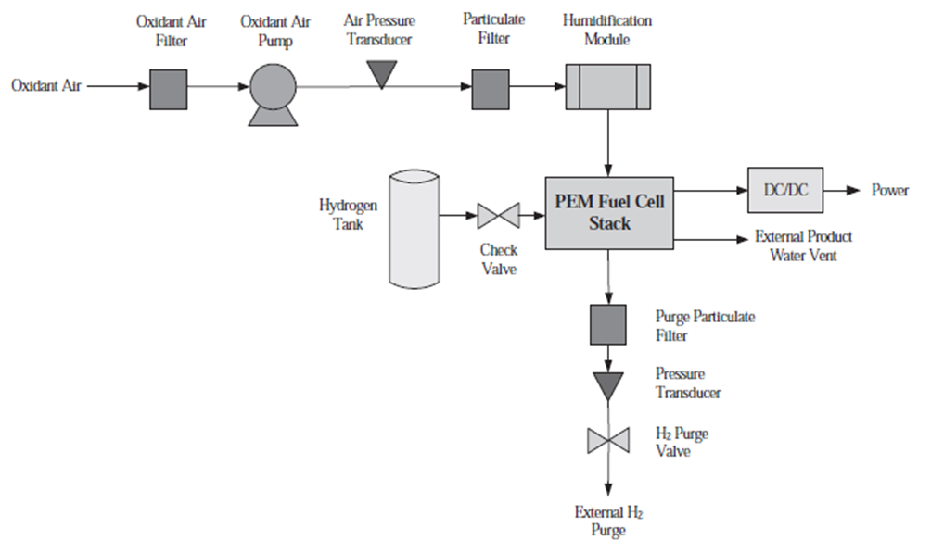
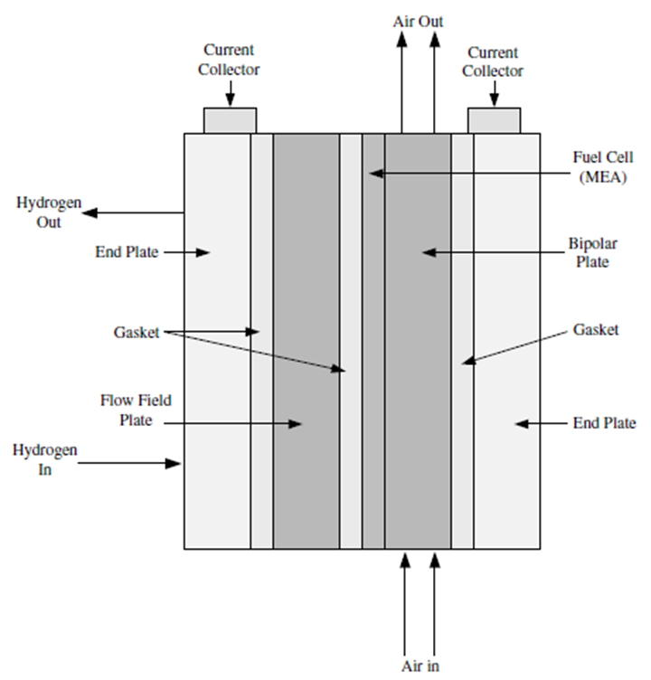
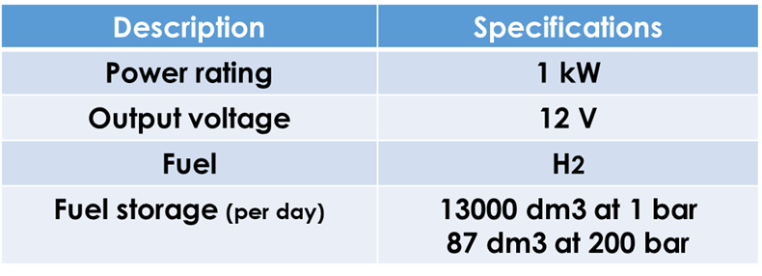
Fuel Cell system
Generalized schematic of a single fuel cell
The advantages are:
· Low emissions
· More efficient compared to a conventional internal combustion engine
· Simplicity, few if any moving parts
· Reliable and long-lasting system
· Silent
The drawbacks are:
· Lifetime
· Cost
· Hydrogen has to be produced
· Not yet available infrastructure for hydrogen
Comparison of Fuel Cell type
Description of our prototype fuel cell system
Existing electrical system
The electrical system consists of the low voltage (12 V) DC system.
Fuel cell stack
The parameter that will be crucial for the size of the stack is the maximum power that should be delivered. As an example, a maximum power level of 1 kW is chosen.
Size
P= U x I → I = $\frac{P}{U}$ = $\frac{1000}{12∗18}$ = 4.63 A
Constructing the Fuel Cell
Step 1: Sizing of the fuel cell stack
The number of cells needed to deliver a specific voltage level is 18 (chosen to 0.7 V based on the voltage-current density graph). At 0.7 V the power is about its maximum value.
Step 2: Area of each cell
It can be found that the current density for 0.7 V is around 550 mA/cm².
A = $\frac{I}{J}$ = $\frac{4.63}{0.55}$ = 8.42 cm²
Step 3: Estimation of H2 needed per day
m = $\frac{E (one day)}{E (H2)}$ = $\frac{10}{33.3}$ = 0.3 Kg
Structure of a fuel cell with edge seals to prevent leakage of the gas at the edges of the electrodes.
Typical fuel cell stack configuration (a two-cell stack)
Physical characters of proton exchange membrane fuel cell (PEMFC)
Gaskets, end plate, and MEA for PEMFC
The Fuel Cell stack (PEMFC)
Bipolar plate design for hydrogen and air flow channels for a PEMFC
Simple PEM fuel cell system
Voltage-current density diagram for a low temperature, air pressure fuel cell
End and flow field plates, gaskets, current collectors, and MEA for a single-cell PEMFC stack
Maryam El REZ @AECENAR/Dec2021

