Slide 1


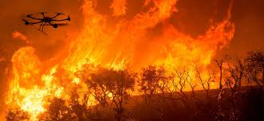
Early fire detection system using uav and artificial intelligence
MASTER THESIS
SUPERVISOR: Dr.Abdelrazzak Merheb
COMMITTEE MEMBERS:
Dr. Ahmad Haddad
Dr. Hussein Ezzeddine
SUBMITTED BY:
Ali Assaad, ID:91630154
Mohamad Mourad,ID:91330058
1
ON THURSDAY , JUNE 10 , 2021

Slide 2
OUTLINE
Introduction
Objectives
Brief about Modeling of drone
NN training procedure using yolov3
Gimbal control
Results
Conclusion and future work

Slide 3
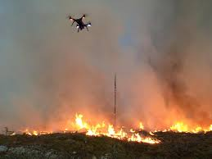
INTRODUCTION
The advancement of industry in the last century increased the environmental pollution and climate change.
The fire detection system using drones has gained a huge turnout especially in the past two decades.
A Convolutional Neural Network (CNN) is a class of deep neural networks for learning frame works.
CNNs are used for image recognition and classification

Slide 4
OBJECTIVES
To reduce false alarms and determine the locations of wildfires
Design and implement an early fire detection system, with the aid of quadcopter based on Machine Learning (ML)/Neural Networks (NN).
Applying a NN training using YoloV3 to detect smoke and fire.

Slide 5
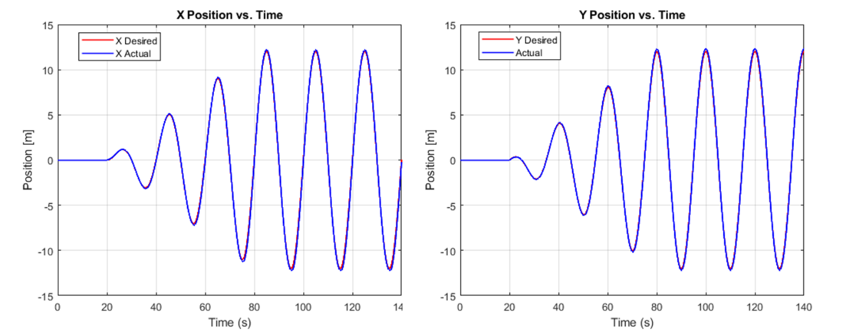
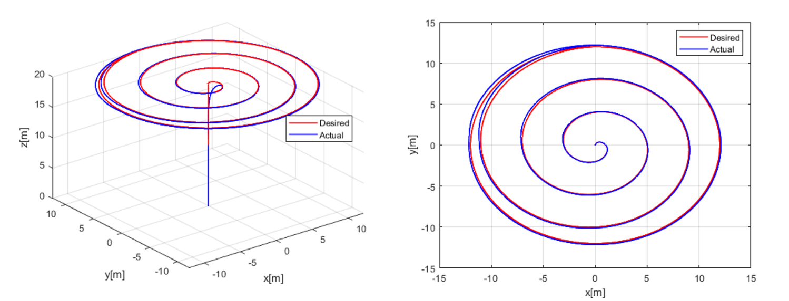
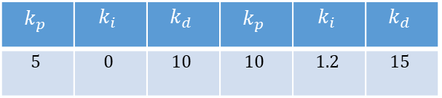
Brief about Modeling of drone
Position controller | Attitude controller

Slide 6
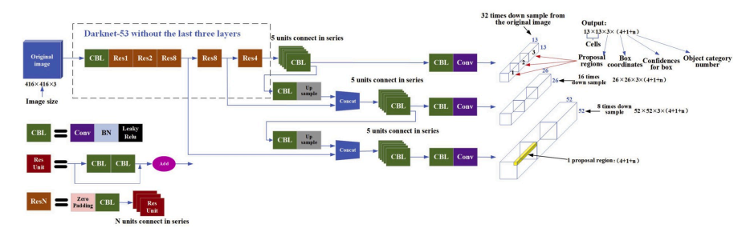
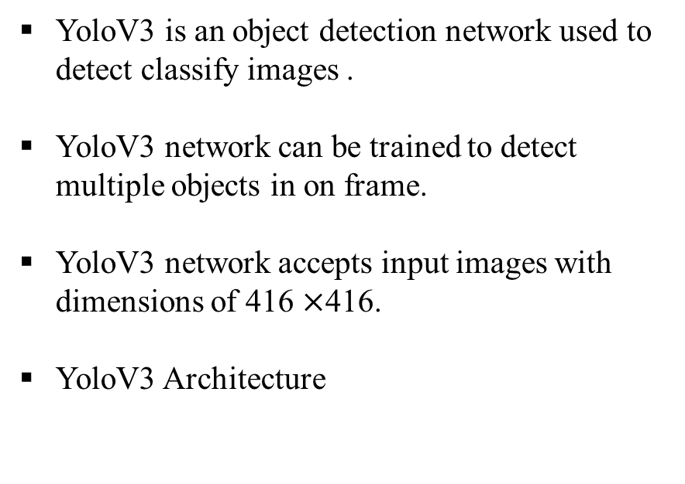
NN training procedure using yolov3
YoloV3

Slide 7
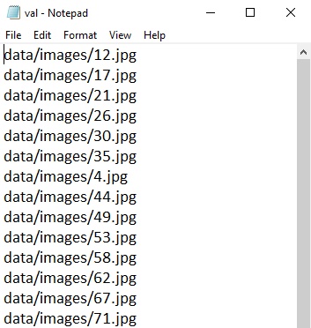
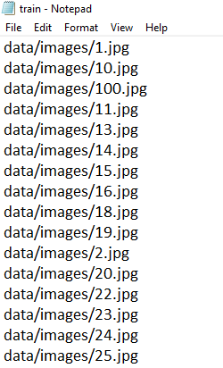
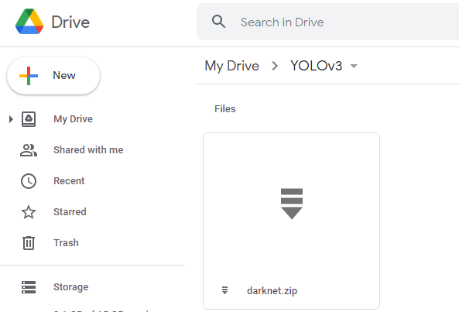
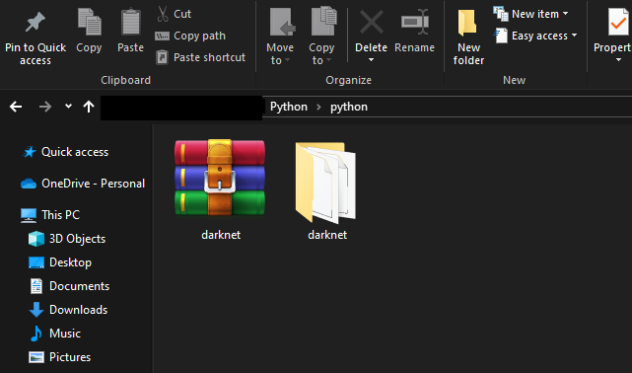
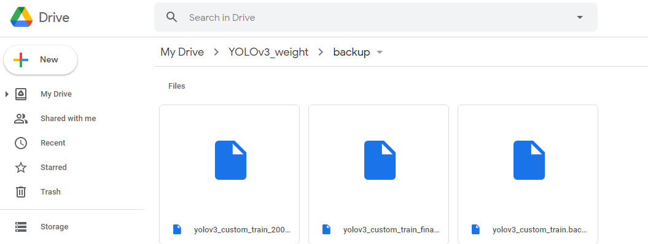
DARKNET
Darknet is an open source neural network.
Edit the Makefile in the Darknet folder.
Applying the filter respect to number of classes.(filters = (classes + 5) *3).
From directory darknet\examples folder, open file “detector.c” . At line 138, modify this line: if (i%1000==0 || (i < 1000 && i%100 == 0)).
Split our dataset into a training set and validation set.
The file has been darknet.zip format and upload it in google drive

Slide 8
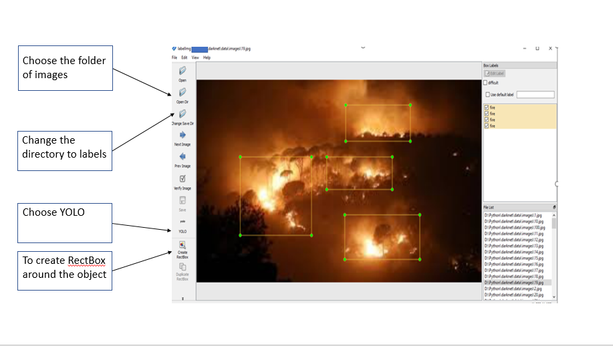
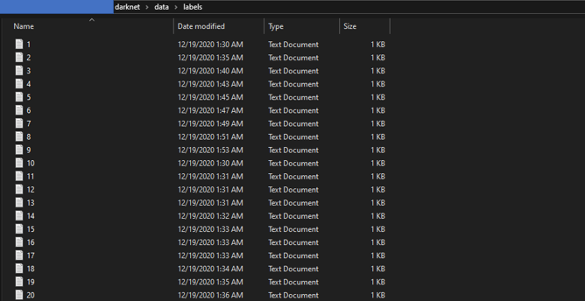

LABELING
Training the CNN-based algorithm requires a huge amount of data. Therefore 1200 fire and smoke images were collected.
Using Labeling image annotation tool, each image in the dataset is annotated with a bounding box around fire and smoke
When finishing, each image will be associated with a label file which defined by the following syntax:
<object-class> <x_center> <y_center> <width> <height>

Slide 9
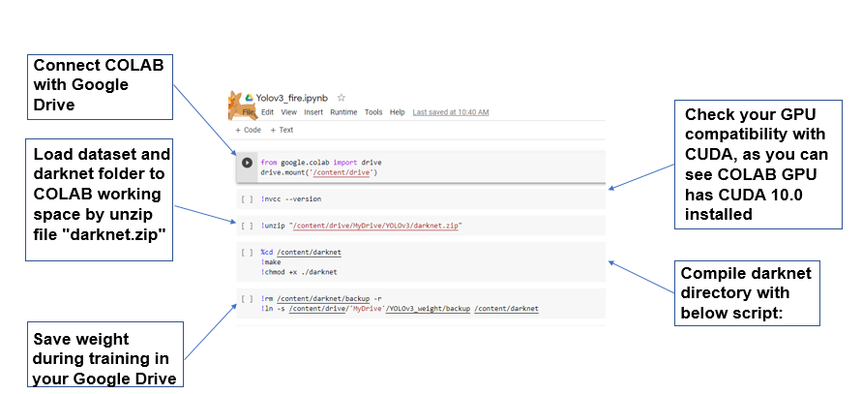
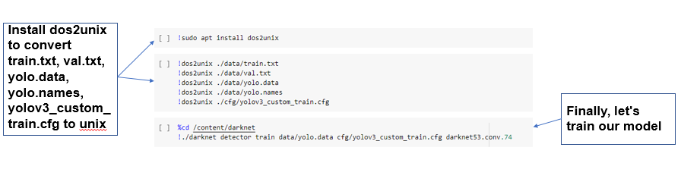
GOOGLE COLAB
Free online cloud-based Jupyter notebook environment get free GPU.
This notebook illustrates the step-by-step training procedure and explanation of each code cell.

Slide 10
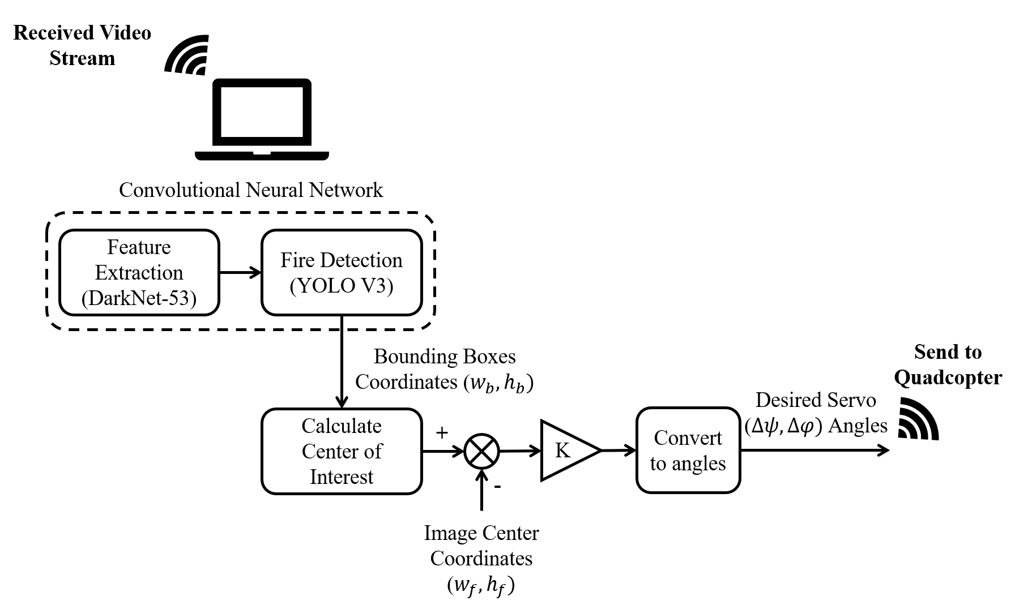
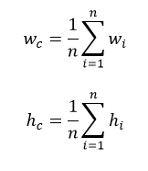
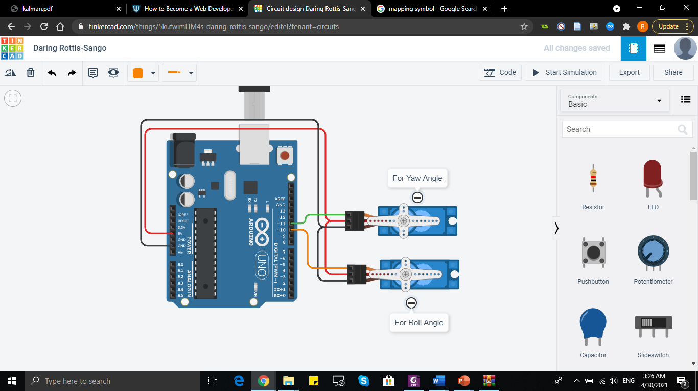
GIMBAL CONTROL
The camera mounted on the quadcopter will always concentrate on the center of the fire and smoke.
Gimbal Control Strategy
circuit diagram

Slide 11
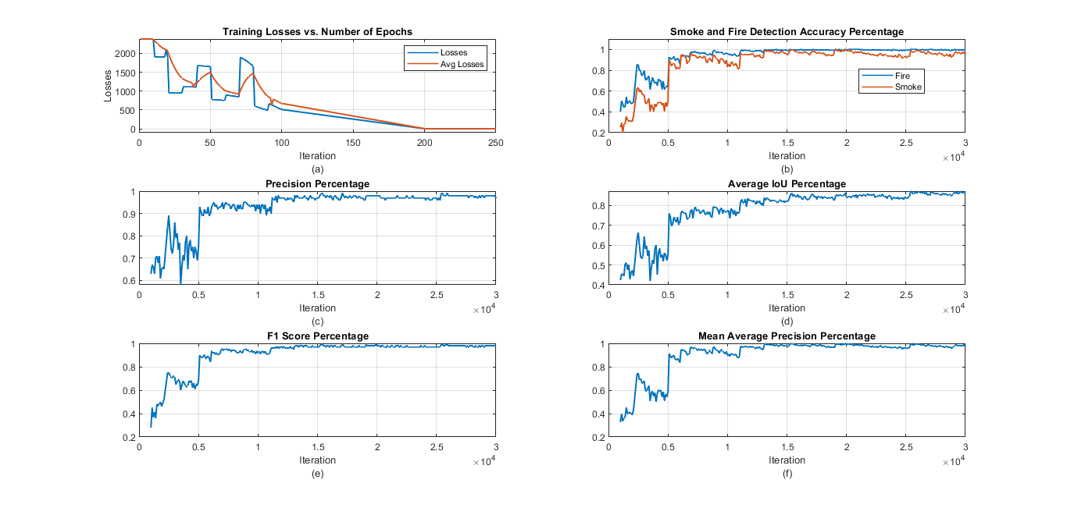
RESULTS
Training Losses (a), Detection Accuracy (b), Training Precision Percentage (c), Average Intersection Over Union (d), F1 Score (e), and Mean Training Precision(f)

Slide 12
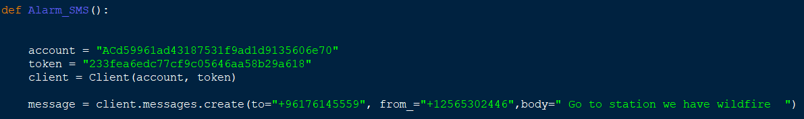
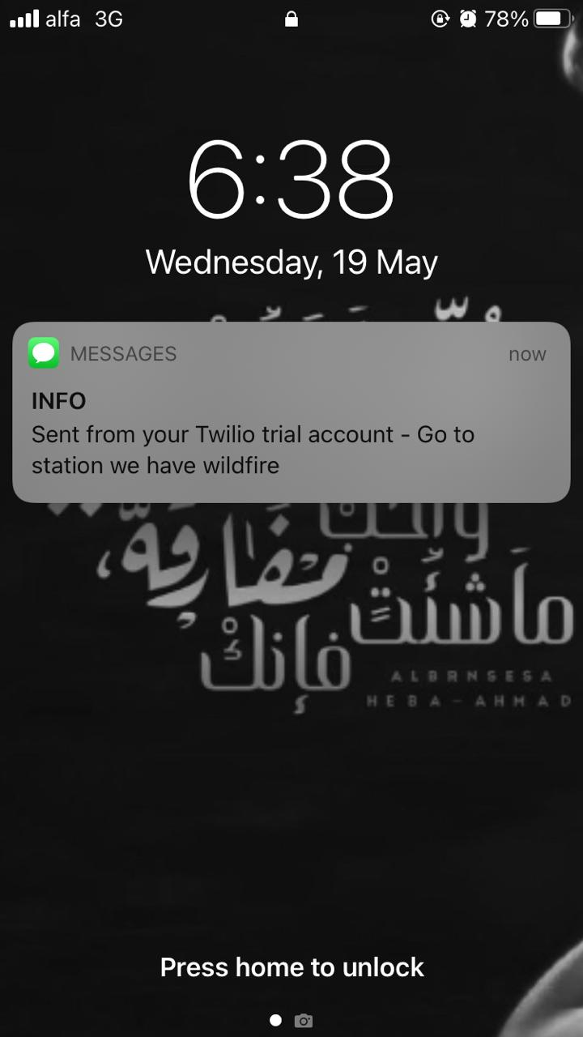
SMS Function
SMS Message on device

Slide 13
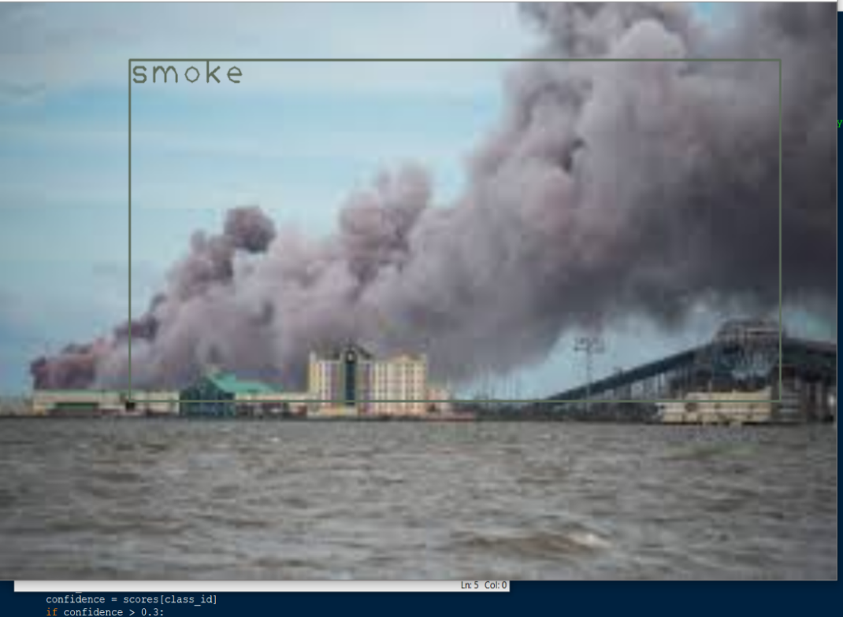
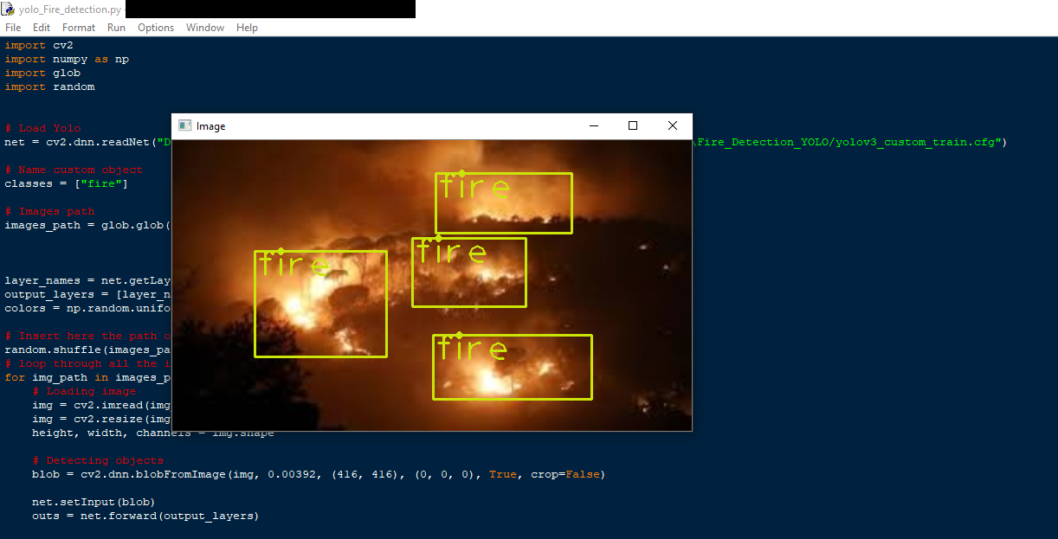
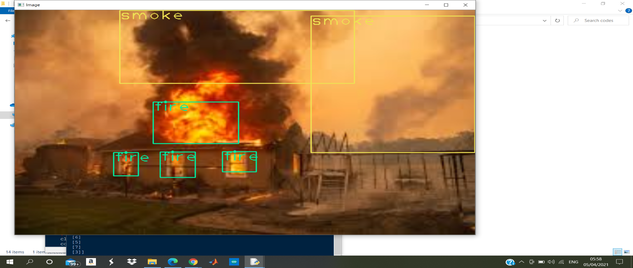
Fire & smoke detection
Smoke detection
Fire detection

Slide 14
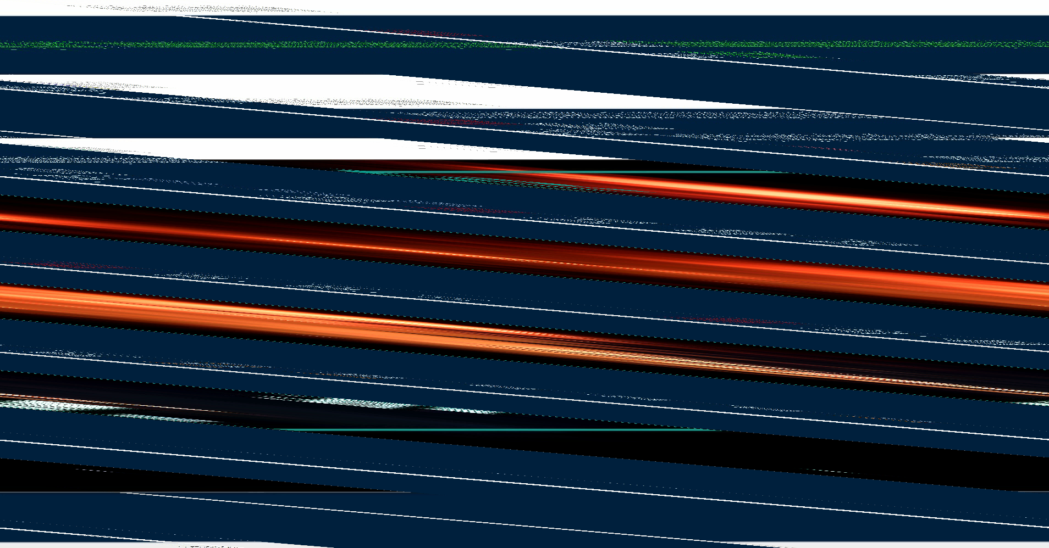
Fire and smoke detected from video

Slide 15
CONCLUSION
Running the fire and smoke detection system on a GPU is 7 times faster than running it on a CPU. A significant fps drop resulted from running the system on CPU.
Training YOLO v3 models is much flexible compared to other types of models such as RCNN, faster RCNN …
Training the model on 5000 iterations gave significantly unsatisfactory detection accuracy of 55% for smoke and 65% for fires. The model needed to be trained at a minimum number of 11,000 iterations to exceed the 90% accuracy line.
The propagation speed of the fires can be estimated for extra monitoring information that can help locals to better take decisions.
The system can be trained to detect humans in video frames and send special kind of alert to the stakeholders.

Slide 16
THANK YOU FOR LISTEN

