Slide 1


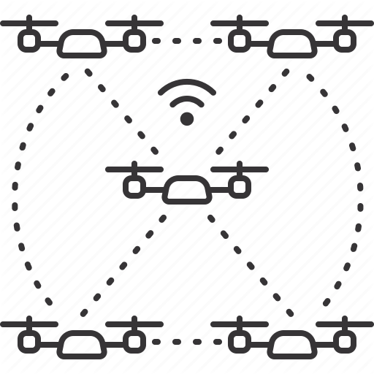
Quadcopter Swarm for Forest Fires Monitoring
MASTER THESIS
ON MONDAY FEB 8, 2021
PRESENTED BY:
Raja Murad – 51430254
Nour Karim – 51630080
SUPERVISED BY:
Dr. Abdulrazzak Merheb
COMMITTEE MEMBERS:
Dr. Hussein Kassem
Dr. Chady Abdallah

Slide 2
OUTLINE
Background
Problem Statement
Objectives
Design Procedure
Results
Conclusion & Future Work

Slide 3






BACKGROUND
LEBANON FIRES IN THE LAST DECADE
156 FIRES IGNITED
1852 HECTARES BURNED
120 FIRES IGNITED
200 HECTARES BURNED
2010
2016
2020
2014
2019
320 FIRES IGNITED
4661 HECTARES BURNED
260 FIRES IGNITED
1871 HECTARES BURNED
--- FIRES IGNITED
--- HECTARES BURNED

Slide 4
PROBLEM STATEMENT
WEATHER CONDITIONS:
DRY WEATHER
WIND SPEED ~ 10 m/s
TEMPERATURE > 30º C
UNCONTROLLABLE
WEAK RESPONSE:
SLOW EARLY RESPONSE
LACK OF FIREFIGHTERS
ABSENCE OF EQUIPMENT
WHY ?
UNCONTROLLABLE
NO PREVENTION METHODS:
NO EARLY FIRE DETECTION TECHNOLOGY
CONTROLLABLE

Slide 5




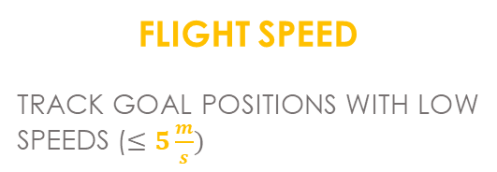
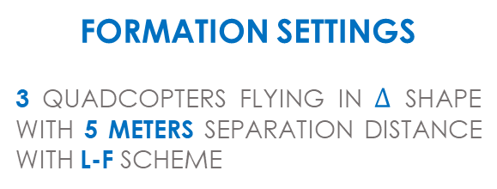
OBJECTIVES
MONITOR FORESTS WITH QUADCOPTER SWARM
AVOID OBSTACLES
IMPLEMENT AN INDEPENDENT OBSTACLE AVOIDANCE ALGORITHM BASED ON APF
FORMATION SETTINGS
3 QUADCOPTERS FLYING IN $∆$ SHAPE WITH 5 METERS SEPARATION DISTANCE WITH L-F SCHEME
FLIGHT TIME
ACHIEVE A FLIGHT TIME OF 20 MINUTES
DECENTRALIZED CONTROL
PLAN AND ACT ONBOARD WITHOUT USING A CENTRAL PC
FLIGHT SPEED
TRACK GOAL POSITIONS WITH LOW SPEEDS ($≤5\frac{m}{s})$

Slide 6
WHY MULTIPLE UAVs ?
SINGLE UAV
MULTIPLE UAVs
LESS EFFICIENT
CAN ONLY FOCUS ON A SINGLE AREA AT A TIME
MORE EFFICIENT
SURVEY APPROXIMATELY 3 TIMES MORE AREA WITH THE SAME TIME
LESS RELIABLE
LOSE ALL MONITORING IN CASE OF UAV FAILURE
MORE RELIABLE
CAN STILL MONITOR EVEN IN CASE OF A SINGLE UAV FAILURE

Slide 7






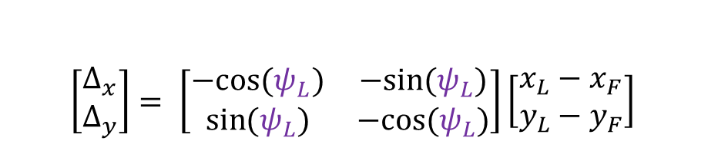
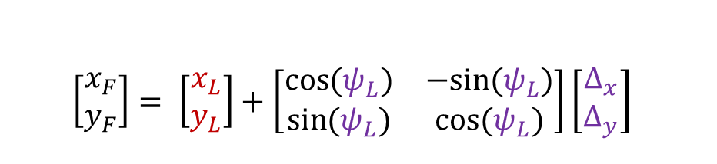




DESIGN
L-F CONCEPT
DISTANCE IS MEASURED RELATIVE TO THE LEADER’S FRAME
$$y_{L}^{B}$$
$Δ_{x}$ AND $Δ_{y}$ ARE THE DESIRED SEPERATION DISTANCE
$$x_{L}^{B}$$
$$\left[\begin{matrix}Δ_{x} \\ Δ_{y}\end{matrix}\right]= \left[\begin{matrix}−cos{(ψ_{L})} & −sin{(ψ_{L})} \\ \sin{(ψ_{L})} & −cos{(ψ_{L})}\end{matrix}\right]\left[\begin{matrix}x_{L}−x_{F} \\ y_{L}−y_{F}\end{matrix}\right]$$
$$y_{L}$$
$$ψ_{L}$$
$$Δ_{x}$$
$$Δ_{y}$$
$$y_{F}$$
$$Δ$$
INVERSE
$$\left[\begin{matrix}x_{F} \\ y_{F}\end{matrix}\right]= \left[\begin{matrix}x_{L} \\ y_{L}\end{matrix}\right]+\left[\begin{matrix}\cos{(ψ_{L})} & −sin{(ψ_{L})} \\ \sin{(ψ_{L})} & \cos{(ψ_{L})}\end{matrix}\right]\left[\begin{matrix}Δ_{x} \\ Δ_{y}\end{matrix}\right]$$
$$x_{F}$$
$$x_{L}$$

Slide 8
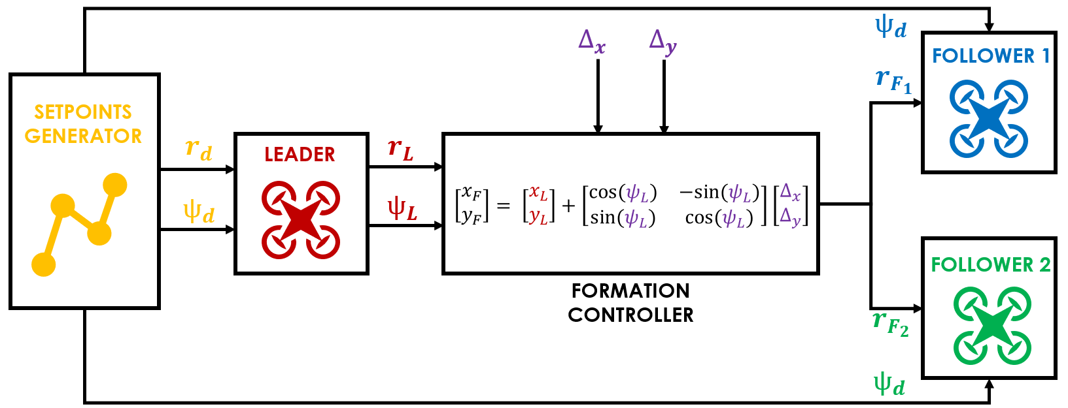









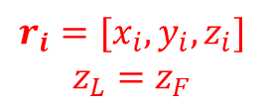


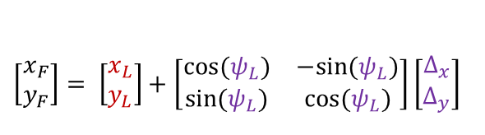

DESIGN
FORMATION METHODS
$$ψ_{d}$$
$$∆_{x}$$
$$∆_{y}$$
FOLLOWER 1
$$r_{F_{1}}$$
SETPOINTS GENERATOR
$$r_{d}$$
LEADER
$$r_{L}$$
$$\left[\begin{matrix}x_{F} \\ y_{F}\end{matrix}\right]= \left[\begin{matrix}x_{L} \\ y_{L}\end{matrix}\right]+\left[\begin{matrix}\cos{(ψ_{L})} & −sin{(ψ_{L})} \\ \sin{(ψ_{L})} & \cos{(ψ_{L})}\end{matrix}\right]\left[\begin{matrix}Δ_{x} \\ Δ_{y}\end{matrix}\right]$$
$$ψ_{d}$$
$$ψ_{L}$$
FOLLOWER 2
FORMATION
CONTROLLER
$$r_{F_{2}}$$
$$ψ_{d}$$
EACH QUADCOPTER WILL HAVE ITS OWN LOCAL PLANNER
DESIRED POSITION WILL BE FED FOR EACH FOLLOWER!
$$r_{i}=[x_{i},y_{i},z_{i}]$$
$$z_{L}=z_{F}$$

Slide 9
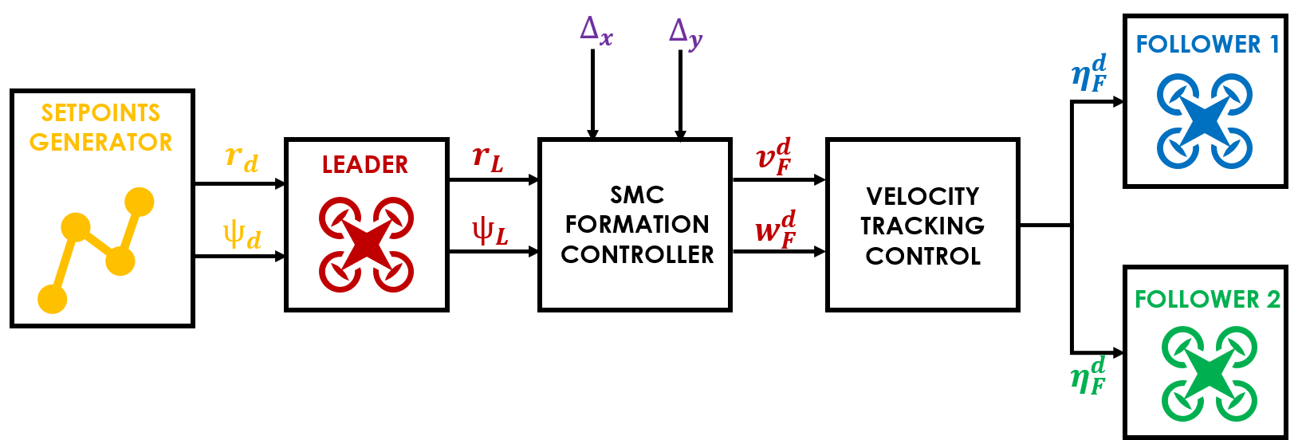








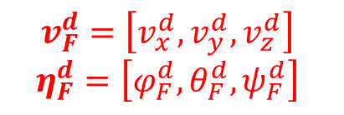


DESIGN
FORMATION METHODS
$$∆_{x}$$
$$∆_{y}$$
FOLLOWER 1
$$η_{F}^{d}$$
SETPOINTS GENERATOR
$$r_{d}$$
LEADER
$$r_{L}$$
$$v_{F}^{d}$$
VELOCITY TRACKING CONTROL
SMC FORMATION
CONTROLLER
$$ψ_{d}$$
$$ψ_{L}$$
$$w_{F}^{d}$$
FOLLOWER 2
$$η_{F}^{d}$$
$$v_{F}^{d}=\left[v_{x}^{d},v_{y}^{d},v_{z}^{d}\right]$$
$$η_{F}^{d}=\left[φ_{F}^{d},θ_{F}^{d},ψ_{F}^{d}\right]$$

Slide 10
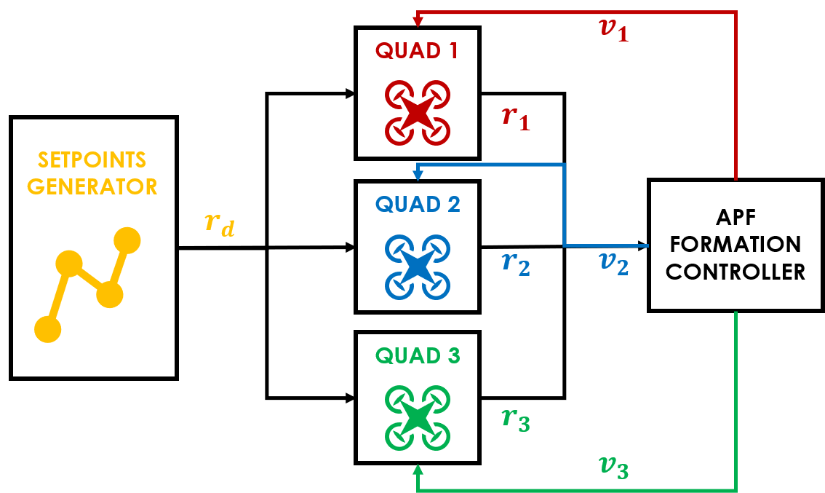








DESIGN
FORMATION METHODS
$$v_{1}$$
QUAD 1
$$r_{1}$$
SETPOINTS GENERATOR
$$r_{d}$$
QUAD 2
APF
FORMATION
CONTROLLER
REPEL WHEN CLOSE
ATTRACT WHEN FAR
$$r_{2}$$
$$v_{2}$$
QUAD 3
$$r_{3}$$
$$r_{i}=[x_{i},y_{i},z_{i}]$$
APF: Artificial Potential Fields
$$v_{3}$$

Slide 11

DESIGN
FORMATION METHODS
SIMPLE TO IMPLEMENT AND DECENTRALIZED
CAN TRACK COMPLEX TRAJECTORIES
COMPLETELY INDEPENDENT
EASY TO TUNE CONTROLLERS
UNSENSITIVE TO DISTURBANCES
CANNOT TRACK COMPLEX TRAJECTORIES AND SENSITIVE TO DISTURBANCES
SMC SUFFERS FROM INPUT CHATTERING AND REQUIRES A LOT OF FINE-TUNING
REQUIRES A CENTRAL PROCESSOR TO ESTABLISH COORDINATION

Slide 12
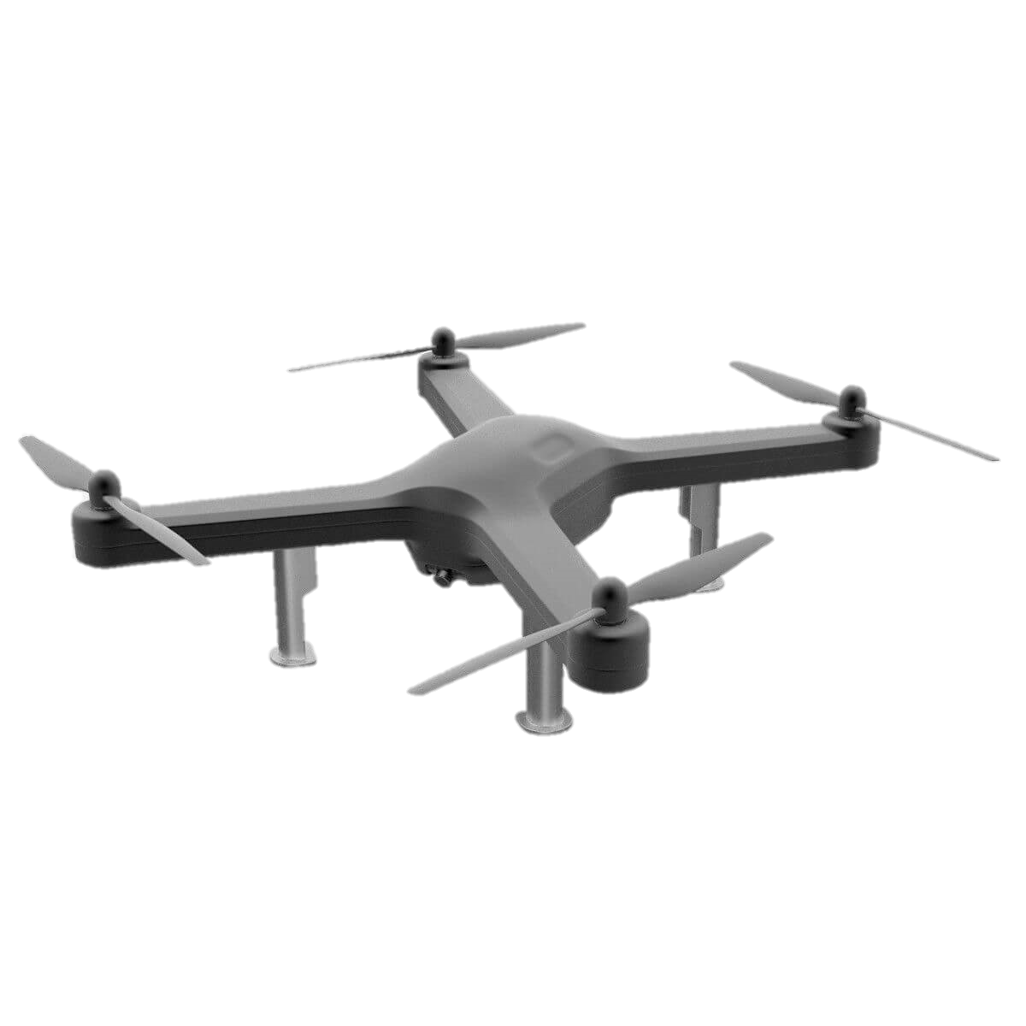
DESIGN
MATH MODEL
X
Y
Z
2
4
2
3
1
3
1
4
CONTROL INPUTS:
U1: EQUAL THRUST FOR ALL MOTORS $→$ ALTITUDE, Z
U2: THRUST DIFFERENCE BETWEEN MOTORS 2 AND 4 $→$ $φ$ ROLLING, Y
TRANSLATIONS ARE COUPLED WITH ROTATIONS
U3: THRUST DIFFERENCE BETWEEN MOTORS 1 AND 3 $→$ $θ$PITCHING, X
U4: THRUST DIFFERENCE BETWEEN MOTORS 1,3 AND 2,4 $→$ $ψ$YAWING
THE GOAL IS TO CALCULATE THE BEST U1,U2,U3 AND U4 INPUTS VIA PID CONTROLLER

Slide 13

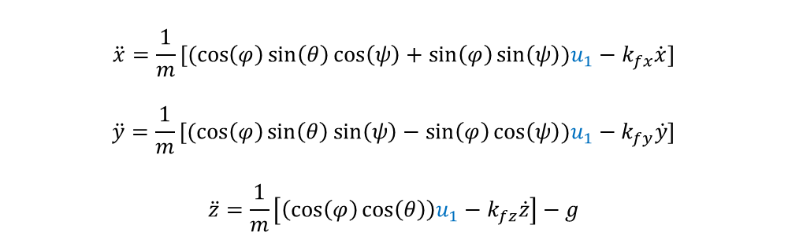



DESIGN
MATH MODEL
X
Y
Z
ALL FORCES ARE WITH RESPECT TO BODY FRAME
NAVIGATING IN INERTIAL FRAME REQUIRES INPUTS TRANSFORMATION FROM INERTIAL FRAME TO BODY FRAME
$$\ddot{x}=\frac{1}{m}[(\cos\left(φ\right)\sin\left(θ\right)\cos\left(ψ\right)+\sin\left(φ\right)\sin\left(ψ\right))u_{1}−k_{fx}\dot{x}]$$
$$\ddot{y}=\frac{1}{m}[(\cos\left(φ\right)\sin\left(θ\right)\sin\left(ψ\right)−\sin\left(φ\right)\cos\left(ψ\right))u_{1}−k_{fy}\dot{y}]$$
$$\ddot{z}=\frac{1}{m}\left[\left(\cos\left(φ\right)\cos\left(θ\right)\right)u_{1}−k_{fz}\dot{z}\right]−g$$
TRANSLATIONAL SUBSYSTEM
$$R_{body}^{inertial}$$
$$\ddot{φ}=\frac{1}{I_{xx}}\left[\dot{θ}\dot{ψ}\left(I_{yy}−I_{zz}\right)−J_{tp}\overline{Ω}\dot{θ}+u_{2}\right]$$
$$\ddot{θ}=\frac{1}{I_{yy}}\left[\dot{φ}\dot{ψ}\left(I_{zz}−I_{xx}\right)+J_{tp}\overline{Ω}\dot{φ}+u_{3}\right]$$
$$\ddot{Ψ}=\frac{1}{I_{zz}}\left[\dot{θ}\dot{φ}\left(I_{xx}−I_{yy}\right)+u_{4}\right]$$
$$R_{inertial}^{body}$$
ROTATIONAL SUBSYSTEM

Slide 14


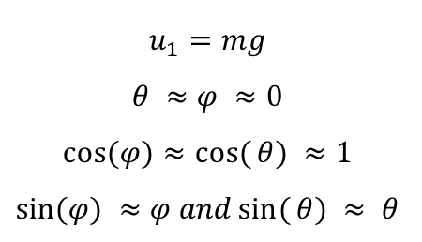





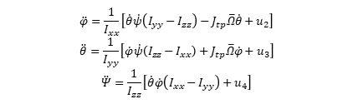
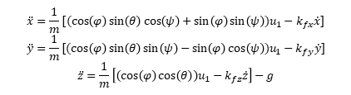



DESIGN
CONTROLLERS
$$x_{d} y_{d} z_{d}$$
$$ψ_{d}$$
USE SMALL ANGLE APPROXIMATION:
LINEARIZE ABOUT HOVERING
POSITION PID
$${\ddot{x}}_{d}^{PID} {\ddot{y}}_{d}^{PID}$$
CONVERT TO ANGLE
$$φ_{d}$$
$$θ_{d}$$
ATTITUDE PID
APF REPULSIVE FORCES
$${\ddot{φ}}_{d} { \ddot{θ}}_{d} { \ddot{ψ}}_{d}$$
$${\ddot{x}}_{d}^{APF},{\ddot{y}}_{d}^{APF}$$
CONVERT TO BODY
$${\ddot{z}}_{d}^{PID}$$
$$φ θ ψ$$
$$u_{1} u_{2} u_{3} u_{4}$$
$$u_{1}=mg$$
$θ ≈$ $φ ≈0$
$$\cos{(φ})≈\cos{(}θ) ≈1$$
$$\sin{(φ}) ≈φ and\sin{(}θ) ≈ θ$$
$$\ddot{x}=\frac{1}{m}[(\cos\left(φ\right)\sin\left(θ\right)\cos\left(ψ\right)+\sin\left(φ\right)\sin\left(ψ\right))u_{1}−k_{fx}\dot{x}]$$
$$\ddot{y}=\frac{1}{m}[(\cos\left(φ\right)\sin\left(θ\right)\sin\left(ψ\right)−\sin\left(φ\right)\cos\left(ψ\right))u_{1}−k_{fy}\dot{y}]$$
$$\ddot{z}=\frac{1}{m}\left[\left(\cos\left(φ\right)\cos\left(θ\right)\right)u_{1}−k_{fz}\dot{z}\right]−g$$
$$x y z$$
$$\ddot{φ}=\frac{1}{I_{xx}}\left[\dot{θ}\dot{ψ}\left(I_{yy}−I_{zz}\right)−J_{tp}\overline{Ω}\dot{θ}+u_{2}\right]$$
$$\ddot{θ}=\frac{1}{I_{yy}}\left[\dot{φ}\dot{ψ}\left(I_{zz}−I_{xx}\right)+J_{tp}\overline{Ω}\dot{φ}+u_{3}\right]$$
$$\ddot{Ψ}=\frac{1}{I_{zz}}\left[\dot{θ}\dot{φ}\left(I_{xx}−I_{yy}\right)+u_{4}\right]$$
DYNAMICS & KINEMATICS

Slide 15
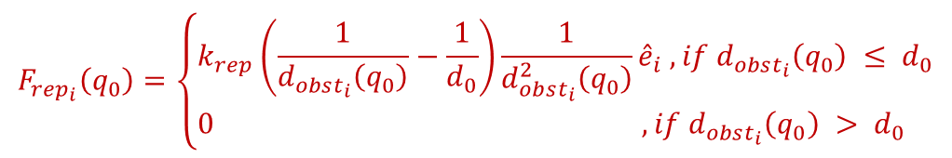
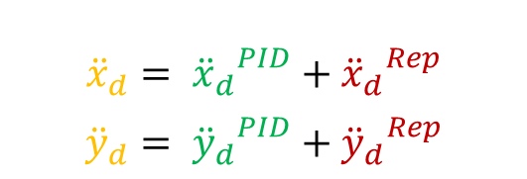

ATTRACTIVE ACCELERATION
DESIGN
CONTROLLERS
REPULSIVE ACCELERATION
RESULTANT ACCELERATION
APF REPULSIVE FORCES
POSITION PID
REPEL THE QUADCOPTER FROM OBSTACLES
ATTRACT THE QUADCOPTER TO GOAL POSITION
$$u\left(t\right)=K_{p_{x}}e\left(t\right)+K_{i_{x}}\int{e\left(t\right)dt}+K_{d_{x}}\frac{\left.de(t\right)}{dt}$$
CHARACTERIZED BY INTENSE STRENGTH NEAR OBSTACLES
HAVE NO EFFECT WHEN FAR FROM OBSTACLES
$$F_{rep_{i}}\left(q_{0}\right)=\left\{\begin{aligned}&k_{rep}\left(\frac{1}{d_{obst_{i}}\left(q_{0}\right)}−\frac{1}{d_{0}}\right)\frac{1}{d_{obst_{i}}^{2}\left(q_{0}\right)}{\hat{e}}_{i} , if d_{obst_{i}}\left(q_{0}\right) ≤ d_{0} \\ &0 ,if d_{obst_{i}}\left(q_{0}\right) > d_{0} \end{aligned}\right.$$
GOAL
$${\ddot{x}}_{d}= {{\ddot{x}}_{d}}^{PID}+{{\ddot{x}}_{d}}^{Rep}$$
$${\ddot{y}}_{d}= {{\ddot{y}}_{d}}^{PID}+{{\ddot{y}}_{d}}^{Rep}$$
-
OBSTACLE
+
+

Slide 16
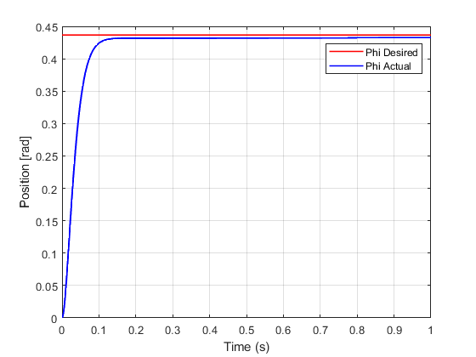
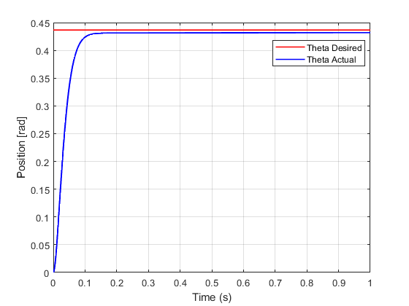
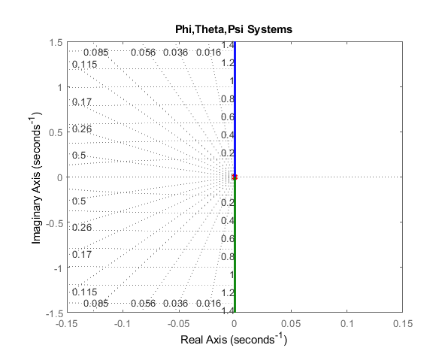
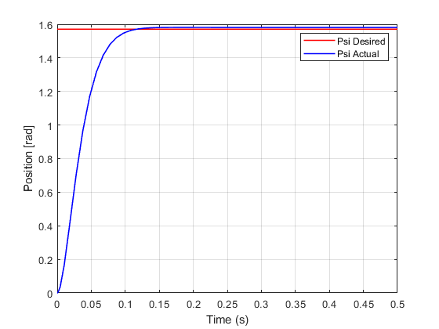
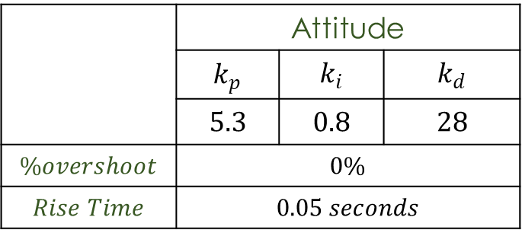
RESULTS
ATTITUDE CONTROLLER
PHI SYSTEM
THETA SYSTEM
 | Attitude
 | $$k_{p}$$ | $$k_{i}$$ | $$k_{d}$$
 | $$5.3$$ | $$0.8$$ | $$28$$
$$\%overshoot$$ | $$0\%$$
$$Rise Time$$ | $$0.05 seconds$$
PSI SYSTEM

Slide 17
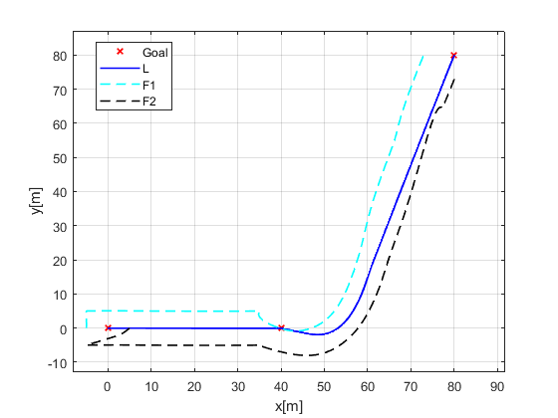
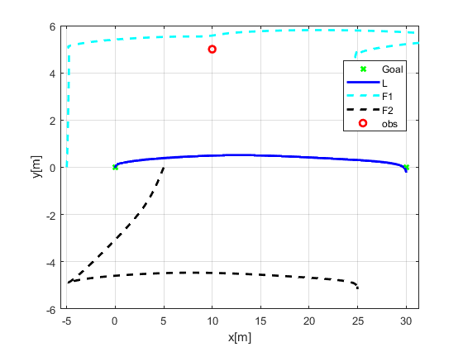
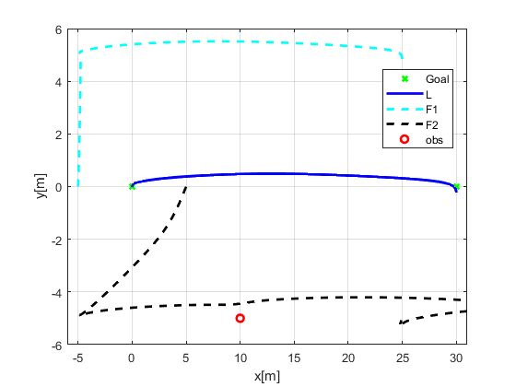
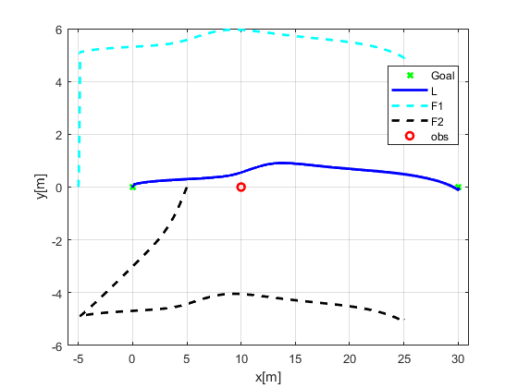
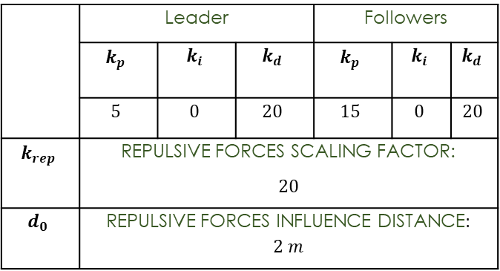
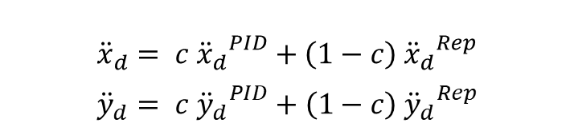
RESULTS
POSITION CONTROLLER
NECESSITY OF USING A COMPLEMENTARY FILTER
$${\ddot{x}}_{d}= c {{\ddot{x}}_{d}}^{PID}+\left(1−c\right) {{\ddot{x}}_{d}}^{Rep}$$
$${\ddot{y}}_{d}= c {{\ddot{y}}_{d}}^{PID}+\left(1−c\right) {{\ddot{y}}_{d}}^{Rep}$$
POSITION PID TUNED GAINS
 | Leader |  |  | Followers
 | $$k_{p}$$ | $$k_{i}$$ | $$k_{d}$$ | $$k_{p}$$ | $$k_{i}$$ | $$k_{d}$$
 | $$5$$ | $$0$$ | $$20$$ | $$15$$ | $$0$$ | $$20$$
$$k_{rep}$$ | REPULSIVE FORCES SCALING FACTOR: $$20$$
$$d_{0}$$ | REPULSIVE FORCES INFLUENCE DISTANCE: $2 m$

Slide 18
CONCLUSION &
FUTURE WORK
LEADER-FOLLOWER SCHEME GAVE SATISFACTORY RESULTS BUT IT LACKS INDEPENDENCE
FOR PART B:
WILL TEST THIS FORMATION CONTROL METHOD ON REAL HARDWARE
WILL USE KALMAN FILTER TO BETTER ESTIMATE POSITION WITH THE PRECENSE OF SENSOR NOISES

Slide 19
THANK YOU FOR LISTENING

