Slide 1

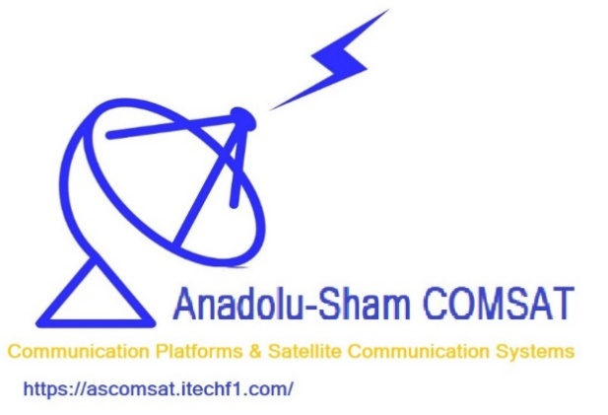
AS-COMSAT
AS COMSAT HABERLEŞME PLATFORMLARI VE UYDU HABERLEŞME SİSTEMLERİ SANAYİ VE TİCARET LİMİTED ŞİRKETİ
TEPEÜSTÜ MAH. KAFİYE SOK. NO:47/3 ÜMRANİYE/İSTANBUL
ALEMDAĞ V.D. V.NO:0861584690
İTO: 457897-5 MERSİS NO: 0086-1584-6900-0001
Istanbul/Türkiye – Heidelberg/Germany - Tripoli/Lebanon
Laboratory Teststands
ACS Teststand (Cold Gas, Helmholtz coils for earth magnetic field sim.)
Orbit Change Actuator Teststand
E-Propulsion Testing (Vacuum Chamber, …)
Antennas Teststand
Devices (Product Portfolio)
Communication/Off-the-ShellSatellite Components
2.4 GHz Transceiver
2.4 GHz Patch Antenna
Platform Systems (Configurable Systems according to Customer Requirements)
AS-COMSAT_1 LEO COM System
Components Procurement & Development & Integration
System Testing (Vacuum Chamber, …), Qualification
Marketing
AS-COMSAT CNA (Ambulance)
Components Procurement & Development & Integration
System Testing, Qualification
Marketing
Addresses
  German Branch: Im Klingenbühl 2/1, 69123 Heidelberg, Germany
  Turkish Branch: Kafiye Sk., 34771 Ümraniye/İstanbul, Türkiye
  Lebanese Branch: Bahsas, Haykalieh Str., Harba Bld., Ground Flr., Tripoli, Lebanon
Contact
  Dr. Eng. Samir Mourad, CEO
  Mobile +49 178 72 855 78 (WhatsApp) / +961 76 341 526
  Email: samir.mourad@temo-group.com
Staff
1 System Engineer, 2 Electronics Engineers, 2 Software Engineers, 1 Electric Engineer

Slide 2
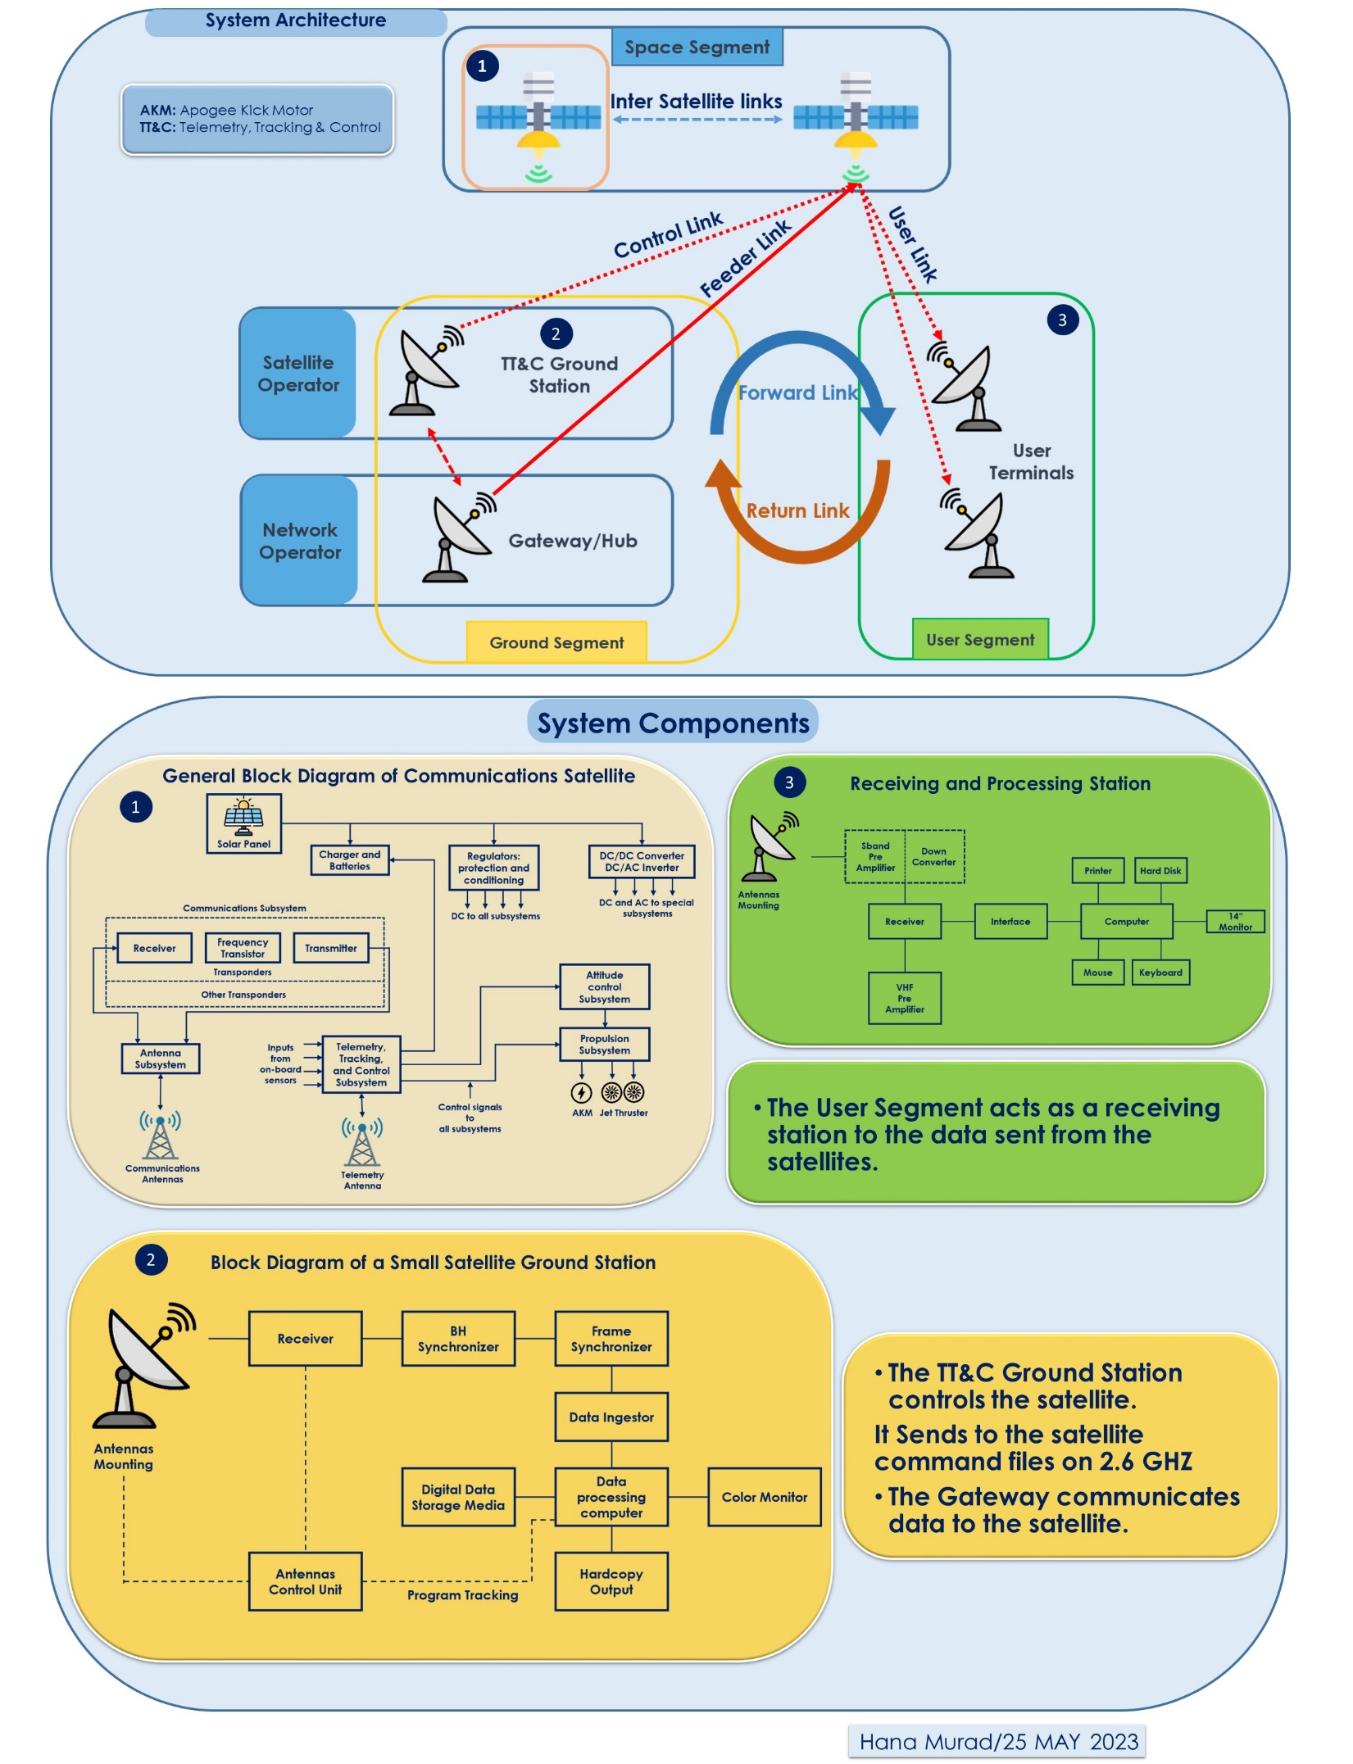
AS-COMSAT_1 LEO COM System
System Architecture

Slide 3
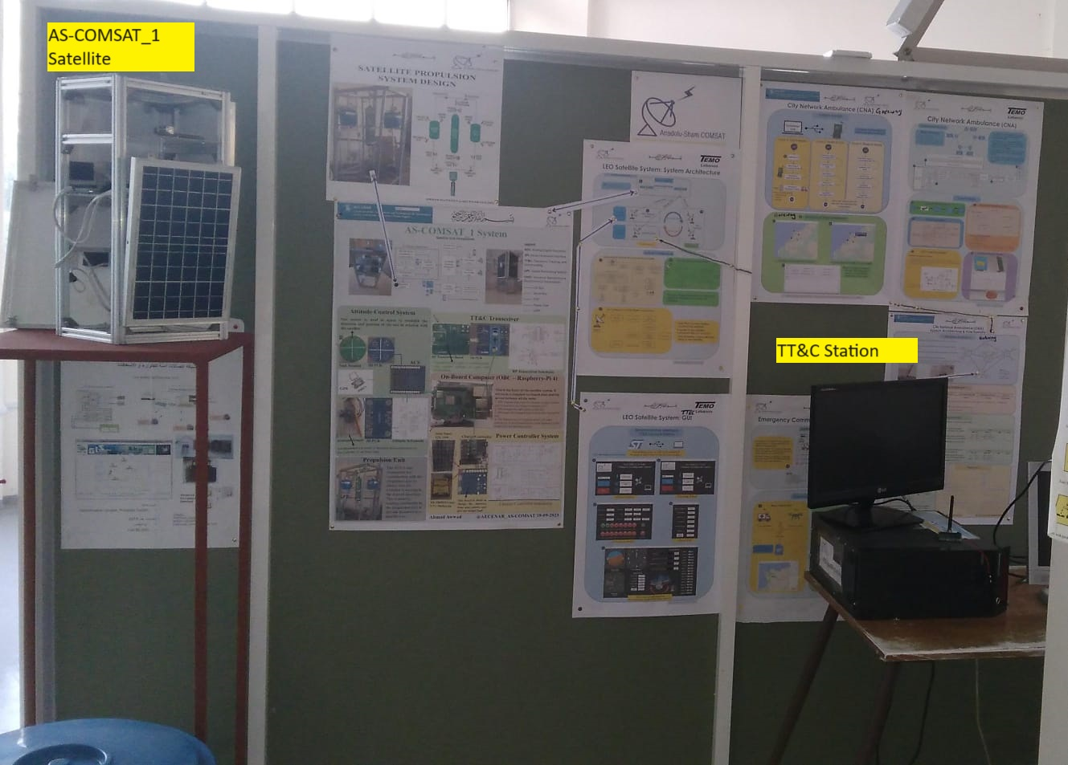
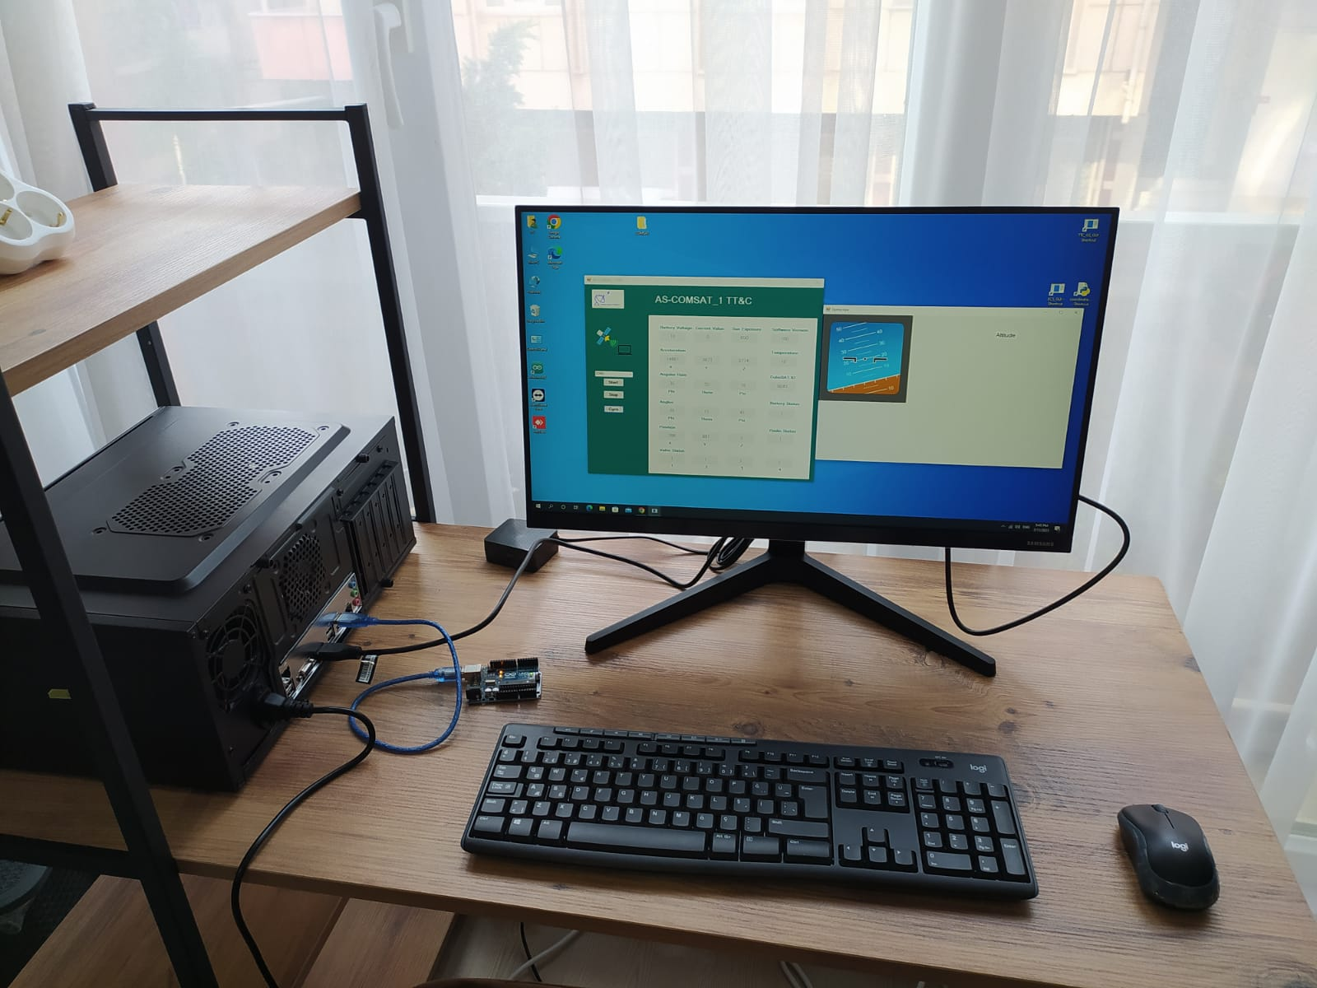
AS-COMSAT_1 LEO COM System
Laboratory Demonstration Environment

Slide 4
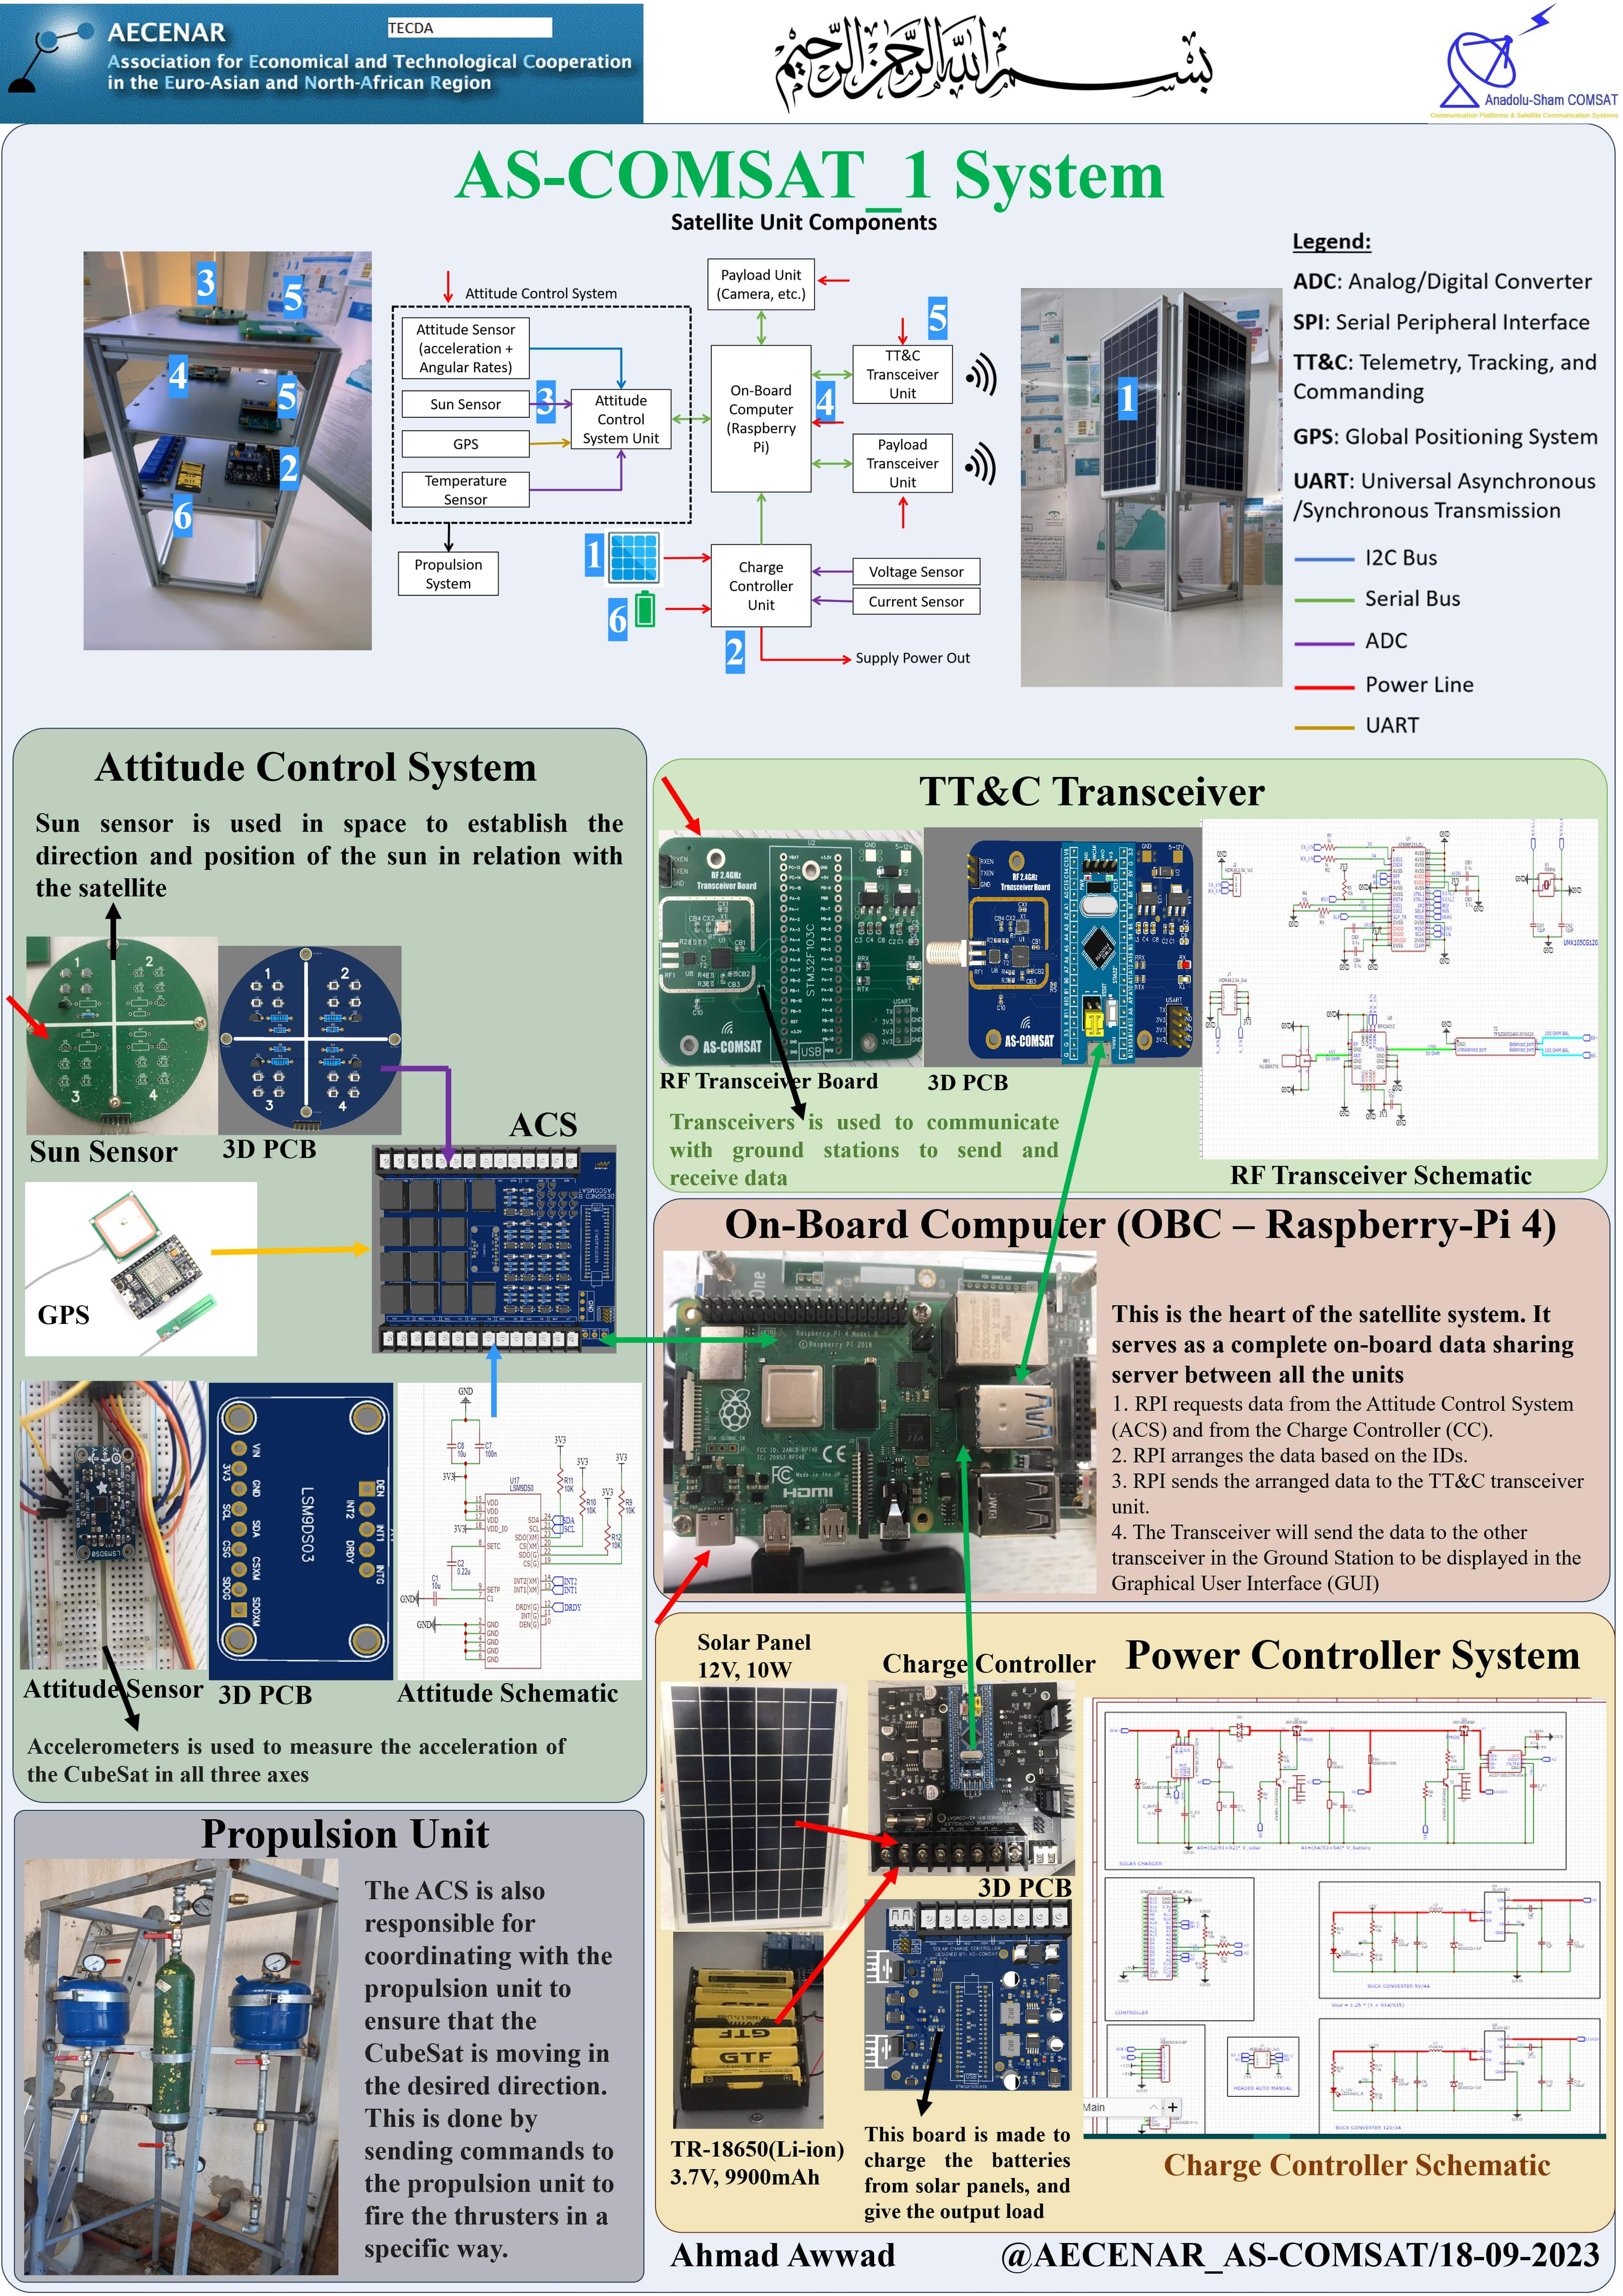
AS-COMSAT_1 LEO COM System
Satellite System Architecture

Slide 5
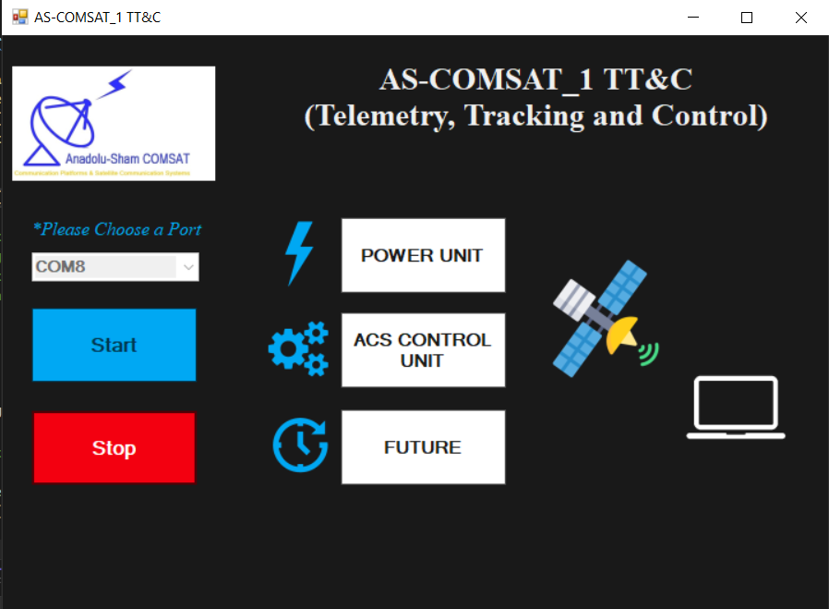
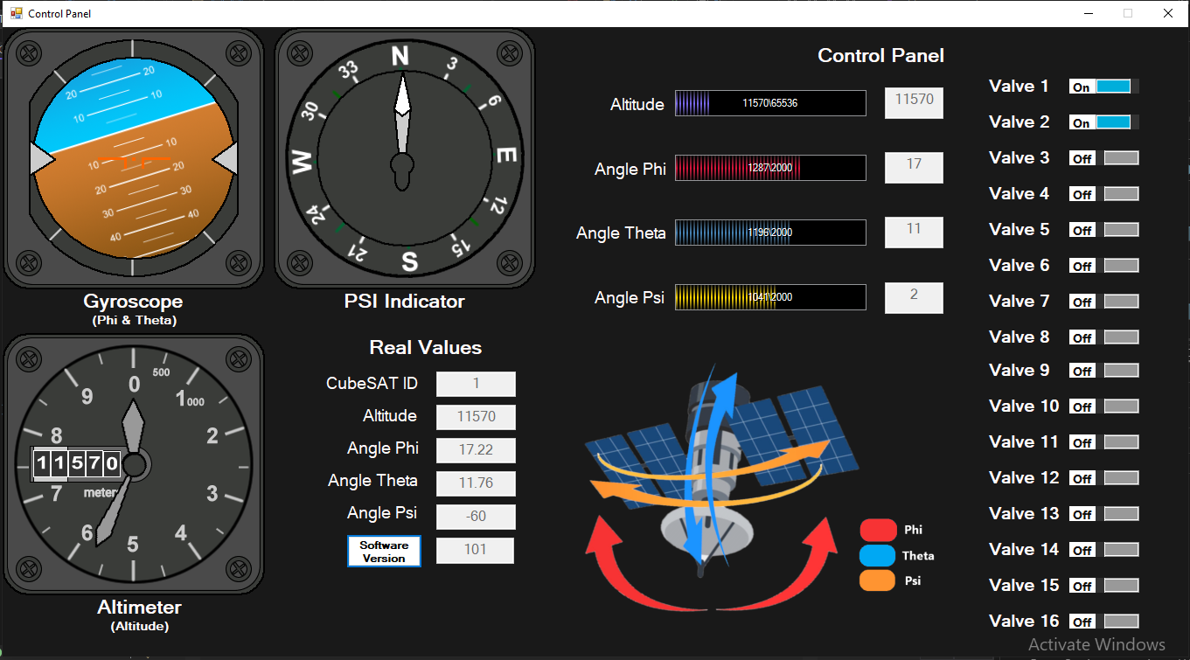
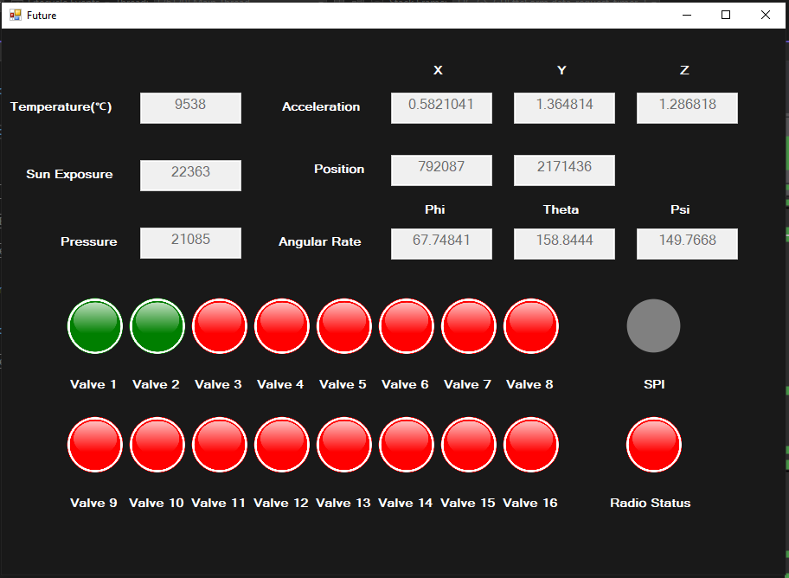
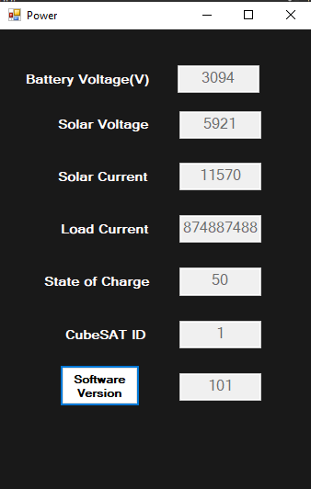
AS-COMSAT_1 LEO COM System
TT&C GUI

Slide 6
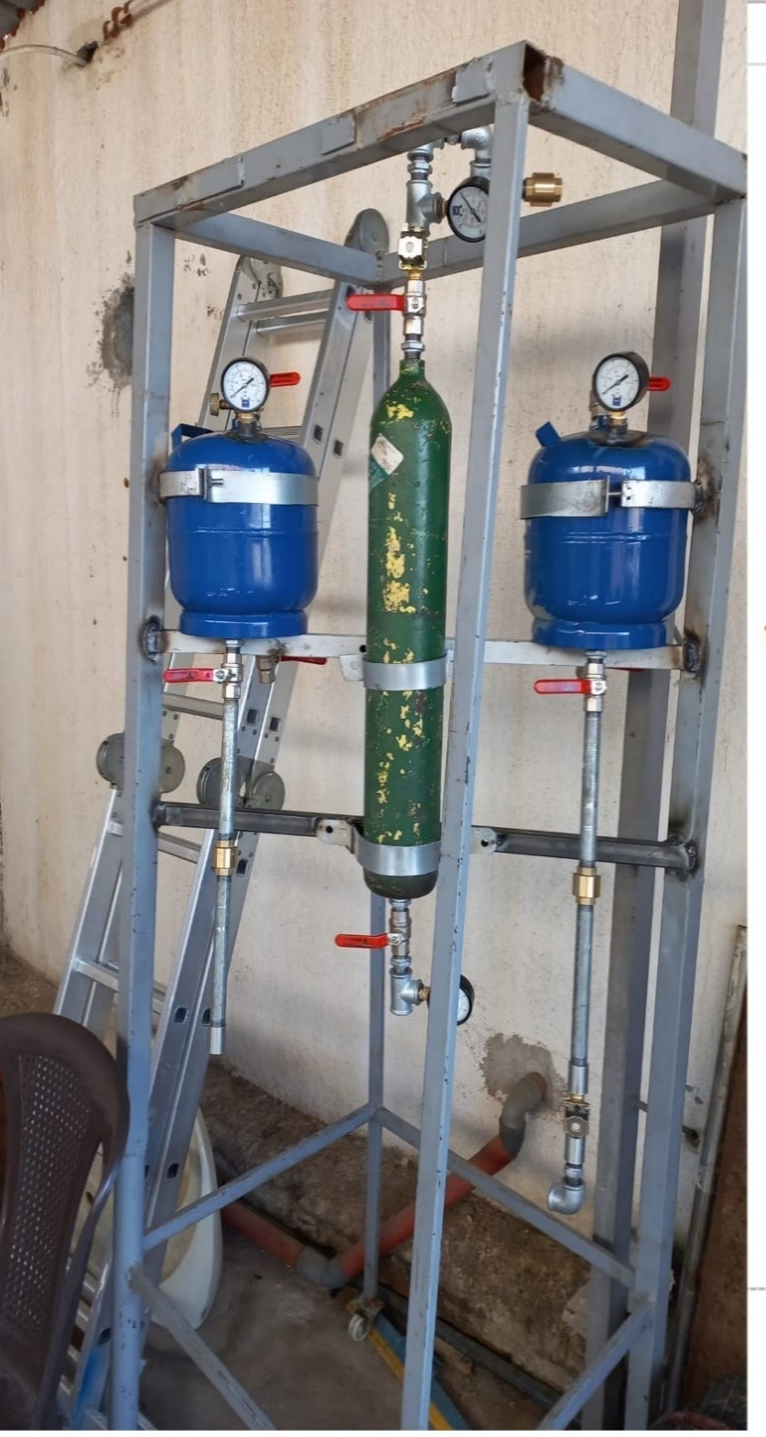
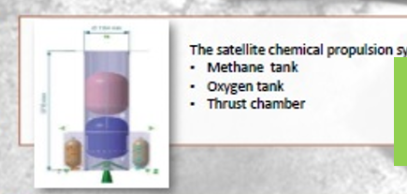
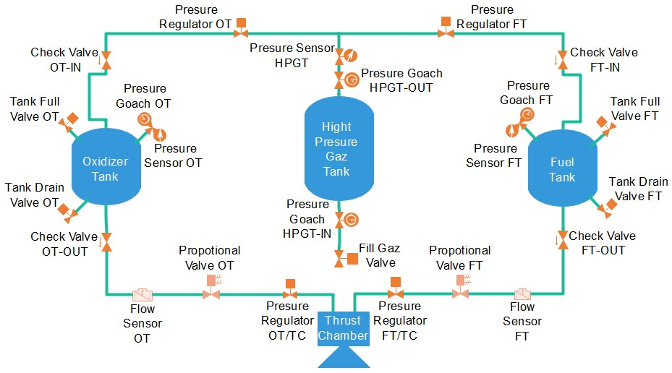
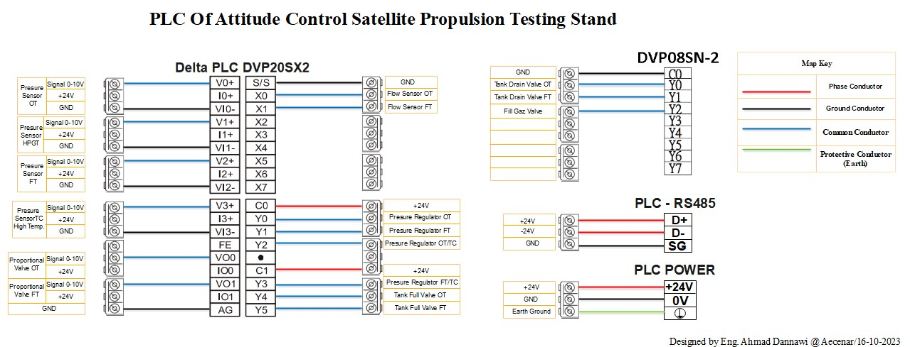
AS-COMSAT_1 LEO COM System
Orbit Change Propulsion Unit Testrig

Slide 7
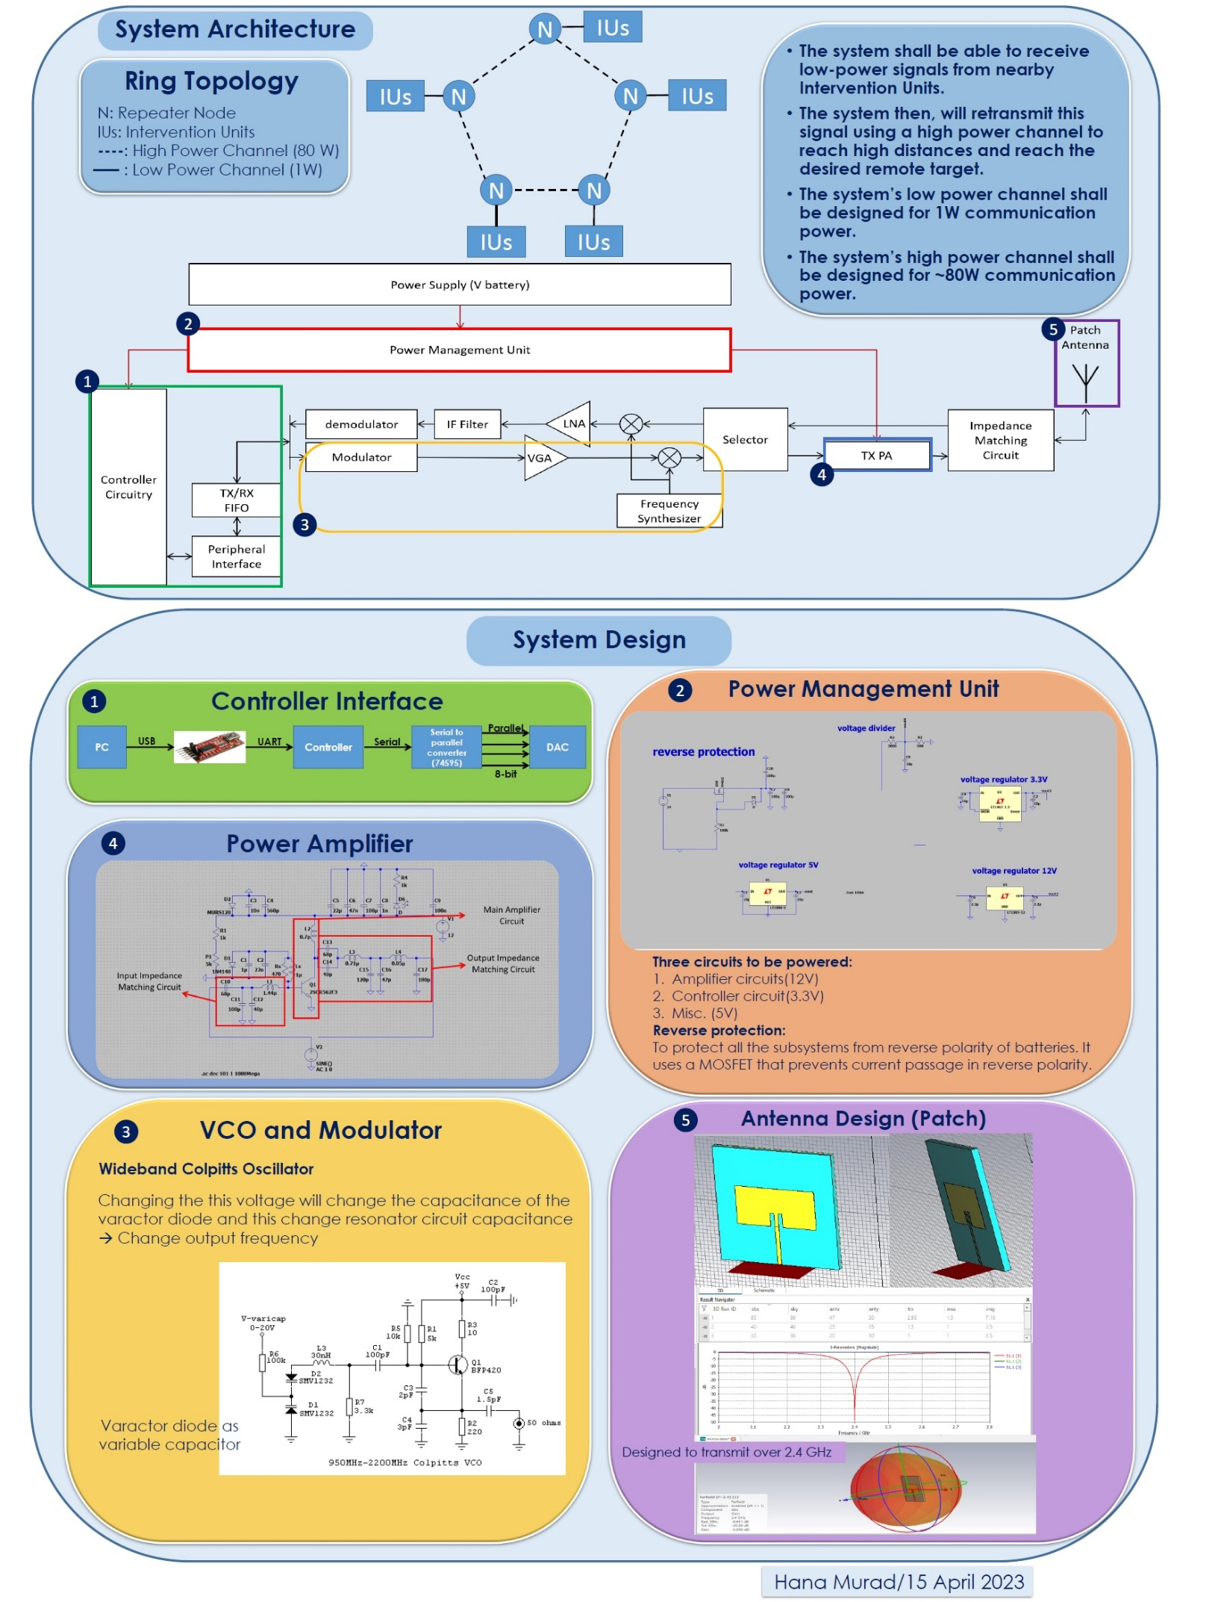
CNA (Communication Network Ambulance)
System Architecture

Slide 8
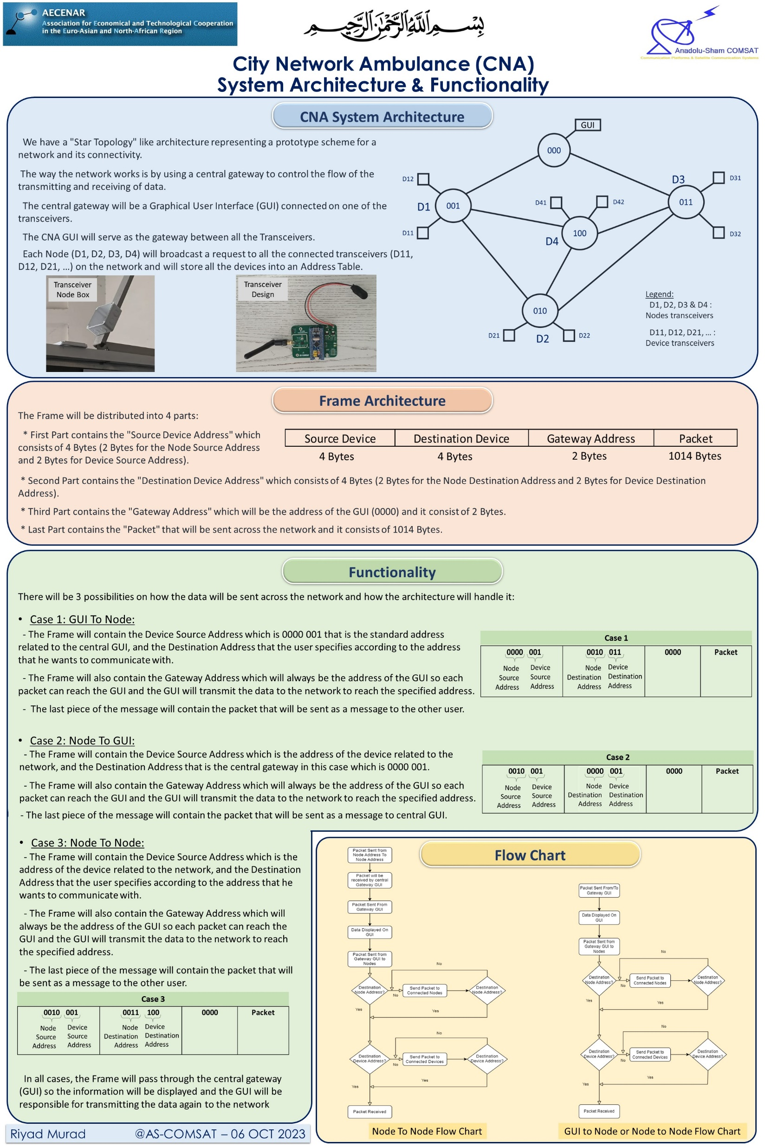
CNA (Communication Network Ambulance)
System Architecture & Functionality

Slide 9
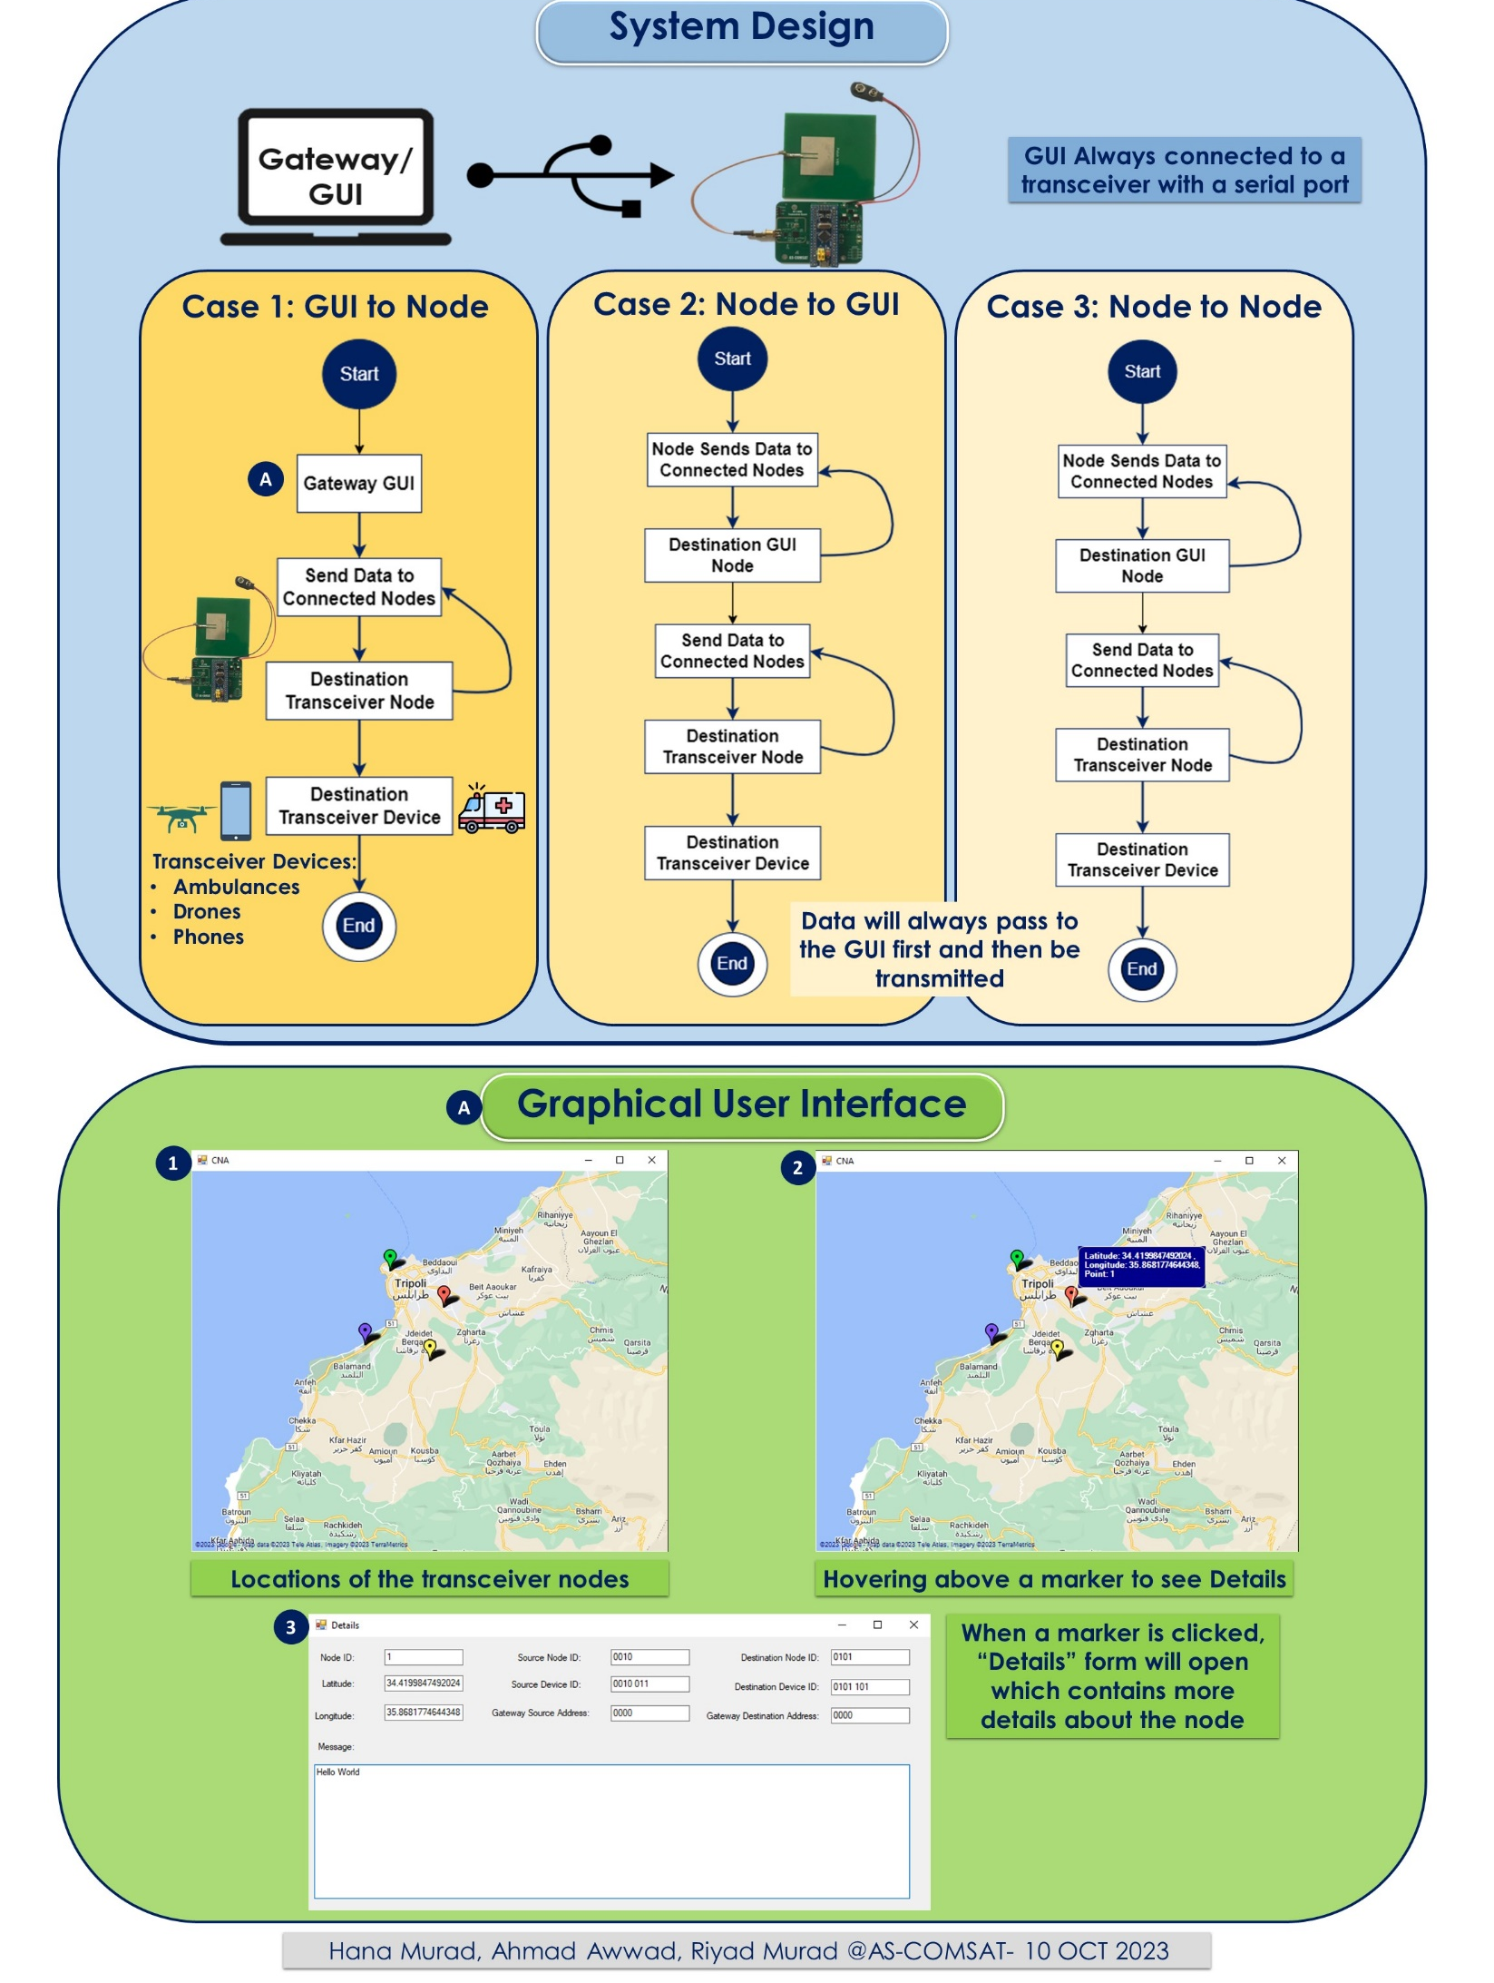
CNA (Communication Network Ambulance)
System Architecture & Graphical User Interface (GUI)

Slide 10
Istanbul
Automatic Identification System
•Required on any international ship with gross tonnage of 300 or more tons.
•Requiredon ALL passenger ships regardless of size
•Tracking system for ships
–Ship-to-ship communication in open-sea
•Some Applications:
–Vessel Traffic Services
–Collision Avoidance
–Maritime Security
–Search and rescue, Accident investigation
•AIS 1: Works on 161.975 MHz(ship to ship)
•AIS 2: 162.025 MHz(ship to shore)
AIS Application with clustering
CANDAR KARABULUT, S - A I S B a s e d Ma r i t i m e N e t w o r k : D i s t r i b u t e d V e s s e l C l u s t e r i n g, Master Thesis 2022, Marmara University Istanbul
@AS-COMSAT April 2024

