Slide 1



X-Ray detector for Nano satellite IAP-SAT
Presented by Yahya Al Abbouchi
In order to obtain the Research Master of Physics of Radiation-Matter Interaction
Supervisor :
Dr. Ahmad Osman Reviewer:
Dr. Samir Mourad Pr. Adnan Naja

Slide 2
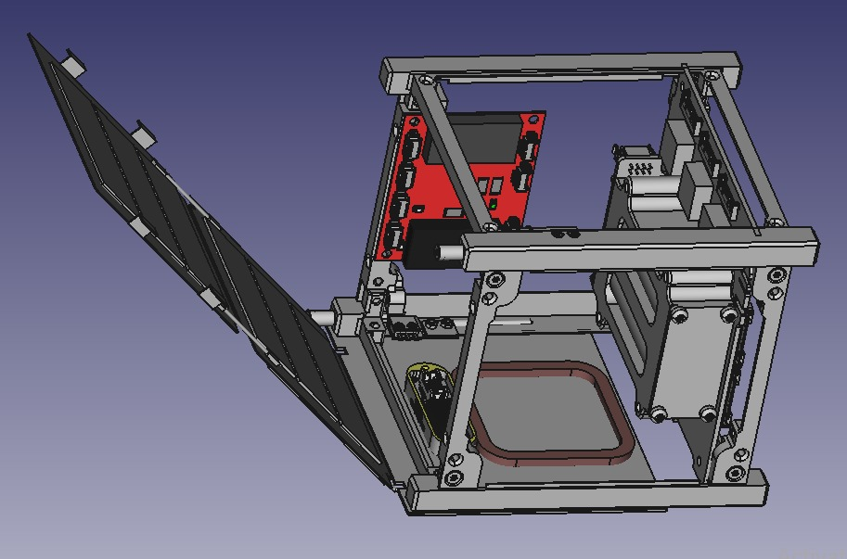
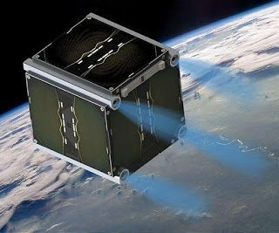
the goal of building an X-Ray detector is for the purpose of Nano satellites
Launched in space to measure the both of the incident energy and
the intensity to which the Satellite is exposed

Slide 3
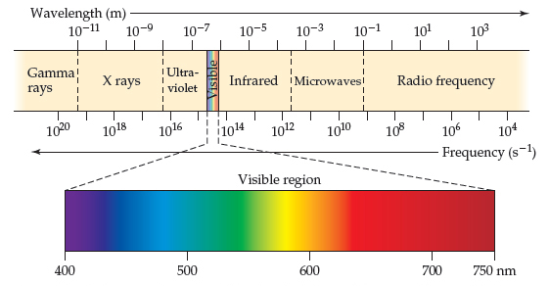
Introduction
X-Ray source
principle
Contribution
Results and conclusion
Detector
principle
Nature of X-Ray:
    X-Ray beam is a kind of electromagnetic radiation, in addition , relative to quantum mechanics the electromagnetic radiation can be considered as a set of particles.
X-ray energy is measured in eV , where 1 eV is the energy of electron when applied
a potential energy equal to 1 VOLT

Slide 4
Introduction
X-Ray source
principle
Contribution
Results and conclusion
Detector
principle
  In chapter 1 :
We used an evacuated X-ray tube consist of aluminum filament as cathode and copper road as anode.
A high potential electric source is applied between the anode and the cathode that will result in
electrons being accelerated from cathode to anode.
  In chapter 2 :
We will discuss the following title :
the concept of solid state detector.
An organic scintillators to convert the X-Ray into visible light.
The type of radiation-matter interaction : photoelectric effect
And Compton scattering effect .
The PIN photodiode used.
The relation between the intensity and the mass coefficient attenuation.

Slide 5
Introduction
X-Ray source
principle
Contribution
Results and conclusion
Detector
principle
In chapter 3 :
A Cockcroft-Walton ( voltage multiplier circuit ) to achieve a high voltage around 48 KV
Vacuum pump to pump the air outside the glass container
Fixing all the parts together ( source , vacuum pump , Cockcroft-Walton circuit )
In chapter 4 :
We was analyze the light detected by the photodiode using MATLAB

Slide 6
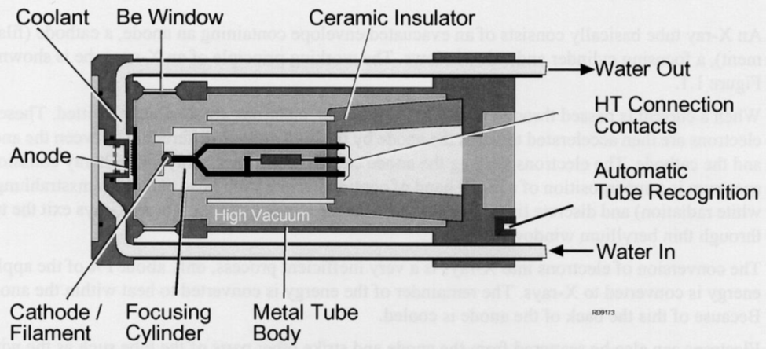
Introduction
X-Ray source
principle
Contribution
Results and conclusion
Detector
principle
As the energy is very high, 99% of input
energy will lost as heat
We must have to passing water through
the anode to protect it from melting
X-Ray source are created by bombarding a copper target with electrons inside a device known as X-Ray tube
In X-Ray tube, the electron beam can flight from the cathode to the anode by applying a high
potential up to 60 KV

Slide 7
Introduction
X-Ray source
principle
Contribution
Results and conclusion
Detector
principle
Anode material | Atomic number | Application
Copper ( Cu ) | 29 | Often used for most diffraction testing. Most widely used as anode material.
Moly ( Mo ) | 42 | Often used for testing on steels and metal alloys with elements in the range Titanium (Ti) (Z = 22) and Zinc (Zn) (Z = 30) as higher atomic number.
Cobalt ( Co ) | 27 | Suitable for ferrous samples, the Iron (Fe) fluorescence radiation it causes interference and cannot be eliminated by other way.
Iron ( Fe ) | 26 | Testing of ferrous samples. Again for use with metals instead of Co and Cr tubes in case we can't use.
Chromium ( Cr ) | 24 | Used for complex organic materials as well as strong radiative measurements on steel.
Tungsten ( W ) | 74 | Mostly used where the intense white spectrum is more important than the characteristic.

Slide 8
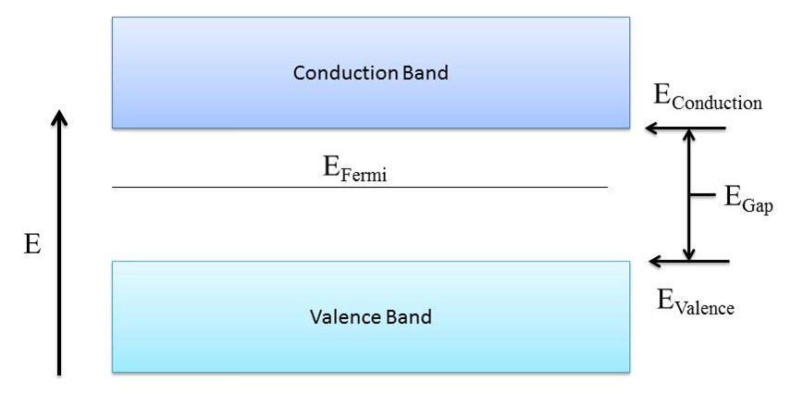
Introduction
X-Ray source
principle
Contribution
Results and conclusion
Detector
principle
Concept of solid state detector :
Are manufactured from semiconductor materials that exploit the small gap between
the valence band and conduction band.
Silicon materials are the most widely used in detectors.
An incident sufficient energy can
ionize electrons from the
valence Band to conduction band

Slide 9
Introduction
X-Ray source
principle
Contribution
Results and conclusion
Detector
principle
Interaction X-ray with matter:
Usually, in this type of work there are two kind of interaction :
photoelectric effect and Compton scattering effect.
Compton scattering is dominate if E>55 K eV and the photoelectric effect
is the main contribution if E< 55 K eV.
In this thesis the max voltage is 48 K eV, so the Compton scattering is out of scope.

Slide 10
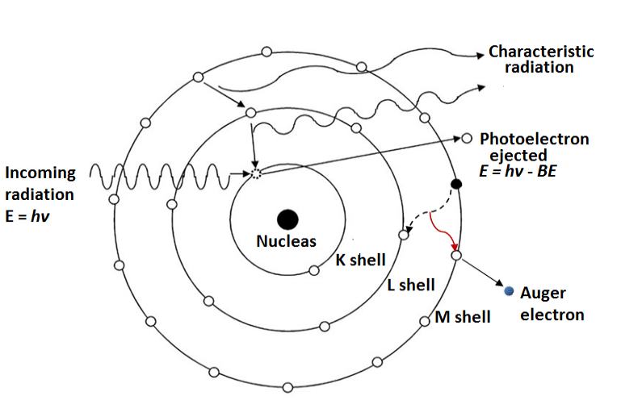
Introduction
X-Ray source
principle
Contribution
Results and conclusion
Detector
principle
Photoelectric effect :
The photon can be completely
absorbed by the atom,
their energy lead to the ejection
Of an electron if that energy is
bigger than binding energy

Slide 11
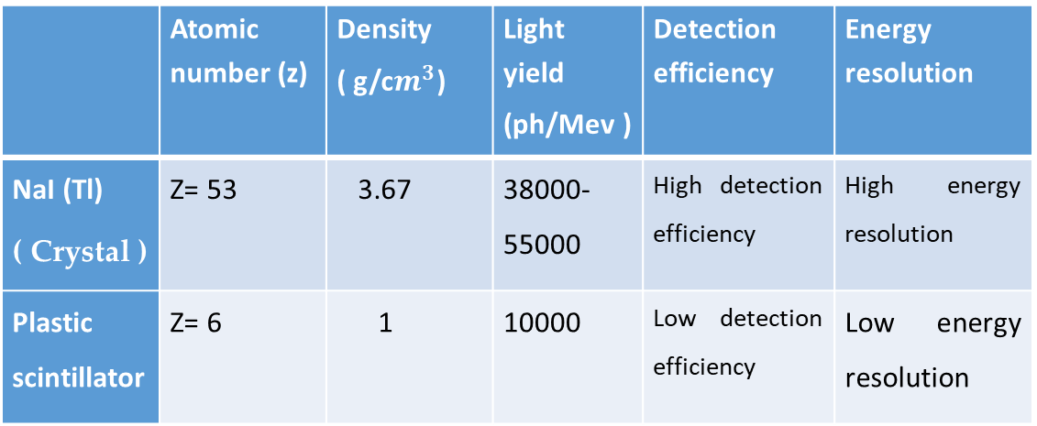
Introduction
X-Ray source
principle
Contribution
Results and conclusion
Detector
principle
Scintillators :
Scintillators are materials can absorbed radiation and transform it to detectable visible
or near visible light
There are two type of scintillators : organic ( plastic , liquid ) and inorganics ( crystals )
Comparison between organics and inorganics :
 | Atomic number (z) | Density ( g/c$m^{3}$) | Light yield (ph/Mev ) | Detection efficiency | Energy resolution
NaI (Tl) ( Crystal ) | Z= 53 | 3.67 | 38000-55000 | High detection efficiency | High energy resolution
Plastic scintillator | Z= 6 | 1 | 10000 | Low detection efficiency | Low energy resolution

Slide 12
Introduction
X-Ray source
principle
Contribution
Results and conclusion
Detector
principle
Photodiode :
The principle of the photodiode has a depleted semiconductor region
For enhance the time response we need a thin depletion region and for achieve
A high quantum efficiency the depletion region must be thick
We use the PIN photodiode because the depletion region can be tailored
To optimize the quantum efficiency and speed of response
In addition, the PIN photodiode is a special type of p-n photodiode

Slide 13
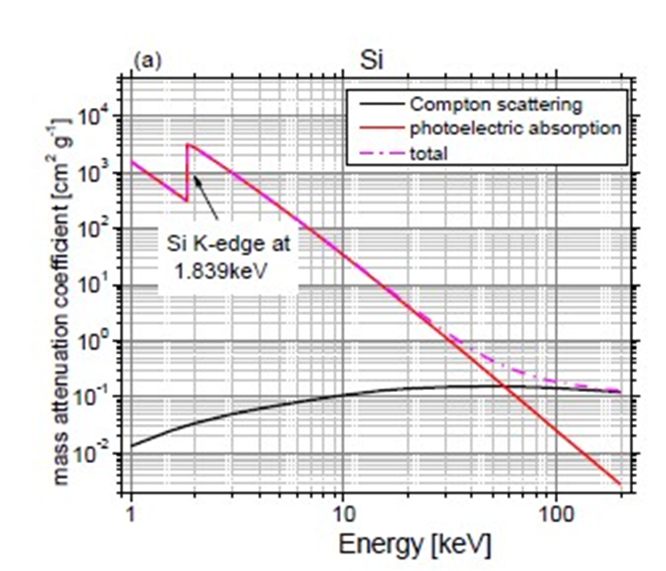
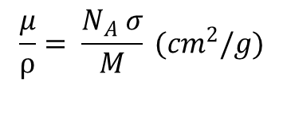
Introduction
X-Ray source
principle
Contribution
Results and conclusion
Detector
principle
Attenuation coefficient of silicon :
$$\frac{μ}{⍴}= \frac{N_{A} σ}{M} ({cm}^{2}/g)$$
with 𝜇 is the linear absorption coefficient with a unit cm-1
and 𝜌 is the density of the material.
𝑁𝐴 is the Avogadro number and 𝑀 the molar weight.
The k-edge is the sudden increase in X-Ray
absorption occurring when the photon interact With
the electron in k-shell
On the other hand, the mass attenuation coefficient
is increase when the atomic number Z is increase

Slide 14
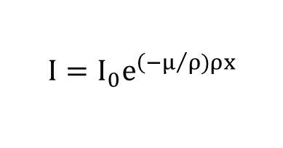
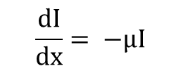
Introduction
X-Ray source
principle
Contribution
Results and conclusion
Detector
principle
Intensity of X-Ray :
When x-rays encounter any form of matter, along the thickness x, after the distance dx into the body,
the X-rays intensity becomes decreasing because it's partly transmitted and partly absorbed.
$$\frac{dI}{dx}= −μI$$
After integration along the direction x :
$$I=I_{0}e^{\left(−μ/ρ)ρx\right.}$$

Slide 15
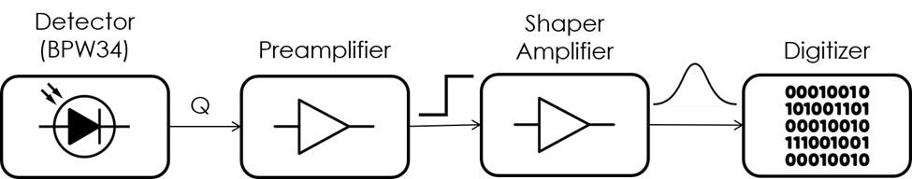
Introduction
X-Ray source
principle
Contribution
Results and conclusion
Detector
principle
X-Ray detector amplifier
The PIN photodiode (BPW34) have low-voltage input signal and have to be amplified
Via an extremely low-noise preamplifier.
A shaping amplifier is used to make a reasonable signal shape that can be processed
And interpreted by a microcontroller

Slide 16
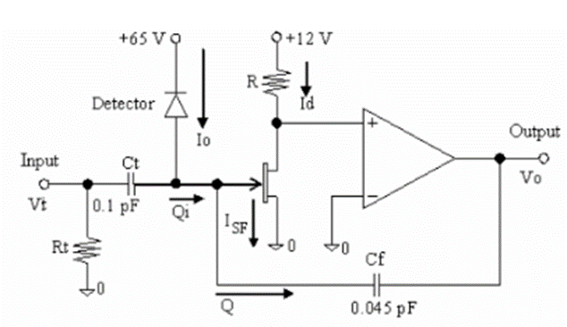
Introduction
X-Ray source
principle
Contribution
Results and conclusion
Detector
principle
Preamplifier design :
After many experience to avoid noise, the preamplifier circuit design is shown in this figure below .
A JFET transistor should be used at the output
of the detector with low capacitance junction
To collect the charges from the detector .

Slide 17
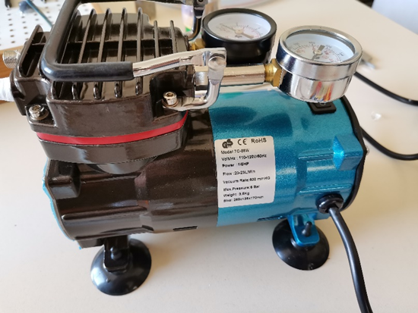
Introduction
X-Ray source
principle
Contribution
Results and conclusion
Detector
principle
X-Ray source container :
in this thesis the x-ray source consist of a vacuum tube including:
An aluminum filament from a bulb light (cathode )
A copper road from air conditioners ( anode )
The support used for anode is also used to pump the air outside the glass container
The vacuum pump used has a rating of 600 torr
Which is 79% of vacuum

Slide 18
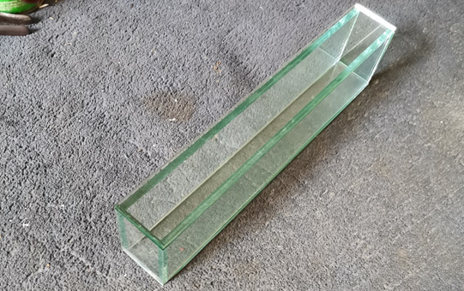
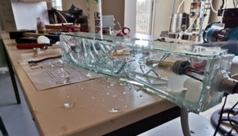
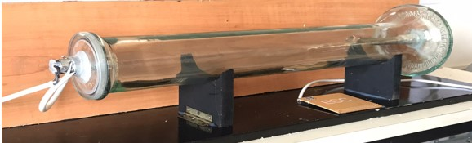
Introduction
X-Ray source
principle
Contribution
Results and conclusion
Detector
principle
Glass container :
At first, a cubic shape container was used but it could not stand the pressure difference.
So instead of this we use a circular shape with a thickness of 3 mm can support the 79% of vacuum.

Slide 19
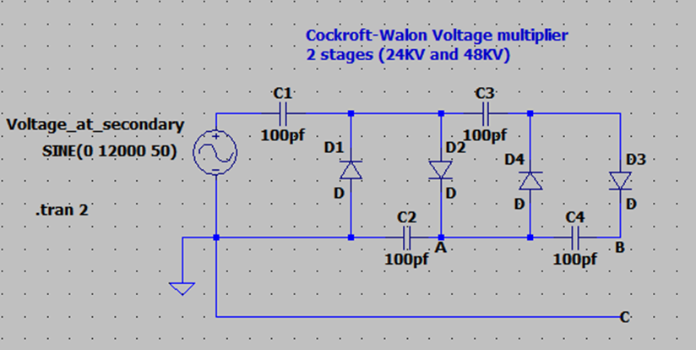
Introduction
X-Ray source
principle
Contribution
Results and conclusion
Detector
principle
Transformer :
In order to obtain 48 KV as an output voltage a step-up transformer 220V /12kV has been used
Cockcroft-Walton voltage multiplier:
The input of Cockcroft-Walton circuit is came
from transformer which is 12KV
The Cockcroft-Walton circuit is an electric
circuit which convert low AC voltage
Into high DC voltage

Slide 20
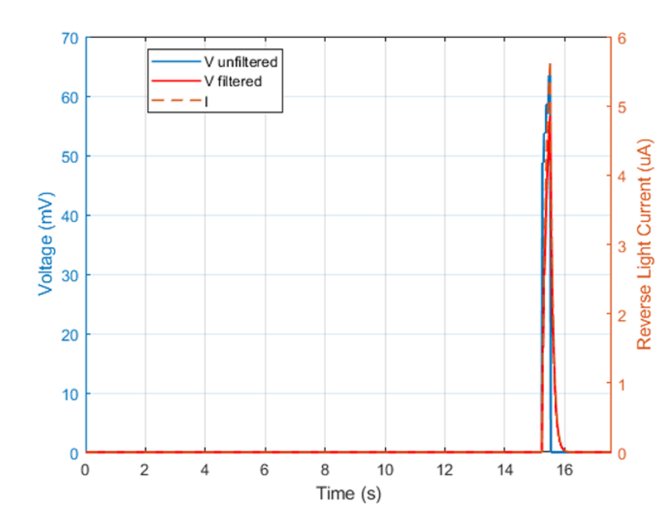
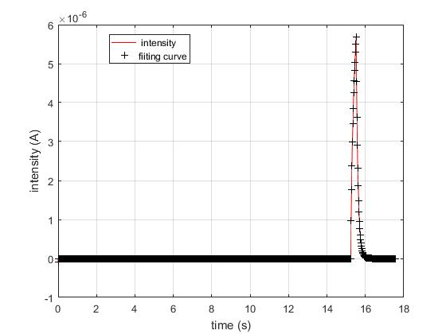
Introduction
X-Ray source
principle
Contribution
Results and conclusion
Detector
principle

Slide 21
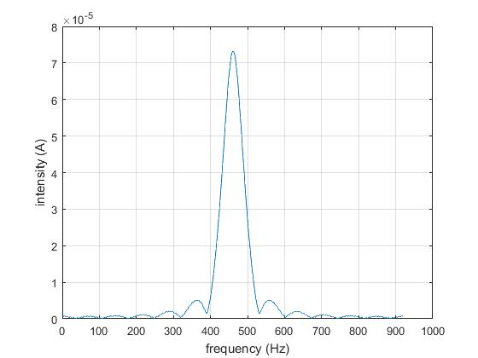
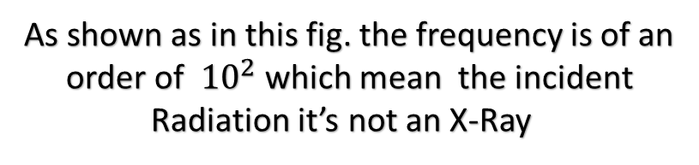
Introduction
X-Ray source
principle
Contribution
Results and conclusion
Detector
principle
Fourier transform :
As shown as in this fig. the frequency is of an
order of ${10}^{2}$ which mean the incident
Radiation it’s not an X-Ray

Slide 22
Introduction
X-Ray source
principle
Contribution
Results and conclusion
Detector
principle
Conclusion:
We need a vacuum pump achieved 90% vacuum at least.
High voltage up to 60 KV
Reduce the distance between the cathode and anode to 3 cm instead of 35 cm
Use a tungsten anode rather than copper anode
Passing water through the anode to protect it from the melting
A rotating anode can save the target for the long time
Note : the first three condition is enough to achieve an
X-Ray radiation.

Slide 23

Thx for your
attention

