Slide 1
Last update:
18.05.2024
Mass spectrometer FOR Measurement of Heavy Metal Residuals in Municipal WASTE Incineration after Flue Gas Filtering
By Omar Zreika (for Master Thesis in Energetic Physics
Weekly Review

Slide 2
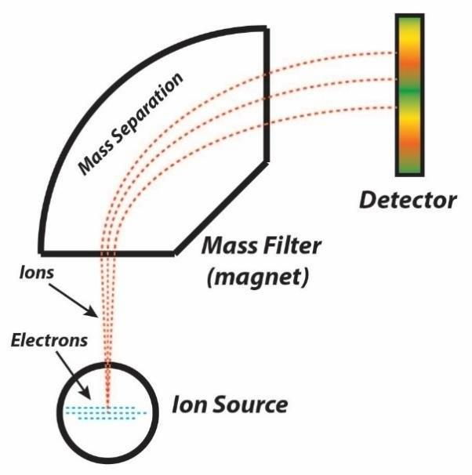
. Working Principle .
Slide 2
07.05.2024
1. Ionization
2. Acceleration
3. Deflection
4. Detection

Slide 3
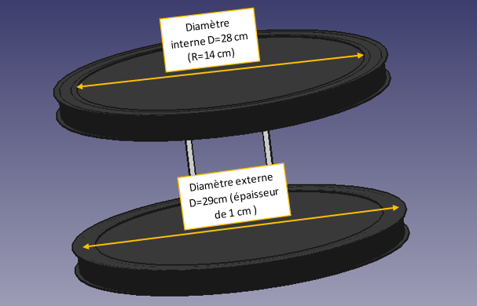
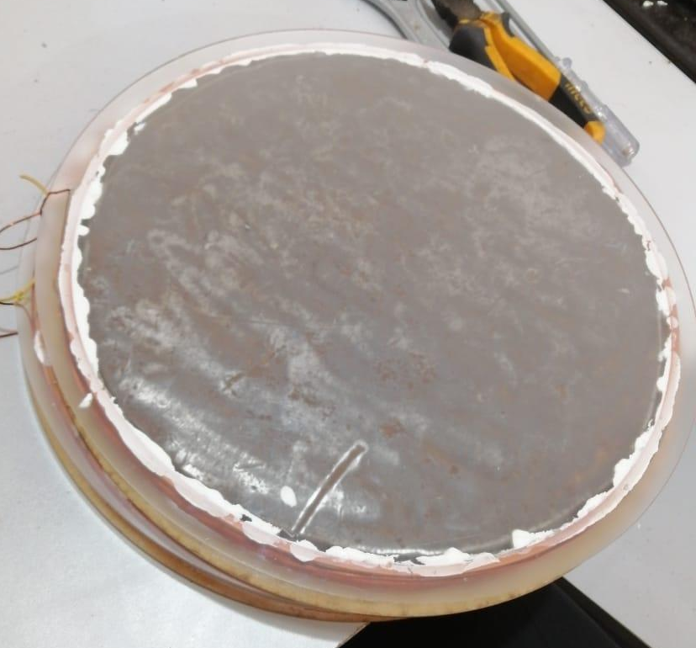
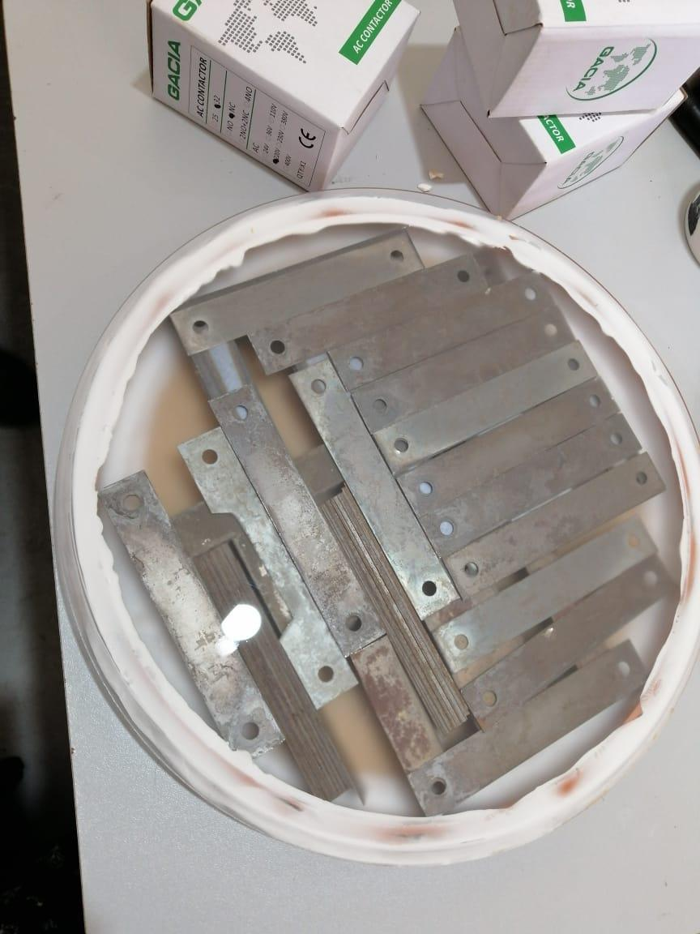
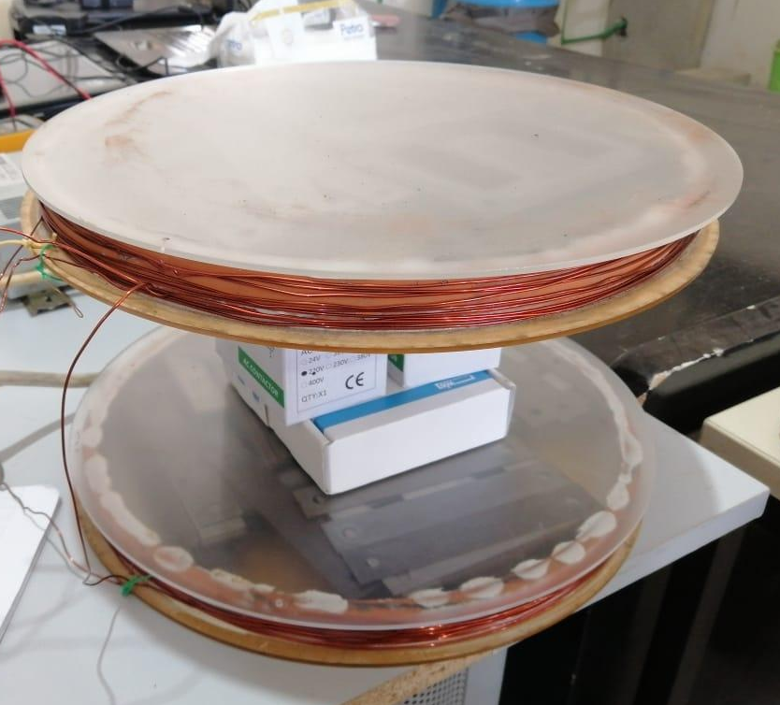
. Asmaa Report .
Slide 3
07.05.2024
Goal: Obtain a 0.2 Tesla
Result: Failed
Why!?
Reason: Using of helmoltz coil (weak)
Unknown Permeability

Slide 4
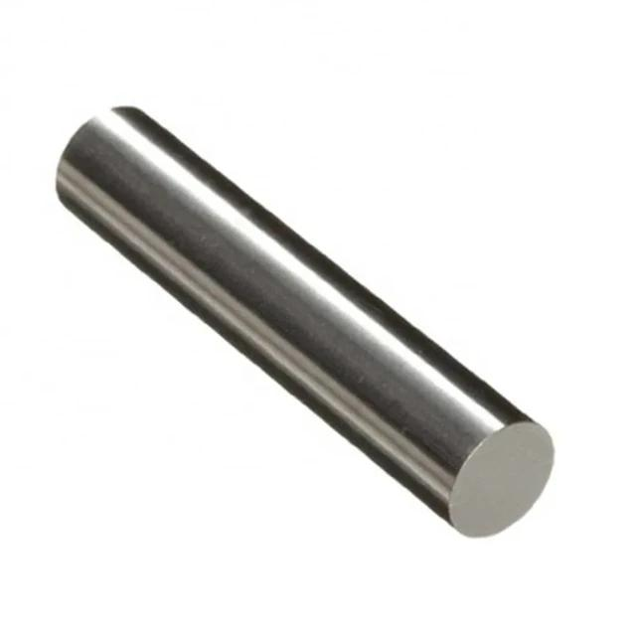
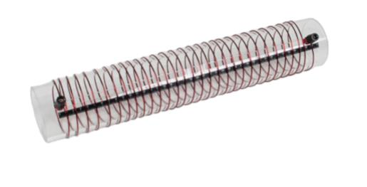
. Electromagnet .
Slide 4
07.05.2024
The ferromagnetic core “μ”
B = μnI
The number of turns “n”
B: magnetic field in Tesla
μ: permeability in Henry per Meter
n: number of Turns per Meter
I: electrical current in Ampere
Our Goal
Achieve a 0.2-0.25 Tesla
The electrical current “I”

Slide 5
. Alibaba .
Slide 5
07.05.2024
Alibaba best result:
10 pieces , purity 99.5%, shipping 82$, need annealing 70$ to reach 25000 relative permeability
Aliexpress:
Iron purity 99.9% but no data sheet
Pure iron is the best option for a high permeability compared to the air (relative permeability)

Slide 6
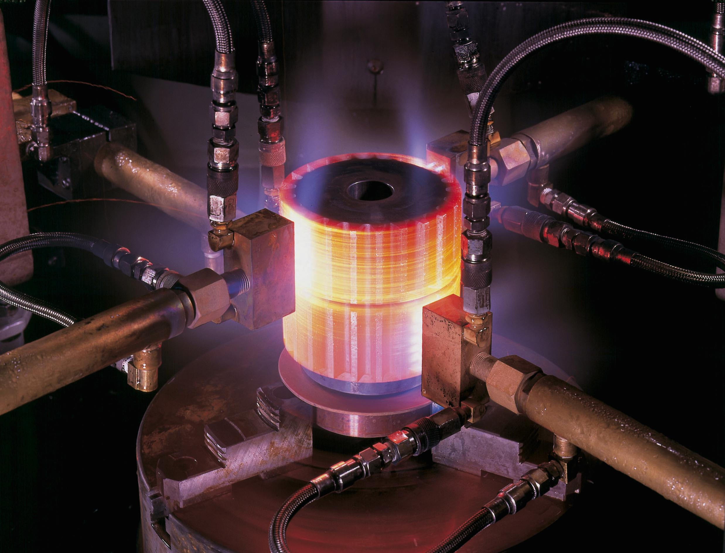
. Annealing .
Slide 6
07.05.2024
Annealing process is to rise the relative permeability of the iron:
Temperature: 800-900 °C
Time of heating: 1hour per inch
Cooling rate: 1-2°C per hour
Is it possible?!
Is it easy?!
We need a programmable furnace

Slide 7
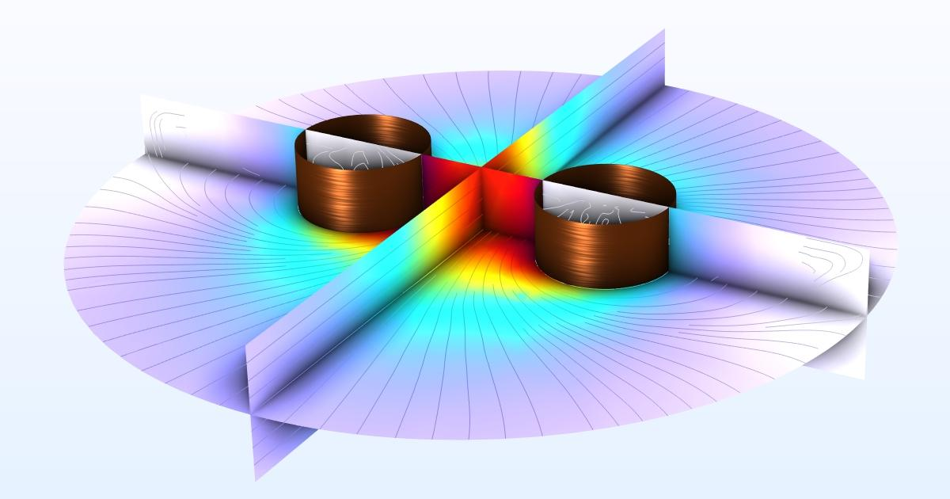
. Simulation .
Slide 7
07.05.2024
We should learn How (×3):
How to install the program
How to use the program
How to make the coil simulation
This will help us to know:
The best shape of the coil
The best number of turns
The strength of the magnetic field
COMSOL multiphysics

Slide 8
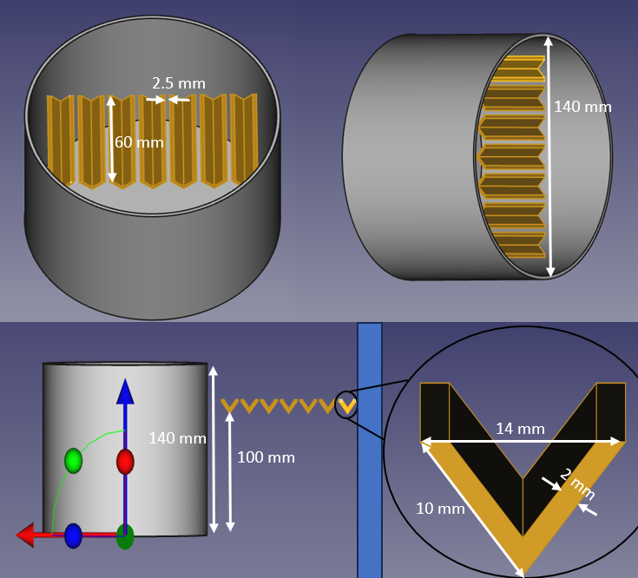
. The detector .
Slide 8
07.05.2024
If the electromagnet isn’t ready
We can’t do the test for the detector and know how to get the samples
We must hurry…
We can’t do the test!!

Slide 9
. Permeability .
Slide 9
Soft Iron
In Electromagnetism, permeability refers to a material’s ability to concentrate magnetic fields compared to the empty space,
and symbolized by μ
It tells you how easily a material gets magnetized
It’s measured in Henry per meter (H/m)
focuses and amplify magnetic fields
Wood
doesn’t affect the magnetic fields

Slide 10
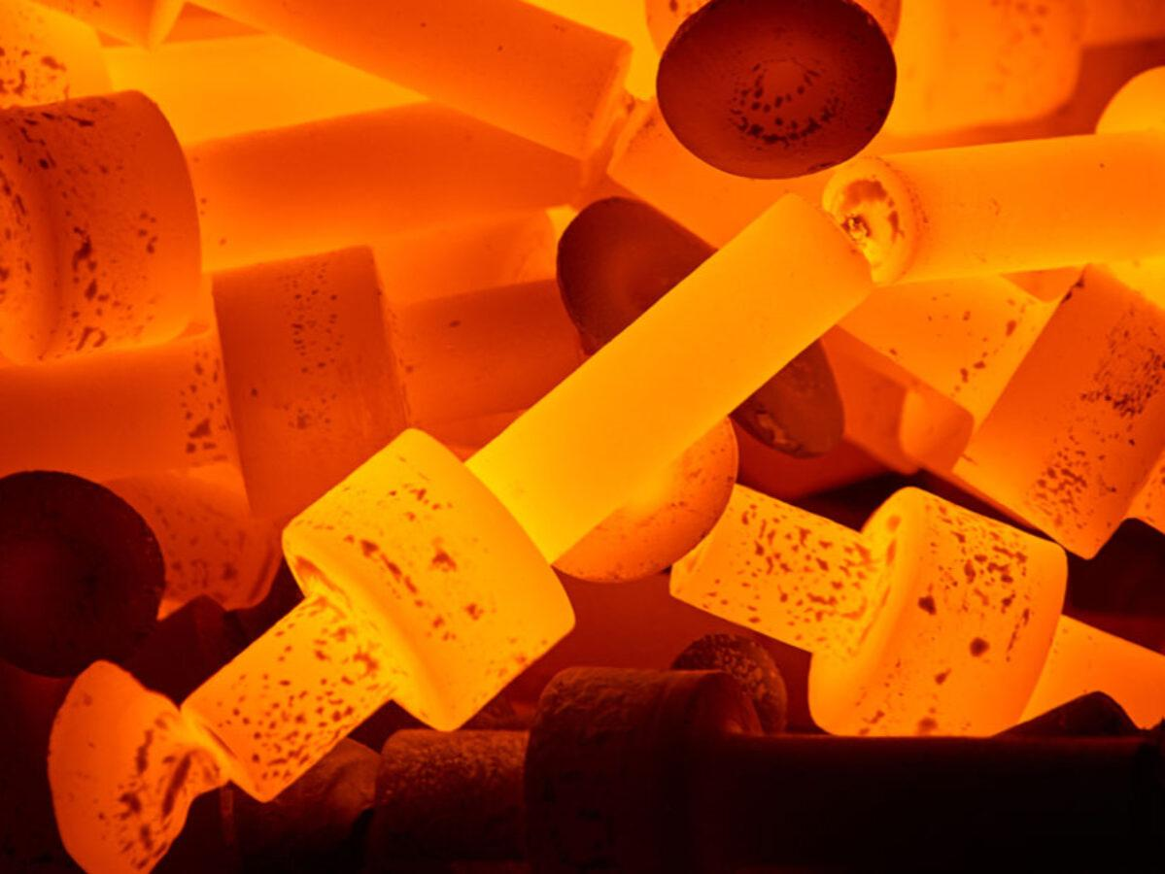
. Annealing II .
Slide 10
The Temperature affects the permeability:
( 800 to 900°C is the best )
The purity of the metal affects the time of the annealing:
( impure metals take more time than the pure ones )
The size affects the time of the annealing:
( The smallest the metal size, the smallest the time needed )

Slide 11
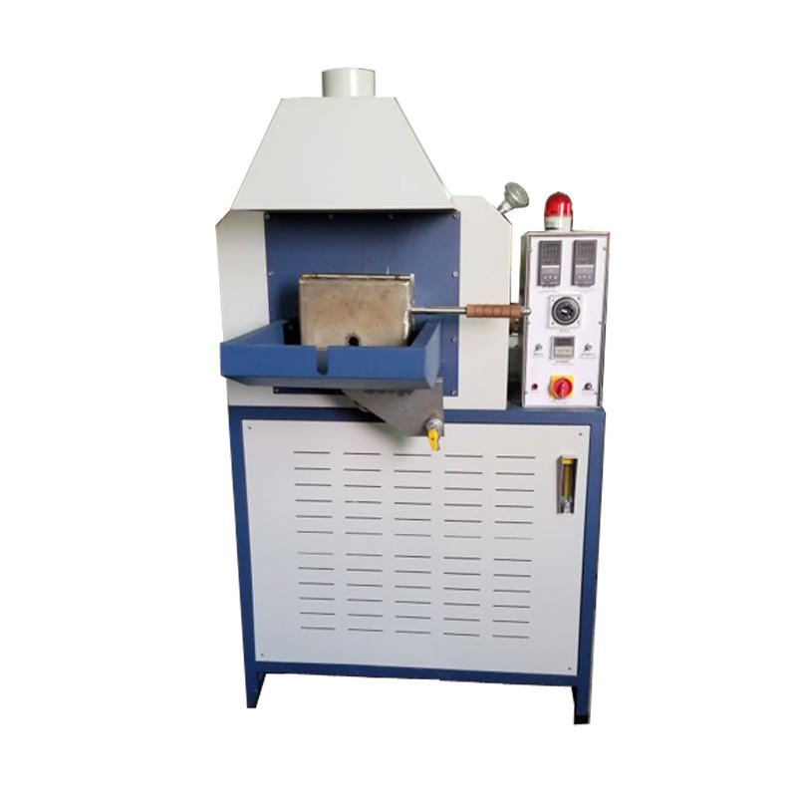
A programmable furnace is needed for the annealing process
. Annealing III .
Slide 11
Two critical Specifications:
Can rise the temperature up to 850°C
Have a control panel to determine the time and the temperature of the annealing process
Heat treatment

Slide 12
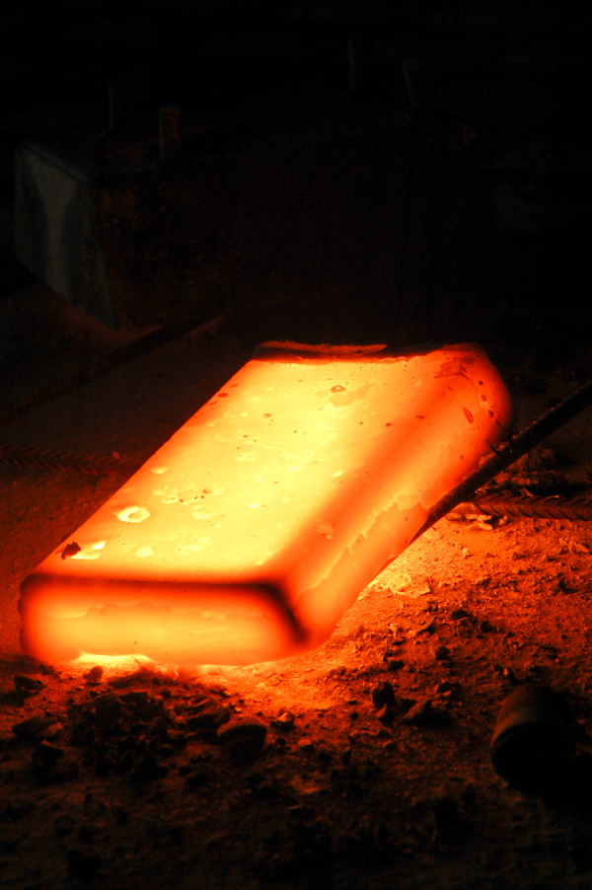
. Annealing III .
Slide 12
We need to clean the iron rod surface with a solvent (acetone or ethanol) to remove any dirt
Oxygen can react with iron at high temperature so we need to use an inert gas (nitrogen) to minimize the oxidation
We should purge the furnace with the inert gas about 10-15 min before introducing the iron rod
A continuous flow rate of the inert gas during the annealing process is recommended
We place the iron in the furnace and gradually rise the temperature to 850 °C, and hold it about 1 hour, we let it cool slowly and naturally while the furnace is closed

Slide 13
Copper Case
Result: Good
. Purification .
Slide 13
Impure Copper
( Anode )
Pure Copper
( Cathode )
e⁻
e⁻
Cu²⁺
Cu
Cu²⁺
Cu²⁺
Cu
Cu²⁺
CuSO₄ Solution

Slide 14
Iron Case
Result: Bad
. Purification .
Slide 14
Impure Iron
( Anode )
Impure Iron
( Cathode )
e⁻
e⁻
Fe²⁺
Fe
Fe²⁺
Fe²⁺
Fe²⁺
Fe
FeSO₄ Solution

Slide 15
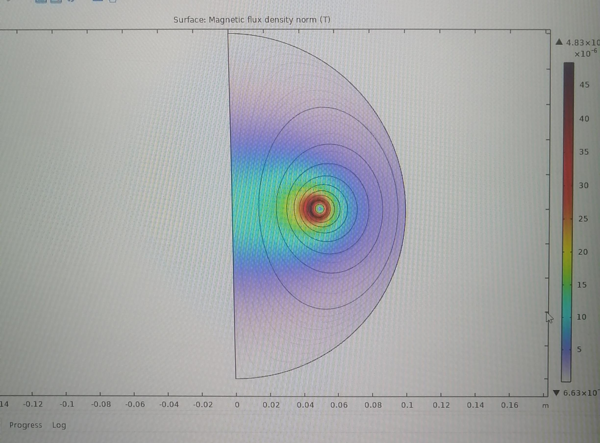
. Simulation II .
Slide 15
The program still need time to understand
how it works
If so, we can move on to make our coil simulation for the strength of the magnetic field
We successfully installed
COMSOL multiphysics

Slide 16
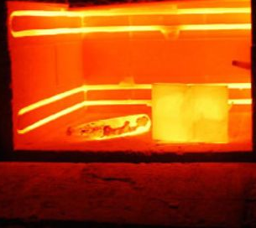
Annealing Process
. Annealing IV .
Slide 16
Wipe down the iron rod with ethanol
Purge the nitrogen gas in the furnace
Turn on the furnace and set it to somewhere between 800 and 850 °C
Put the iron rod in a clay pot
Keep purging the nitrogen gas during all the annealing process
Place the iron rod inside the furnace carefully using gloves and tongs
Once it reaches the target temperature let the iron sit there for about one hour
Turn off the furnace
Let the furnace closed so the iron can be cooled slowly

Slide 17
. Annealing V .
Slide 17
Muffle furnace advantages: Controlled environment: It prevents oxidation of the iron during annealing, which is important for magnetic properties. Uniform heating: Ensures consistent results in terms of microstructure and permeability. Precise temperature control: Allows for optimal annealing for permeability.

