Slide 1


North Lebanon Automotive Systems (NLAS)
Products
Agricultural 4-wheels Electrical Tuk-Tuk
Transportation 4-wheels Electrical Tuk-Tuk
Lithium-Ion Batteries and Battery Mangement Systems (BMS)
Electrical Vehicles for Deep-Sea Research
Address
Bahsas, Haykalieh Str., Harba Bld., Ground Flr., Tripoli, Lebanon
Contact
Dr. Eng. Samir Mourad, CEO Mobile +49 178 72 855 78 / +961 76 341 526 Email:samir.mourad@aecenar.com
Eng. Mahmud Zohby, Project Management and Suppliers Control Mobile +961 3 671 621
@NLAS November 2023

Slide 2
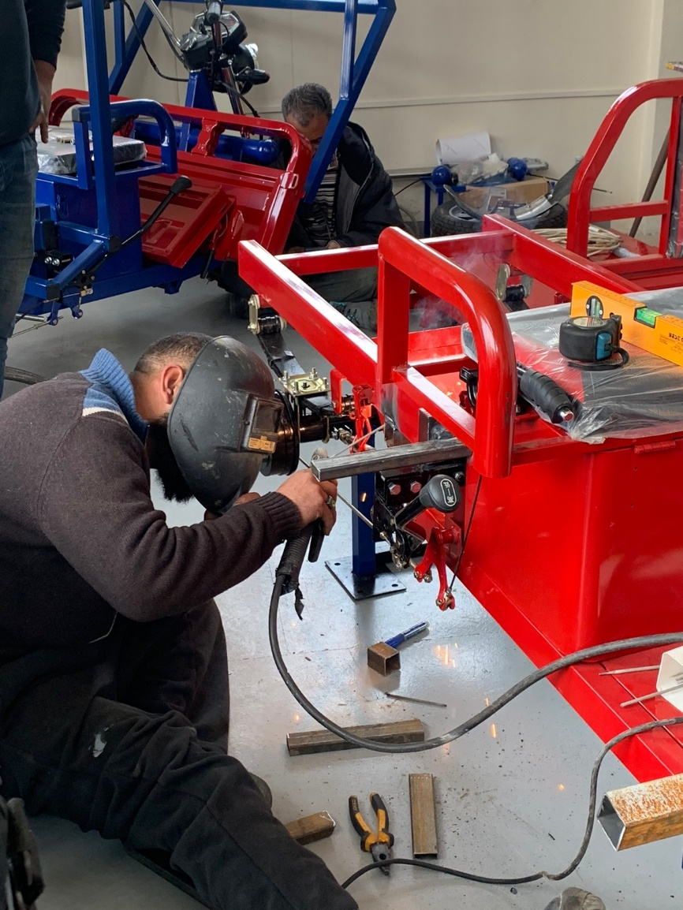
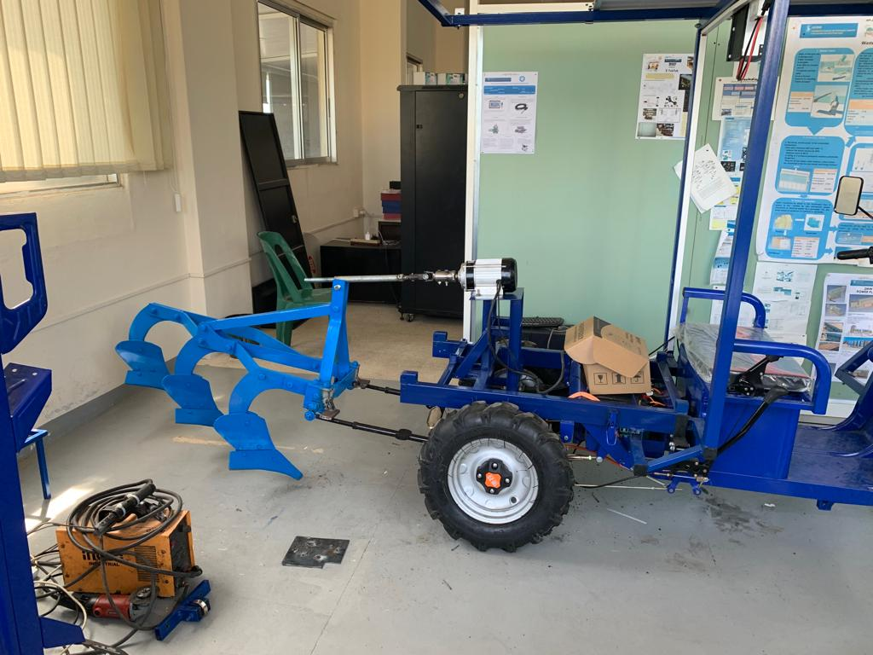
Laboratory Test vehicle

Slide 3
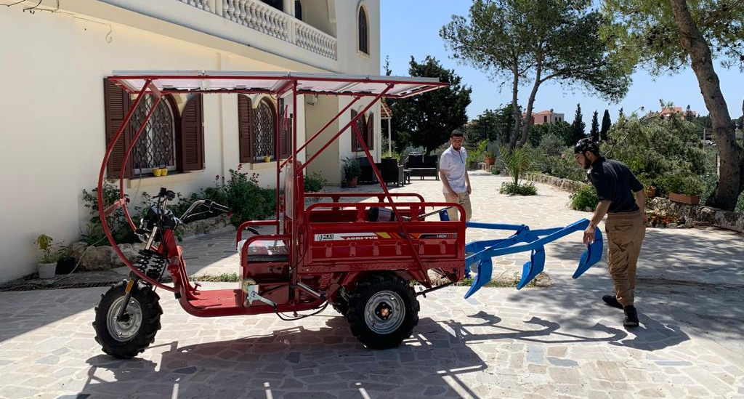
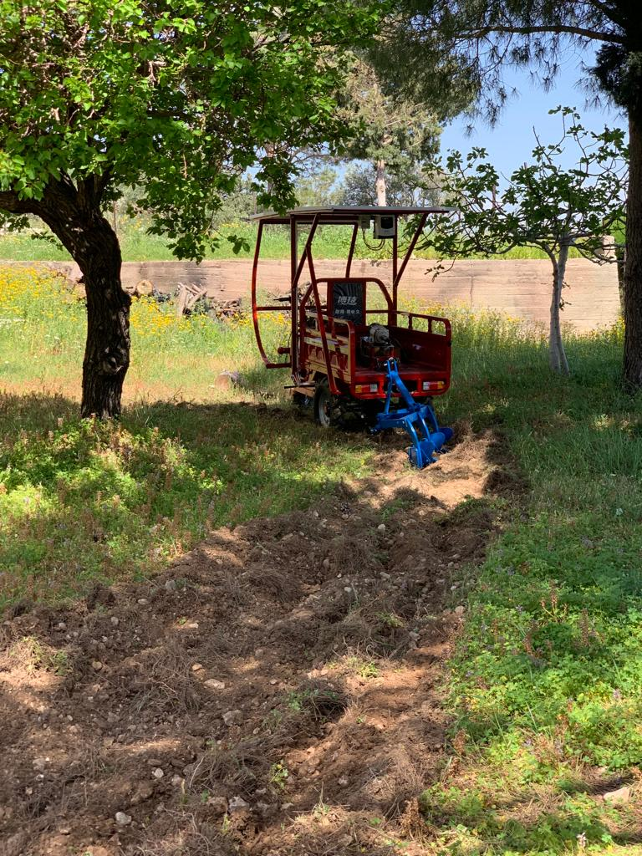
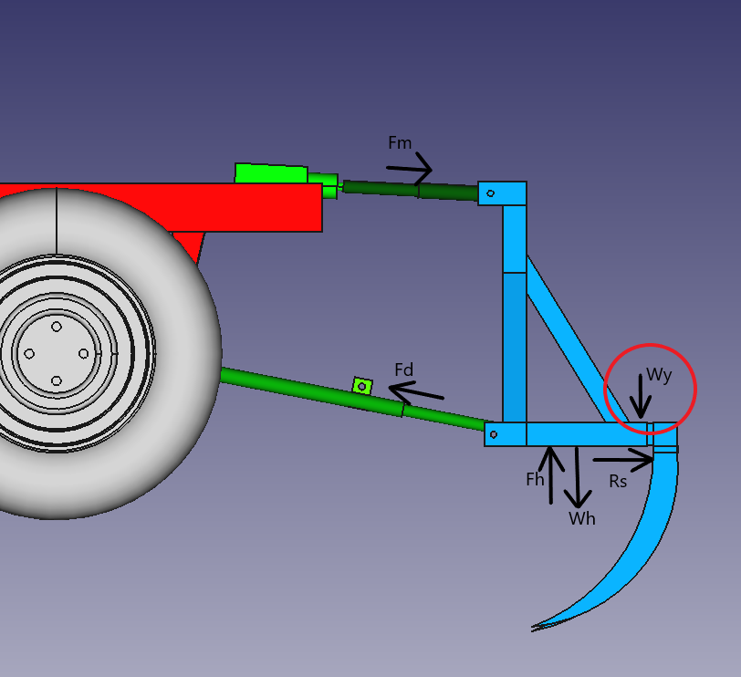
Agricultural 4-wheels Electrical Tuk-Tuk

Slide 4
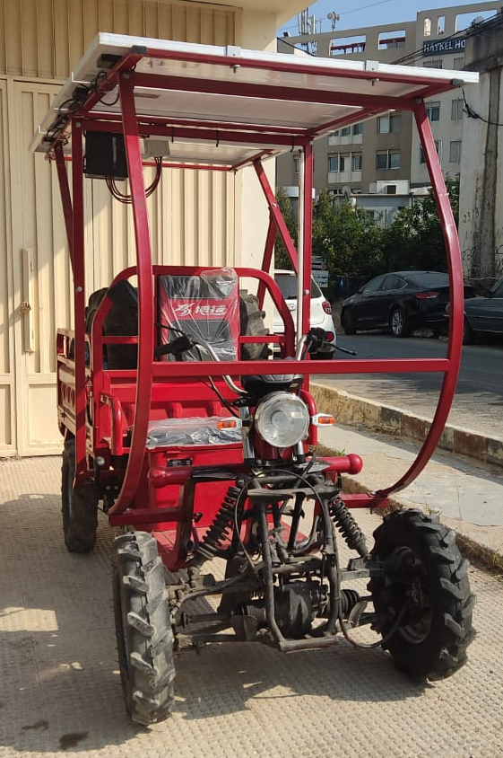
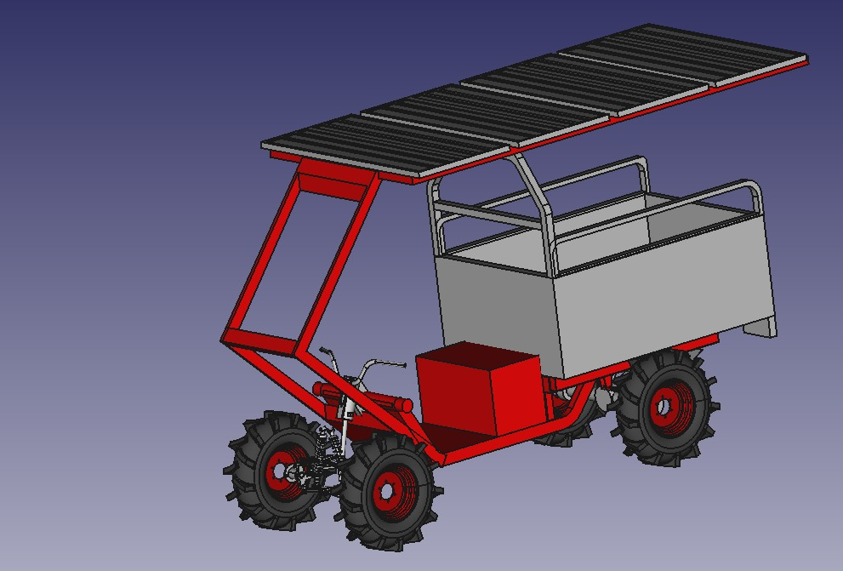
Transportation 4-wheels Electrical Tuk-Tuk
Part | quantity | discription
tuk tuk parts
Front sides flashers | 1 | the two are connected to each other
Rear flashers | 2
differartial regulation axe | 2
rear brake axe | 3
flasher coil 60v | 1
pins for rear dampers | 12
digital 60v dashboard | 1
T shape front suspension axe | 1
12 inch rear rims | 2 | without standard tires
start switch | 1
rear differatial axe | 1 | with gear and fising pins
front steering wheel bearing | 1
control circuit for all electric parts | 1
Gear shifter rod | 1
brake sensor | 1
6 pins connector box | 1 | for power distribution
steering wheel switches and buttons | 1 set
supports for rear damper | 2
controller 1500w 72v BRSH-60 | 1
steering wheel | 1
Gear shifter handle | 1
hand brake handle | 1
speed controller FR-3S | 1
rear dampers | 2
electric motor 1500w 72v | 1
Solar panels parts
MPPT | 1
solar panels 100w | 5
solar system connectror and wires | 1 set
front suspension parts
Front shock absorber | 2 | 350mm for 200cc ATV
Upper swing arm | 2
Lower swing arm | 2
steering strut knuckle spindle and wheel hub | 2
Bolts | 4
chassis and body
long chassis with front suspesion chassis | 1
battery container and driver seat | 1
cabin | 1
solar panels stand | 1

Slide 5
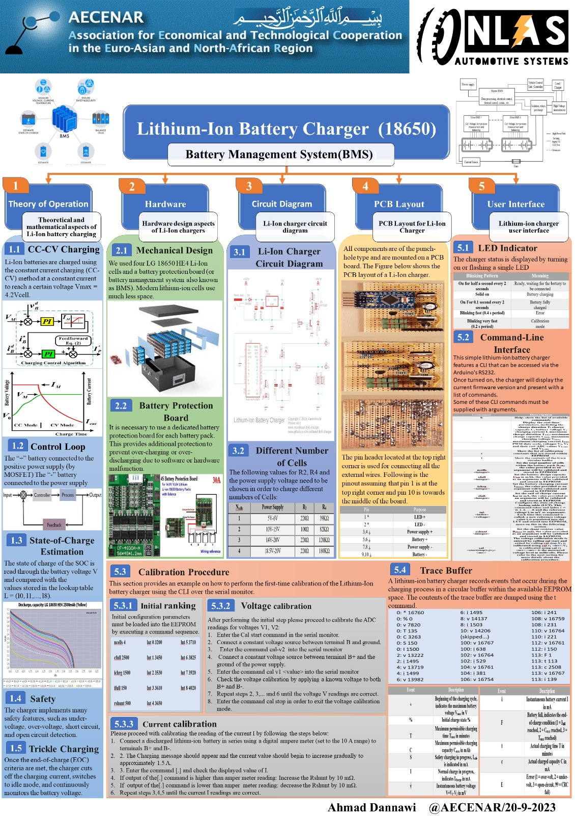
Battery Mangement System (BMS)

Slide 6
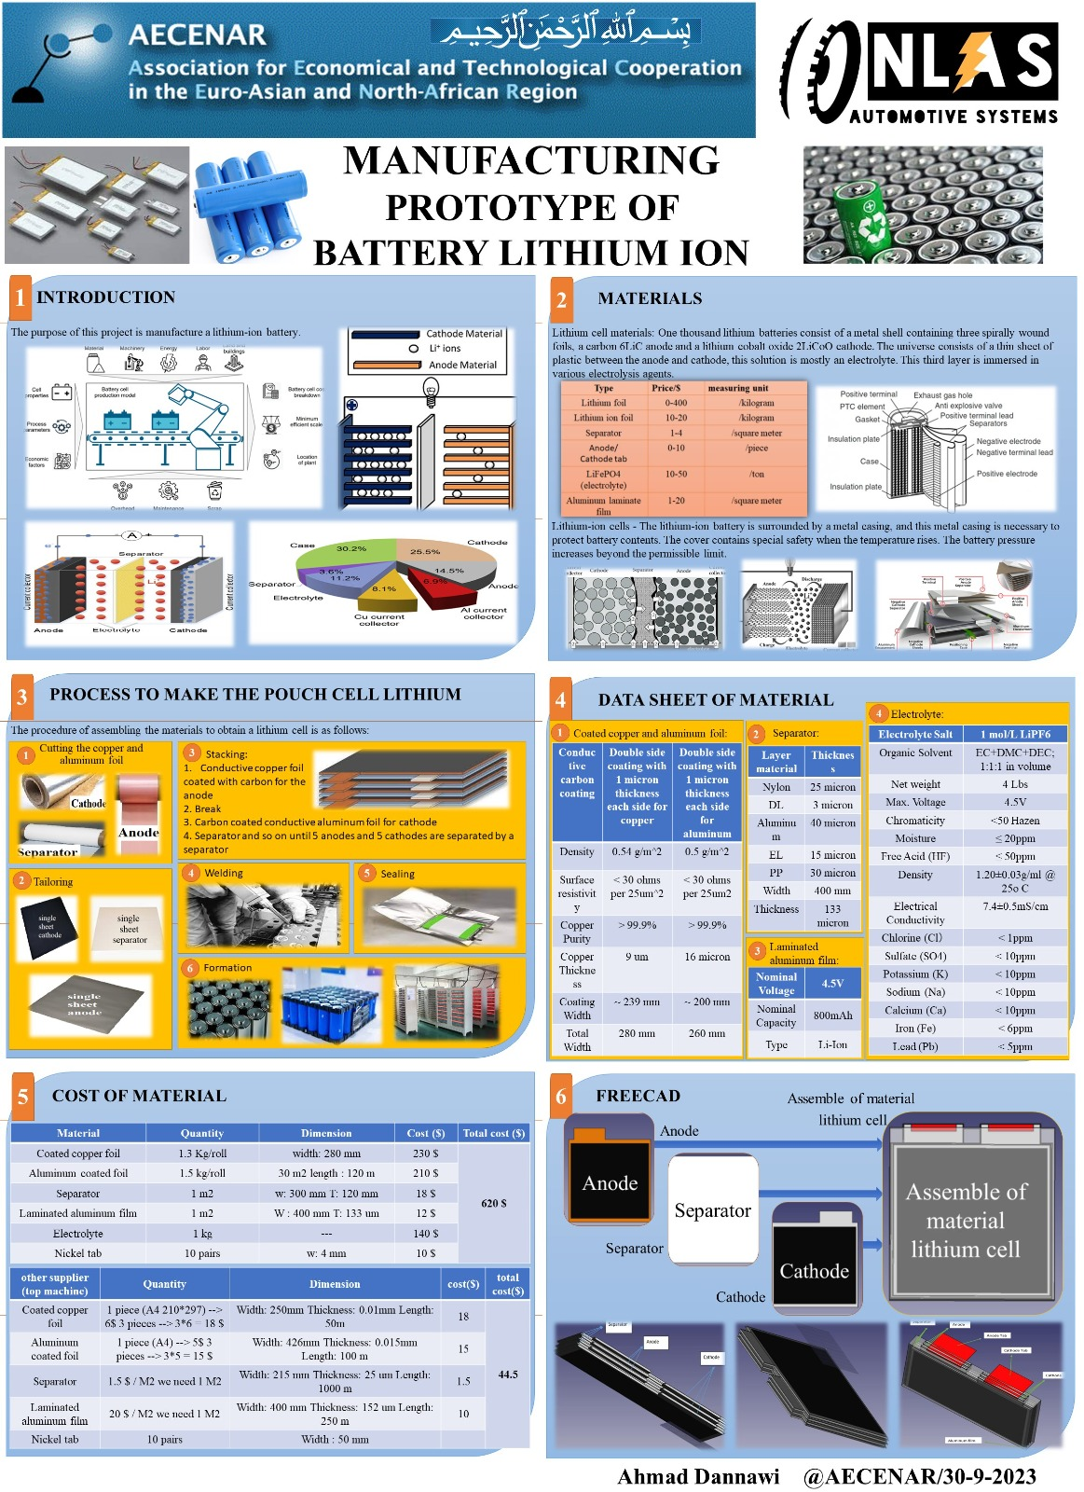
Lithium Battery Production

Slide 7

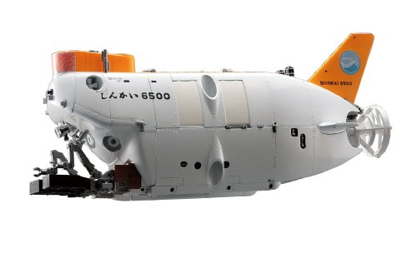
Electrical Vehicles for Underwater (Deep-Sea) Research
Planned

