Slide 1



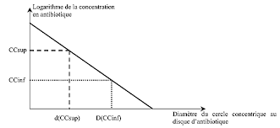
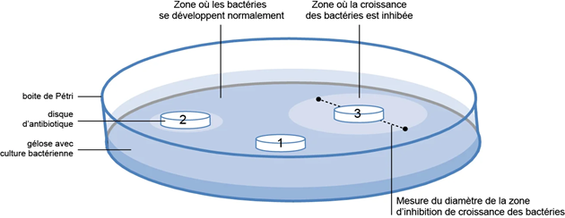
www.aecenar.com
Lab Scale Production of Ampicillin With Quantification of Penicillin and Ampicillin
Introduction:
Semi-synthetic penicillins antibiotics (SSPAs), one of the most important families of anti-infection drugs in the world market, are mainly producedby a two-step fashion. Ampicillin is one of the most widely used -lactam antibiotics in therapy as it is suitable for a wide spectrum of bacterial infections and has a good level of activity and tolerability. The qualitative analysis was done through β-lactamase test using penicillin or ampicillin resistant Escherichia.coli . Then quantitative analysis was performed by measuring the diameter of zones of inhibition of all the culture samples and comparing them with the standard curve drawn by measuring the diameter of zones of inhibition of standard dilutions of commercially available penicillin G or Ampicillin.
Experiment 1: Quantification of the produced penicillin
C- Quantification of the produced penicillin:
Experiment 3: Quantification of the produced ampicillin
The quantitative analysis was done through β-lactamase test using penicillin resistant Esherichia coli.
1- After the growth time, we measure the zone of inhibition that had appeared using a ruler.
2- We draw a graph showing the concentration of penicillin as a function of the diameter in order to be able to quantify the produced penicillin (Log C as a function of diameter)
1-Preparation of the turbidity calibration 0.5 McFarland(1):
Track the same steps referred to the first experiment(Quantification of penicillin)
1-Preparation of the turbidity calibration 0.5 McFarland(11):
1- we add 0.5 mL of a 0.048 mol/L solution of BaCl₂ (1.175% w/v BaCl₂ 2H₂O) to 99.5 mL of a 0.18 mol/L solution (0.36 N) of H₂SO₄ (1% v/v) and we shook vigorously.
2- We check the density of the suspension using a spectrophotometer with a 1 cm beam and matching cuvettes. The absorbance at 625 nm should be between 0.08 and 0.13.
3- We distribute the suspension in tubes of the same size as those used to adjust the inoculum and then we seal the tubes.
4- Once sealed, we store these tubes at room temperature and protect from light. Before use, we mix the tube vigorously using a Vortex (6 months’ storage)
2- The three bacterial strains which can be used:
E.coli / S.aureus / S.pneumonia .
Here we use E.coli as sensitive strains
        3- Quantification of the produced penicillin using the disk diffusion method (Kirby-Bauer Test):
        Track the same steps referred to the first experiment but by replacing the penicillin by the ampicillin
        2-Quantification of the produced penicillin using the disk diffusion method (Kirby-Bauer Test):
Experiment 2: Enzymatical process to produce Ampicillin from penicillin using iPGA :
        A-Preparation of the inoculum
1- We took 3 to 5 colonies of the isolated colonies with a loop, and we added them in 2ml sterile saline (NaCl 0.9%)
2- We Vortex the saline tube to create a smooth suspension.
3- We adjust the turbidity of this suspension to a 0.5 McFarland standard by adding more organism if the suspension is too light or diluting with sterile saline if the suspension is too heavy.
4- Use this suspension within 15 minutes of preparation.
5- We inoculate the surface of Mueller Hinton agar plate by streaking the swab 3 times over the entire agar surface, we rotate the plate approximately 60֯ each time to ensure an even distribution of the inoculum
6- We allow the plate to sit at room temperature at least 3 to 5 minutes (but no more than 15 minutes) for the surface of the agar plate to dry before proceeding to the next step
To produce semi-synthetic β-lactam(Ampicillin), there are two proposed methods: One put-one step synthesis(1P1S) and one put two step synthesis while the second has showed a most overall yield then the first:
1P1S (One put one system):
Pen G: 15 ml of 20 mM
D-PGME: 60 mM in 100 mM Phosphate buffer;PH7
iPGA(99.2 UPenG)
We add all the materials in round bottom flask on magnetic stir plate at Tº(22-25ºC) about 160min
1P2S (one put two system):
Pen G: 7.5ml of 40mM
Phosphate buffer: 100mM; PH7
iPGA:124UPenG/gram of carrier
We add all the materials in round bottom flask on magnetic stir plate at Tº(22-25ºC). Then after about 60 min we add D-PGME(7.5 ml/120 mM).
Then after 160 min the PH was adjusted with NaOH from approximately 6.4-7.0
B- Preparation of the disks
1- We dilute the standard penicillin 10 times (Concentrations: 1.5; 1.4; 1.3; 1.2; 1.1; 1.0; 0.9; 0.8; 0.7; 0.6) to obtain different concentrations.
2- We dip each of the 10 discs in one of the 10 concentrations of penicillin.
3- We dip another one disk in the unknown produced penicillin
4- We distribute the 11 disks in plates at a distance of (26) mm apart
5- Once all disks are in place, we replace the lid, reverse the plate and place it at 37ºC for 18 to 24 hours.
AEH: Soluble amino ester hydrolase from Xanthomonas campestris pv. Campestris
iPGA: Eupergit-immobilized penicillin G acylase from Escherichia coli
D-PGME: (D)-phenylglycine methyl ester hydrochloride
6-APA: 6- amino-penicillinic acid
!
The two-enzyme system with iPGA and AEH outperformed the systems that used only iPGA, thus demonstrating the clear advantage of using AEH(1).
This results can be shown at the figure below
Hind Abd El Hamid@ MEGBI/ AECENAR 2021

