Slide 1


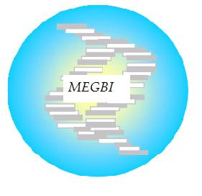
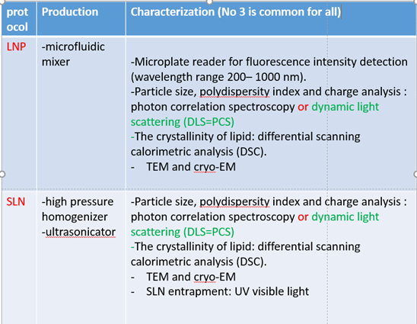
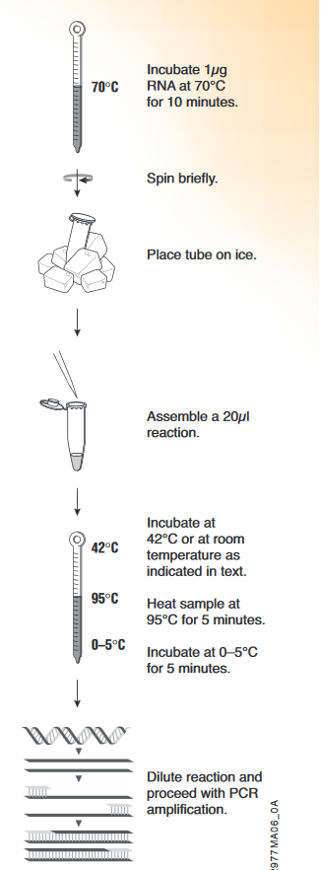
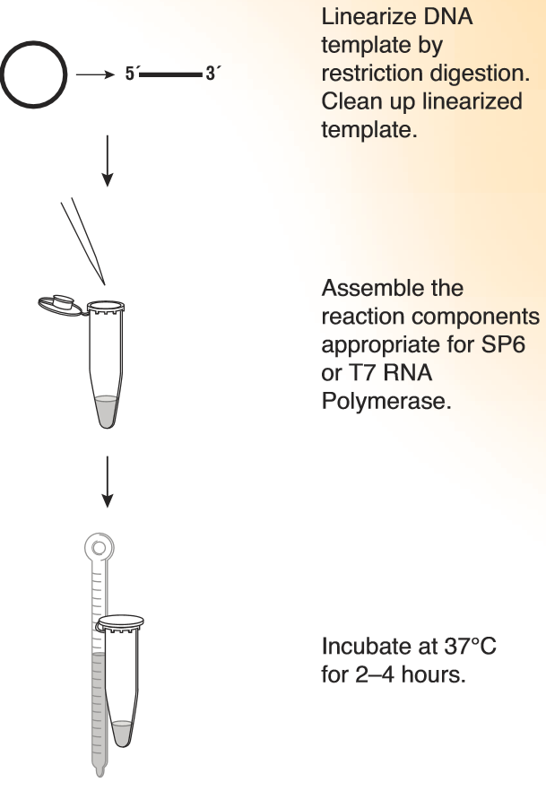
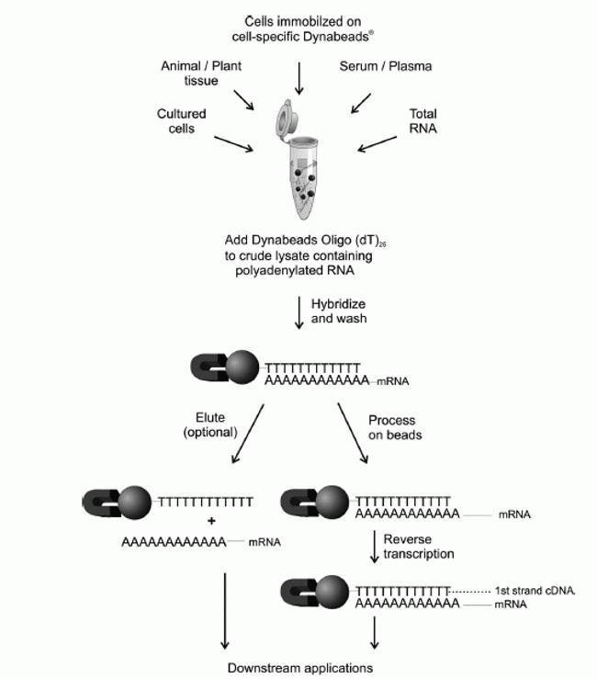
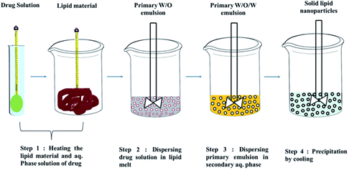
SOLID LIPID NANOPARTICLE (SLN) RNA VACCINE PRODUCTION (LAB SCALE)
Protocol
Overview As the world continues to fight the COVID-19 pandemic and prepare for the global distribution of vaccines. The global need for vaccine and the wide geographic diversity of the pandemic require more than one effective vaccine approach. the mRNA vaccine has become deservedly popular as the technology to ensure stable mRNA developed, along with superior delivery methods to get the vaccine into the host cell. In this study we have chosen SLN which are nanoparticles composed of lipids as mRNA delivery vehicles.
Available protocols for RNA vaccine production:
SLN method
  1. Reverse Transcription Reaction (First-Strand cDNA Synthesis)
2. Transcription protocol
3. RNA purification
is a laboratory technique combining reverse transcription of RNA into DNA (in this context called complementary DNA or cDNA)
This will lead for more RNA copies
Total RNA purification involves the extraction and purification of total RNA from your sample
>
Materials
Compritol ATO 888 is a mixture of approximately15% mono-, 50% di-, and 35% triglycerides of behenic acid(C22). The melting point lies between 69 and 74°C. from Gattefosse ́ (D-Weil am Rhein, Germany).
PluronicF68 and the cationic surfactant from Sigma-Aldric
dimethyldioctadecylammoniumbromide (DDAB) were purchased from Sigma-Aldric
4. SLN formulation (emulsion method)
Preparation of Solid-Lipid Nanoparticles.
The SLN were prepared from a warm oil-in-water (o/w) microemulsion by using Compritol ATO 888 and DDAB as the lipid matrix.Briefly,
0.273 mmol of Compritol were heated to 10°C abovei ts melting point and mixed with 2.5 mL of a hot aqueous solution of Pluronic F68 (0.158 mmol) and DDAB (1.45 mmol)to form a clear microemulsion, under mechanical stirring. Then,cationic nanoparticles were obtained by dispersing under mechanical stirring at 1000 rpm the warm o/w microemulsionin cold water (2-3°C) (organic/aqueous volume ratio equal to1:10). The obtained cationic nanoparticles were purified by dialysis using a Visking Tubing Dialysis 18/32′′(with amolecular weight cutoff of 12 000-14 000 Da). Then, cationic nanoparticles were freeze-dried using a Modulo freeze-dryer(Labconco Corporation, Missouri). To label SLN, fluoresceinfree acid was added to the lipid phase during preparation of the microemulsion.
Amin Etro @MEGBI/AECENAR Dec 2020

