Slide 1



MEGBI/ASPIRIN
Laboratory-Pilot plant

Slide 2


ASPIRIN / lab part
Our Aspirin that’s produced in laboratory has a small amount of impurities (most probably : salicylic acid)
Solution : Get a better quality of the reactive : (salicylic acid/acetic anhydride)
According to the melting point tester:
Commercial aspirin : 134-136 °C
MEGBI aspirin : 127-129 °C
Timeline : depend if we found a good quality of SA or acetic anhydride (till now no one has it in stock).
News: we the salicylic acid has arrived and we will see the best protocol to use it.
7-10days !

Slide 3
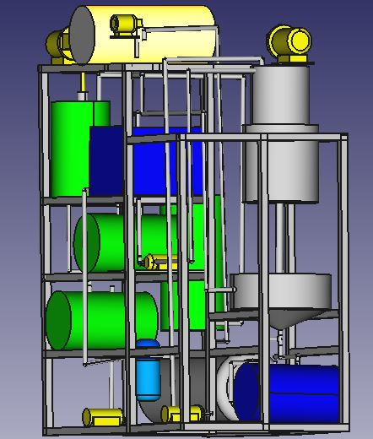
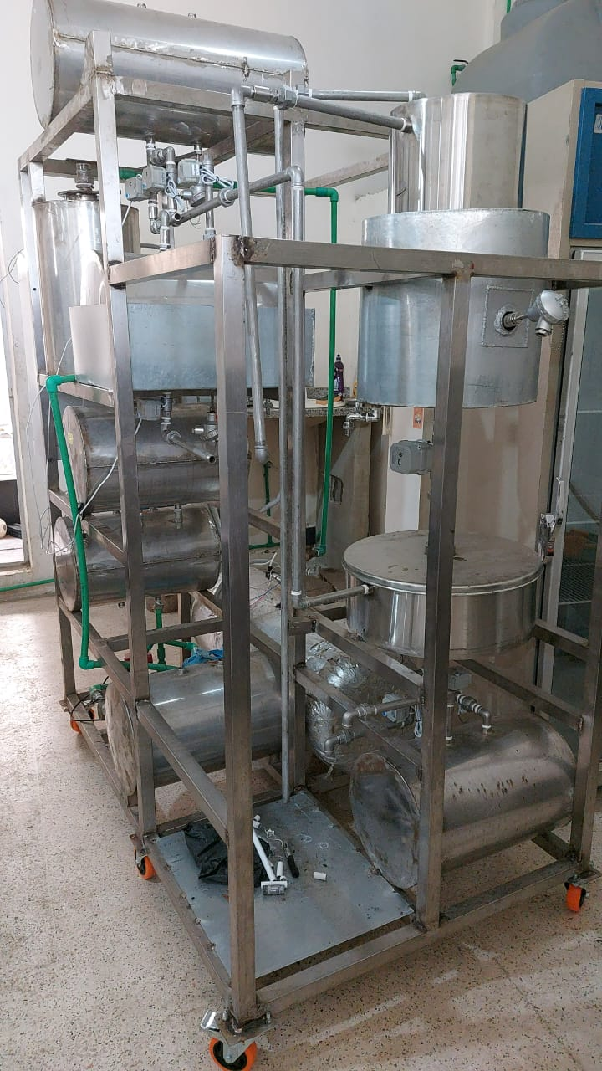
ASPIRIN / Pilot plant part
Missing parts :
1- the reactor (small tank with heating/cooling system)- tank for ethanol ?
2- pumps (2 pumps and 1 vacuum pump) – PS : ready to be installed
Timeline:
7-10 days

Slide 4
Pilot Plant Scale Aspirin Production
Reagent | Quantity per cycle | Quantity ordered | Price | Reference
Salicylic acid | 1.013 Kg | 2 Kg | 101.64$ | Biosynth | Alternatively | 5 Kg | 241.4$ | Biosynth
Acetic anhydride | 2.5 L | 5 L | 238.87$ | VWR
Sulfuric acid (we have 440ml) | 30-40 ml | - | - | -
Ethanol 50-70% | 1L | 5L | 1L = 6$ 5L= 30$ | Wissam ghieyh
Total |  |  | 370.51$ Per cycle : 200.2$

