Slide 1



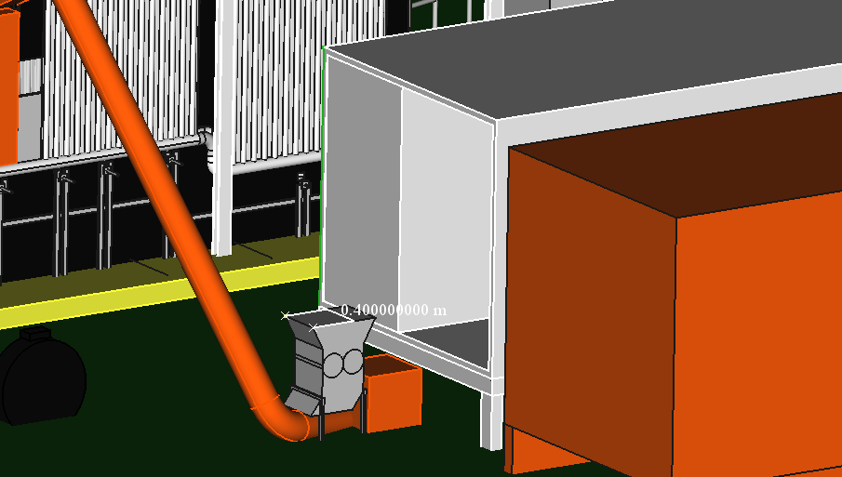
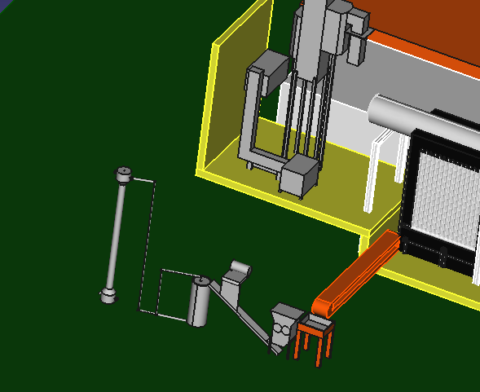
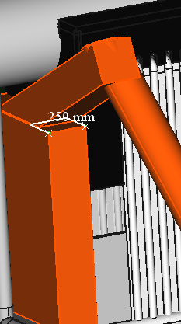

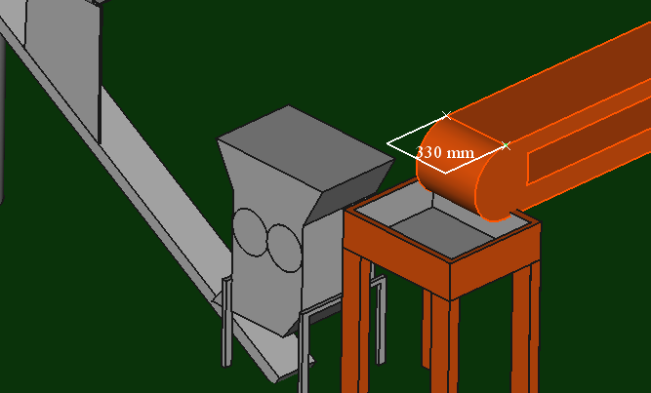
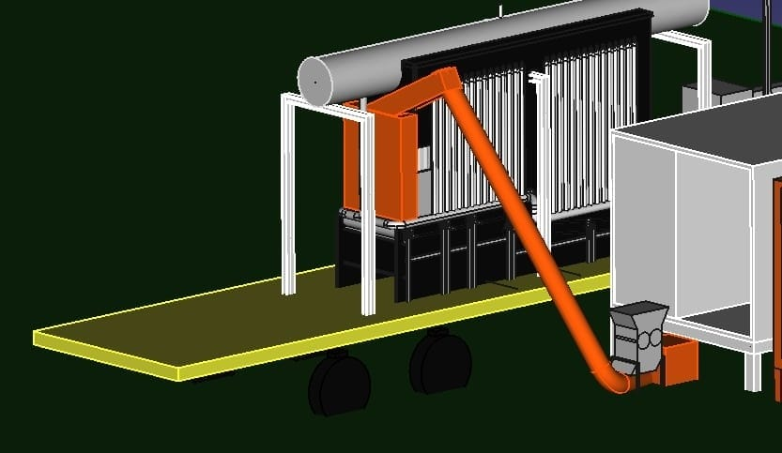
Demonstration Plant NLAP-WEDC at Masjid AS-SALAM in Tripoli-Lebanon
Municipal waste Inlet
Bottom ashes Outlet
Containers
25 cm
40 cm
Magnetic seperator
Blower
Bottom ashes
conveyor
2.42 m
Ashes recycling
Shredder
33 cm
container
Jana Ghemrawi,Rouba Ghemrawi @AECENAR December 2021

