Slide 1
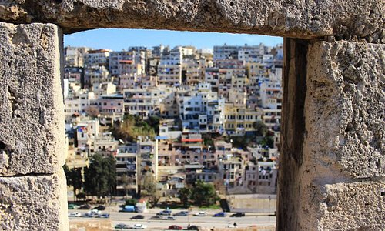
TRIPOLI

Slide 2
Tripoli
Case of study
Municipality | Caza | Population | GENERATION | Project started | Coordinates
Al Fayhaa | North Lebanon | 850000 | 315 ton/jour | ########

Slide 3
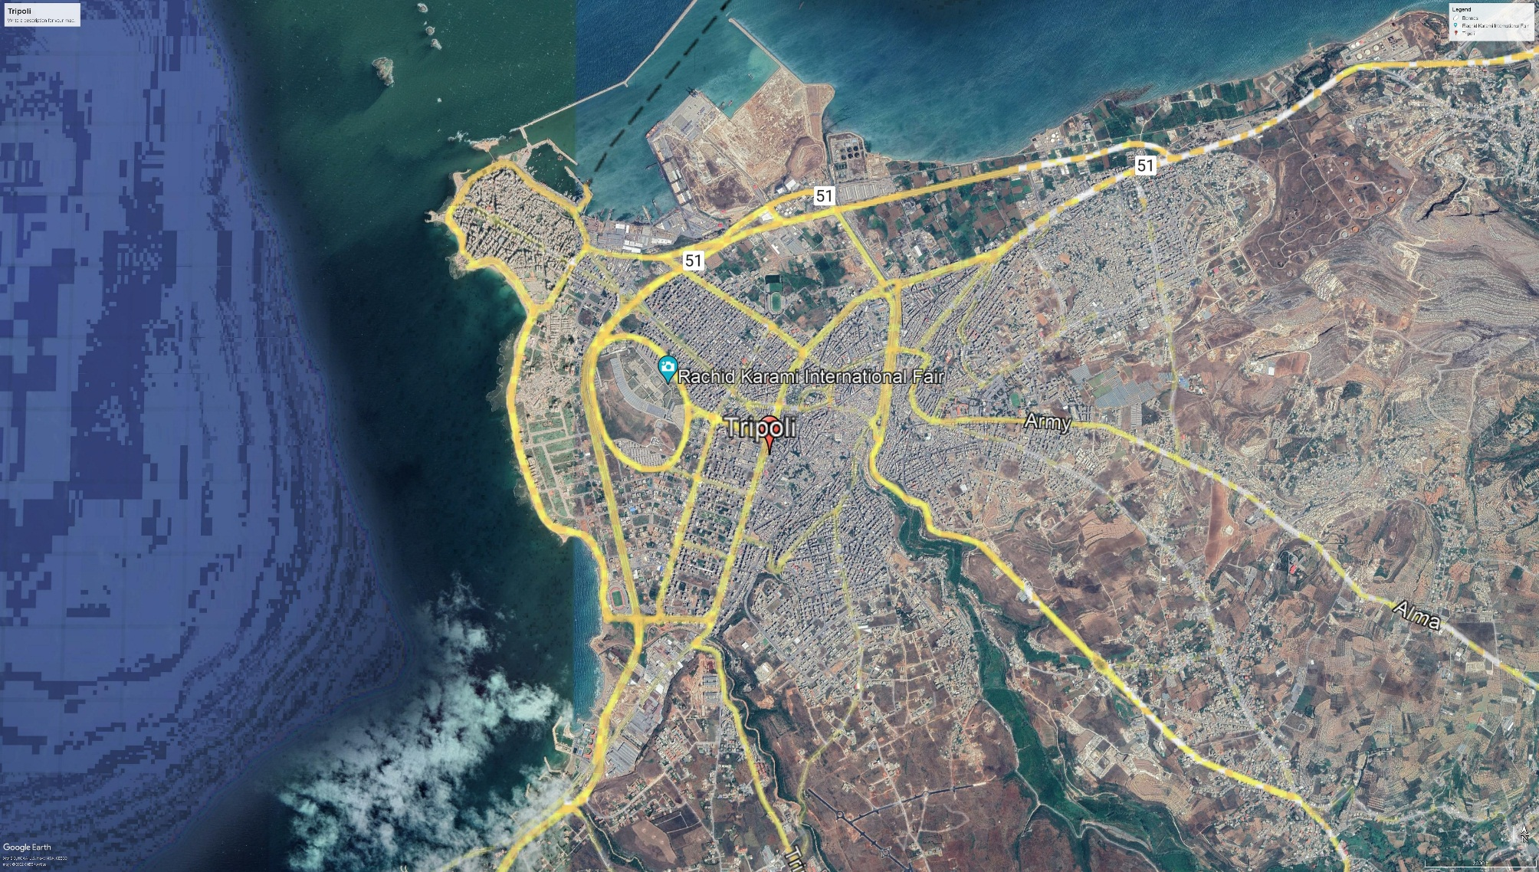
Area | 33km3
Population | 850000
Density/Km | 7086
SW Tripoli | 63%
SW generation/capi/pers | 0.95kg/pers/day

Slide 4
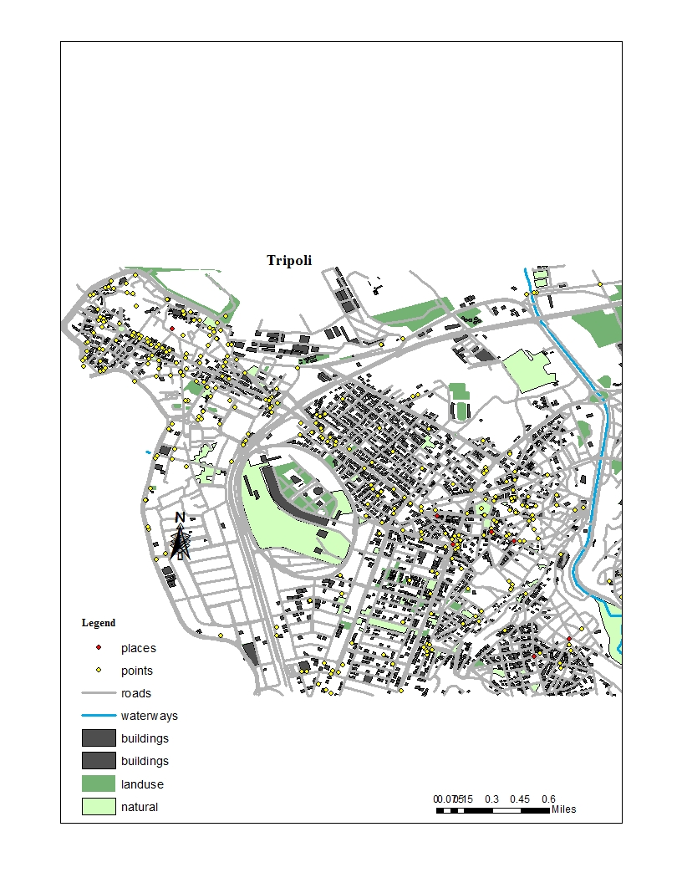

Slide 5
Composition of Waste disposed

Slide 6
Composition of Waste disposed

Slide 7
Daily average

Slide 8
Obstacles facing Waste Management in Tripoli:
The economic crisis facing Lebanon is the principal obstacle in the consequences:
The inability of these companies to their work due to financial difficulties (personnel, transportation
And maintenance costs).
Waste piled up in containers.
Increase insects and animals near containers.
This threatens environmental and health risks.

Slide 9
Road map
Suggested Road map for AECENAR:
1
Home level
2
Warehouse for sorting
4
Incinerator power plant
3
Electricity
Recycling factory

Slide 10
Waste management scenario
Step1: Home level cost
Wide range :2 ton/day
1
Home level
Raw materials
2 tonnes
1 big truck
Fuel
In collaboration with Lavajet company
615$/month
580 L.L/Day
1 million/month/ pers
A discuter####
Cleaners

Slide 11
Waste management scenario
Step 2: Warehouse for sorting
2
Raw materials
Cost rent Warehouse
700$/month
Sorting workers
A discuter####
Security guard
100$/Month
Recycling factory

Slide 12
Waste management scenario
Step 4: Incineration
Raw materials
Transportation cost
Security guard
100$/Month
4
Truck
Electricity

Slide 13
Random waste disposal
Road map
1
Suggested Road map for AECENAR:
3
2
Transporting
5
Electricity
4

Slide 14
Random waste disposal
Road map
Suggested Road map for AECENAR:
2
Transporting
Cost/day
1
Collecting
Collect waste
2 workers
Suggestion: Putting waste containers in these sites
Fuel
Truck rent
Driver

Slide 15
Random waste disposal
Road map
Suggested Road map for AECENAR:
3
Recycling
Cost/month
Warehouse rent
700$
Recycling workers
4
100$
Security guard

