Slide 1
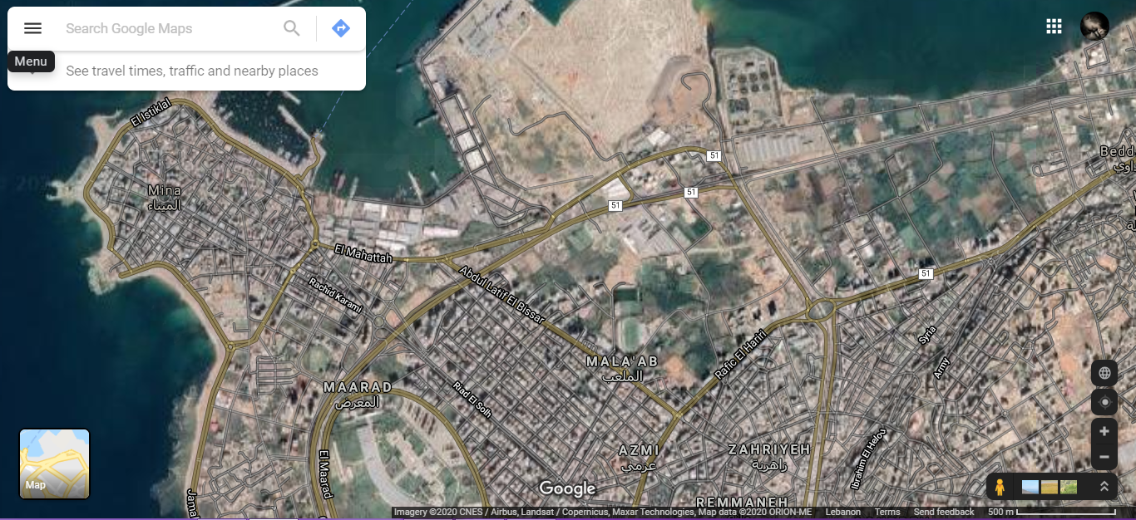
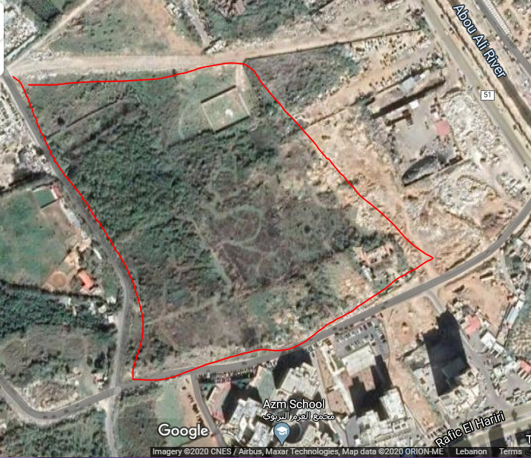
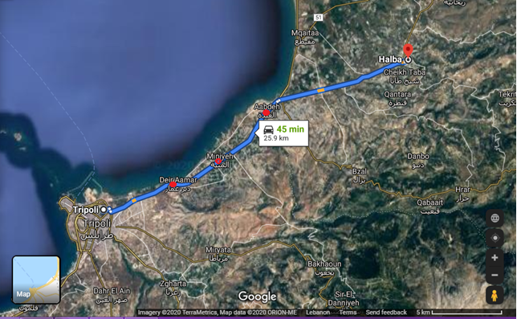
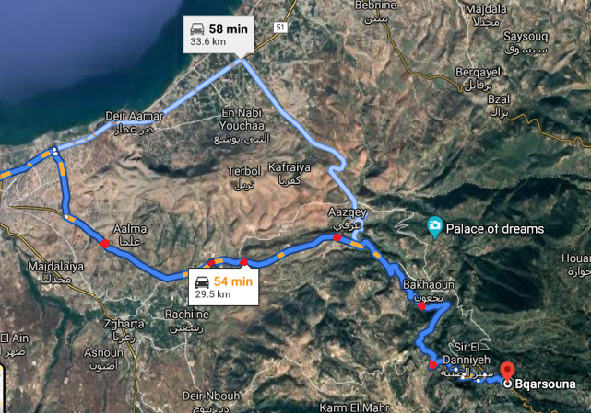
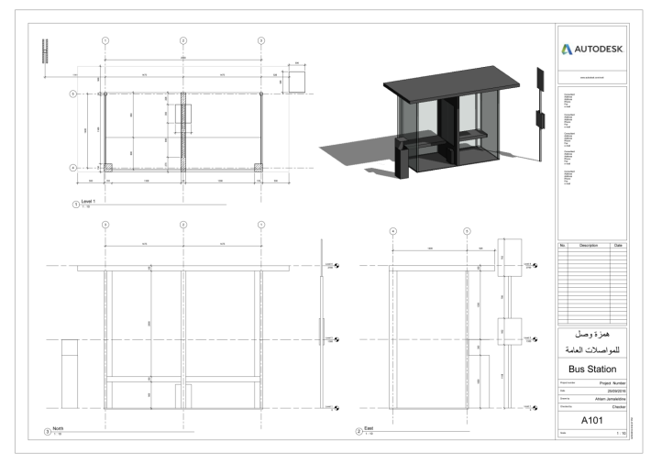
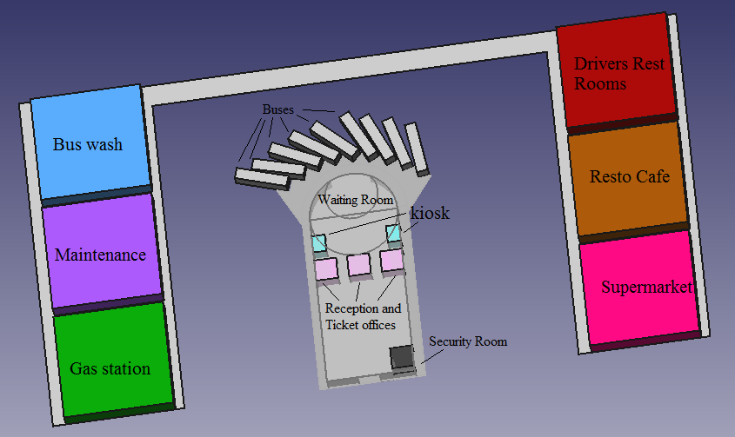
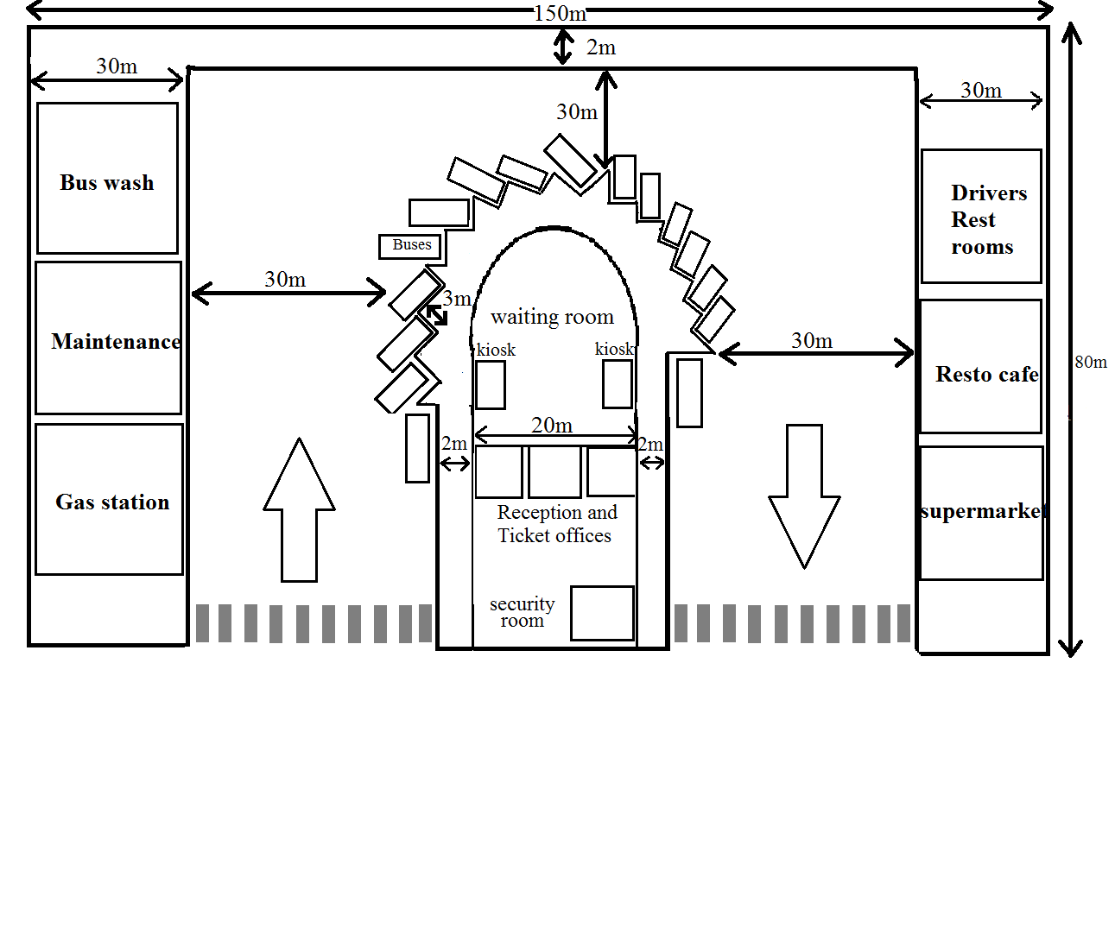
North Lebanon Bus Station
Location
Description
Our bus station will be placed in the center of Tripoli. It will have 2 main line, one to Halba Akkar and the other one to Bqarsouna Danniyeh. The station will use the existing buses with good conditions and buy new ones if needed. The employees will collect the position of each bus using GPS every 5 min so the passengers will be able to contact the reception all day and get the location of the closest bus to them. The station is designed to contain all the facilities needed for the buses from gas, maintenance and washing services. It will also have a resto-café and a supermarket for the passenger’s needs. Our bus station will be able to host external buses coming from Syria since it will have drivers rest rooms. Every half hour a bus will leave the station.
Bus lines and Bus stop locations
To Halba Akkar
To Bqarsouna Danniyeh
Bus Stop Design
Bus Station FreeCAD Design
Bus Station Design
 | Number Needed | Costs
Employees for Reception and ticket offices | 3 | 2,700$/month
Security men | 2 | 1800$/month
Persons for the Cleaning | 2 | 1,800$/month
Drivers | 9 | 8,100$/month
Persons for the Kiosks | 2 | 1,800$/month
Buses | 9 | 720,000$ (80,000$/bus)
Building | 1 | 15,000$
Total |  | 751,200$
Maryam Abdel-karim
@AECENAR /2020

