Slide 1
Modeling the Fusion Reaction in an Inertial Electrostatic Confinement Reactor with the Particle-in-Cell Method
Presented by: Maryam Abdel-Karim

Slide 2
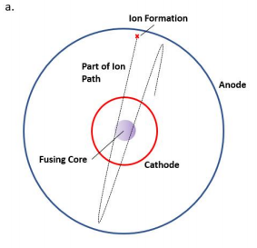
Inertial Electrostatic Confinement Fusion
IECF does not rely on any magnetic field, uses an electric field to perform the plasma confinement.
Two spherical metal meshes concentrically.
Large voltage across them, typically 10 to 100 kV in vacuum.
Fusion fuel is deuterium.
The large voltage ionizes a portion of the gas.
Positively charged ions are accelerated by the electric field toward the center of the device, where most will pass straight through the cathode at the center and out the other side. The electric field slows the ions and eventually turns them back towards the center, setting up a recirculation.
The ion density in the center increases, and eventually fusion occurs.

Slide 3
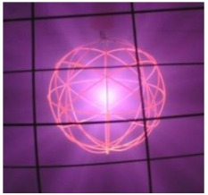
It does not require nearly as large a machine as the tokamak: typical IEC devices comfortably sit on tabletops.
In this work, a hypothetical IEC device is proposed that could demonstrate fusion occurring, and a working computational model of the device’s performance is created.
A photo of an IEC device in operation at the University of Wisconsin-Madison [3]. The cathode grid glows orange from heat, while the anode (foreground) does not.
A photo of an IEC device in operation at the University of Wisconsin-Madison [3]. The cathode grid glows orange from heat, while the anode (foreground) does not.

Slide 4
Application of Inertial Electrostatic Confinement
IEC fusion is not yet seen as a viable source for fusion electric power reactors.
Application 1:
Neutron activation analysis
Materials are characterized to determine what elements make up the material sample.
Accomplished by bombarding a material sample with neutrons and observing the type of radiation that is emitted from the material.
An IEC device can produce a large amount of neutron radiation on demand and can be shut off simply by cutting power
Application 2:
Space propulsion concept.
Argon fuel is injected into an IEC device and guided out the back of the device to form plasma thrust.
Have a higher specific impulse than other well-established plasma thrusters such as the Hall thruster

Slide 5
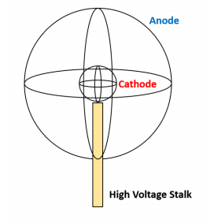
Construction Considerations
Large gaps in the spherical surface are formed between a relatively small amount of wire to prevent ion collisions with the wires.
A high voltage stalk, which is a cylindrical tube with wire running up the center. The stalk is typically made from ceramic to withstand the high temperature of the plasma and the ion bombardment the stalk will endure.
The vacuum chamber proposed for this study is made from aluminum and thus will interact with the electric field created by the grids.
A higher grid voltage is required to achieve a higher ion kinetic energy. Thus, increasing the grid voltage increases the fusion cross section and results in a higher D-D fusion reaction yield.

Slide 6
System Overview
Model consists of a cylindrical aluminum vacuum chamber, three ceramic stalks used to support the anode and cathode wire grids, the anode and cathode wire spheres, and electrical and vacuum systems.
The wall voltage is stepped up to 20 kV DC and is applied to the cathode grid (the smaller of the two wire spheres). The anode (the larger sphere) is grounded.
The vacuum chamber should be brought down to a steady state pressure of roughly 7 Pa.
The measurement of 2.45 MeV fusion neutrons should be carried out by a scintillation neutron detector surrounded by a Bonner sphere neutron moderator
a. Section cut view of vacuum chamber and IEC grid assembly with high voltage ceramic stalk support structure. Figure
b. Assembled vacuum chamber, IEC grid, and surrounding support structure.

Slide 7
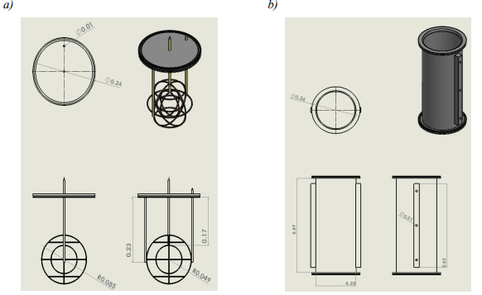
High voltage is supplied by the wall outlet and will be stepped up and converted to DC at a maximum of -30 kV. The current will be on the order of 10 mA.
Safety precautions to mitigate risk from the high voltage power supply to the central grid include a kill switch and fuse to cut power, and a standard operating procedure (SOP) regarding discharging the device.
The vacuum chamber is made from aluminum which is grounded during operation of the device.
The cathode grid for the proposed device was constructed out of tungsten 20-gauge wire.
The anode grid is built from stainless steel 20-gauge wire.
The fabrication process involves wrapping wire around Styrofoam balls of the correct radius in the desired geometry and spot-welded at intersections. The Styrofoam is then dissolved away using acetone, leaving the wire grid behind.
Engineering drawing for top flange and IEC anode and cathode wire meshes. Dimensions are in meters. The anode and cathode stalk lengths are shown, and the anode and cathode radii are also shown.
b. Engineering drawing for the vacuum chamber, in meters.

Slide 8
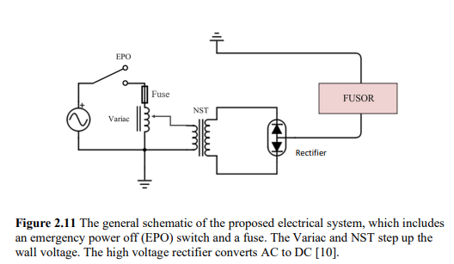

Slide 9
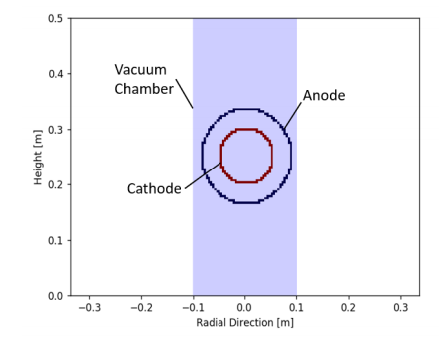
Computational Domain
The computational model of the IEC device replaces the physical wire grids with two circular equipotential of the same radii.
The potential of these circles is equal to the grid voltage.
The computational domain is two-dimensional.
assuming the anode and cathodes are closed circles, assigning a geometric transparency.
The stalk was ignored in this study.

Slide 10
Results

Slide 11
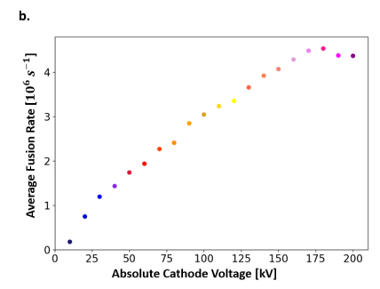

Slide 12
Code
Constants and Dimensions

Slide 13
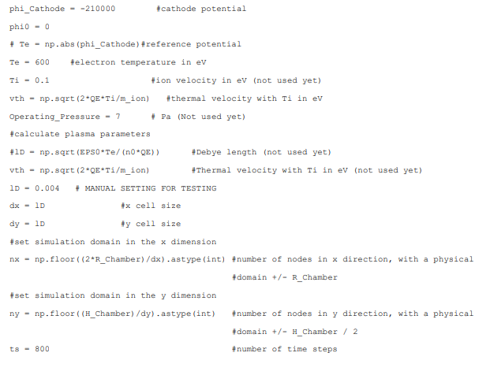
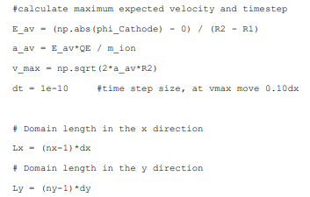

Slide 14
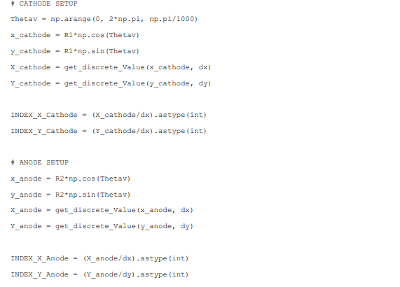
Grid Representation

Slide 16
Prepare to insert Particles

Slide 17
Potential solver function

Slide 18
Ion Source function

Slide 19
Fusion Cross Section

Slide 20
Initializing

Slide 21
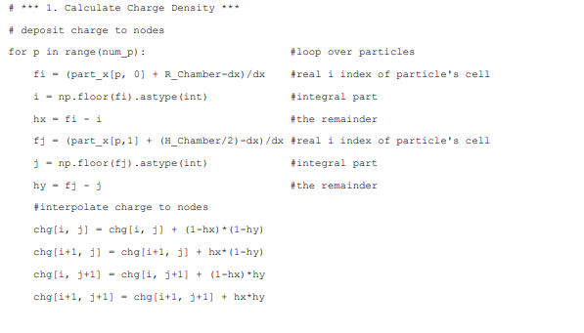
Loop over time steps
Calculate Charge Density

Slide 22
Calculate Potential
Calculate Electric Field

Slide 23
Generate new Particles

Slide 24
Moving Particles

Slide 25
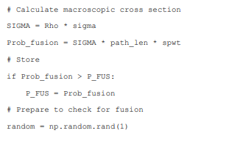

Slide 26
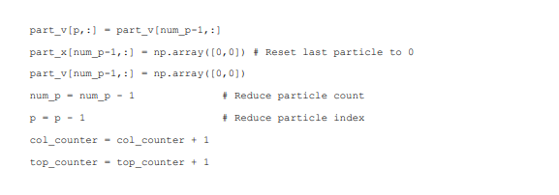
Boundaries

Slide 27
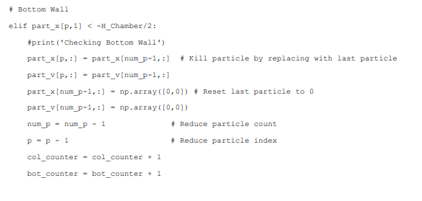

Slide 28
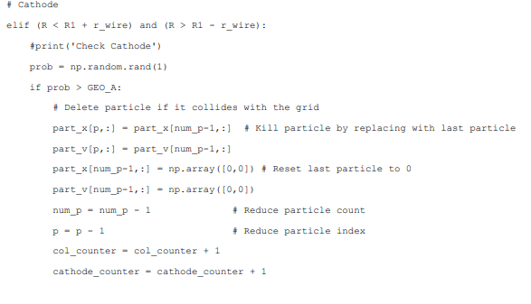
Grids

Slide 29
Check fusion

Slide 31
Reference
Modeling the Fusion Reaction in an Inertial Electrostatic Confinement Reactor with the Particle-in-Cell Method by Jacob van de Lindt. (Presented May 29, 2020 Commencement June 2021)

