Slide 1



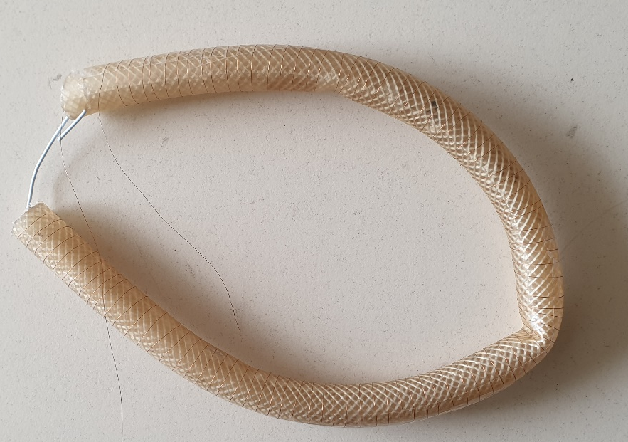
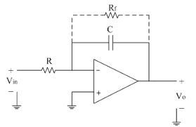


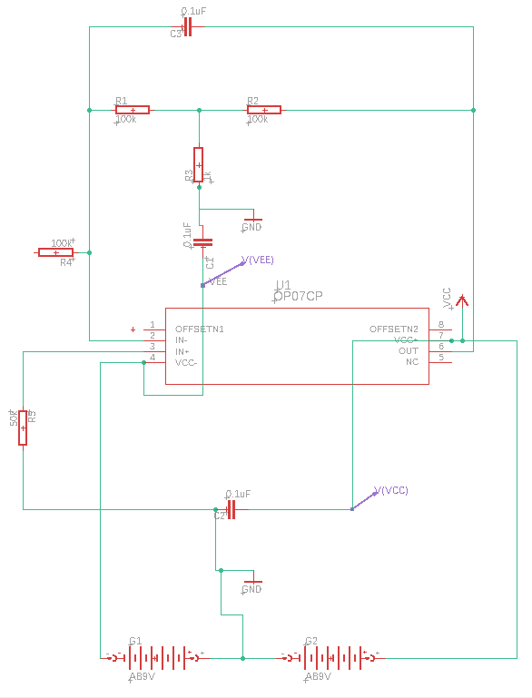
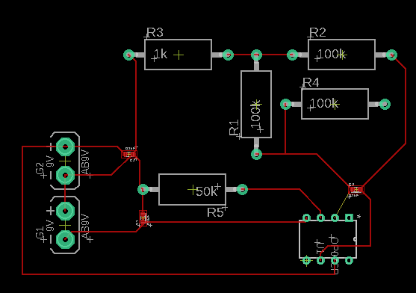
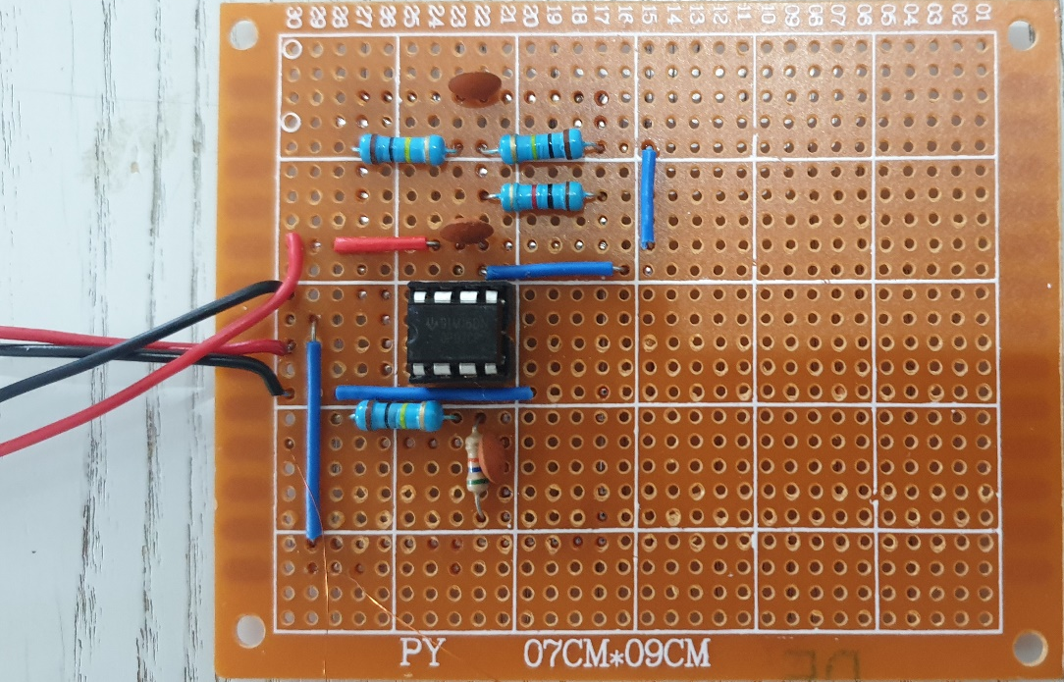
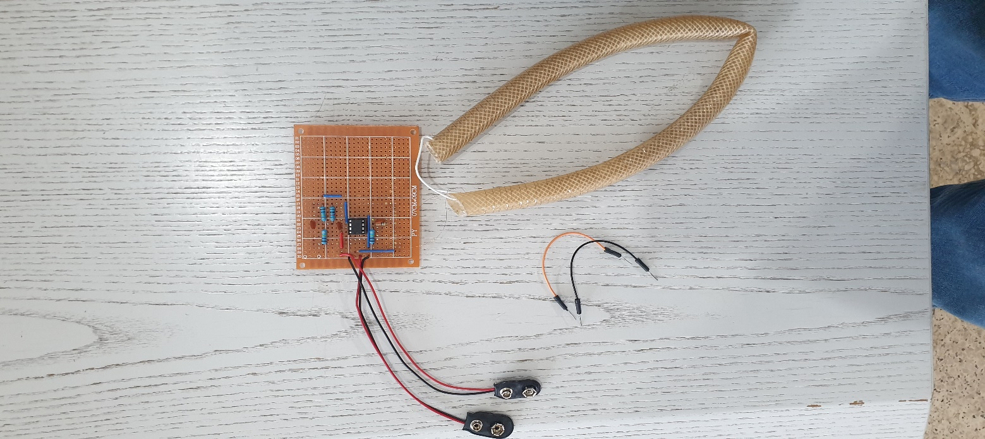
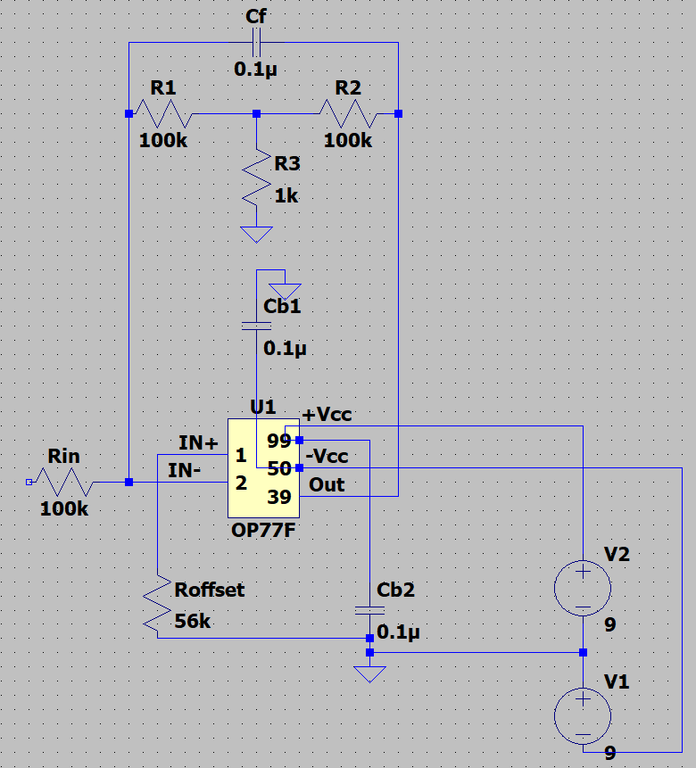
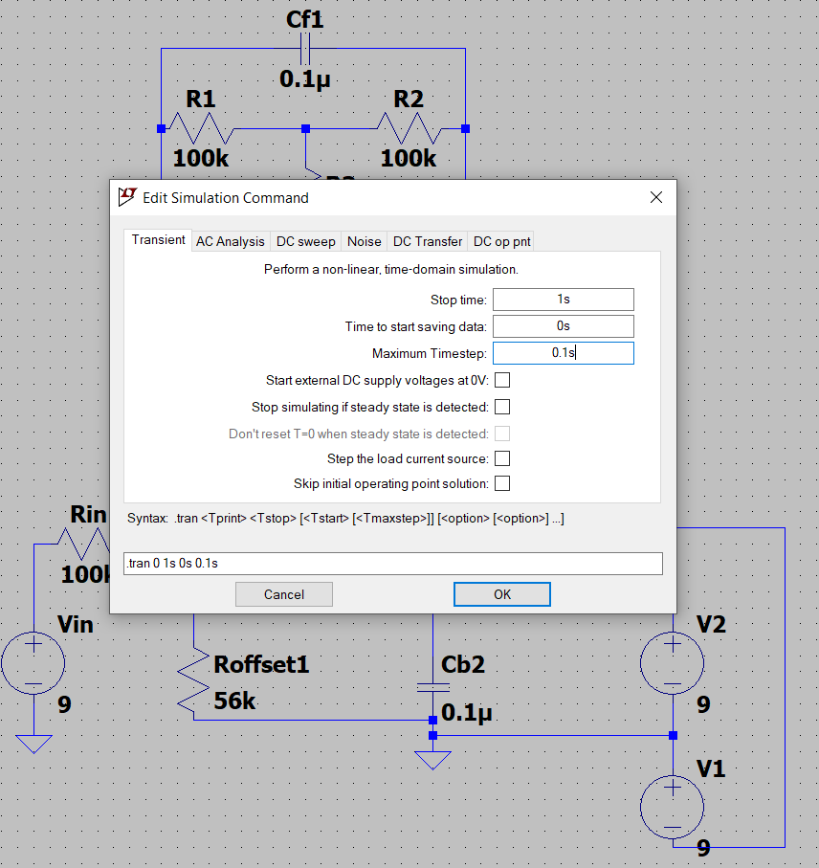
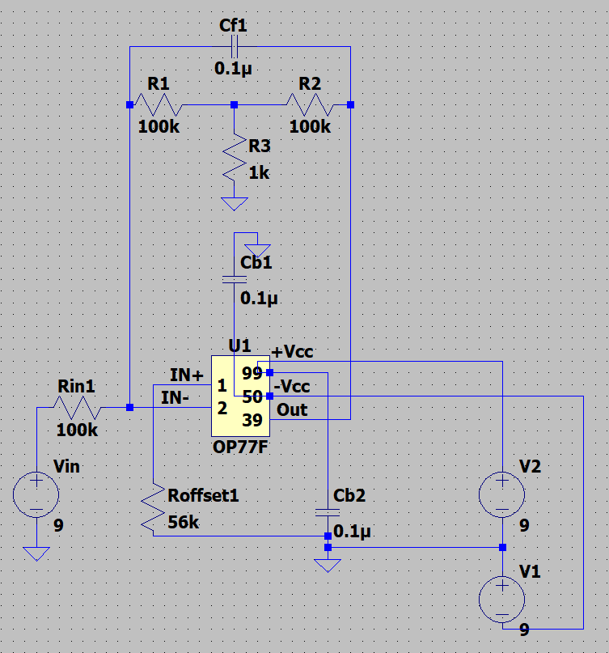
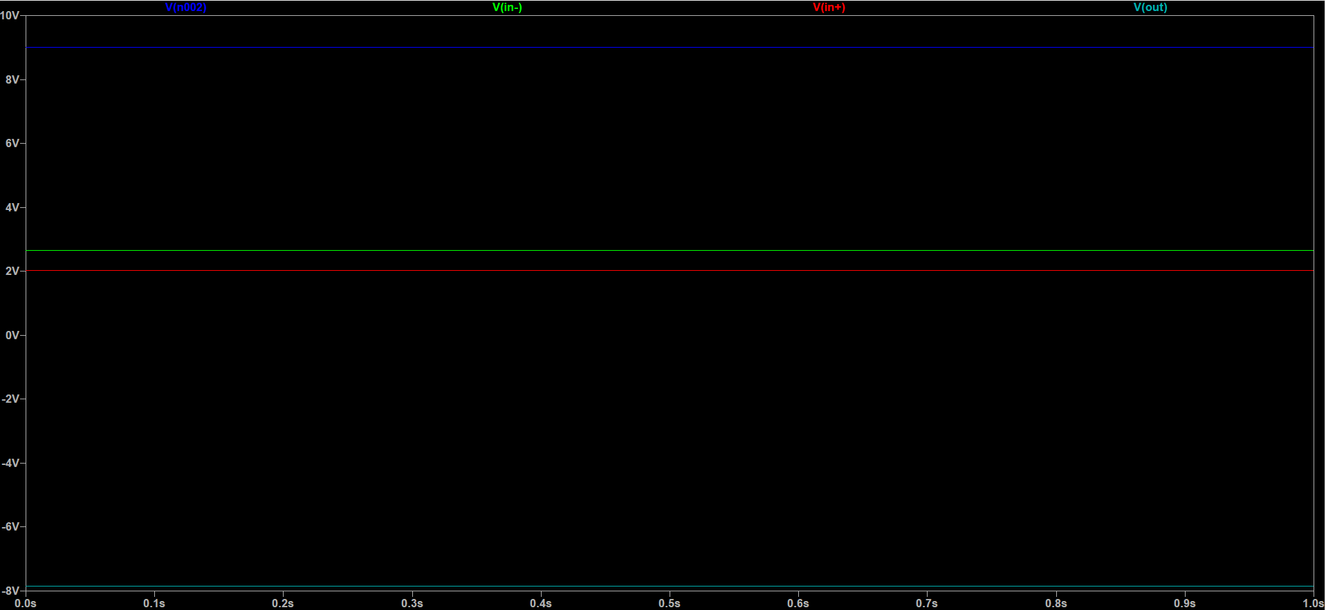

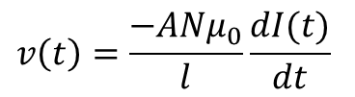
Theory
Rogowski Coil
Electro filter test and improvement
Approach, Design and construction
Rogowski Coil:
The Rogowski coil is defined as an electrical device that is used to measure alternating current (AC).
A Rogowski coil is an evenly wounded coil with N number of turn and constant cross-section area A.
There is no metal core in a Rogowski coil.
The end terminal of the coil is returned through the central axis of the coil to another end.
Rogowski coils work on the principle of faraday’s law.
When current passes through the conductor, it will create a magnetic field.
Due to an intersection with a magnetic field, a voltage is induced between the terminals of the Rogowski coil.
The output of Rogowski coils is connected with the integrator circuit.
Design experiment of Rogowski Coil in Lab
Rogowski Coil without integrator
The voltage produced by a Rogowski coil is:
$$v\left(t\right)=\frac{−ANμ_{0}}{l}\frac{dI(t)}{dt}$$
Design and construction of Active Integrator
The constructed active integrator with DC gain control
Active integrator
Schematic, Board using Eagle CAD
Construction of Rogowski Coil in Lab
This integrator was selected ten times more than the time duration of the signal.
By connecting the output of Rogowski coil to the inverting input terminal of operational amplifiers, the input and output differ in phase and the role of this integrator is shown in equation:
$$G\left(s\right)=−R_{ftot }/{ R}_{in}(1+R_{ftot}C_{c}s)$$
Operational amplifier OP07CP has ultralow drift and high accuracy to form in-phase amplifier circuit .
Using the schematic on Eagle CAD, we build the active integrator which is connected to the coil.
This is how we build the Rogowski Coil.
All that remains is to mount the oscilloscope wires.
Simulation using LTspice
Schematic
The operational amplifier OP07CP is the same as OP07C.
The OP77 is the next generation of the OP07.
By comparing the outputs of the two operational amplifiers, we demonstrate that we can use the OP77F instead of OP07CP in the simulation.
Simulation: DC operating point
Add an input voltage to the schematic
Results
louayindakji@gmail.com / AECENAR 2021

