Slide 1



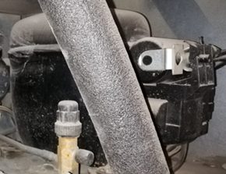
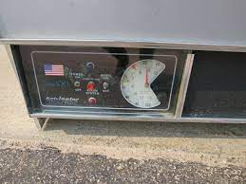
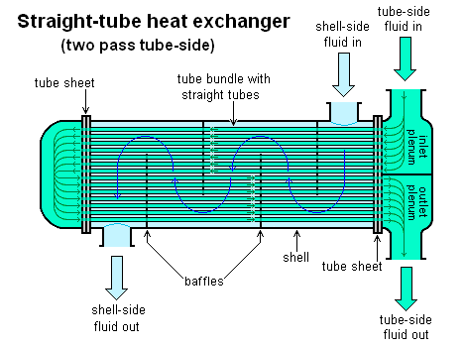
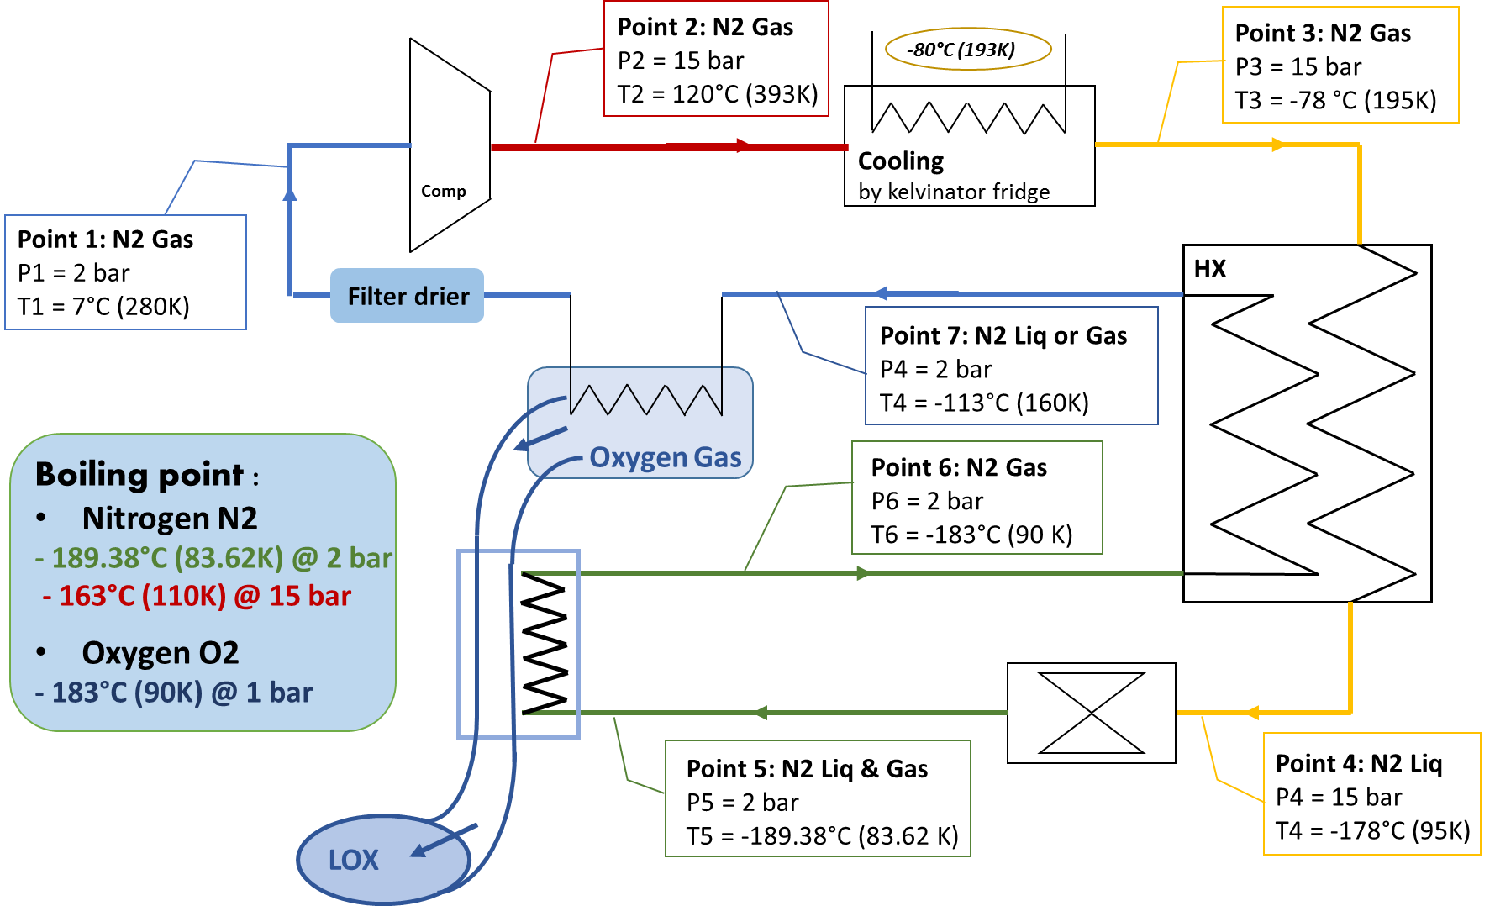
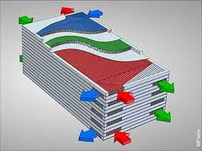
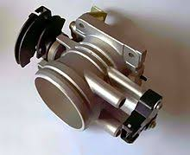
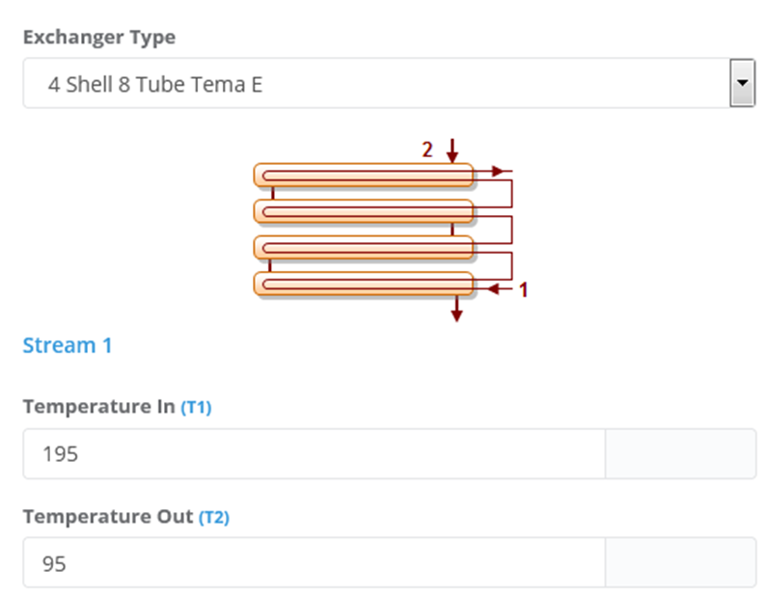
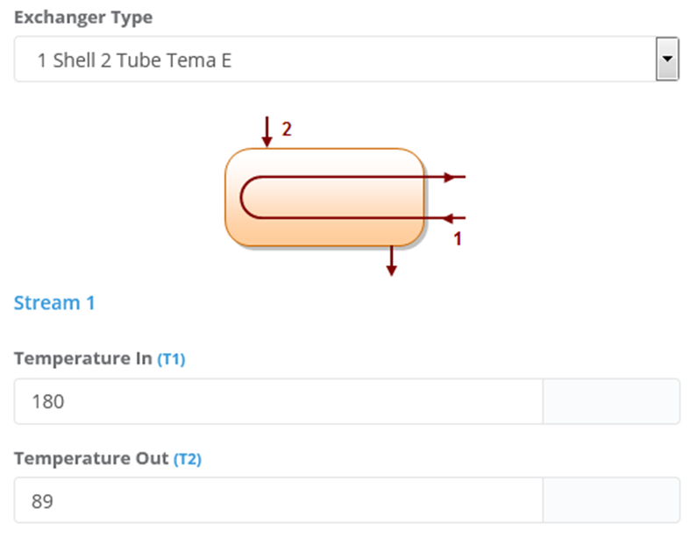
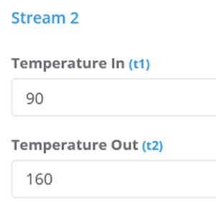
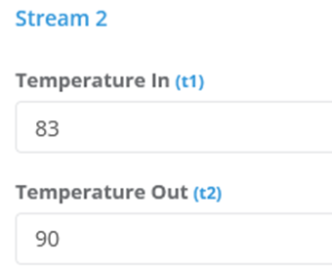
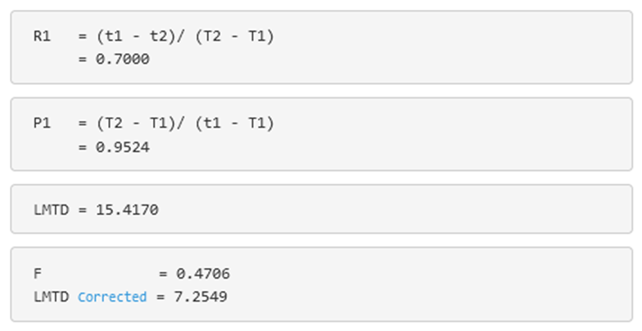
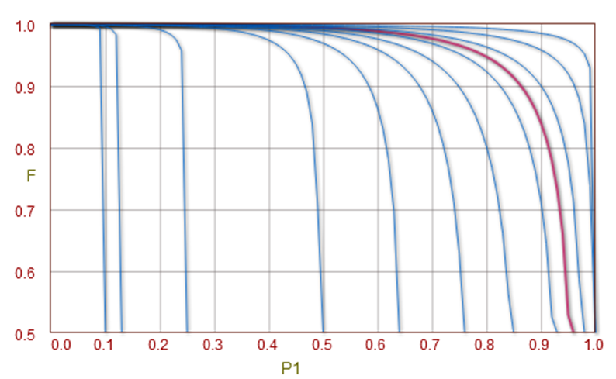
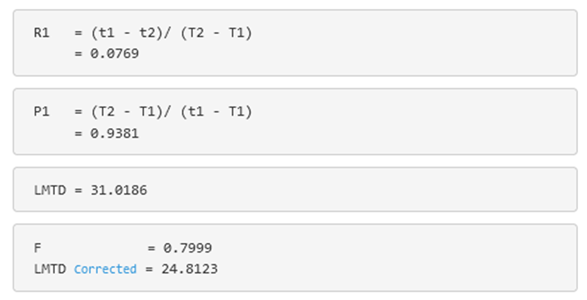
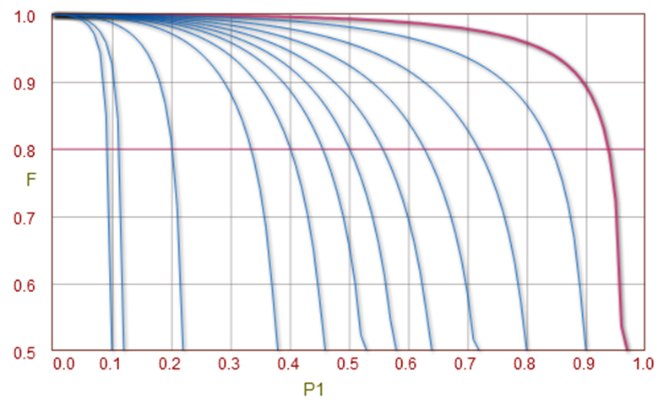
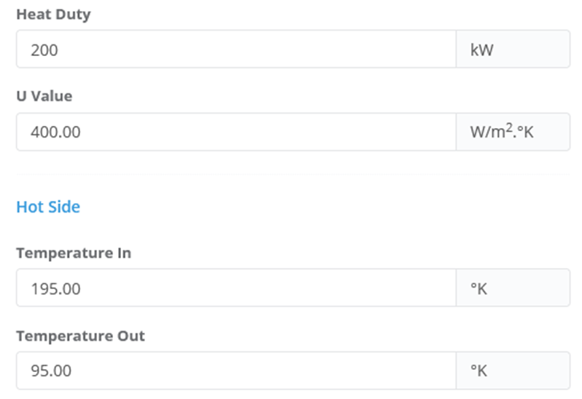
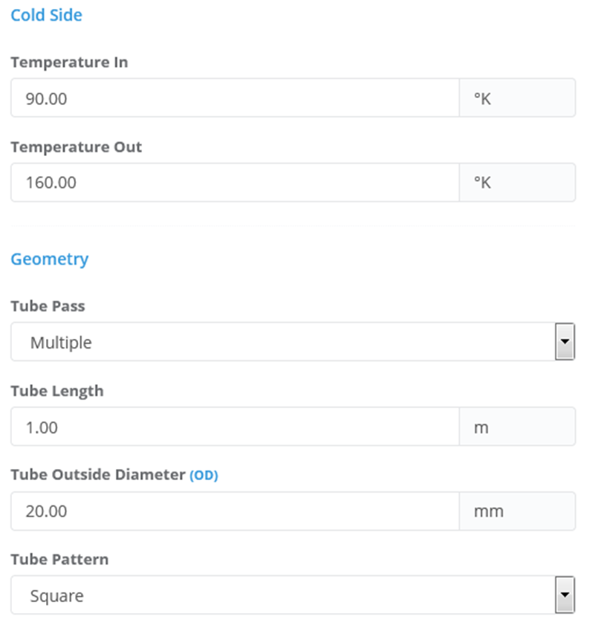
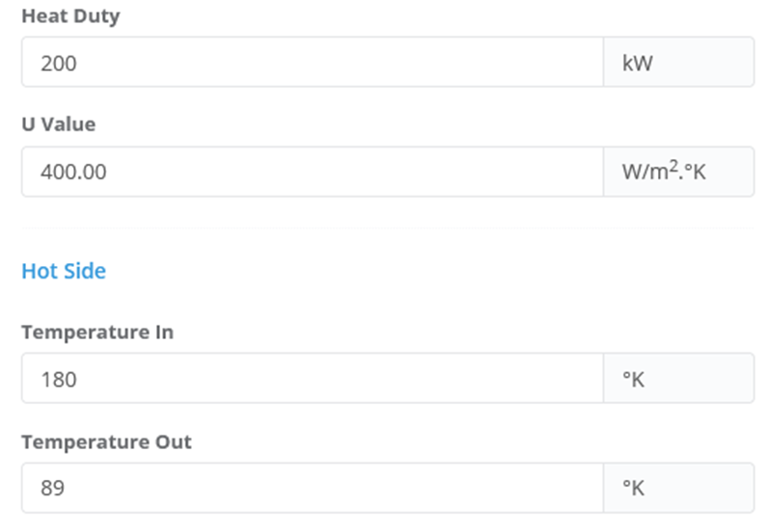
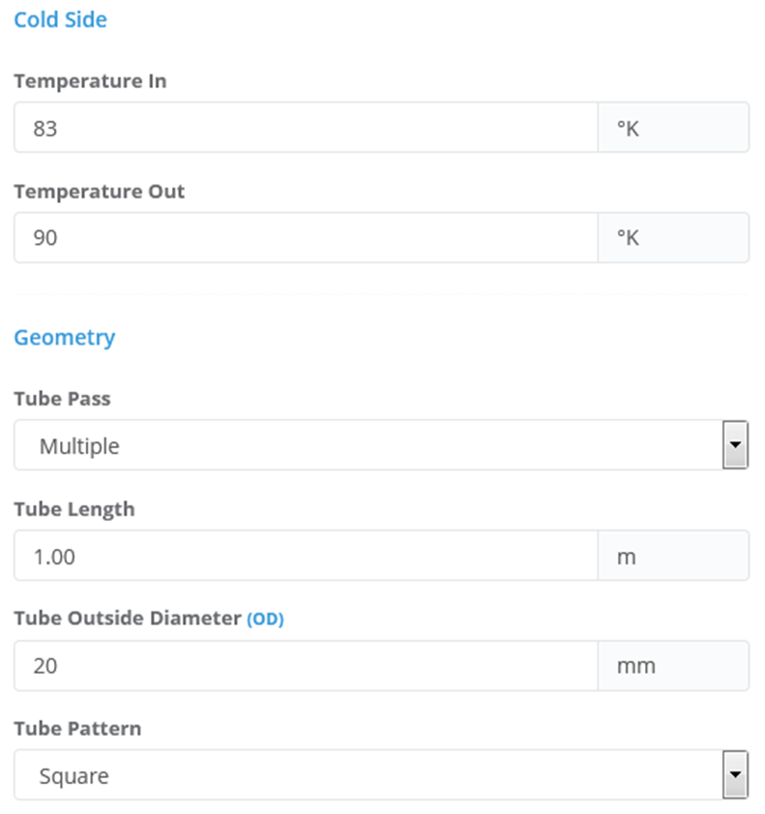
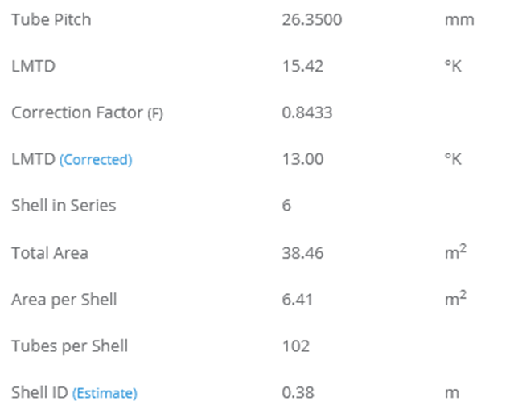
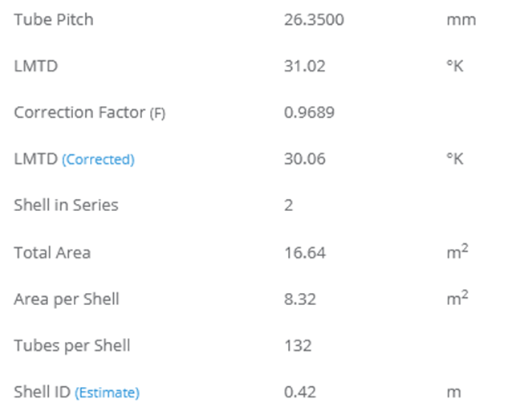
Prototype of Oxygen liquefaction
LR25B Laboratory refrigerator
Compress about 2 to 15 bar
Suction line 5/16” (0.79375 cm)
Discharge line ¼” (0,635 cm)
Plate heat exchanger
T(O2 gas)= -93˚C (180 K)
T(O2 liq)= -184˚C (89K)
Gas flow rate of compressor : 25 Kg/hr = 6.9 g/s in condition of:
Condensing temperature: 55˚C
Evaporating temperature: 7˚C
  Prototype Heat exchanger (HX - N₂/N₂)
  Prototype Heat exchanger (HX - N₂/O₂)
LMTD Correction Factor Charts
Calculates Logarithmic Mean Temperature Difference (LMTD) Correction factor for different configuration of exchangers.
LMTD Correction Factor Charts
Calculates Logarithmic Mean Temperature Difference (LMTD) Correction factor for different configuration of exchangers.
- Data:
- Data:
- Result:
- Result:
Shortcut Heat Exchanger Sizing
Estimates LMTD (Log Mean Temperature Difference), Exchanger surface area, number of tubes, shell diameter and number of shell in series.
- Data:
Shortcut Heat Exchanger Sizing
Estimates LMTD (Log Mean Temperature Difference), Exchanger surface area, number of tubes, shell diameter and number of shell in series.
- Data:
- Result:
- Result:
Maryam EL-REZ @AECENAR/May 2021

