Slide 1
Oxygen liquefaction

Slide 2
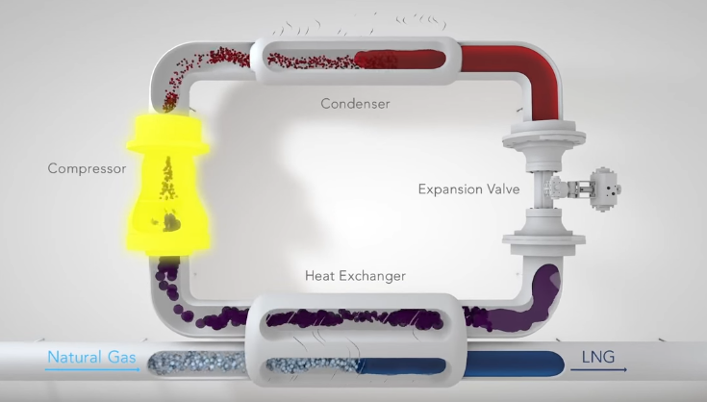
Oxygen Gas
LOX

Slide 3
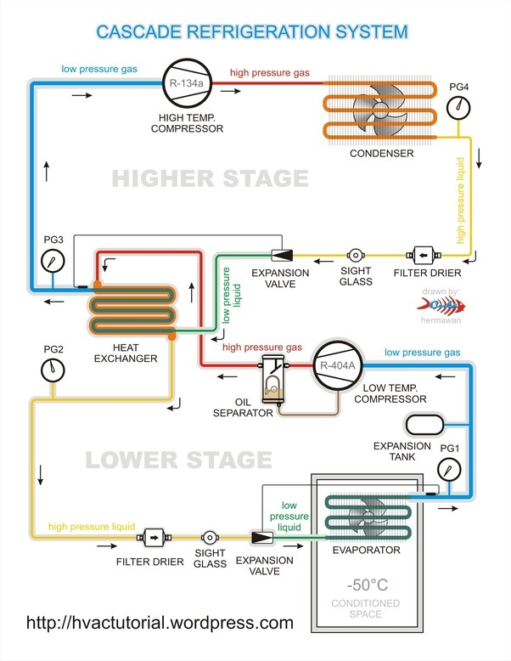
Point 4: Gas
P4= 1 bar
T4= -16°C (> -20 °C)
R-502
Point 1: Gas
P1= 25.85 bar
T1= 90°C (>60 °C)
R-502 (Higher stage)
Chemical formula: C₃HCl₂F₇
Boiling point:
- 45.5°C @ 1 bar
+ 61.5 °C @ 25.85 bar (375 psi)
R-503 (Lower stage)
Chemical formula: CC1F3,CHF3
Boiling point:
- 87.5°C @ 1 bar
- 20°C @ 25.85 bar (375 psi)
Point 2: Liq
P2= 25.85 bar
T2= 50°C (<60 °C)
Point 3: Liq or Gas
P3= 1 bar
T3= - 50°C (< - 45.5 °C)
R-503
Point A: Gas
PA= 25.85 bar
TA= 10°C (> -20 °C)
Point B: Liq
PB= 25.85 bar
TB= -30 (< -20 °C)
Point D: Gas
PD= 1 bar
TD= - 83°C (> -87.50 °C)
Point C: Liq or Gas
PC= 1 bar
TC= - 90.5°C (< -87.5°C)
- 80°C

Slide 4
Liquefaction of oxygen Prototype cycle
Point 2: N2 Gas
P2 = 10 bar
T2 =
Point 3: N2 Gas
P3 = 10 bar
T3 = -78 °C (195K)
-80°C (193K)
Cooling
by kelvinator fridge
Comp
Point 1: N2 Gas
P1 = 1 bar
T1 = -165°C (108K)
HX
Filter drier
Oxygen Gas
Point 6: N2 Gas
P6 = 1 bar
T6 = -183°C (90 K)
Boiling point :
Nitrogen N2
- 195.8°C (77.2K)@ 1 bar
- 169.3°C (103.7K) @ 10 bar
Oxygen O2
- 183°C (90K) @ 1 bar
Point 5: N2 Gas
P5 = 1 bar
T5 = -186.33°C (86.67K)
[T5 < 90K]
Point 4: N2 Liq or Gas
P4 = 10 bar
T4 = -170°C (103K)
[T4 < 105 K]
LOX

Slide 5
Liquefaction of oxygen Prototype cycle
Point 2: N2 Gas
P2 = 15 bar
T2 = 120°C (393K)
Point 3: N2 Gas
P3 = 15 bar
T3 = -78 °C (195K)
-80°C (193K)
Cooling
by kelvinator fridge
Comp
Point 1: N2 Gas
P1 = 2 bar
T1 = 7°C (280K)
HX
Filter drier
Point 7: N2 Liq or Gas
P4 = 2 bar
T4 = -113°C (160K)
Boiling point :
Nitrogen N2
- 189.38°C (83.62K) @ 2 bar
- 163°C (110K) @ 15 bar
Oxygen O2
- 183°C (90K) @ 1 bar
Oxygen Gas
Point 6: N2 Gas
P6 = 2 bar
T6 = -183°C (90 K)
Point 5: N2 Liq & Gas
P5 = 2 bar
T5 = -189.38°C (83.62 K)
Point 4: N2 Liq
P4 = 15 bar
T4 = -178°C (95K)
LOX

Slide 6
Linde Oxygen Liquefaction Cycle
Point 1
ṁ = 2.75 Kg/sec
P = 1 bar
T = 290 K
H = 263.52 kJ/Kg
Point 2
ṁ = 2.75 Kg/sec
P = 50 bar
T = 400 K
H = 361.58 kJ/kg
Point 3
ṁ = 2.75 Kg/sec
P = 50 bar
T = 280 K
H = 240.74 kJ/Kg
Oxygen inlet
ṁ = 0.07737 Kg/sec
P = 1 bar
T = 300 K
H = 272.71 kJ/Kg
Oxygen Inlet
Mixer
|
1
|
2
Cooling
|
3
Comp
Point 6
ṁ = 2.6723 Kg/sec
P = 1 bar
T = 220 K
H = 199.43 kJ/Kg
|
6
Point g
ṁ = 2.6723 Kg/sec
P = 1 bar
T = 90.06 K
H = 79.597 kJ/Kg
HX
|
g
Separator
|
5
|
4
Liquid Oxygen
|
f
Throttling
Point 5
ṁ = 2.75 Kg/sec
P = 1 bar
T = 90.06 K
H = 62.646 kJ/Kg
X = 0.9717
Point 4
ṁ = 2.75 Kg/sec
P = 50 bar
T = 155 K
H = 62.646 kJ/Kg
Point f
ṁ = 0.07737 Kg/sec
P = 1 bar
T = 90.06 K
H = -133.58 kJ/Kg

Slide 7
Linde Air Liquefaction Cycle _ In general
Point 1
ṁ = uu Kg/sec
P = 1 bar
T = 290 K
H = 290 kJ/Kg
Point 2
ṁ = uu Kg/sec
P = 10 bar
T = 400 K
H = 400.28 kJ/kg
Point 3
ṁ = uu Kg/sec
P = 10 bar
T = 200 K
H = 195.2 kJ/Kg
Air inlet
ṁ = uu-vv Kg/sec
P = 1 bar
T = 300 K
H = 300.31 kJ/Kg
Air filter & dryer
Mixer
|
2
Cooling
|
1
|
3
Comp
Point 6
ṁ = vv Kg/sec
P = 1 bar
T = 180 K
H = 179.54 kJ/Kg
|
6
Point g
ṁ = vv Kg/sec
P = 1 bar
T = 81.611 K
H = 78.671 kJ/Kg
HX
|
g
Separator
|
5
|
4
Liquid Air
|
f
Throttling
Point 5
ṁ = uu Kg/sec
P = 1 bar
T = 78.91 K
H = -103.73 kJ/Kg
X = yy
Point 4
ṁ = uu Kg/sec
P = 10 bar
T = 90 K
H = -103.73 kJ/Kg
Point f
ṁ = uu-vv Kg/sec
P = 1 bar
T = 78.9 K
H = -103.73 kJ/Kg

Slide 8
Linde Air Liquefaction Cycle #1
Point 1
ṁ = uu Kg/sec
P = 1 bar
T = 300 K
H = 300.31 kJ/Kg
Point 2
ṁ = uu Kg/sec
P = 10 bar
T = 400 K
H = 400.28 kJ/kg
Point 3
ṁ = uu Kg/sec
P = 10 bar
T = 200 K
H = 195.2 kJ/Kg
Air inlet
ṁ = uu-vv Kg/sec
P = 1 bar
T = 300 K
H = 300.31 kJ/Kg
Air filter & dryer
Mixer
|
2
Cooling
|
1
|
3
Comp
Point 6
ṁ = vv Kg/sec
P = 1 bar
T = 300 K
H = 300.31 kJ/Kg
|
6
Point g
ṁ = vv Kg/sec
P = 1 bar
T = 300 K
H = 300.31 kJ/Kg
HX
|
g
Separator
|
5
|
4
Liquid Air
|
f
Throttling
Point 5
ṁ = uu Kg/sec
P = 1 bar
T = 195.54 K
H = 195.2 kJ/Kg
X = yy
Point 4
ṁ = uu Kg/sec
P = 10 bar
T = 200 K
H = 195.2 kJ/Kg
Point f
ṁ = 0 Kg/sec
P =
T =
H =

Slide 9
Linde Air Liquefaction Cycle #2
Point 1
ṁ = uu Kg/sec
P = 1 bar
T = 290 K
H = 290 kJ/Kg
Point 2
ṁ = uu Kg/sec
P = 10 bar
T = 400 K
H = 400.28 kJ/kg
Point 3
ṁ = uu Kg/sec
P = 10 bar
T = 200 K
H = 195.2 kJ/Kg
Air inlet
ṁ = uu-vv Kg/sec
P = 1 bar
T = 300 K
H = 300.31 kJ/Kg
Air filter & dryer
Mixer
|
2
Cooling
|
1
|
3
Comp
Point 6
ṁ = vv Kg/sec
P = 1 bar
T = 249.49 K
H = 249.5 kJ/Kg
|
6
Point g
ṁ = vv Kg/sec
P = 1 bar
T = 246.11 K
H = 246.09 kJ/Kg
HX
|
g
Separator
|
5
|
4
Liquid Air
|
f
Throttling
Point 5
ṁ = uu Kg/sec
P = 1 bar
T = 246.11 K
H = 246.09 kJ/Kg
X = yy
Point 4
ṁ = uu Kg/sec
P = 10 bar
T = 249.06 K
H = 246.09 kJ/Kg
Point f
ṁ = 0 Kg/sec
P =
T =
H =

Slide 10
Linde Air Liquefaction Cycle #3
Point 1
ṁ = uu Kg/sec
P = 1 bar
T = 290 K
H = 290 kJ/Kg
Point 2
ṁ = uu Kg/sec
P = 10 bar
T = 400 K
H = 400.28 kJ/kg
Point 3
ṁ = uu Kg/sec
P = 10 bar
T = 200 K
H = 195.2 kJ/Kg
Air inlet
ṁ = uu-vv Kg/sec
P = 1 bar
T = 300 K
H = 300.31 kJ/Kg
Air filter & dryer
Mixer
|
2
Cooling
|
1
|
3
Comp
Point 6
ṁ = vv Kg/sec
P = 1 bar
T = 223.97 K
H = 223.82 kJ/Kg
|
6
Point g
ṁ = vv Kg/sec
P = 1 bar
T = 218.5 K
H = 218.32 kJ/Kg
HX
|
g
Separator
|
5
|
4
Liquid Air
|
f
Throttling
Point 5
ṁ = uu Kg/sec
P = 1 bar
T = 218.5 K
H = 218.32 kJ/Kg
X = yy
Point 4
ṁ = uu Kg/sec
P = 10 bar
T = 222.17 K
H = 218.32 kJ/Kg
Point f
ṁ = 0 Kg/sec
P =
T =
H =

Slide 11
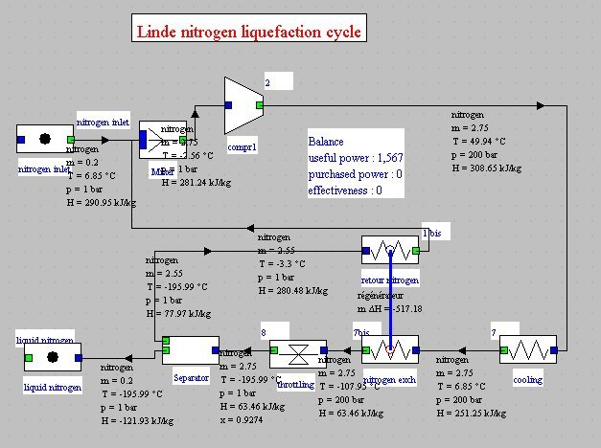

Slide 12
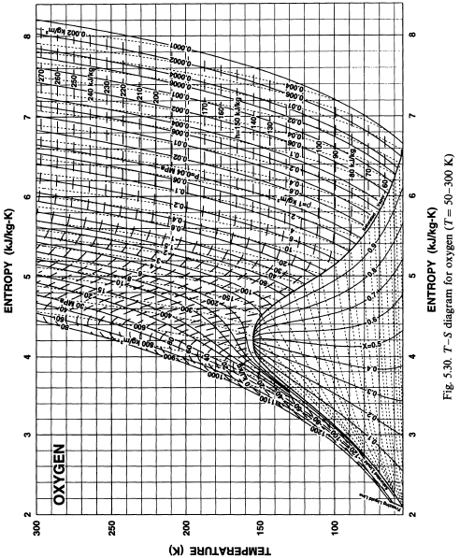
300 K
X
X
X
X
X
X
X
X
80 K

Slide 13
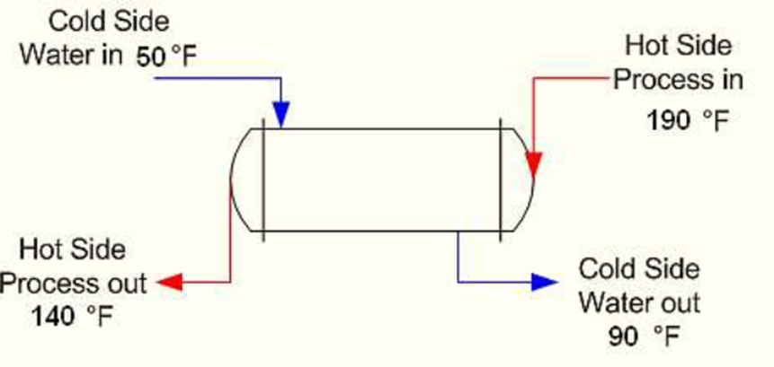
Fluid A: O₂ gas, in
Point g
ṁ = 2.6723 Kg/sec
P = 1 bar
T = 90.06 K
Fluid B: O₂ gas, in
Point 3
ṁ = 2.75 Kg/sec
P = 50 bar
T = 280 K
Fluid B: O₂ gas, out
Fluid A: O₂ gas, out
Point 4
ṁ = 2.75 Kg/sec
P = 50 bar
T = 155 K, 160 K, 165 K, 170 K
Point 6
ṁ = 2.6723 Kg/sec
P = 1 bar
T = 250 K

Slide 14
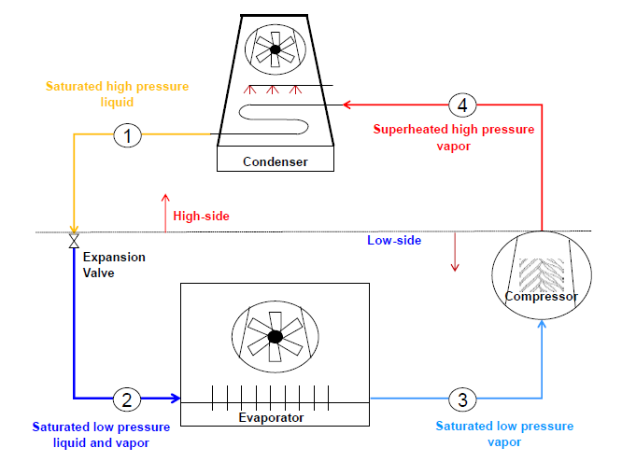
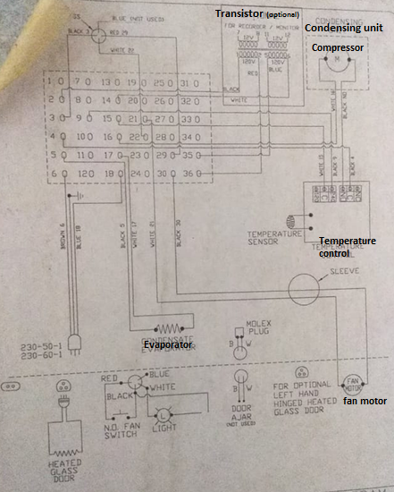
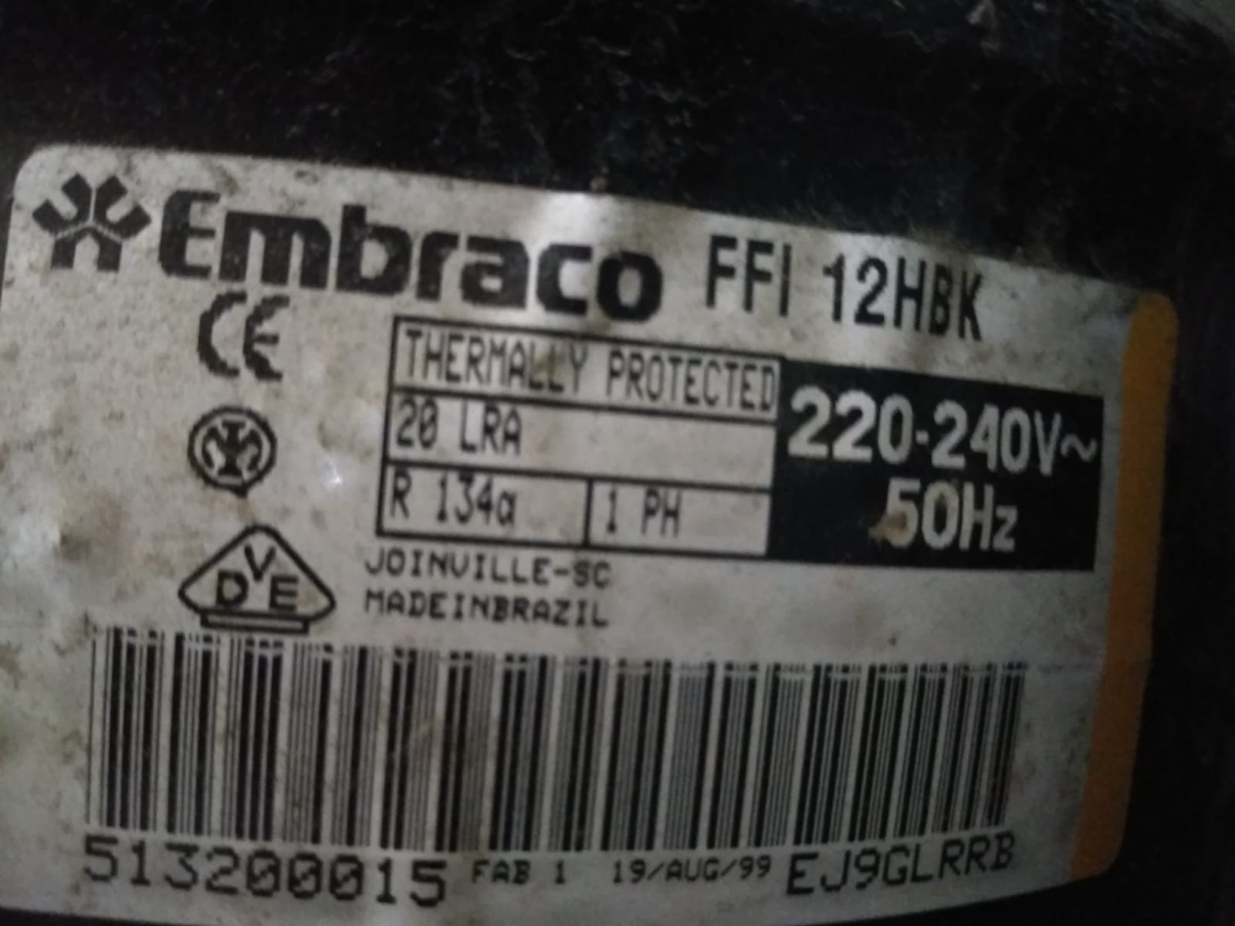

Slide 15
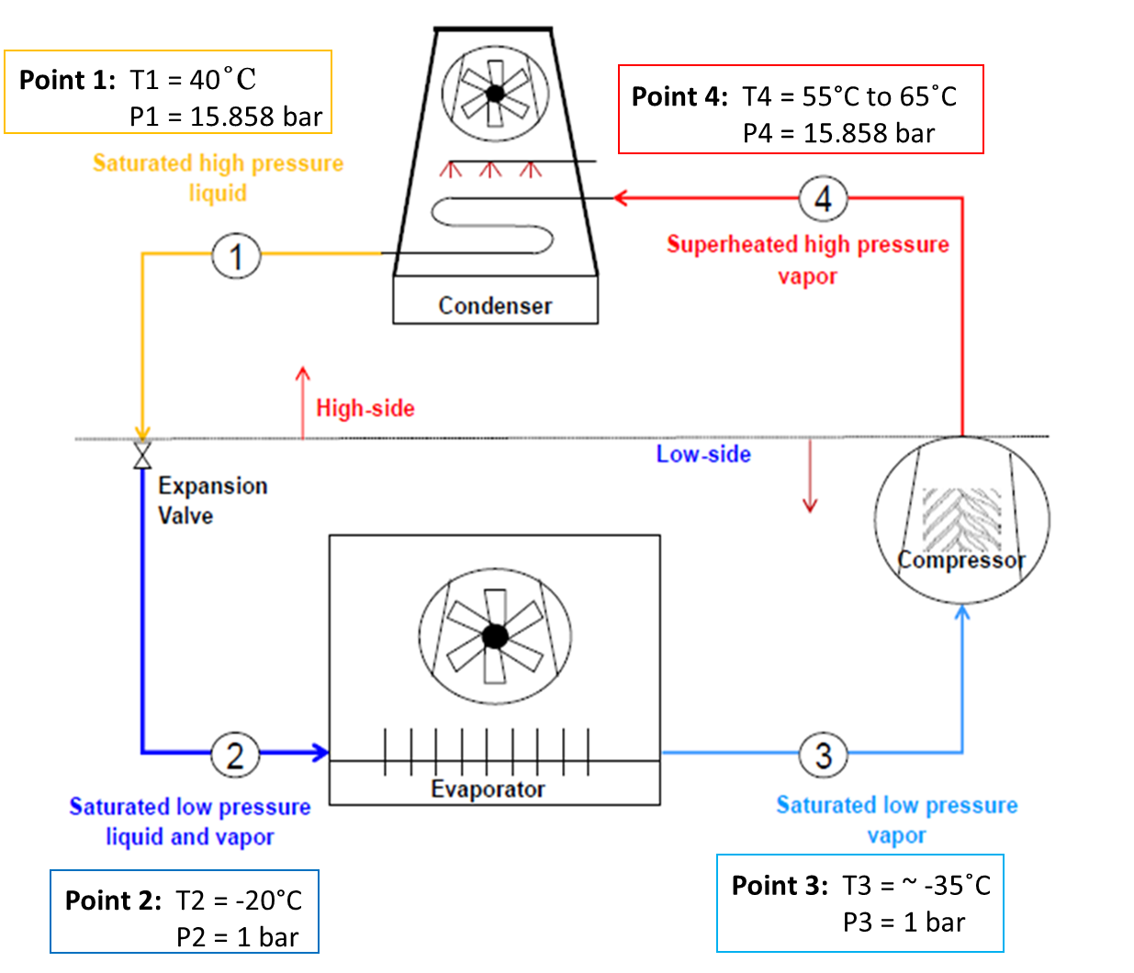
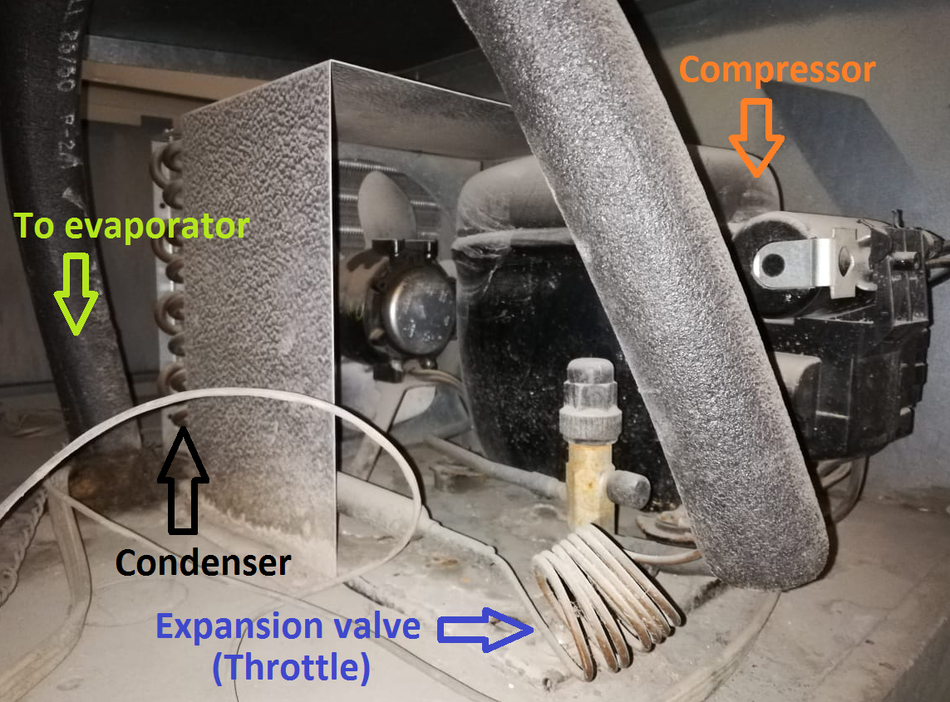

Slide 16

Point 1: T1 = 40˚C
P1 = 15.858 bar
Point 4: T4 = 55°C to 65˚C
P4 = 15.858 bar
Condensing temperature increase → Cooling capacity decreases → Efficiency rate decreases
Temperature ambient equal 32°C
Point 2: T2 = -20°C
P2 = 1 bar
Operating pressure: 230 psig = 15.858 bar
Point 3: T3 = ~ -35˚C
P3 = 1 bar

Slide 17
Point 1: T1 = 40˚C
P1 = 15.858 bar
Point 4: T4 = 55°C to 65˚C
P4 = 15.858 bar
Condensing temperature increase → Cooling capacity decreases → Efficiency rate decreases
Temperature ambient equal 32°C
Operating pressure: 230 psig = 15.858 bar
Point 2: T2 = -20°C
P2 = 1 bar
Point 3: T3 = ~ -35˚C
P3 = 1 bar

Slide 18
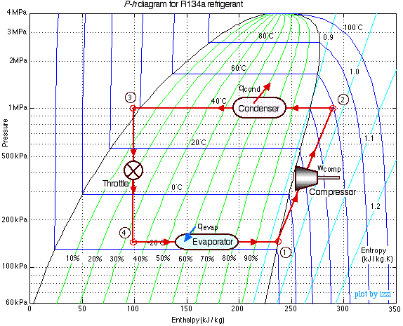
* https://www.ohio.edu/mechanical/thermo/Intro/Chapt.1_6/refrigerator/refrig_problems.html

Slide 19
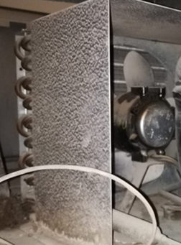
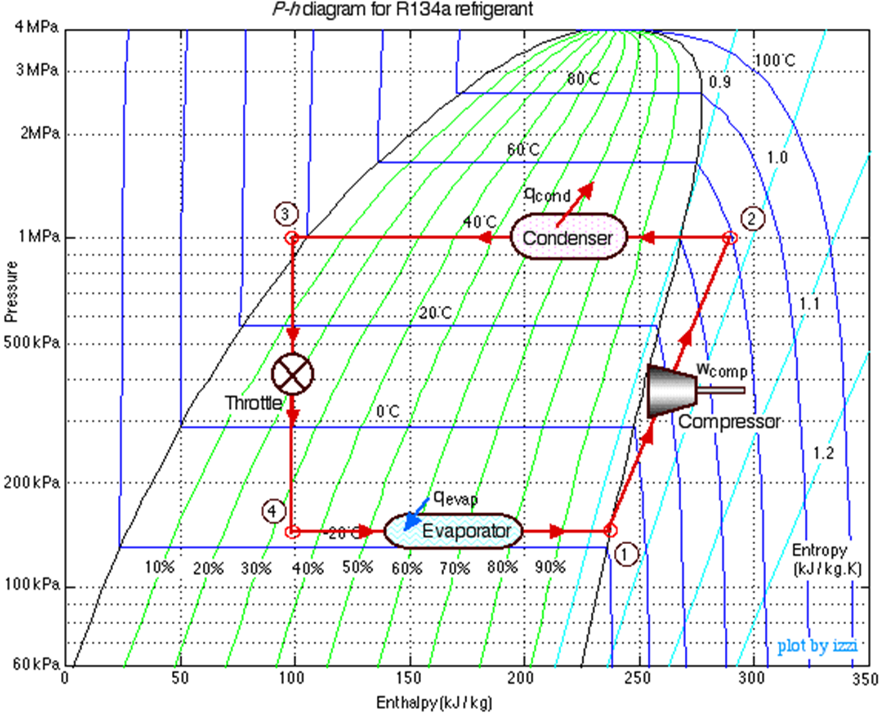
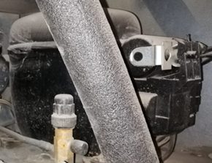
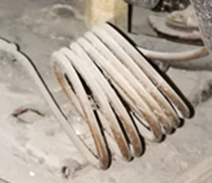

Slide 20
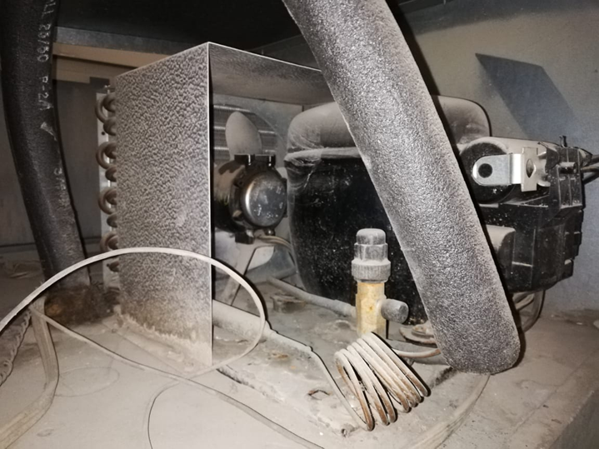
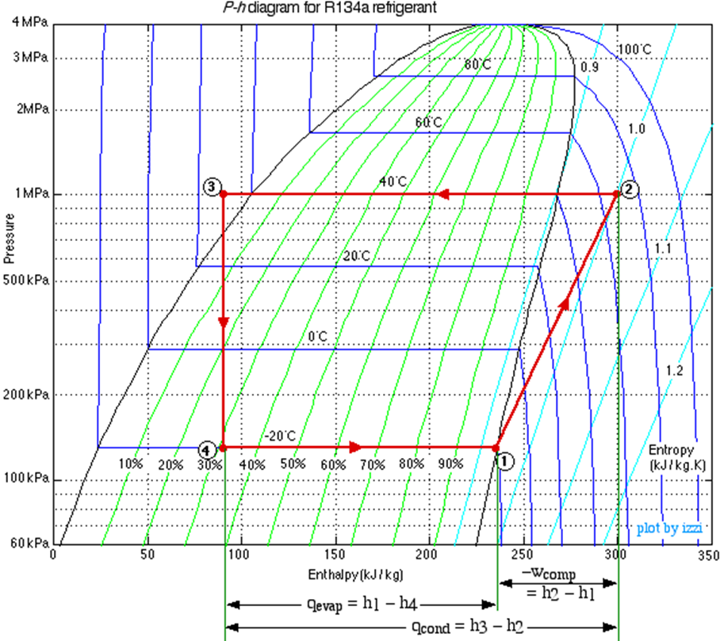
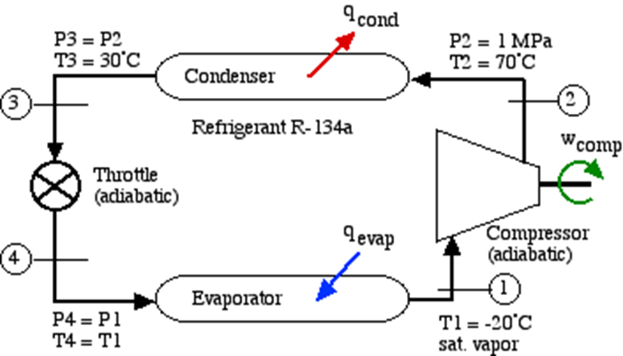
Condenser
Expansion valve
Compressor
Evaporator

Slide 21
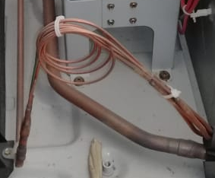
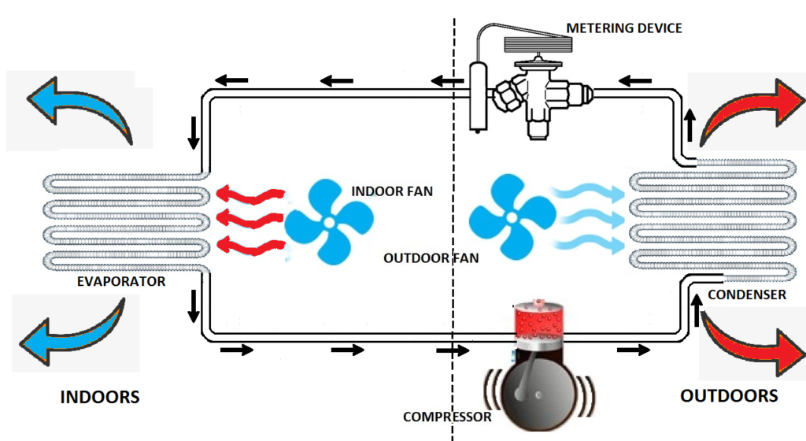
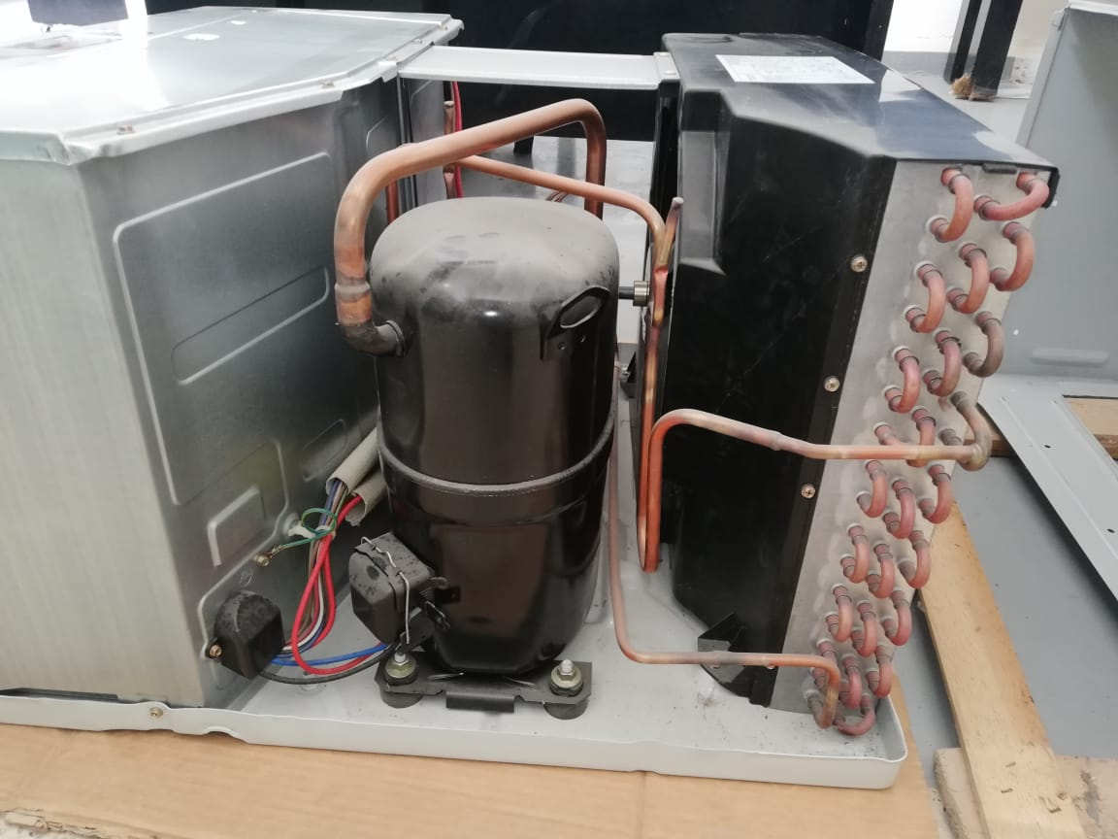
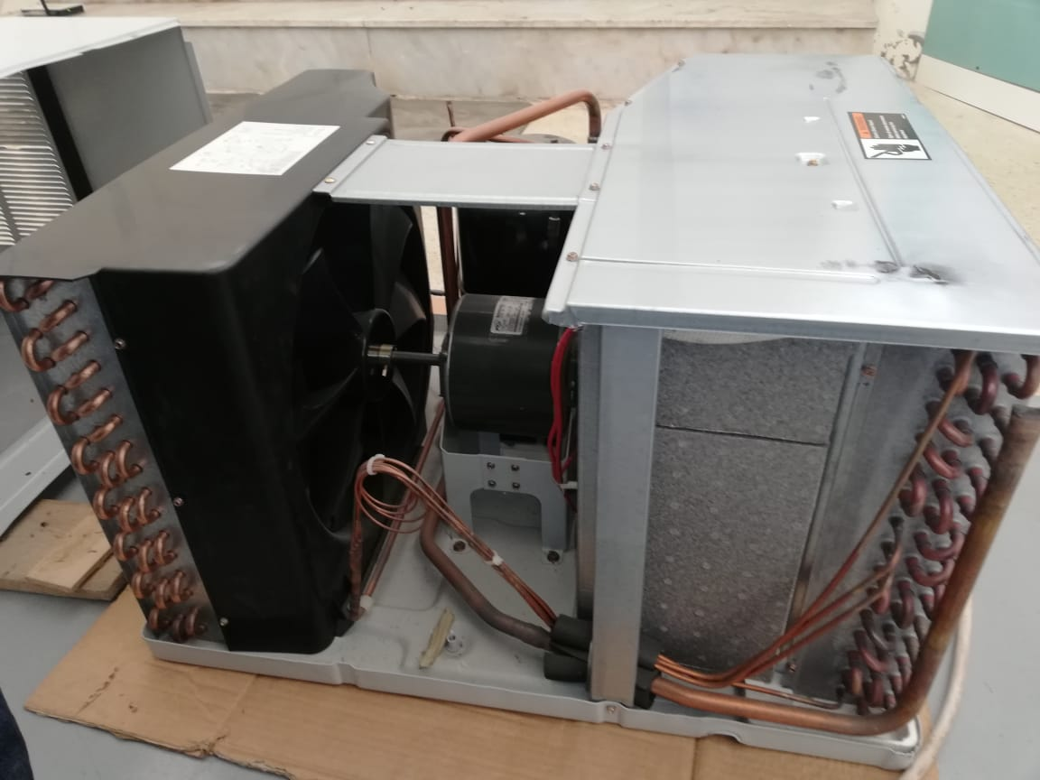

Slide 22
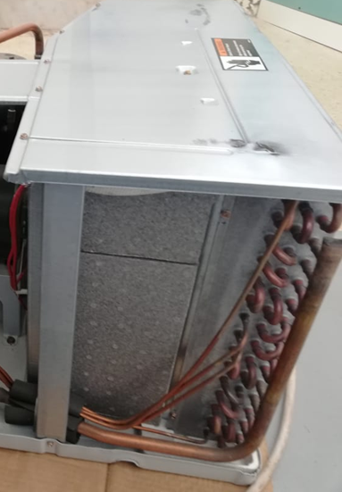
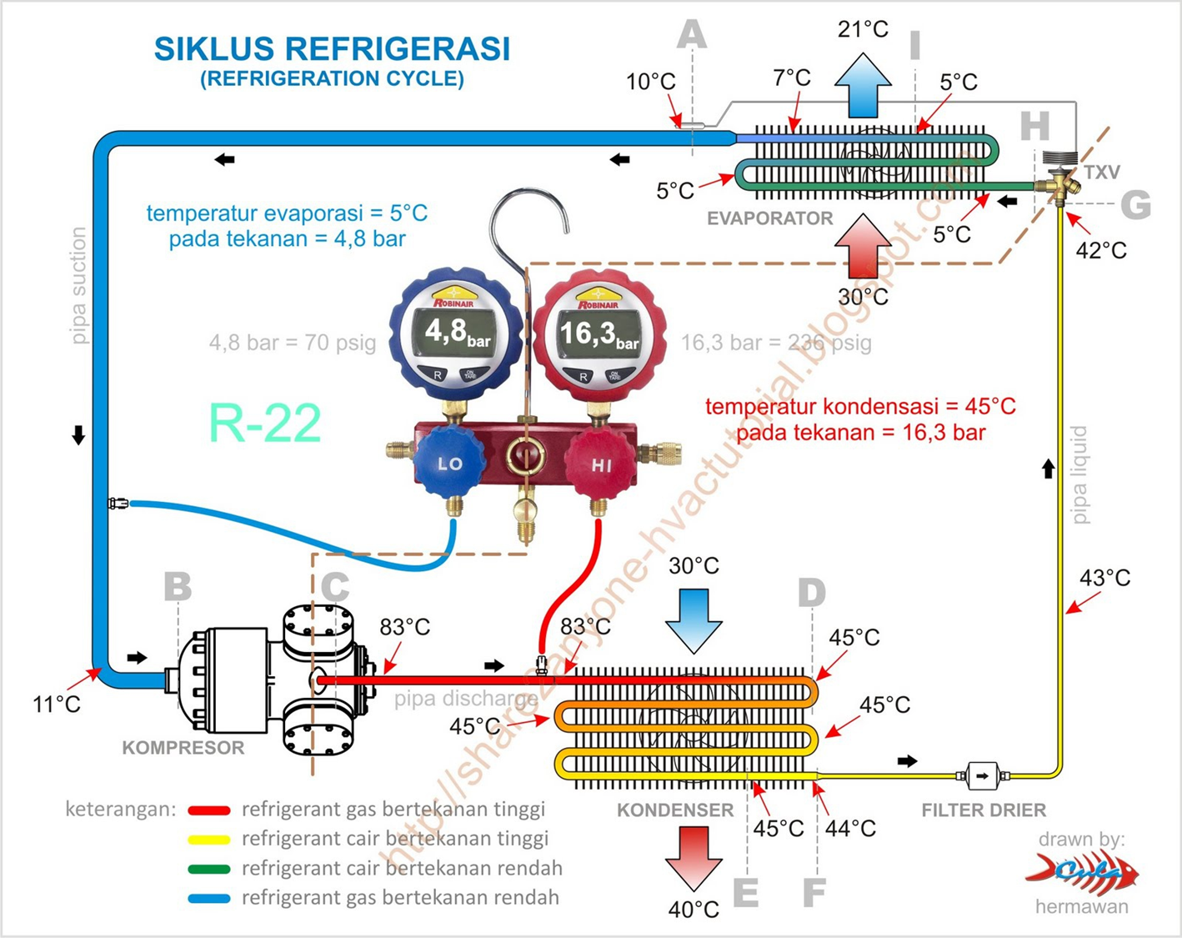
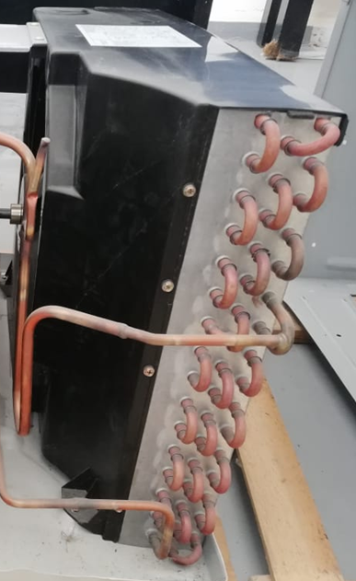
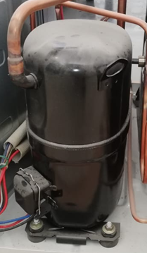
R-22
Nomenclature: Chlorodifluoromethane
Symbol: CHClF₂
Boiling point :
T= - 40.7°C (232.5 K) @ 1 bar
T= 4.9°C (278.05 K) @ 4.8 bar
T= 45.6°C (318.75 K) @ 16.3 bar

Slide 23
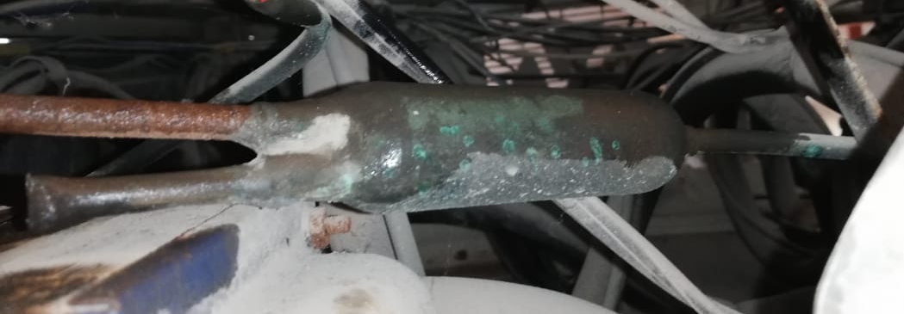
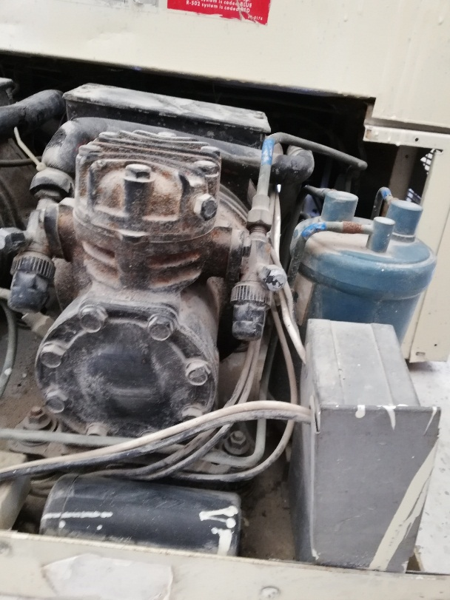
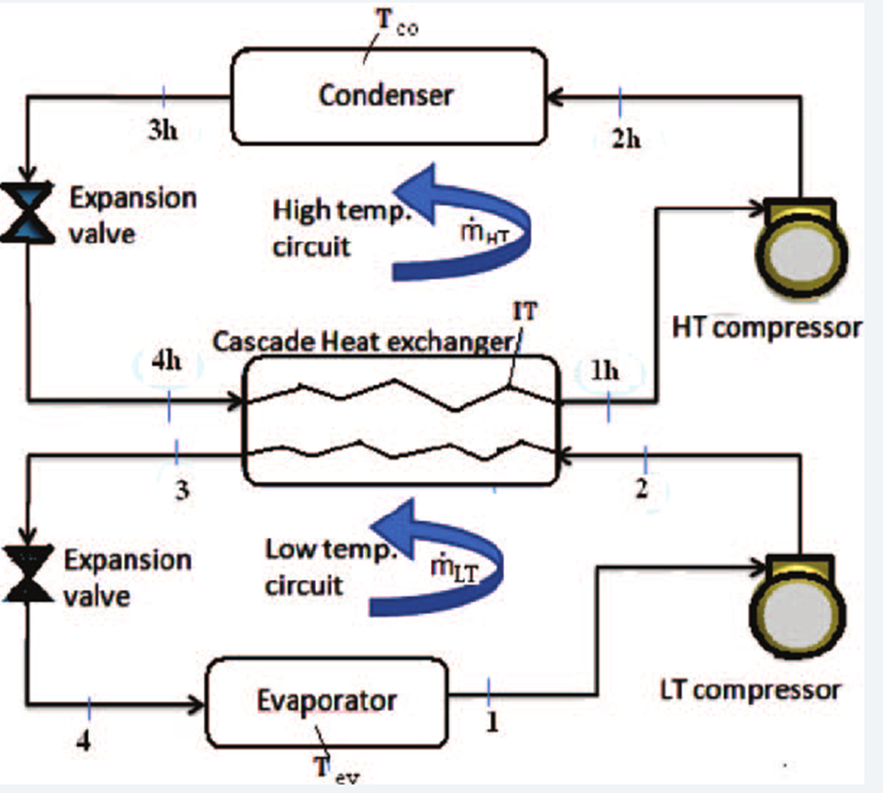
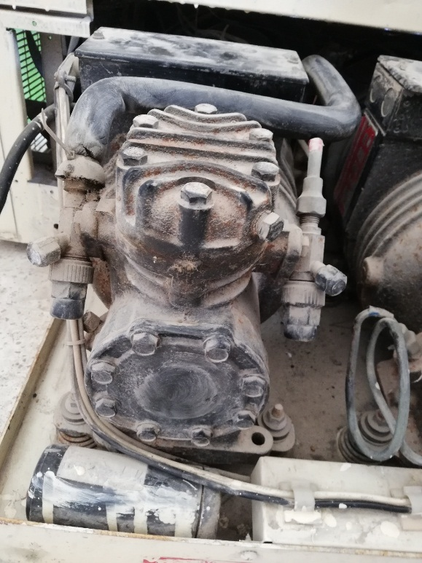
R-502 (High stage)
Nomenclature: Chlorodifluoromethane, Chloropentafluoroethane
Symbol: CHC1F2, CC1F2CF3
Compress: 375 psi = 25.85 bar
Boiling point :
T= - 45.6°C (227.4 K) @ 1 bar
T= 61.5°C (334.7 K) @ 25.85 bar
R-503 (Low stage)
Nomenclature: Azeotropic Blend
Symbol: CHF3
Compress: 375 psi = 25.85 bar
Boiling point :
T= - 88.9°C (184.1 K) @ 1 bar
T= - 20°C (253.2 K) @ 25.85 bar
Refrigerant used R-502
Refrigerant used R-503
* https://www.arma.org.au/wp-content/uploads/2017/02/SDS-R503.pdf

Slide 24
R-502
Point 4: Gas
P4= 1 bar
T4= -16°C (> -20 °C)
Point 1: Gas
P1= 25.85 bar
T1= 90°C (>60 °C)
R-502 (Higher stage)
Molecular Formula:
Boiling point:
- 45.5°C @ 1 bar
+ 61.5 ° C@ 25.85 bar (375 psi)
R-503 (Lower stage)
Molecular Formula: CC1F3,CHF3
Boiling point:
- 87.5°C @ 1 bar
- 20°C @ 25.85 bar (375 psi)
Point 2: Liq
P2= 25.85 bar
T2= 50°C (<60 °C)
Point 3: Liq or Gas
P3= 1 bar
T3= - 50°C (< - 45.5 °C)
R-503
Point A: Gas
PA= 25.85 bar
TA= 10°C (> -20 °C)
Point B: Liq
PB= 25.85 bar
TB= -30 (< -20 °C)
Point D: Gas
PD= 1 bar
TD= - 83°C (> -87.50 °C)
Point C: Liq or Gas
PC= 1 bar
TC= - 90.5°C (< -87.5°C)
- 80°C

Slide 25
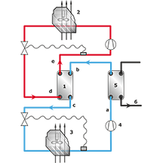
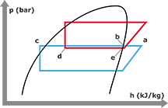
1- cascade heat exchanger
2- Air condenser
3- Cold evaporator
4- compressor
5- desuperheater
6- high-temperature water
Red cycle : R502
Blue cycle : R503

Slide 26
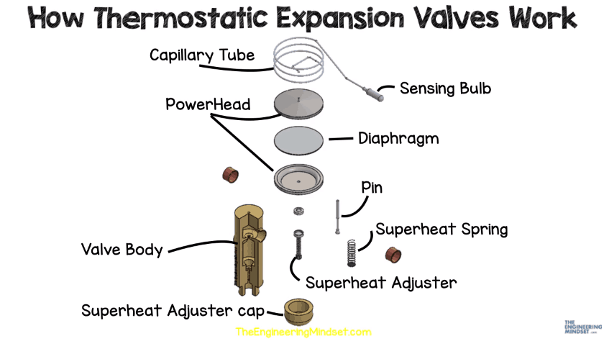
*https://theengineeringmindset.com/thermostatic-expansion-valves-work/

Slide 27
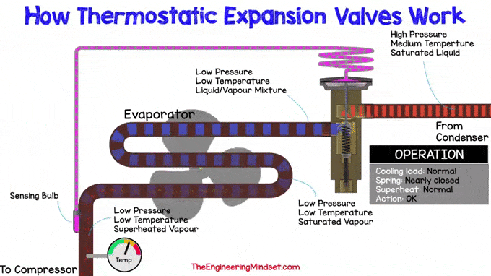
*https://theengineeringmindset.com/thermostatic-expansion-valves-work/

Slide 28
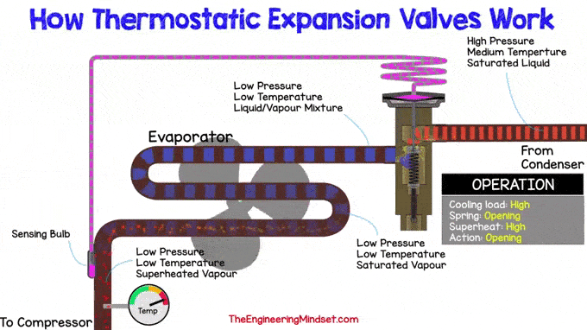
*https://theengineeringmindset.com/thermostatic-expansion-valves-work/

