Slide 1
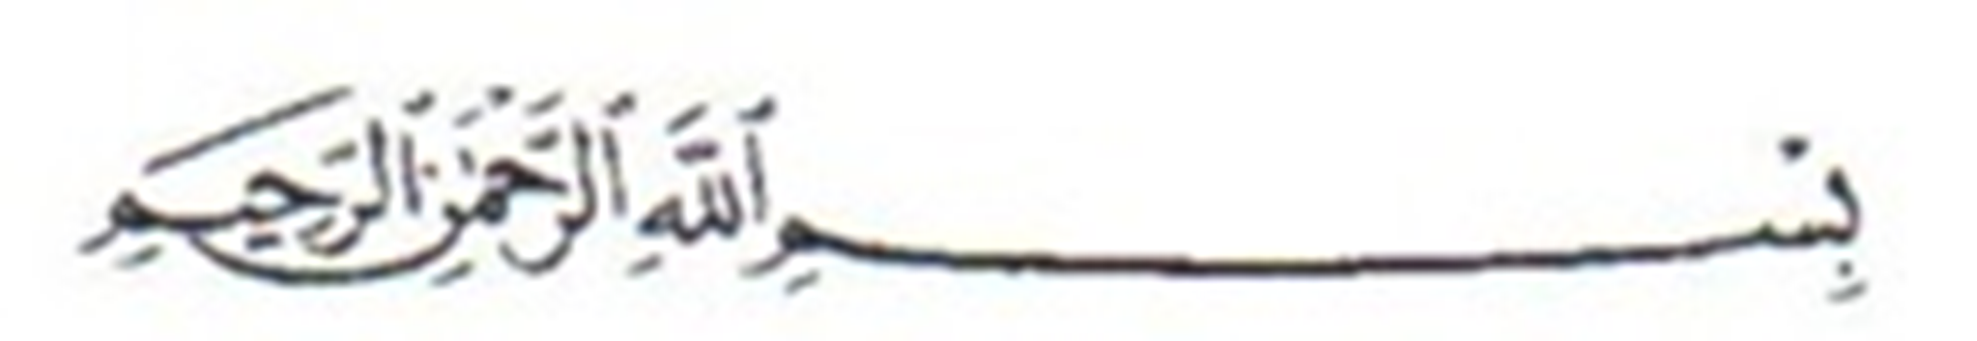


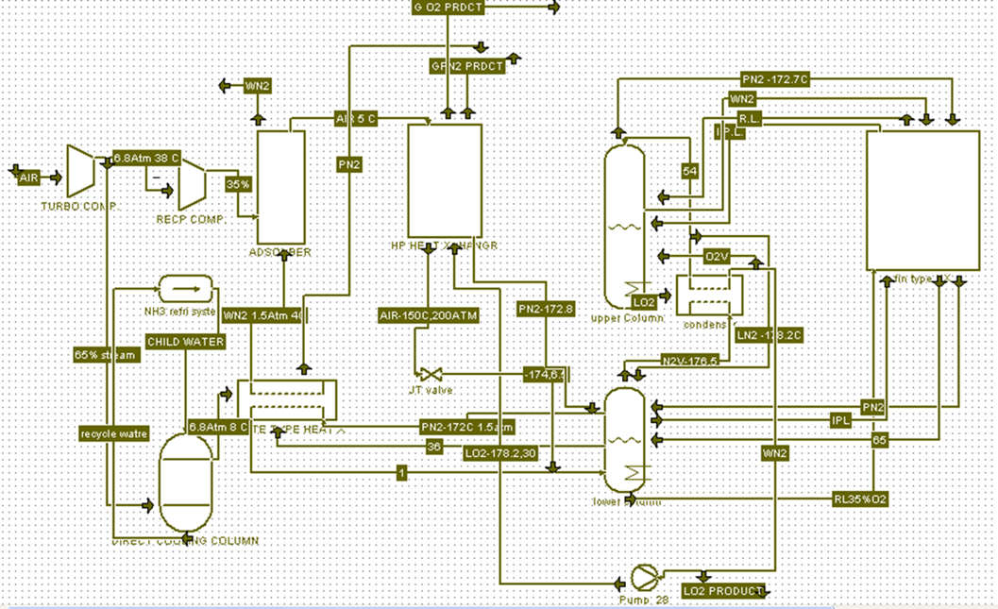
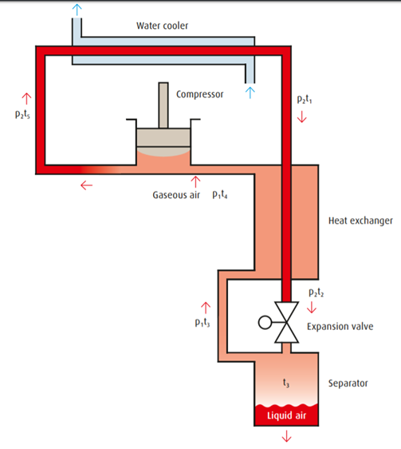
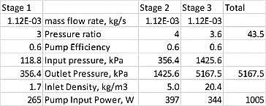
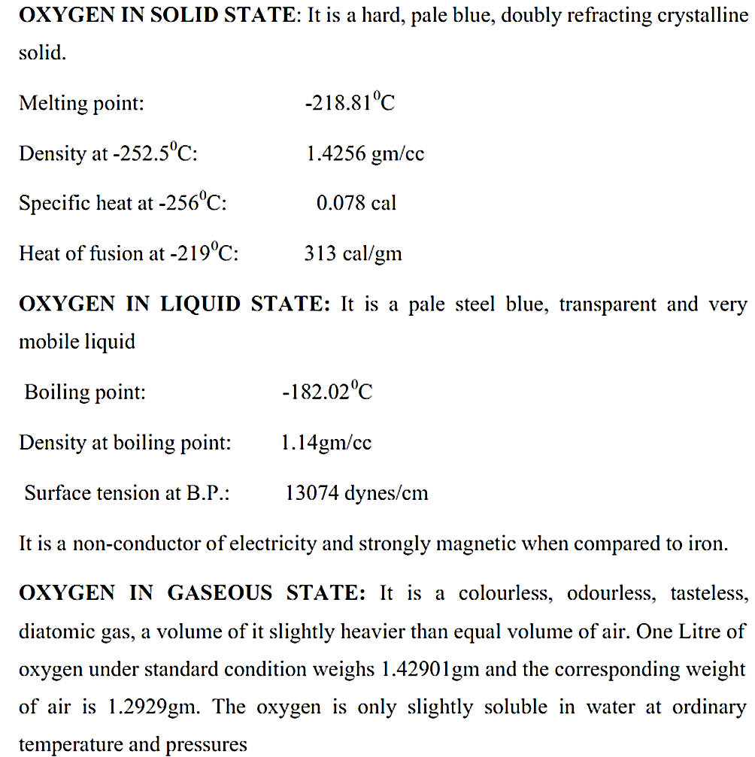
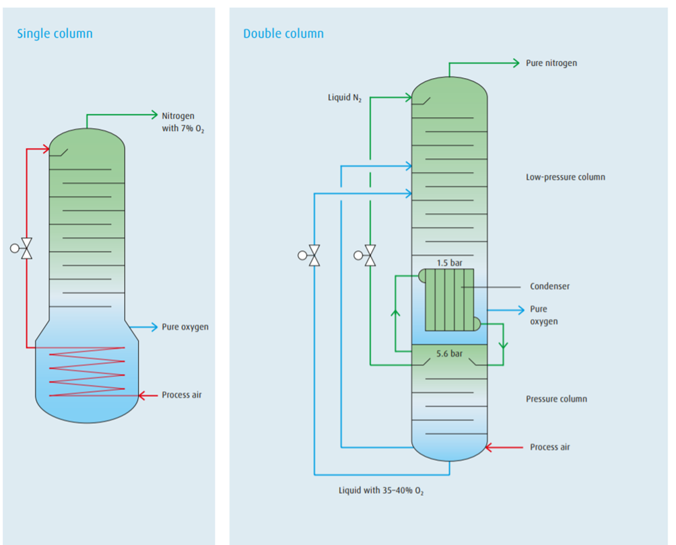
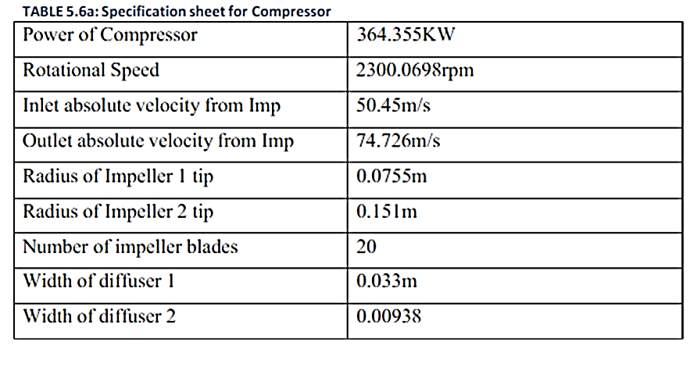
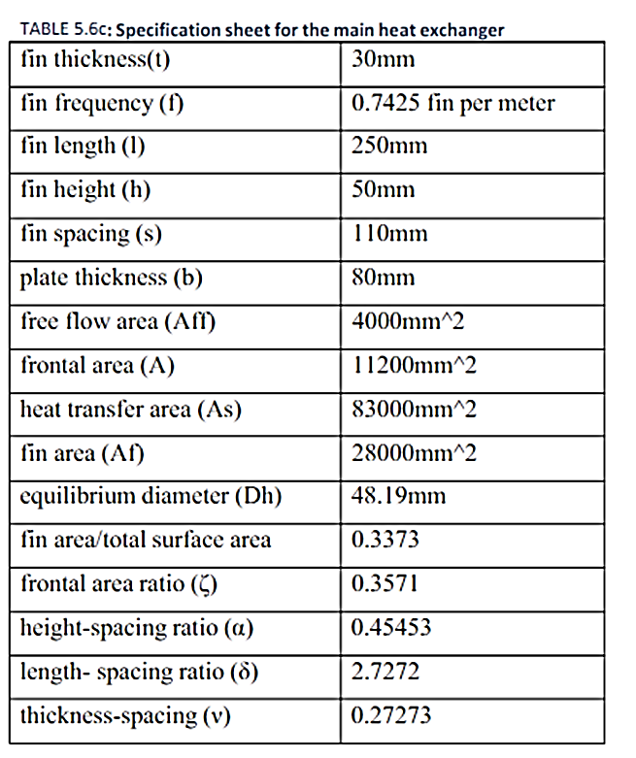
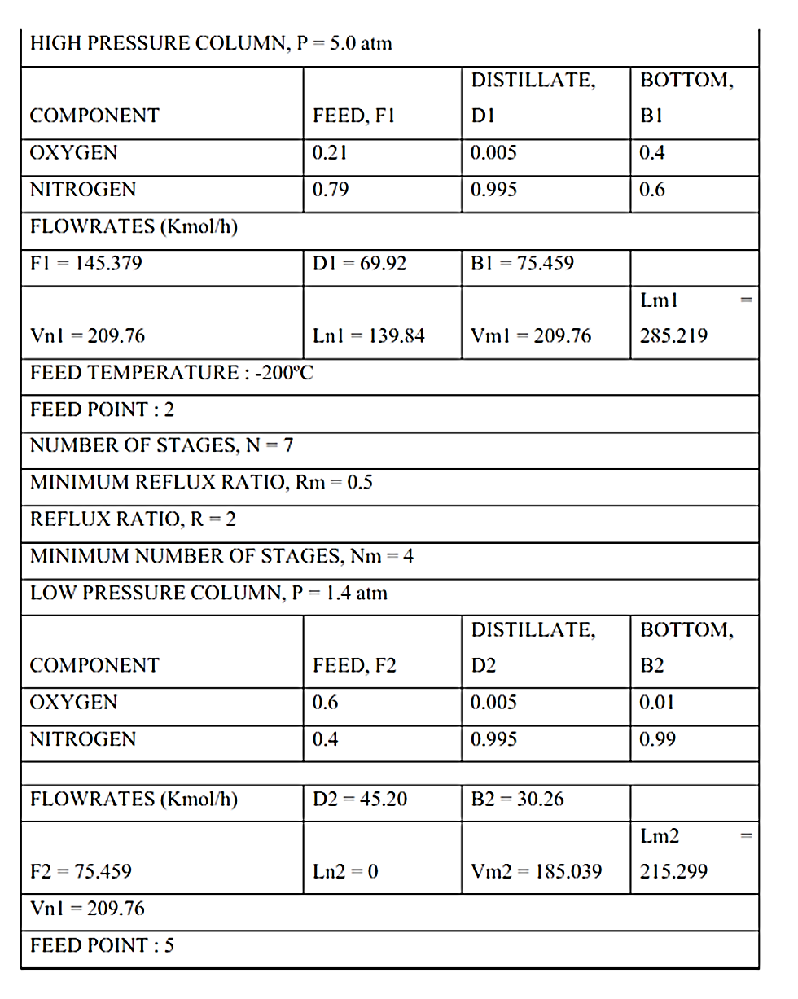
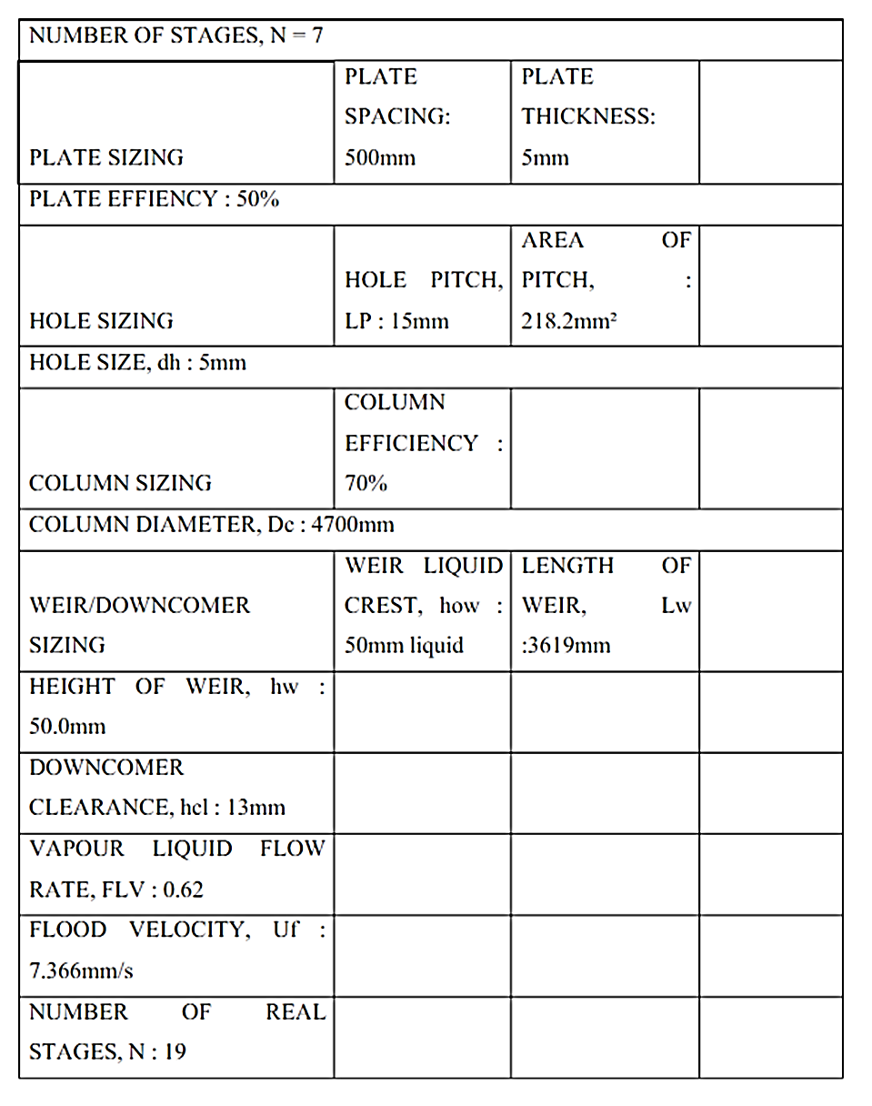
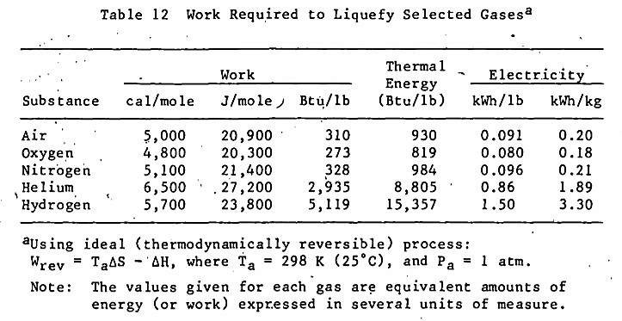
Liquefaction of air(oxygen)
Process of purification and liquefaction of air :
Process of liquefaction of oxygen
o2
- The gas is compressed to 51 bar, which adds external energy (300 k) into the gas, to give it what is needed for running through the cycle.
The high pressure gas is then cooled by immersing the gas in a cooler environment; the gas loses some of its energy (heat).
- The high pressure gas is further cooled with a countercurrent heat exchanger to arrive to 150 k; the cooler gas leaving the last stage cools the gas going to the last stage .
- The gas is further cooled by passing the gas through a Joule–Thomson orifice (expansion valve); the gas is now at the lower when it is forced through a valve or porous plug while keeping it insulated so that no heat is exchanged with the environment.
In this process at first air is filtered & compressed to 6.8 atm in turbo compressor. During the compression cooling is done to maintain the temp to 35 - 40°C.
After compression the air is divided into two streams. One is 65% stream & the other is 35%, now the larger stream is then passed through after cooler and heat exchanger where it is cooled to -150°C to -170°C by the incoming pure nitrogen & waste nitrogen streams produced from rectification columns.
The smaller stream is passed through reciprocating compressor to increase the pressure to about 200atm.Here the air temp is maintained at 4-8°C by intermediate cooling between stages using cold water obtained by ammonia refrigeration.
Then the air goes through high pressure heat exchanger where the temp of air is brought down to about -120 -140°C. Now the air undergoes expansion to about 6.5 atm in the expansion engine.
The temperature of air is brought down from -170 to -174°C by joule Thompson effect.
Now the air will be in liquid state & mixes with the larger stream & changes the whole air stream into saturated liquid state.
This saturation liquid is fed to Linde rectification column. This column may be single, double or compound depending on requirement. the liquid product coming out will have a purity of about 99.4 -99.99%.
This liquid is partially vaporized in condenser, to liquefy the nitrogen vapor &the rest may be taken as liquid product or it may be obtained in gaseous state if it is used for cooling of incoming air, the other products that obtained are pure nitrogen of purity above 98% & waste nitrogen product of purity of about 92-96%.
- The low pressure gas is now at its coolest in the current cycle.
Some of the gas may condense and become output product.
The low pressure gas is directed back to the countercurrent heat exchanger to cool the warmer, incoming, high-pressure gas.
After leaving the countercurrent heat exchanger, the gas is warmer than it was at its coldest, but cooler than it started out at step 1.
The gas is sent back to the compressor to make another trip through the cycle (and become still colder).
Oxygen properties

