Slide 1



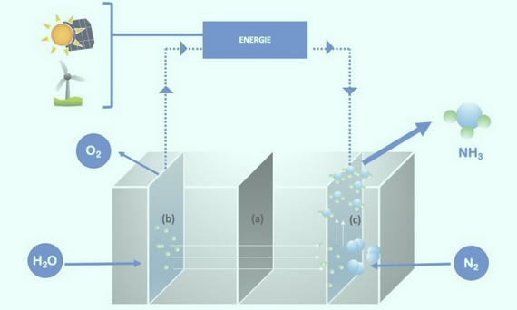


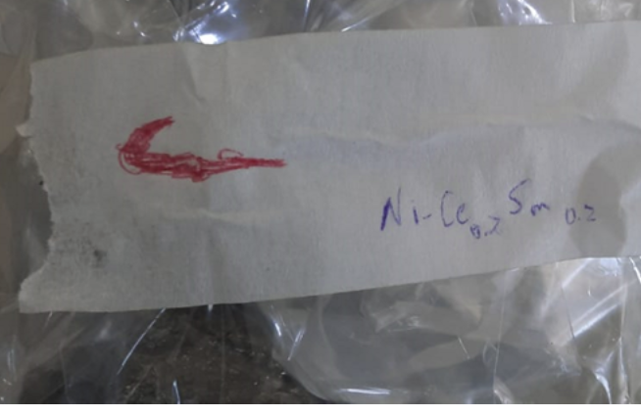
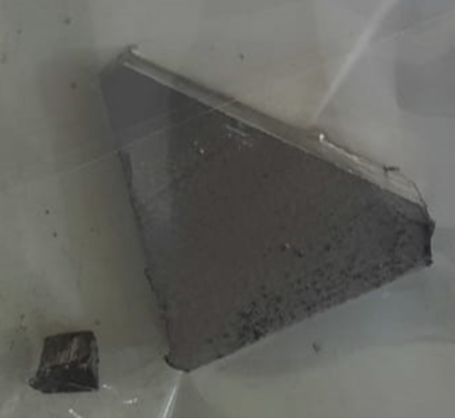
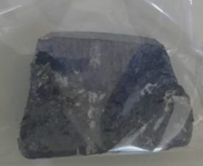
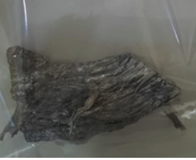
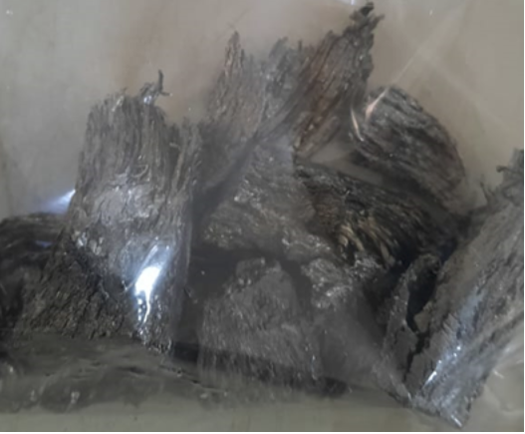
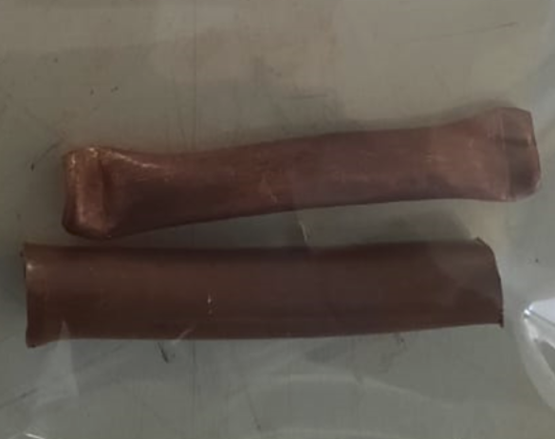
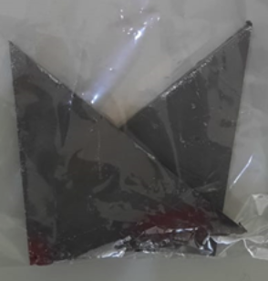
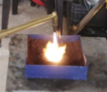
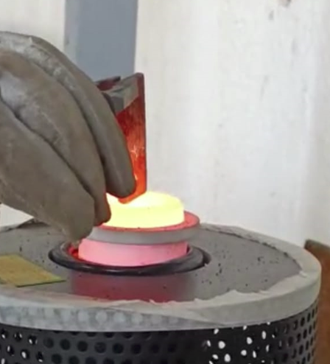
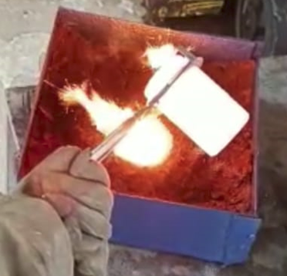
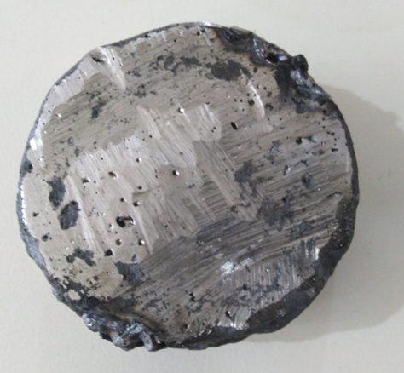
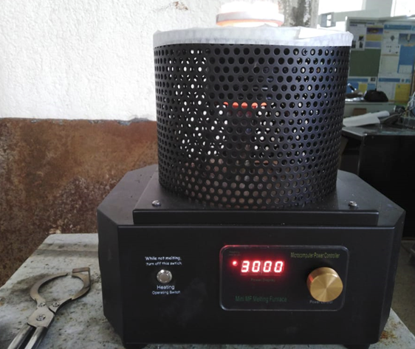
Chemical Formula: Ni-Ce0.8Sm0.2
Volume of the anode (disc shape):
Radius = 6.5 cm Height = 0.1 cm or more
V = π r²h = π*6.52*0.1 = 13.273 cm3 = 13273 mm3
Total volume for 100g mass of this alloy = 13.53 cm3 ρ = 100/13,53 = 7.391 g/cm3
M1 = ρ V = 7.391*13.273 = 98.100743 g
Figure : Alternative ammonia production at low T° and pressure in an electrolysis unit powered by renewable energy. (a) = separation membrane; (b) = anode; (c) = cathode. The dotted arrows indicate the path of the electrons within the device.
Anode Preparation
Cathode Preparation
Chemical Formula: SmFe0.7Cu0.1Ni0.2
Volume of the anode (disc shape):
Radius = 6.5 cm Height = 0.1 cm or more
V = π r2h = π*6.52*0.1 = 13.273 cm3 = 13273 mm3
Total volume for 100g mass of this alloy = 13.01 cm3
ρ = 100/13.01 = 7.69 g/cm3
M2 = ρ V = 7.69*13.273 = 102.06937 g
Metal | Melting point (°C) | Density (g/cm^3)
Nickel | 1455 | 8.902
Cerium | 795 | 6.76
Samarium | 1072 | 7.52
Metal | Melting point (°C) | Density (g/cm^3)
Samarium | 1072 | 7.52
Iron | 1538 | 7.874
Copper | 1538 | 8.96
Nickel | 1455 | 8.902
Metal | Mass (g) | %W | N° of moles | Xi
Nickel | 286 | 30.33 | 4.873 | 0.5134
Cerium | 510 | 54.08 | 3.640 | 0.3835
Samarium | 147 | 15.59 | 0.978 | 0.1030
Alloy | 943 | 100 | 9.491 | 1
Metal | Mass (g) | %W | N° of moles | Xi
Samarium | 147 | 15.59 | 0.978 | 0.1030
Iron | 192 | 18.78 | 3.4381 | 0.35
Copper | 31.5 | 3.08 | 0.5 | 0.05
Nickel | 286 | 30.33 | 4.873 | 0.5134
Alloy | 1022.29 | 100 | 9.8537 | 1
Ni-Ce0.8Sm0.2
Nickel
(58.5g)
Cerium
(510g)
Samarium
(147g)
Samarium
(740g)
Copper
(31.5g)
Nickel(286g)
Alloy producing stages :
1)Melting nickel with a torch
2)After dissolving the nickel well, add the remaining iron to the melted nickel to incorporate it.
Melting metal
Pouring molten metal
Alloy
Oussama Mostapha Al Dahabi
@AECENAR_ICPT_AP 20/Aug/2024

