Slide 1


ECS/CNA Development Process
Last Updated: April 5, 2023
By:
Raja Mourad
Ahmad Awwad
Hana Murad
Karim Meemary
Hanna Abboud

Slide 2
Abbreviations:
ECS: Emergency Communication System
CNA: City Network Ambulance
GUI: Graphical User Interface
PMU: Power Management Unit
API: Application Programming Interface

Slide 3
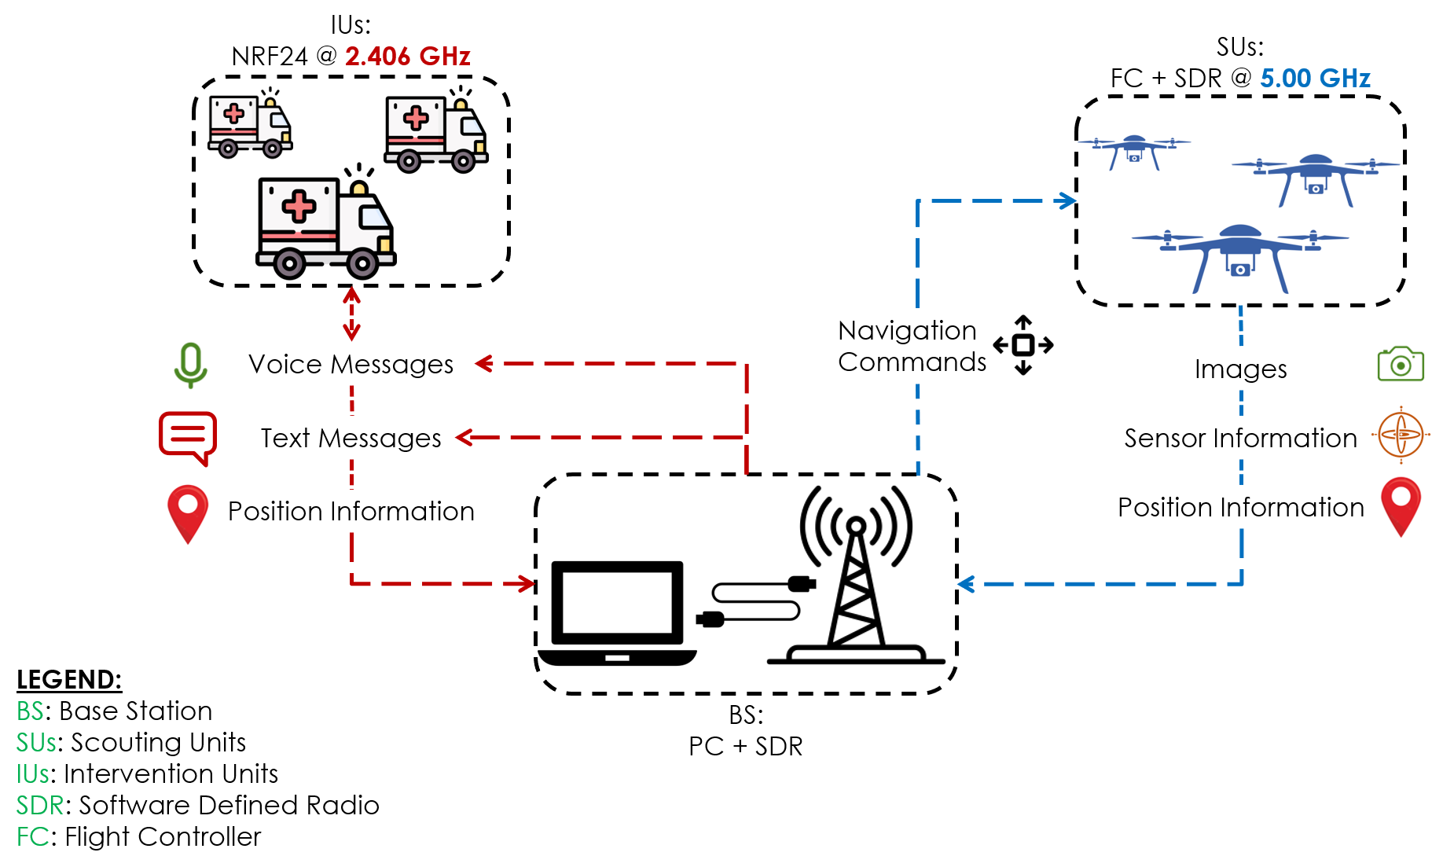
ECS
CNA
ECS System Architecture
Raja Mourad

Slide 4
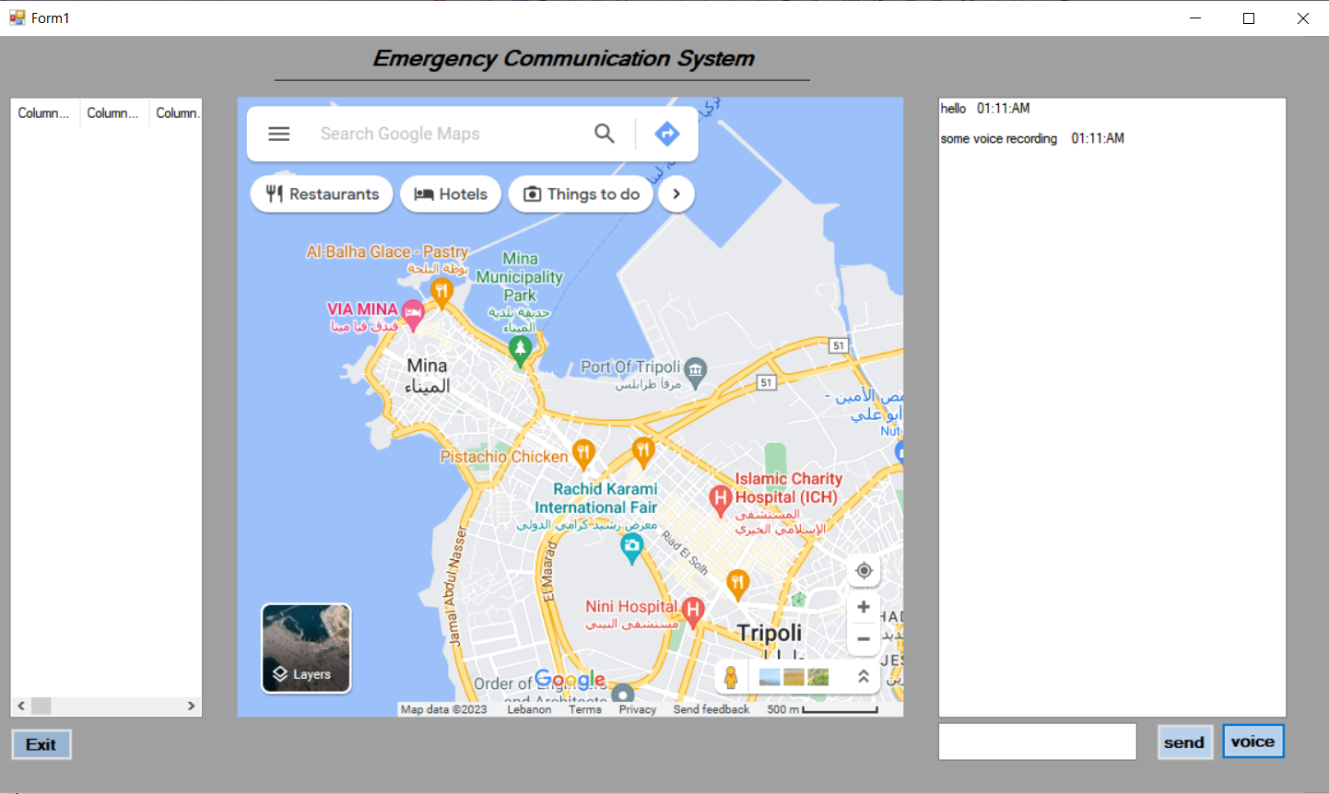
Latest work on ECS-GUI
ECS
CNA
Integrated the map as a website (not preferred).
Inserted a chat box.
Failed to fetch data from text file.
Inactive voice field
Karim Meemary

Slide 5
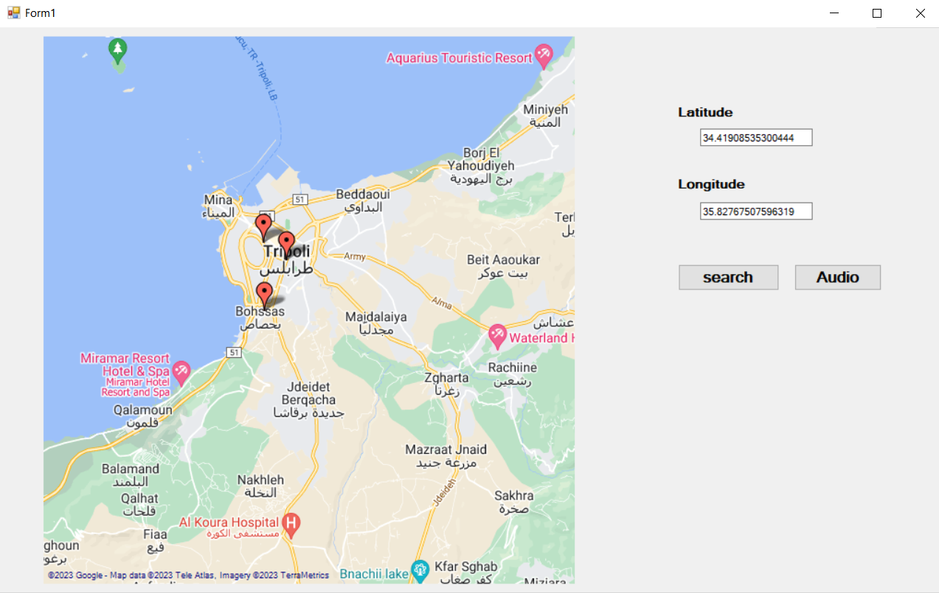
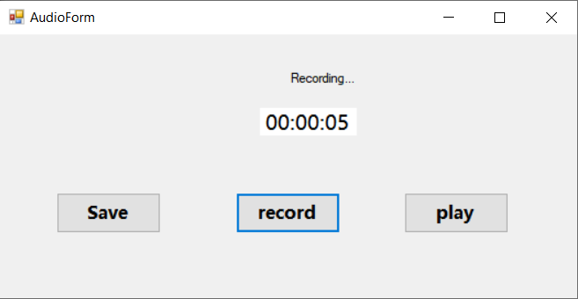
ECS Graphical User Interface
ECS
CNA
Voice messages integration:
Record a voice note.
Save the recorded voice locally.
Play the recorded voice.
Failed to save more than one recording
The recording needs filtering.
Map Interaction:
Inserted a map API in the GUI
Passing locations locally
Failed to fetch positions from text file
Hana Murad

Slide 6
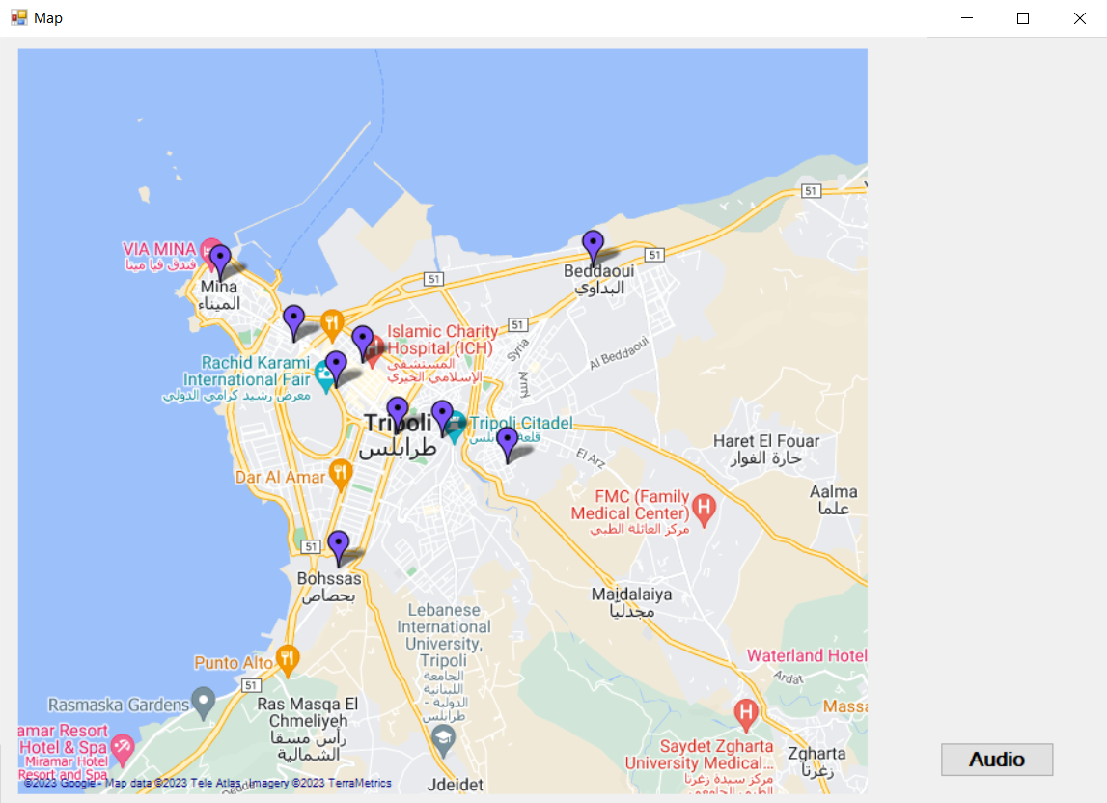
ECS Graphical User Interface
Map Interaction
ECS
CNA
Map Interaction:
Succeeded to fetch positions from text file
Real-time position fetching is still under implementation
Positions extracted from a local file (received from Gnuradio)
Hana Murad

Slide 7
What is next
ECS
CNA
The map has to take its input from a local text file.
Some changes in the audio recorder.
Add the map and the recorder to Karim’s GUI.
Test the GUI with the ECS.
Hana Murad

Slide 8
CNA System Architecture
ECS
CNA
Ring Topology
N
IUs
IUs
N
N
IUs
N
N
N: Repeater Node
IUs: Intervention Units
----: High Power Channel (80 W)
: Low Power Channel (1W)
IUs
IUs
Raja Mourad

Slide 9
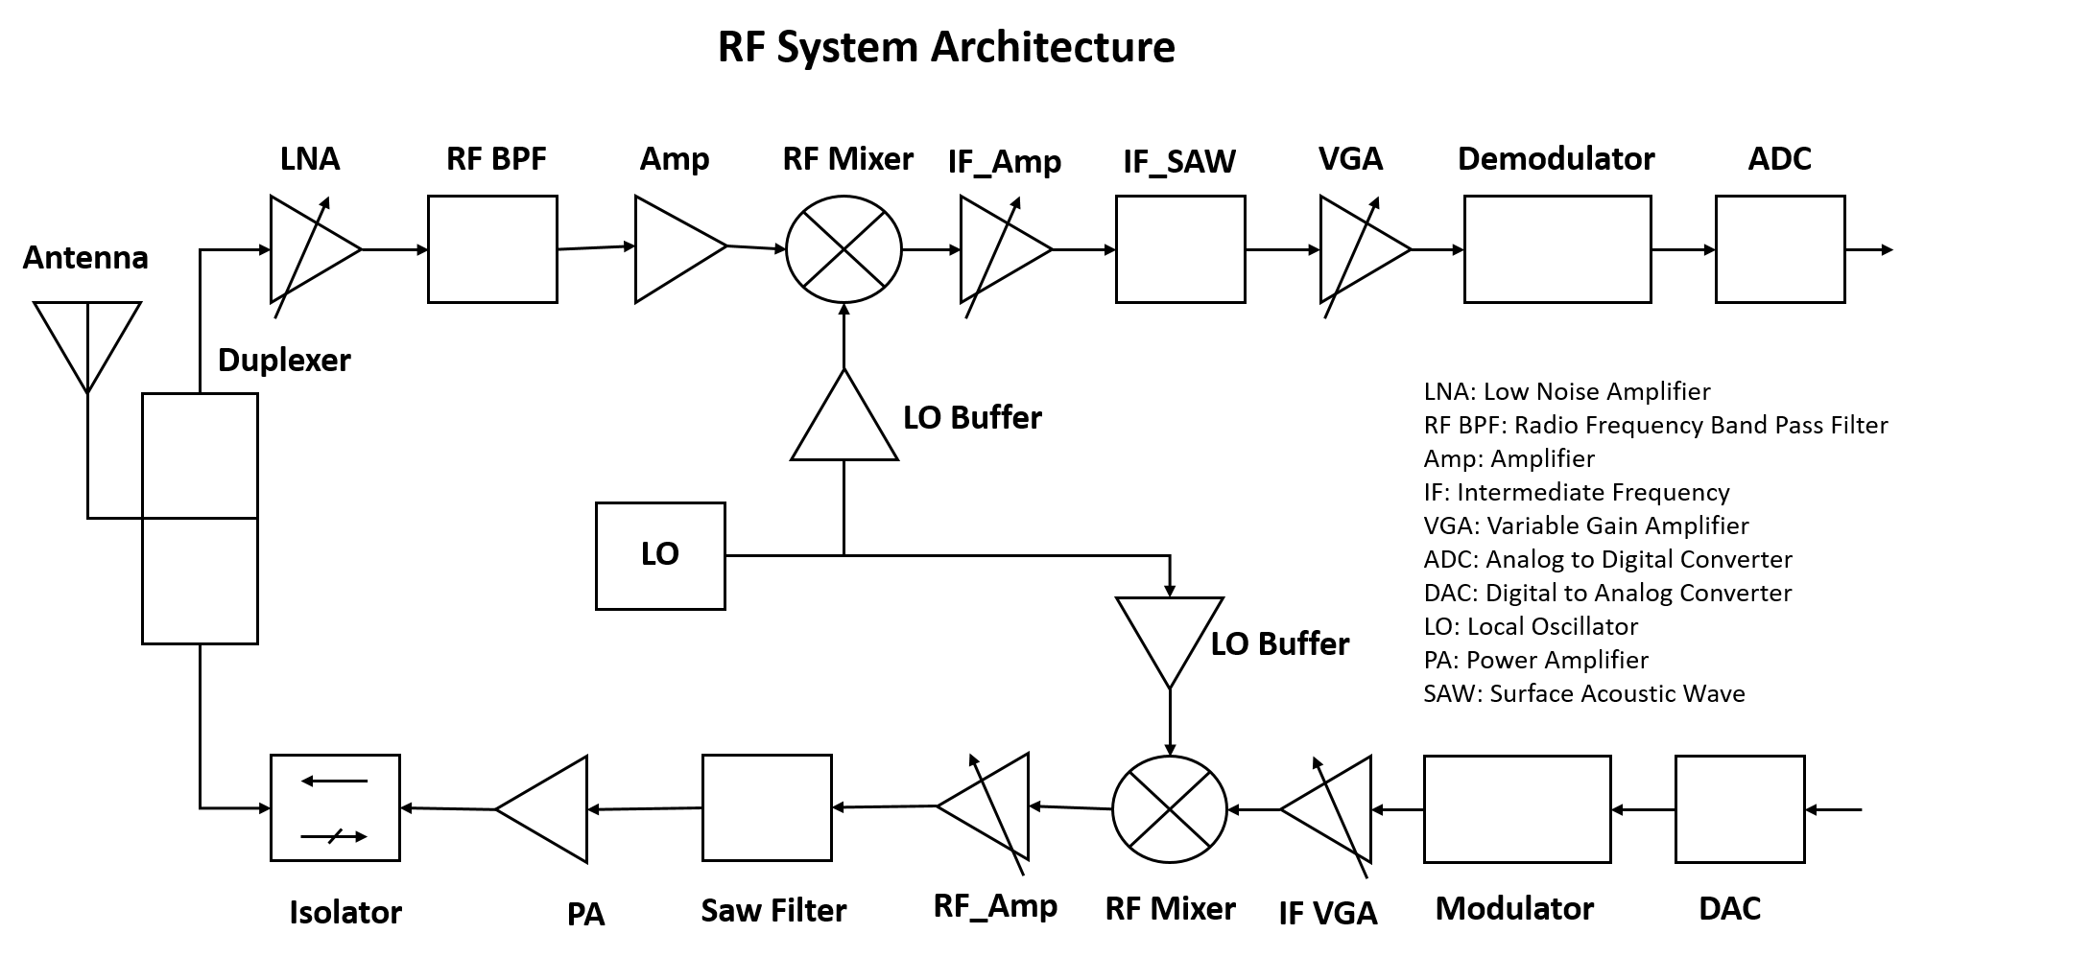
RF development System Architecture
ECS
CNA
Common components required to design a Transceiver
Common Architecture Techniques used in Transceivers
Hana Murad

Slide 10
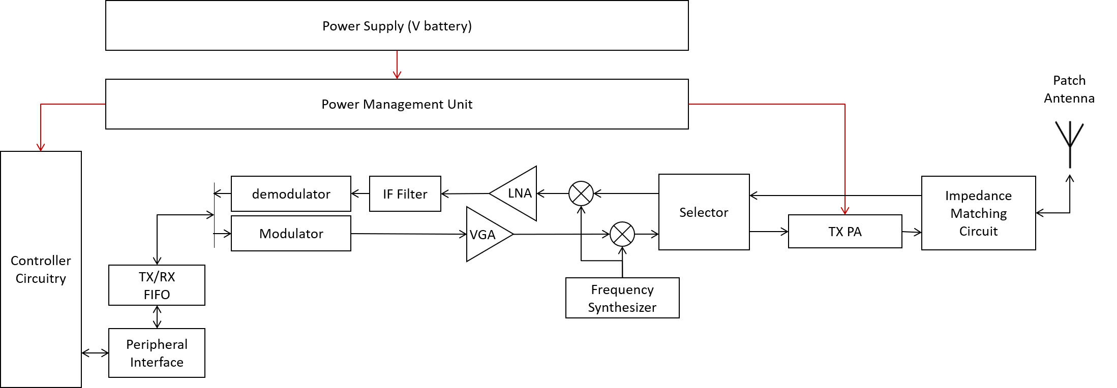
Modified the system architecture (More compact)
ECS
CNA
Raja Mourad

Slide 11
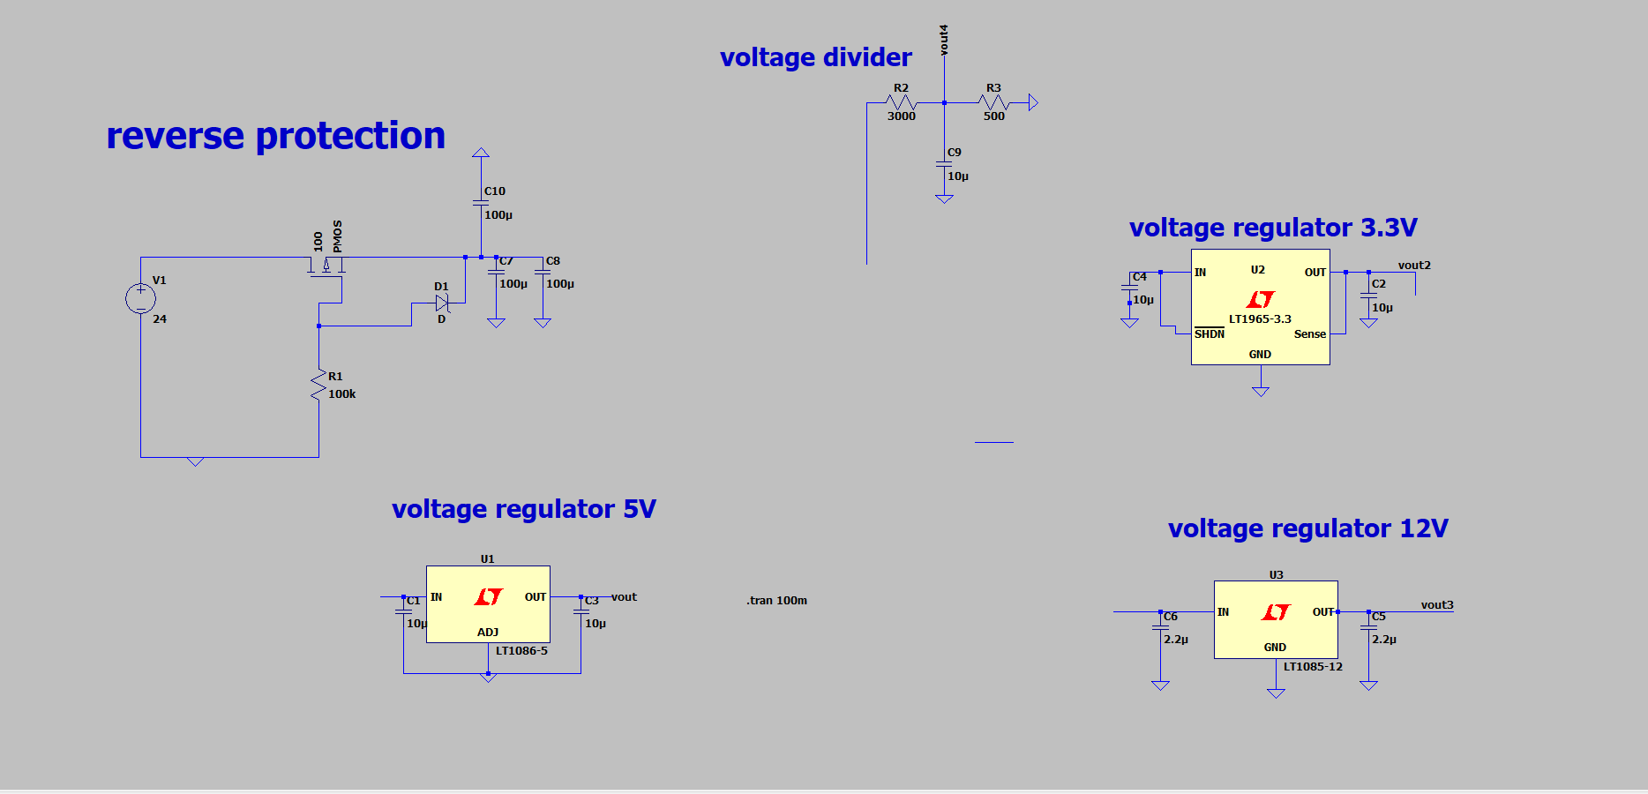
Power Management Unit
ECS
CNA
Three circuits to be powered:
Amplifier circuits(12V)
Controller circuit(3.3V)
Misc. (5V)
Reverse protection:
To protect all the subsystems from reverse polarity of batteries.
Karim Meemary

Slide 12
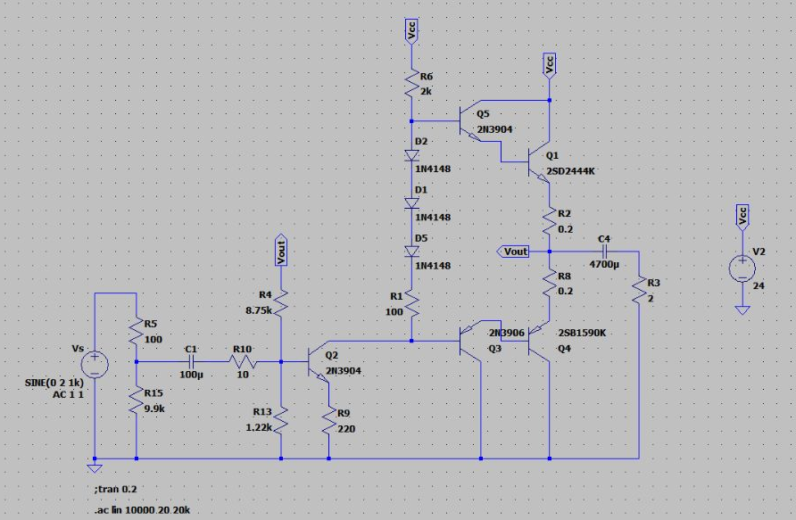
Testing of PA system
CNA
ECS
Class AB amplifier with Darlington Arrangement
1 watt amplifier.
Used before the antenna in the TX stage.
Result: FAILED
Hanna Abboud

Slide 13
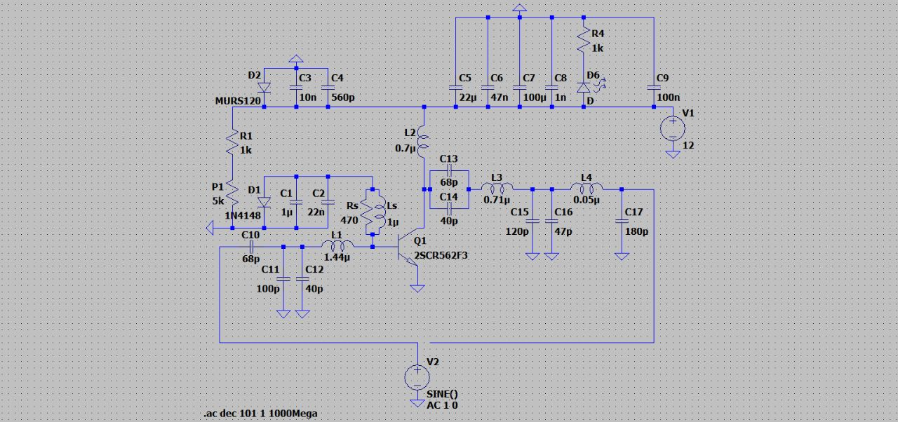
Testing of PA system
CNA
ECS
Class C Amplifier with matching circuit
1 watt amplifier.
Used before the antenna in the TX stage.
Result: Still not very sure! Some parameters have to be tuned…
Hanna Abboud

Slide 14
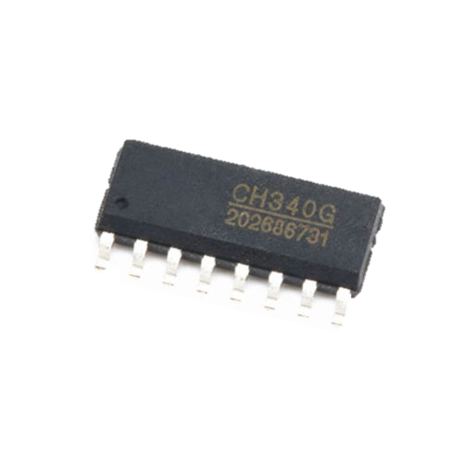
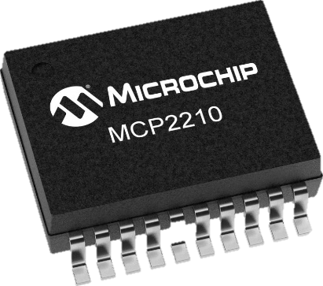
Choosing interface chip
ECS
CNA
These chips are to be used as an interface between the RF system and the controller system.
Microchip MCP2210
SPI-based
CH340G
UART-based
Raja Mourad

Slide 15
Synthesizer
ECS
CNA
We relied on crystal oscillator for low frequency With f=16Mhz
Using a frequency synthesis chip such as the ADF4351 from Analog Devices or the MAX2870 from Maxim Integrated.
These chips provide a PLL (Phase Locked Loop) that can generate an output frequency in the range of 2.2 GHz to 2.6 GHz. Connect the output of the buffer amplifier to the input of the frequency synthesis chip
Ahmad Awwad

Slide 16
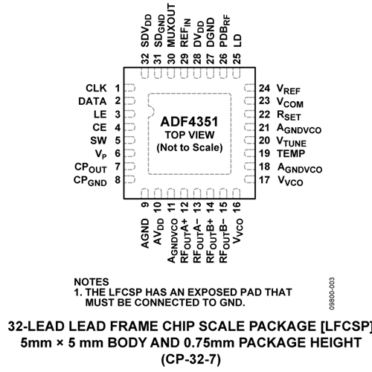
Synthesizer
ECS
CNA
Ahmad Awwad

Slide 17
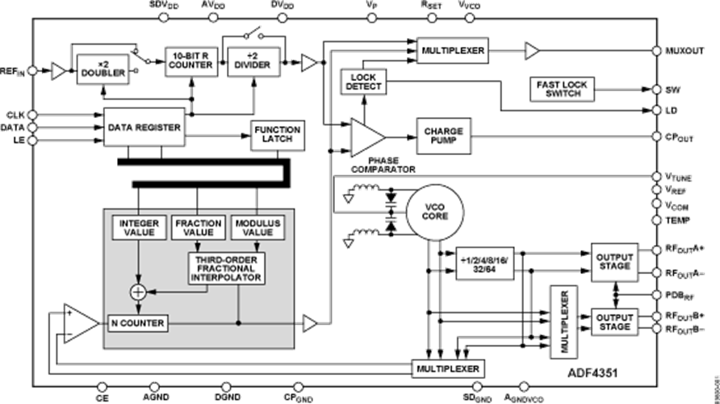
Synthesizer
ECS
CNA
Ahmad Awwad

Slide 18
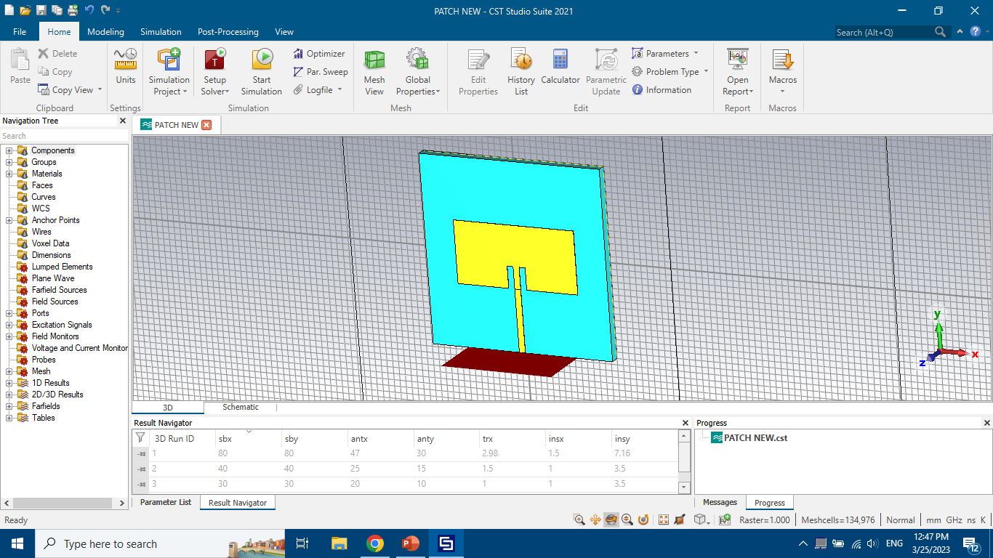
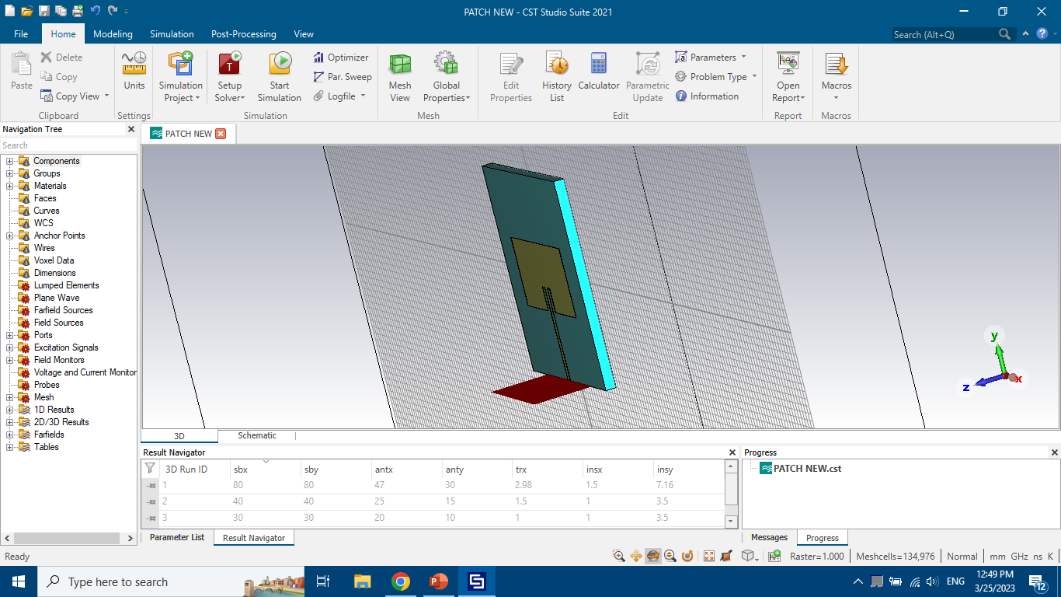
Design Patch Antenna Using Cst
ECS
CNA
Ahmad Awwad

Slide 19
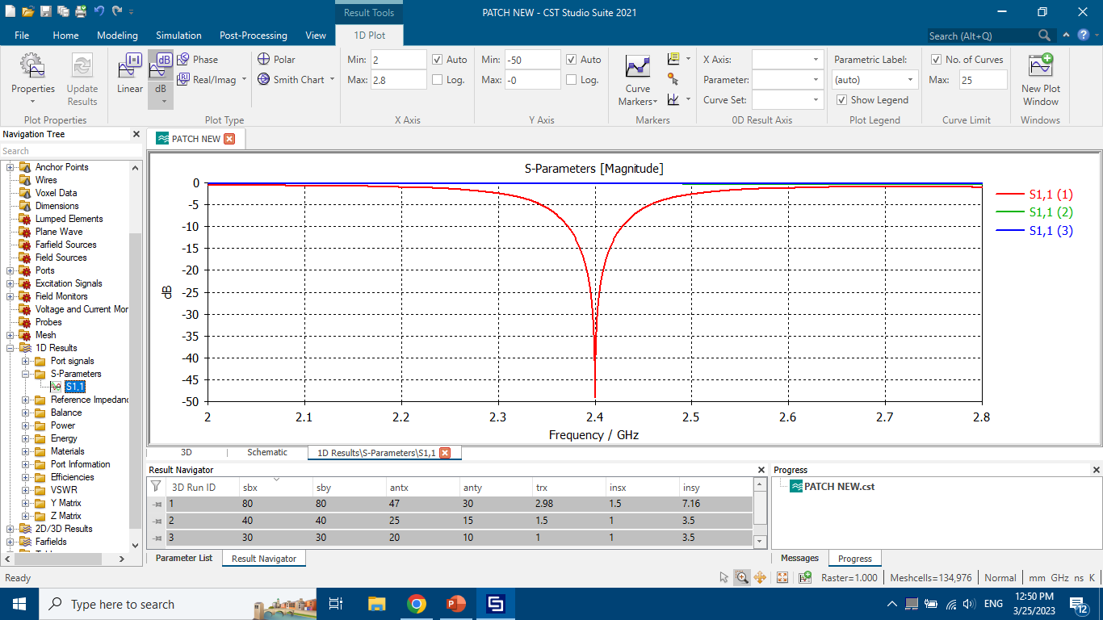
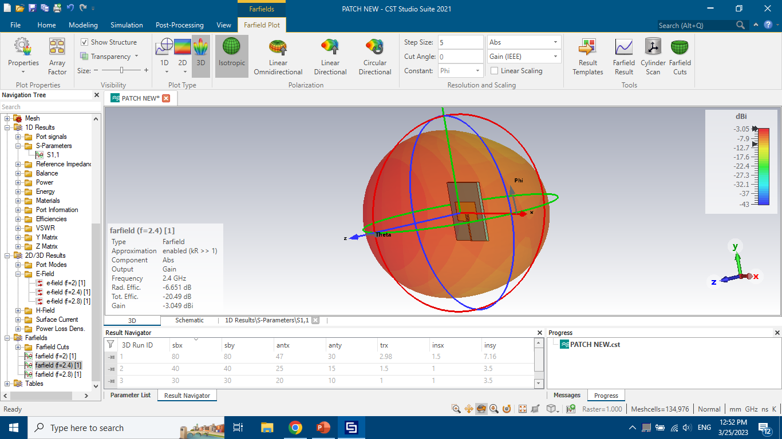
Ahmad Awwad

Slide 20
VCO Circuit Diagram

Slide 21
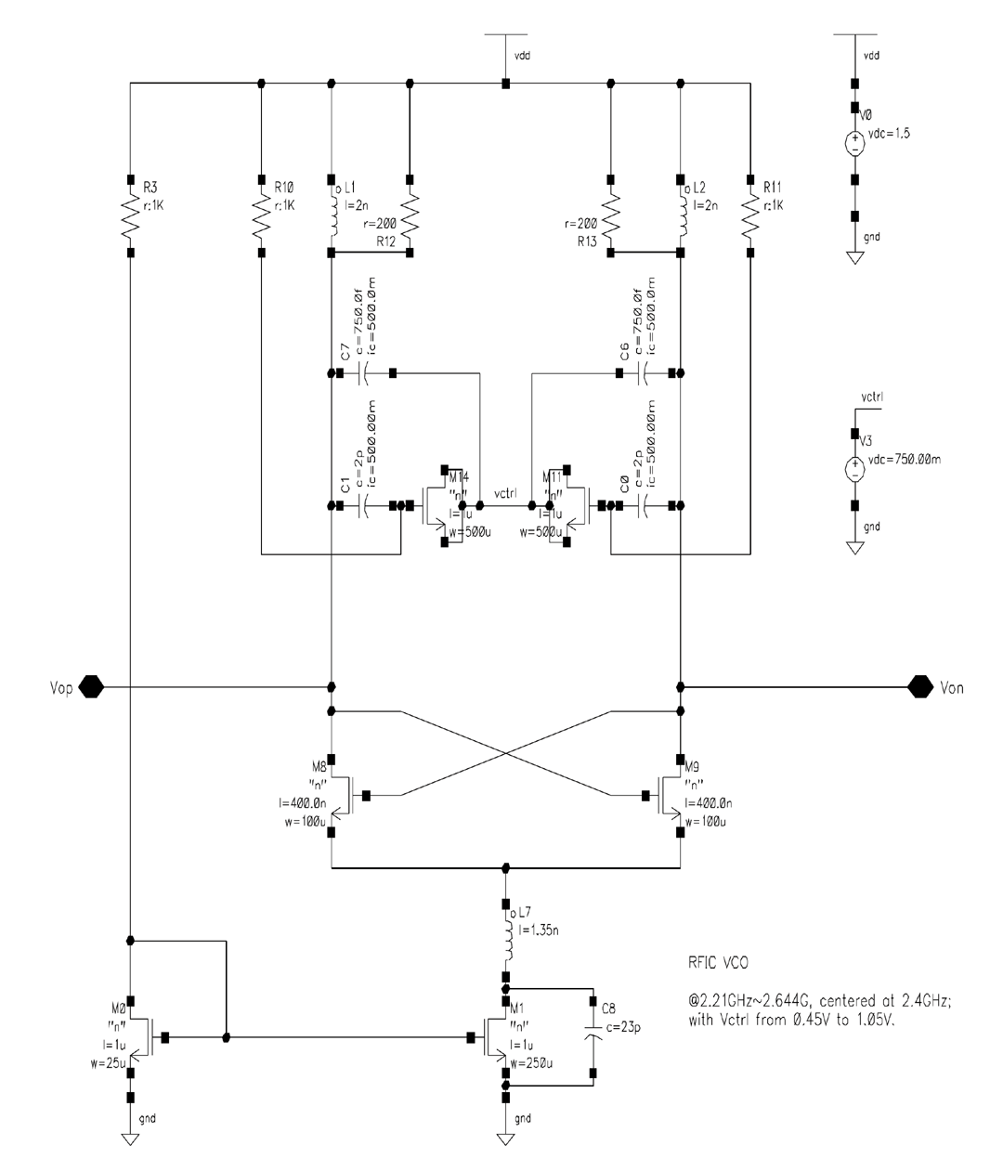

Slide 22
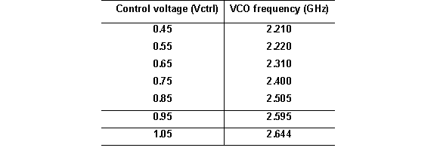
Transistors M8 and M9 form a NMOS cross-coupled differential pair to provide the negative resistance, which is required for generating an oscillation
M0, M1 and R3 form the biasing network for the oscillator
L7 and C8 form the filtering network and form the low pass filter
To further reduce high-frequency noise in the biasing network, we make use of a filtering technique to suppress the contribution of the noise component around 2 f _{Center} to the overall phase noise, where f _{Center} stands for the center frequency
An LC network formed by L7 and C8 are used to accomplish the task
biasing network: to reduce the effect of temperature and change voltage
When the Control Voltage increase → frequency increase

