Slide 1
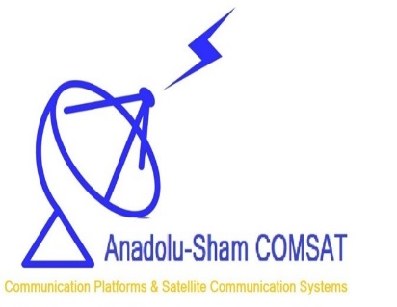
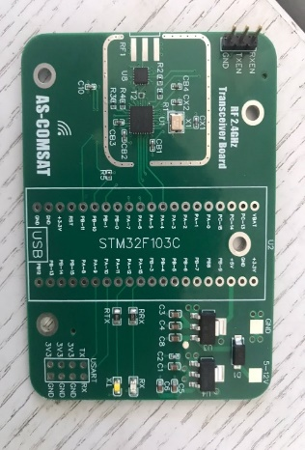
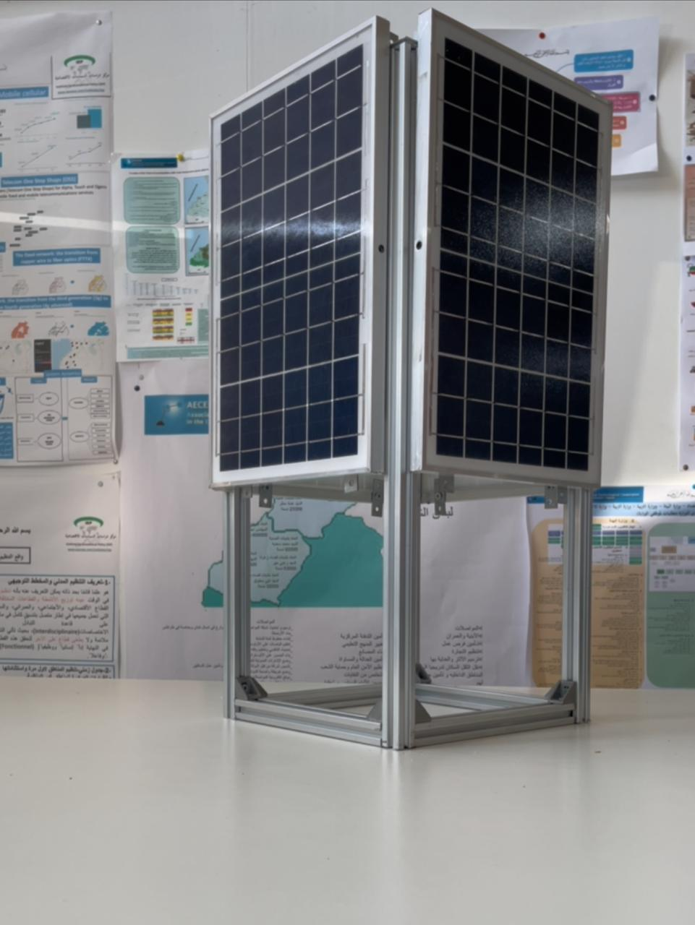
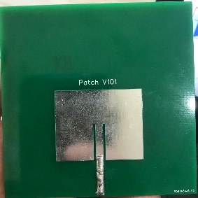
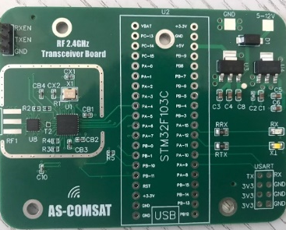
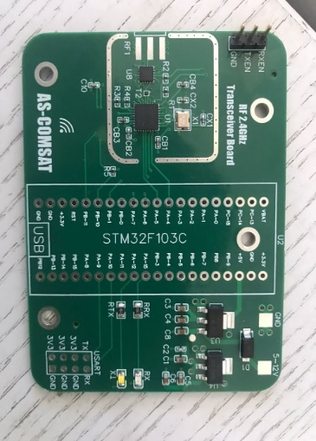
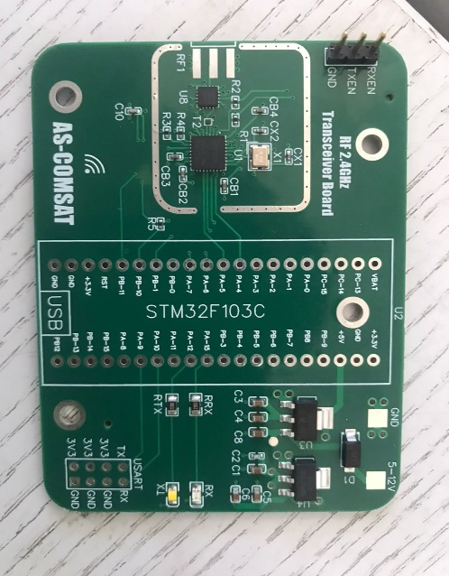
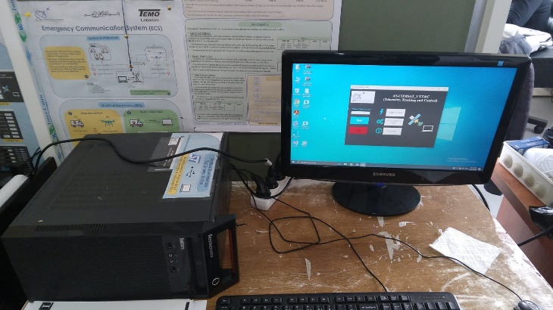
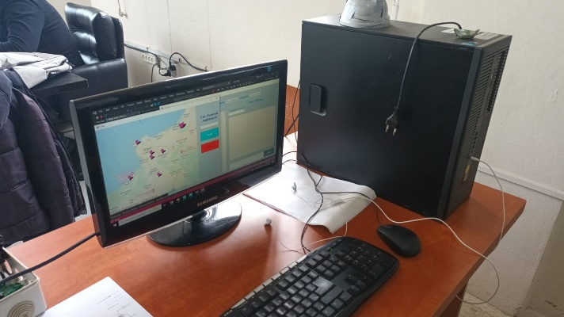
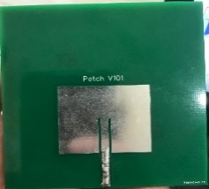
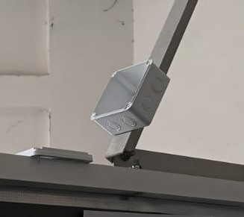
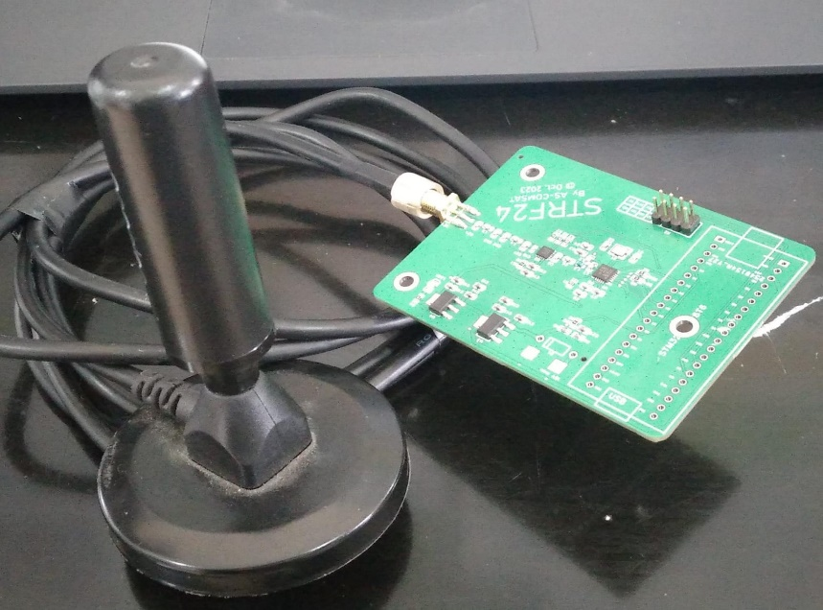
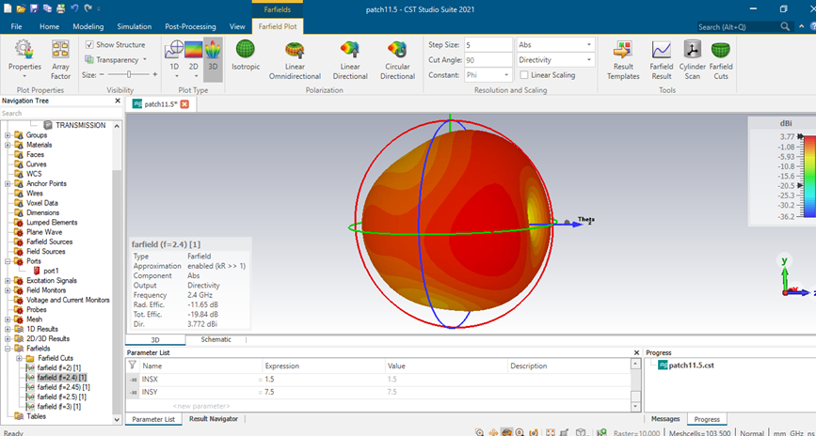
AS-COMSAT_1_LEO+CNA Testbed System Architecture
Satellite Lubnan
RF Transceiver Board
RF Transceiver Board
Satellite Türkiye
RF Transceiver Board
RF Transceiver Board
RF Transceiver Board
RF Transceiver Board
RF Transceiver Board
RF Transceiver Board
TT&C Ground Station Tripoli
Gateway Station Tripoli
RF Transceiver Board
RF Transceiver Board
RF Transceiver Board
TT&C Ground Station Istanbul
Gateway Station Istanbul
RF Transceiver Board
Transceiver Node Box
RF Transceiver Board
RF Transceiver Board
Transceiver Node Box
RF Transceiver Board
RF Transceiver Board
RF Transceiver Board
Transceiver Node Box
RF Transceiver Board
RF Transceiver Board
RF Transceiver Board
Characteristic patch antenna
RF Transceiver Board
@AS-COMSAT 27.11.2023

