Slide 1
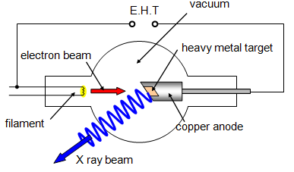
03.04.2021
Master Thesis: Gamma/X-Ray detector development for IAP-SAT
Tasks:
Initializing documentation: 1. PhD ppn CCD, 2. x ray source/pulsed power accelerator / vaccum chamber technology
Source:
pulsed power diode accelerator in vaccum chamber
X-ray source (alternative: dentist x-ray source)
Building x-Ray detector: NaI scintillator + Si detector (PV cell)
Data Reduction SW (C++ with qt)
Testing: Laue diffraction patterns of plastic spheres

Slide 2
Initializing documentation: 1. PhD ppn CCD, 2. x ray source/pulsed power accelerator / vaccum chamber technology
Chapter 2 (Basics)
Timeplan
Topic | Timeline | Documentation
Initializing documentation | Dec 20 - 10.4.21 | Completing Chapter 1 (Introduction, Task, Timeplan) Completing Chapter 2 (Basics)
Source: pulsed power diode accelerator in vaccum chamber (Design and Realization) | 12.4.- 8.5.21 (3 weeks) | Chapter 3 (Contribution) Completing Chapter 3.1 (Realization of x-ray source)
Building x-Ray detector: NaI scintillator + Si detector (PV cell), CAMEX |  | Chapter 3 (Contribution) Completing Chapter 3.2 (Realization of detector)
Testing: Laue diffraction patterns of plastic spheres
Data Reduction SW (C++ with qt)

Slide 3
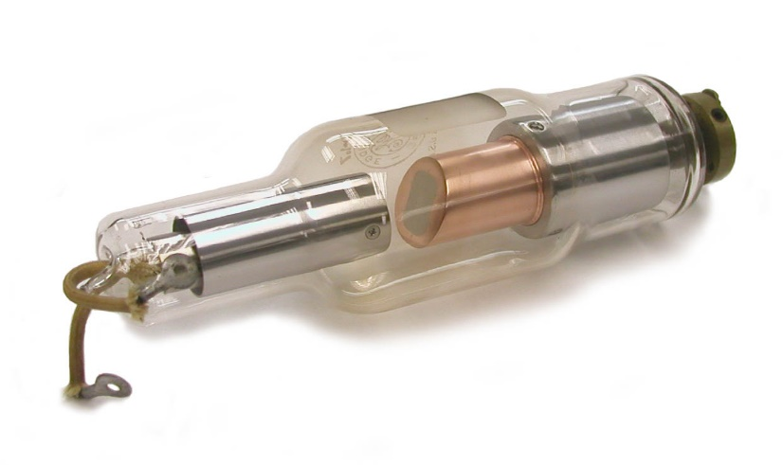
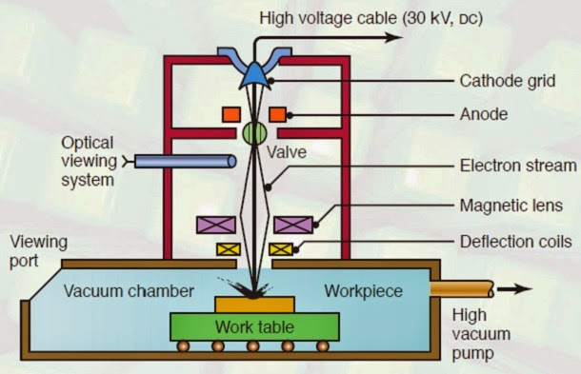
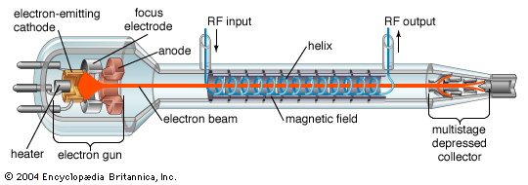
2. Source:
pulsed power diode accelerator in vaccum chamber
X-ray source (alternative: dentist x-ray source)
pulsed power diode accelerator

Slide 4
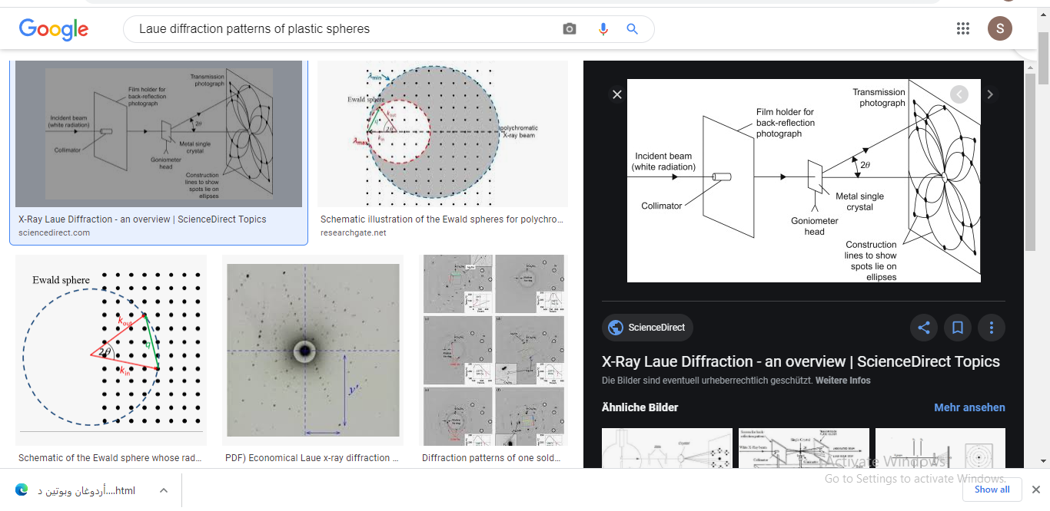
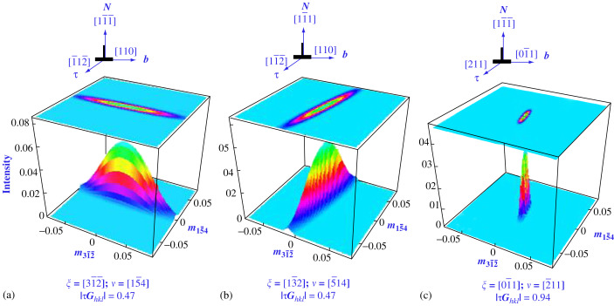
5. Testing: Laue diffraction patterns of plastic spheres
3.2 Natural Axes of the Laue Spot
To describe the intensity redistribution near a Laue spot, due to a particular set of dislocations, the mutual orientation of two planes are important (Figs. 5 and 8):

