Slide 1
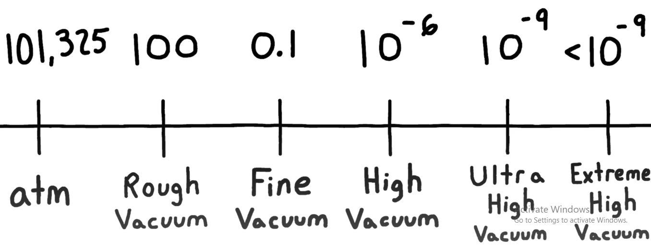
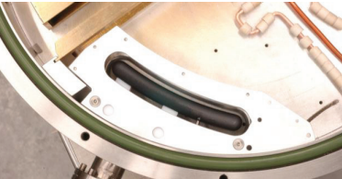
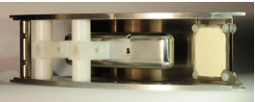
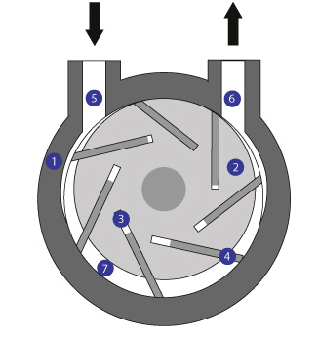
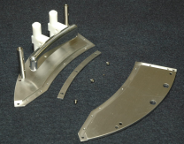
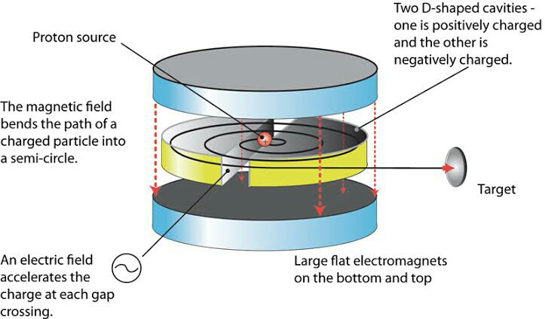
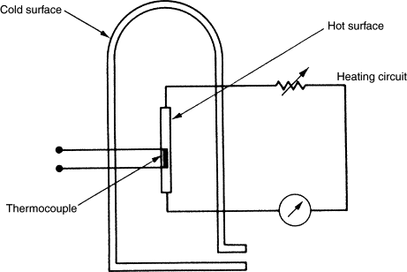
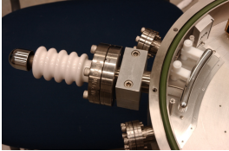
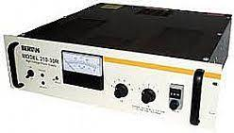
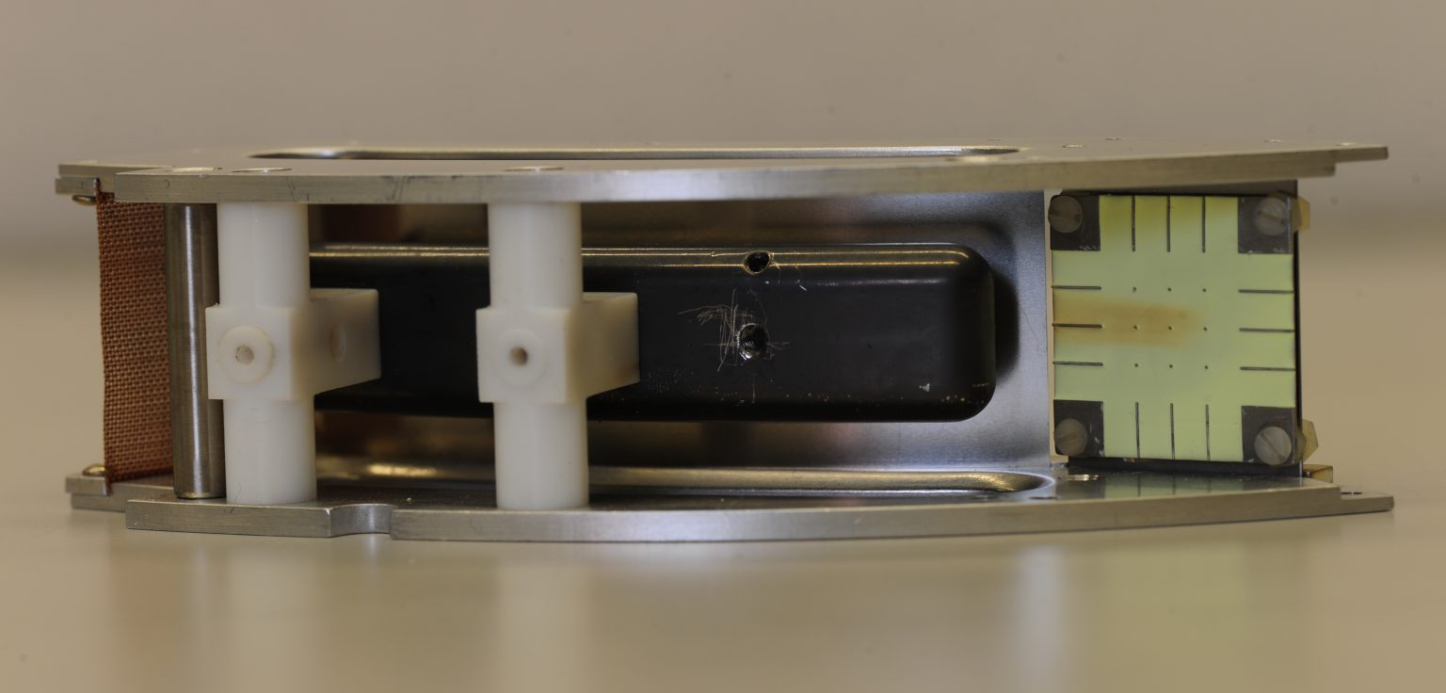
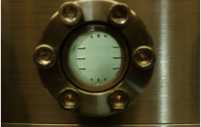
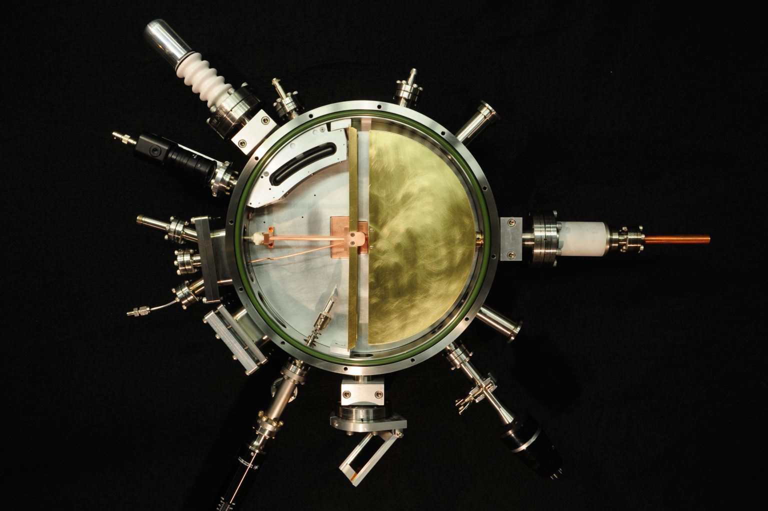
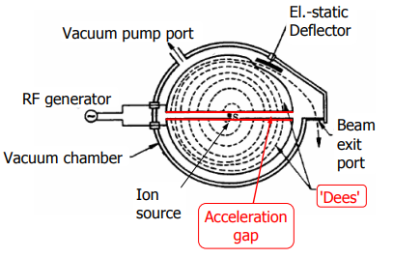
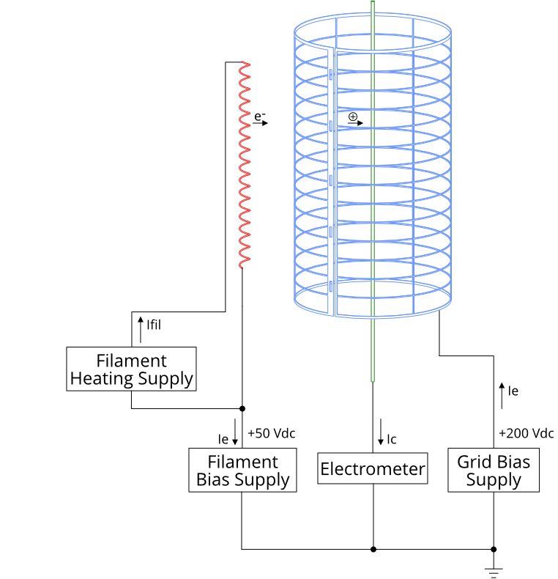
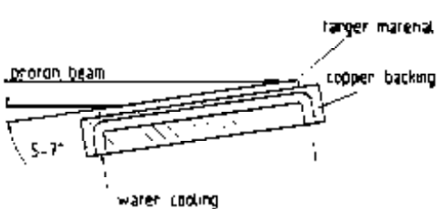
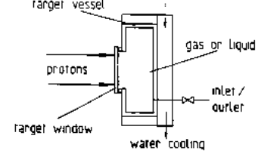
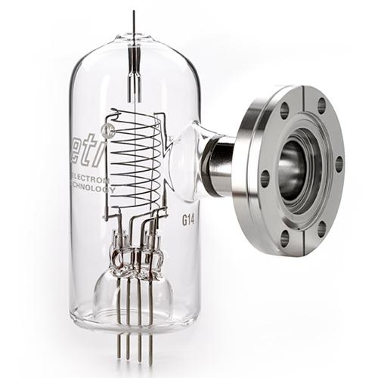
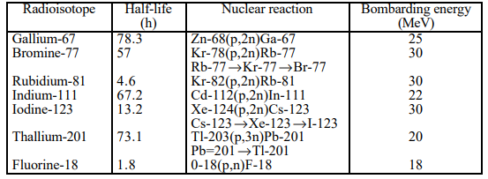
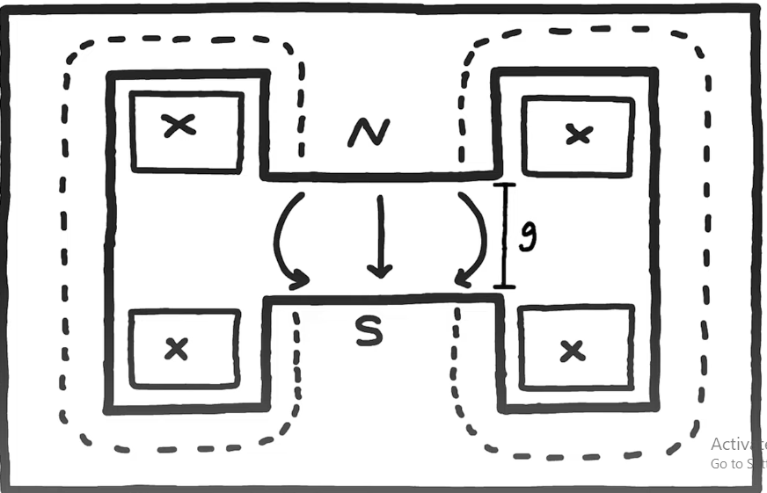
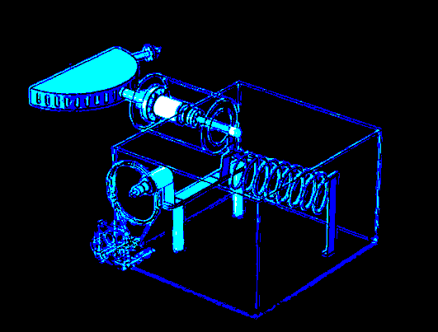
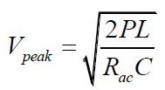
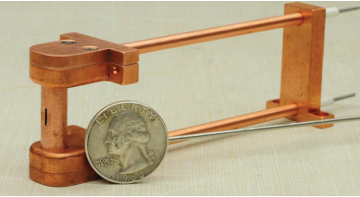
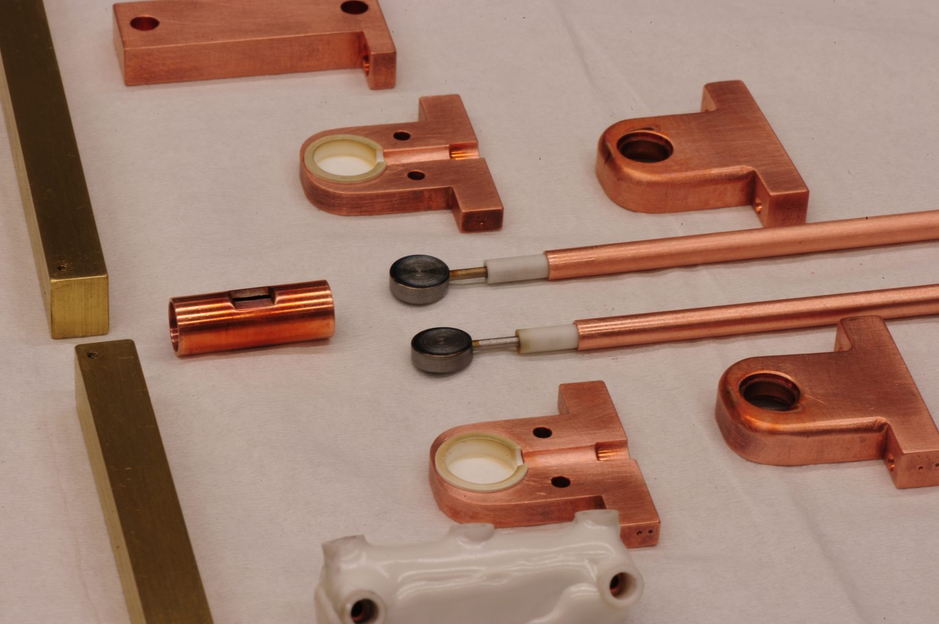
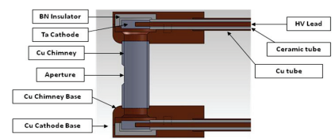
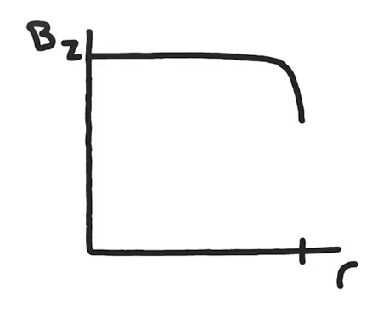
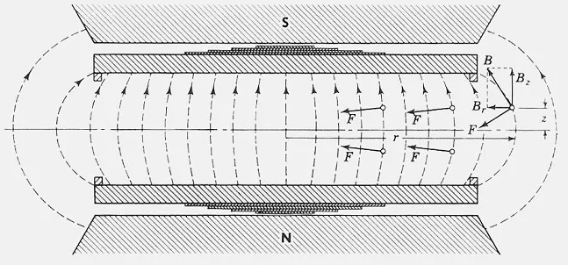
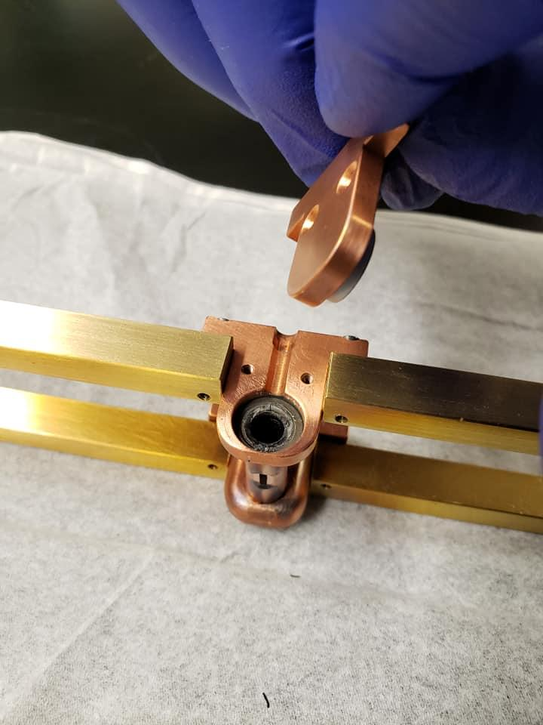
Definition
A cyclotron is a machine that accelerates charged particles or ions to high energies. It was invented to investigate the nuclear structure by E.O Lawrence and M.S Livingston in 1934.
Types of cyclotron
There are two types of cyclotrons, namely, synchrotrons and isochronous cyclotrons.
- Synchrocyclotron: A modified cyclotron that obtains higher energy for charged particles by correcting for the mass change that the particles encounter as their velocity increases are called a synchrocyclotron.
- Isochronous cyclotrons:It is an alternative to the synchrocyclotron. As stated above, in synchrocyclotron, the output beams come with a short gap. To avoid this short gap and get a continuous delivery of beam/particles, the use of isochronous cyclotrons is necessary.
Types of beams
- Proton beams: The simplest type of cyclotron beam, proton beams are typically created by ionizing hydrogen gas.
- H⁻ beams : Accelerating negative hydrogen ions simplifies extracting the beam from the machine. At the radius corresponding to the desired beam energy, a metal foil is used to strip the electrons from the H⁻ ions, transforming them into positively charged H⁺ ions. The change in polarity causes the beam to be deflected in the opposite direction by the magnetic field, allowing the beam to be transported out of the machine.
The Cyclotron
The Vacuum system
Vacuum chamber design :
- Should be magnetic transparent such as Aluminum, Copper, Brass.
- Brass screws
- Safety factor considered; max stress material can withstand / max stress material will encounter in a lifetime.
- Aluminum body aircraft grade such as AL7075 for top and bottom lids.
- White teflon tape & tapped holes for post seals, NPT ( low pressure applications).
- O rings ( Viton or Buna-N) for id body seals).
The Deflector
The deflection channel intercepts the last turn of the cyclotron outward spiral beam. In a production machine, the beam is then guided onto a target where the nuclear interactions occur.
- Ions of specific velocities, determined by the deflector’s electric field E, are transported to a phosphor coated collector plate.
- The deflection channel has a nominal radius of curvature, ρ1, of 7 inches and tangentially intercepts the cyclotron beam at a radius, ρo, of 4.0 inches and transports it to a radius of 4.5 inches over 43° of azimuth.
Mean Free Path (MFP) of the gas beam pipe is much shorter than the beam pipe. The ion beam traveling down the beam path
- For an ion, charge q, of kinetic energy T or equivalently mass m in an axial magnetic field of B at Uo, the required deflecting electric field, E, is found to be:
would quickly lose energy due to battering by gas molecules. Hence, we need to remove all gas molecules from the beam path first. We simply evacuate the cyclotron chamber to clear the way for the ion bam path.
The deflector installation consists of three major components:
▸The deflector assembly:
⁍ Two aluminum plates separated by stainless steel posts formed the skeletal structure. The septum’s curve was machined as a stepped shelf along the inside edge of the top and bottom structural plates. A thin (0.005 inch thick) stainless steel strip was seated against the step forming the septum.
- Heavy ion beams: Beams of particles heavier than hydrogen are referred to as heavy ion beams, and can range from deuterium nuclei (one proton and one neutron) up to uranium nuclei. The increase in energy required to accelerate heavier particles is balanced by stripping more electrons from the atom to increase the electric charge of the particles, thus increasing acceleration efficiency.
- In the rough regime, the (MFP) is actually still short enough that the gas acts viscously like a fluid; motion of gas molecules flow laminarily & exerts sheer force on other gas molecules which makes pumping quite easy. We build a pump similar to that of a compressor known as a Rotary-Vane-pump.
▸ Flywheel expands gas on one side & compresses it on the other.
▸ On the expansion site, gas is drawn in viscously from the chamber & on the far side, gas is compressed & expelled into the atmosphere.
▸ Oil seals everything up & prevents the backflow of gas into the chamber.
⁍ Thin strips of aluminum matching the septum curvature were bolted onto the shelf clamping the septum in place and holding its curvature
⁍ The high voltage electrode was machined 3/8 inch thick from 7075 aluminum; each corner was rounded with a radius also of 3/8 inch .
The electric field:
Components
- Magnets
- Vacuum chamber/system
- The ion source
- RF system
- The deflector
- Machine protection and control system units
- To measure the pressure in the rough vacuum, we use a thermocouple gauge; where the real conductivity is proportional to the (MFP).
▸ Filament connected to the thermocouple element which measures the temperature.
⁍ The electrode was highly polished. It was supported from the back by the stem of two T Shaped Teflon insulators. Bosses were machined in the tips of each arm of the T-insulators, the bosses were seated in detents in top and bottom plates. The T-insulator stems were deeply counter-bored and finished with a blank through hole. Two tapped holes on the rear of the HV electrode, and Nylon screws secured the electrode to the base of the T-insulators. Electrical connection was made to the HV electrode by directly seating a HV ceramic vacuum feed-through conductor into a third and final clearance hole in the back of the electrode, and is captured by a set screw.
Uses/applications
- Nuclear medicine; production of radioisotopes that are used in cancer treatment (targeted therapy).
- PET;short lived positron-emitting isotopes(diagnosis & monitor).
- Neutron production; production of high energy neutrons used for research, nuclear power plant test & cancer treatment.
▸ The phosphor screen detector:
⁍ The screen was mounted at a 45° angle with respect to the incident beam and to the axis of a glass view port.
⁍ The phosphor plate was separated from the carrier plate by 1/8-inch to keep the capacitance reasonably low.
⁍ The carrier plate was clamped into the deflector assembly in a manner similar to the mounting of the septum. The center conductor of a coaxial cable was connected to the phosphor plate
Working principle
- Charged particle beam is accelerated using a high frequency alternating voltage applied to two “Dees” inside a vacuum chamber.
- Dees are placed opposite to each other creating an electric field.
- Two magnets are placed perpendicular to the “Dees”, creating a magnetic field.
- Due to the presence of magnetic fields, particles in the cylinder move or rotate in circular paths.
- Alternating voltage between the “Dees” creates the electric field that accelerates the particle.
▸ A current is passed through the filament in the gauge depositing a constant amount of thermal power.
▸ If the gas surrounding filament is thermally conductive i.e high pressure, the filament remains cool as measured by the thermocouple element.
In the high vacuum regime, MFP is long enough so that the gas molecule spends much more time interacting with the walls of the chamber; this is known as “Molecular Flow”.
In order to pump gas in this flow, use a diffusion pump that uses supersonic jets oil to capture individual gas molecules & pump them down & out of the chamber. To achieve this, the diffusion pump uses 3 parts:
1. Heater: resides at the bottom of the heat chamber & boils oil forcing it upwards, interacting with the “christmas tree”.
2. Christmas Tree: redirects the upward traveling gas back down so that any gas there would be deflected downwards.
3. Water cooling Jacket: located outside the pump which condenses the supersonic boiling oil jet to travel back down to the boiler to be recycled.
4. Cryogenic baffle is normally placed on top of the pump so that no line of sight from the diffusion pump exists to the vacuum chamber. Its goal is to prevent any backstream of oil into the vacuum chamber that causes contamination.
and the coax shield to the grounded carrier plate, the cable was routed to a BNC vacuum feedthrough connector.
⁍ The electrical isolation and connectivity permits the phosphor plate to double as a Faraday collector. The low capacitance of the collecting plate should permit time-resolved electrical measurements of the impinging beam.
Physics
Frequency of the voltage is equal to the frequency of the particle’s cyclotron frequency:
Where, B is the magnetic field strength
q is the electric charge of the particle
m is the relativistic mass of the charged particle
Energy of the particle depends on the strength of the magnetic field & the diameter of the Dees
Centripetal force :
Lorentz’s force :
Solving for Fc=Fb :
▸ The high voltage power supply (E):
⁍ We can use Bertan 205A-50N
⁍ This supply was also only a constant voltage supply requiring a current limiting resistor. The resistor was housed in an acrylic tube, capped at both ends, which was then externally covered with a grounded copper mesh.
⁍ The high voltage was brought from the supply to the series resistor, and continued to the cyclotron chamber’s HV vacuum bush using portable x-ray machine coaxial cable.
Radioisotopes production
The radioisotopes produced for medical applications are used in nuclear medicine for diagnosis. In contrast to X-ray studies where only static information can be obtained, nuclear medicine provides dynamic information and hence allows time-dependent studies of the function of organs. Radioisotopes involved should have the following ideal characteristics: – no β- particle – short effective half-life – γ-energy in the range between 100 and 300 keV.
Specifications
Our cyclotron is a 12 inch, low power cyclotron that uses around (1.2 to 1.5) MeV to accelerate charged particles.
- Bayard Alpert Ionization Gauge is used to measure the pressure at high vacuum.
▸ Triode vacuum tube, first element is a hot filament that produces electrons.
▸ Opposite to it is a collector wire which is biased to a negative high voltage around 500V.
▸ In between there is a coiled wire grid biased to positive voltage.
▸ Electrons from the flament bombard gas in between the filament & the grid where they rest.
▸ If there is very little gas ➨ very few ions are produced.
The Magnet
1.2 Tesla
A proton circulating in a 1T has 15.2 MHz revolutions
Each of the coils are energized by DC power supplies located in the control rack
Power leads should come from the diode box & connected terminals on the backside of the magnet
At full excitation, coils require (40 A).
Impedance of each coil is 0.8 Ω
The production of radioisotopes used in nuclear medicine can be made with solid, gaseous and liquid targets.
The most important cyclotron-produced isotopes for medical applications. Common features for this radionuclide production are: – production via (p,xn)-reaction – proton energy ranges between 10 MeV and 30 MeV – enriched isotopes for target material – recovery of target material – commercially available.
▸ If there is a lot of gas ➨ many ions are produced.
▸ Ions travel through the grid to the negative potential of the collector wire where they rest, then measured by an ammeter to determine the rate of current flow.
The Water Cooling system is used to de-ionize energy. We use two thermocouples as a backup each placed on top and bottom and is actively being read out by the PLC.
The Field
RF System
Rf system design:
- Should be made of Copper or Brass
- Square wave is applied to Dee, the rest of the system is grounded
- rfF feed through Aluminum piping pressfit with Delrin interior
- 1/4-inch copper refrigeration tubing
- Input coupling behind the coil
- Small motor driven trimmer capacitor adjustable from 3 to 30 pF
- Vacuum chamber , electrode system act as capacitor
▸Before we can energize the power supplies , we need to enable the PLC’s magnet permission.
▸We begin ramping up the current & hence the magnetic field.
▸Magnetic field fringing could be visualized by a 3D compass.
Where, B : refers to the magnetic field magnitude un Tesla (T).
μ0 : refers to the permeability of free space (4π x 10⁻⁷ T.m/A).
I : refers to the magnitude of the electric current in amperes (A).
r : refers to the distance in meters (m).
- System is in in parallel with an inductor & it resonates of frequency f=1/2π√(LC)
- Utilizes at most 2000 watts of RF power
Pole Tip Effect
▸ The field is completely vertical at the center of the magnet. This is the point where the field will be the strongest.
▸ The vertical magnetic field will slowly decrease with increasing radius. As the field bulges, the weaker midplane vertical field becomes, this is compensated by an increase in the radial magnetic field components
n = -ΓdB/Bdr
- Use a network analyzer to measure the resonant frequency of a tank circuit & identify the full width ½ max or bandwidth
- High quality means higher amplitude and narrow bandwidth.
- Low quality means lower amplitude and broader bandwidth. We choose Copper or silver-plated materials. Q=f0/Δf(bandwidth)
- DEE voltage: time avg energy stored in the capacitor = time avg energy stored in inductor.
Ion source
- We set out to build a cold cathode Penning Ion Gauge (PIG) source.
- It uses two tantalum cathodes pinned to stainless steel leads that are seated in boron-nitride cups which are housed in copper bases.
- The chimney, chimney bases, and HV lead shields are also all copper. Cooling is through conduction to the upper and lower chamber lids.
- Beam current from an arc current of 5 mA is sufficient for beam physics demonstrations, operating at greater currents quickly burns the phosphor screens.
- At 5 mA, the Mark-III PIG sources operate for greater than 40 hours without requiring servicing. Demanding greater arc currents reduces the source’s lifetime.
Ghassan HOURI @AECENAR_IAP/August 2023

